Slide 1
Owners’ Risks in Today’s Maritime Arena
Safety at Sea/Benkert & AMVER Awards
Virtual Event
Presented by Keith Letourneau
May 21, 2020

Slide 2
Overview
What are the Risks?
Coronavirus Impacts
  Global Supply Chain
  Cruise Industry
  Car Carriers/Bulk Carriers
  Containerships
  Offshore Supply Vessels
  Tankers
  Crew Risks
IMO 2020 0.5% LSFO Update

Slide 3
Coronavirus
On March 3, 2020
  57 Cases in the United States and 80,000 worldwide
89 days later
  More than 1.5 million cases in the United States (more than 90,000 deaths)
  Approx. 5.0 million cases worldwide (more than 300,000 deaths)

Slide 4
What are the Risks?
Existential
  Will companies survive?
  Delays, slow pays and insolvency
Contractual
  Force majeure
  Demurrage
  Storage
  Security
  Epidemic Clauses
Operational
  Crew health and changes
  Inspections and Repairs

Slide 5
Coronavirus Impacts – Supply Chain
Worldwide demand for goods and services has fallen
  Global trade projected to fall by 13 to 32% depending upon depth of global downturn (Congressional Research Service – Global Economic Effects of COVID-19)
  More than 80 countries have closed borders to arrivals from countries with infections
  First QTR U.S. GDP down by 4.8%/EU – 3.8% contraction in First QTR
  IMF - the Great Lockdown has reduced global GDP by 2.0% per month; economic contraction not experienced since the Great Depression; predicts oil prices to fall by 42% in 2020
  The global supply chain is in serious distress (Wall Street Journal – Coronavirus Pushes Shipping Companies into Survival Mode)

Slide 6
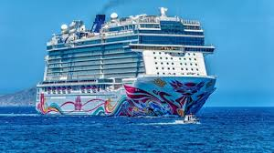
Coronavirus Impacts – Cruise Ships
Cruise ships worldwide are being laid up in place
CDC imposed “No Sail Order” on cruise ships on April 15 locking them down for 100 days or until CDC chooses to amend or modify its ruling
  Complete cessation of cruise operations
In 2018, Cruise industry was worth a reported $150 billion
  In May 2020, none are generating any revenue; stocks have plummeted by 60 to 70%; Carnival announced sweeping workforce reductions; lawsuits by passengers and crewmembers are already in the works
Norwegian recently announced it may file for bankruptcy
No Sail Order requires cruise lines develop operational plans to address infection control and outbreak response – serious impact on crew repatriations
  HVAC system – how do you insure that it doesn’t spread the virus?
  Given CV’s spread aboard cruise ships, how do you protect passengers and crew?
  Project Hygiea – interception, prevention, mitigation and evacuation

Slide 7
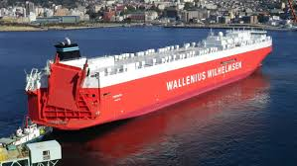
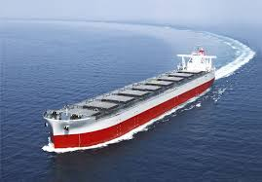
Coronavirus Impacts – Car Carriers/Bulk Carriers
Fleets are being laid up as car manufacturers close factories
  Wallenius Wilhelmsen – furloughing 2,500
  employees and laying up 14 ships
Bulk Carriers
  hit both by U.S.-China Trade War and
  coronavirus outbreak in China,
  which significantly reduced iron ore and coal imports in the
  first quarter
  U.S.-China Phase 1 trade deal – slow implementation of
  commodities purchases by China; commitments likely will not be
  met; severely impacting commodities trade

Slide 8
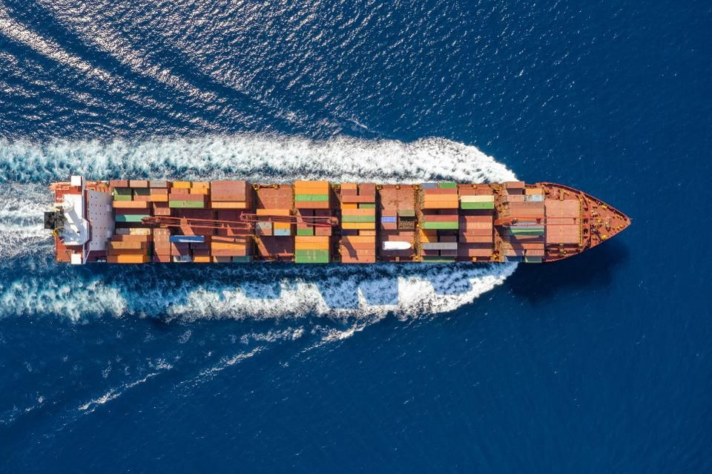
Coronavirus Impacts – Container Ships
Container volumes expected to
decline by 10%
Moody’s has downgraded Maersk
Large operators are laying up ships;
smaller operators trying to hold on
Sailing cancellations are up by over
30%
No bailouts for shipping lines

Slide 9
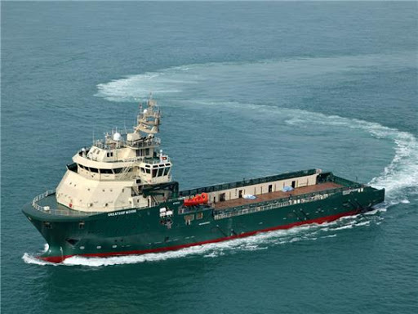
Coronavirus Impacts – Offshore Support Vessels
Double whammy – CV and oil price collapse
Diamond Offshore filed for Chapter 11 bankruptcy citing price war
  Others following suit (e.g., Fieldwood Energy)
Five Oil majors have cut spending an average of 23%, and are reducing deepwater drilling projects
Global spending on oilfield equipment forecast to fall 21%
U.S. Gulf has largest number of OSV lay-ups
  Reflects low-level of offshore drilling activity
How do you guard against charterer insolvency risks/
short-pays in this market?

Slide 10
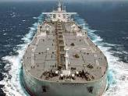
Coronavirus Impacts - Tankers
Oil Demand collapsed
  OPEC + Deal only take up to 10 million barrels out of the market
  Demand is down by 30 million barrels since this time last year
WTI sale price went negative at the end of April; possibility may happen again at the end of May
Tanker freight rates went through the roof
On-shore capacity in the U.S. near capacity
Fleet of Saudi tankers loaded with 50 million barrels of oil are headed to the United States
More vessels are being used for floating storage either voluntarily through agreed floating storage contracts or involuntarily through charter demurrage
Intertanko recently published new floating storage clauses
Issue – Duration of storage contracts

Slide 11
Coronavirus – Crew Risks
Crew changes
  1.2 million seafarers working aboard an international fleet of some 50,000 vessels
  Merchant mariners are being stranded worldwide due to international flight delays and cancellations
  Various nations have imposed crew-change restrictions (e.g., Australia, China, France, India, Mexico, South Africa, etc.)
  Seafarer contracts are being involuntarily extended
  Seafarers have generally not been designated as essential workers
  Crew-change restrictions are leading to sailing cancellations, which means fewer available ships and higher freight costs
  Adverse impact on crew health and welfare
Vessel Inspectors and Maintenance Personnel facing similar challenges reaching ships worldwide

Slide 12
Coronavirus – Crew Risks
Epidemics/Pandemics Clause in Charter Parties (BIMCO Infectious or Contagious Diseases Clause)
  Need for specific clause because force majeure clause may not apply
PSCs are asking whether persons aboard ship have been in China within previous 14 days, as well as declaration of health
  PSC responses range from quarantining individuals to quarantining the ship
Ship operators – limit spread by exit screenings of crew and passengers; collaborate with health authorities

Slide 13
Coronavirus – Other Considerations
Long-term impact on supply chains – decoupling of U.S.-China businesses
  Over-reliance upon one market to supply goods
  Need for diversification away from China
Force Majeure
  Does outbreak constitute force majeure event under applicable contract clause?
    Contract performance prevented, impaired or delayed; event beyond reasonable control and not reasonably foreseeable
    Clauses are generally construed narrowly, and in the context of the parties’ intentions and industry practices
    Potential to suspend or terminate contract; obligation to mitigate damages
  Does particular load or discharge port create potential for force majeure declaration?
  Possibility of cargoes being rejected as demand weakens (LNG buyers in China)
Are demurrage claims included within force majeure clause?
Epidemics Clauses
  Quarantines/Port Delays/Compliance with Local Restrictions

Slide 14
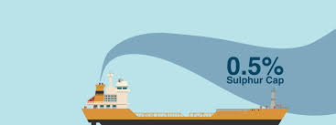
Coronavirus Impacts – IMO 2020 0.5% LSFO
Coronavirus wiping our scrubber savings
Marine fuel prices have fallen year over year; oil demand has fallen
Declining fuel spread
  VLSFO prices declined while HSFO has not
January 2020 – Scrubber-equipped tankers were netting $25,000 per day more in TCE earnings than non-scrubber equipped tankers; scrubber-equipped Capesize bulker earning – $10,000 more
  Net savings have declined
  Payback periods likely to much longer

Slide 15

Questions
Keith Letourneau, Partner and Practice Group Leader
717 Texas Avenue, Suite 1400
Houston, TX 77002
+1-713-402-7650
kletourneau@blankrome.com

