Slide 1
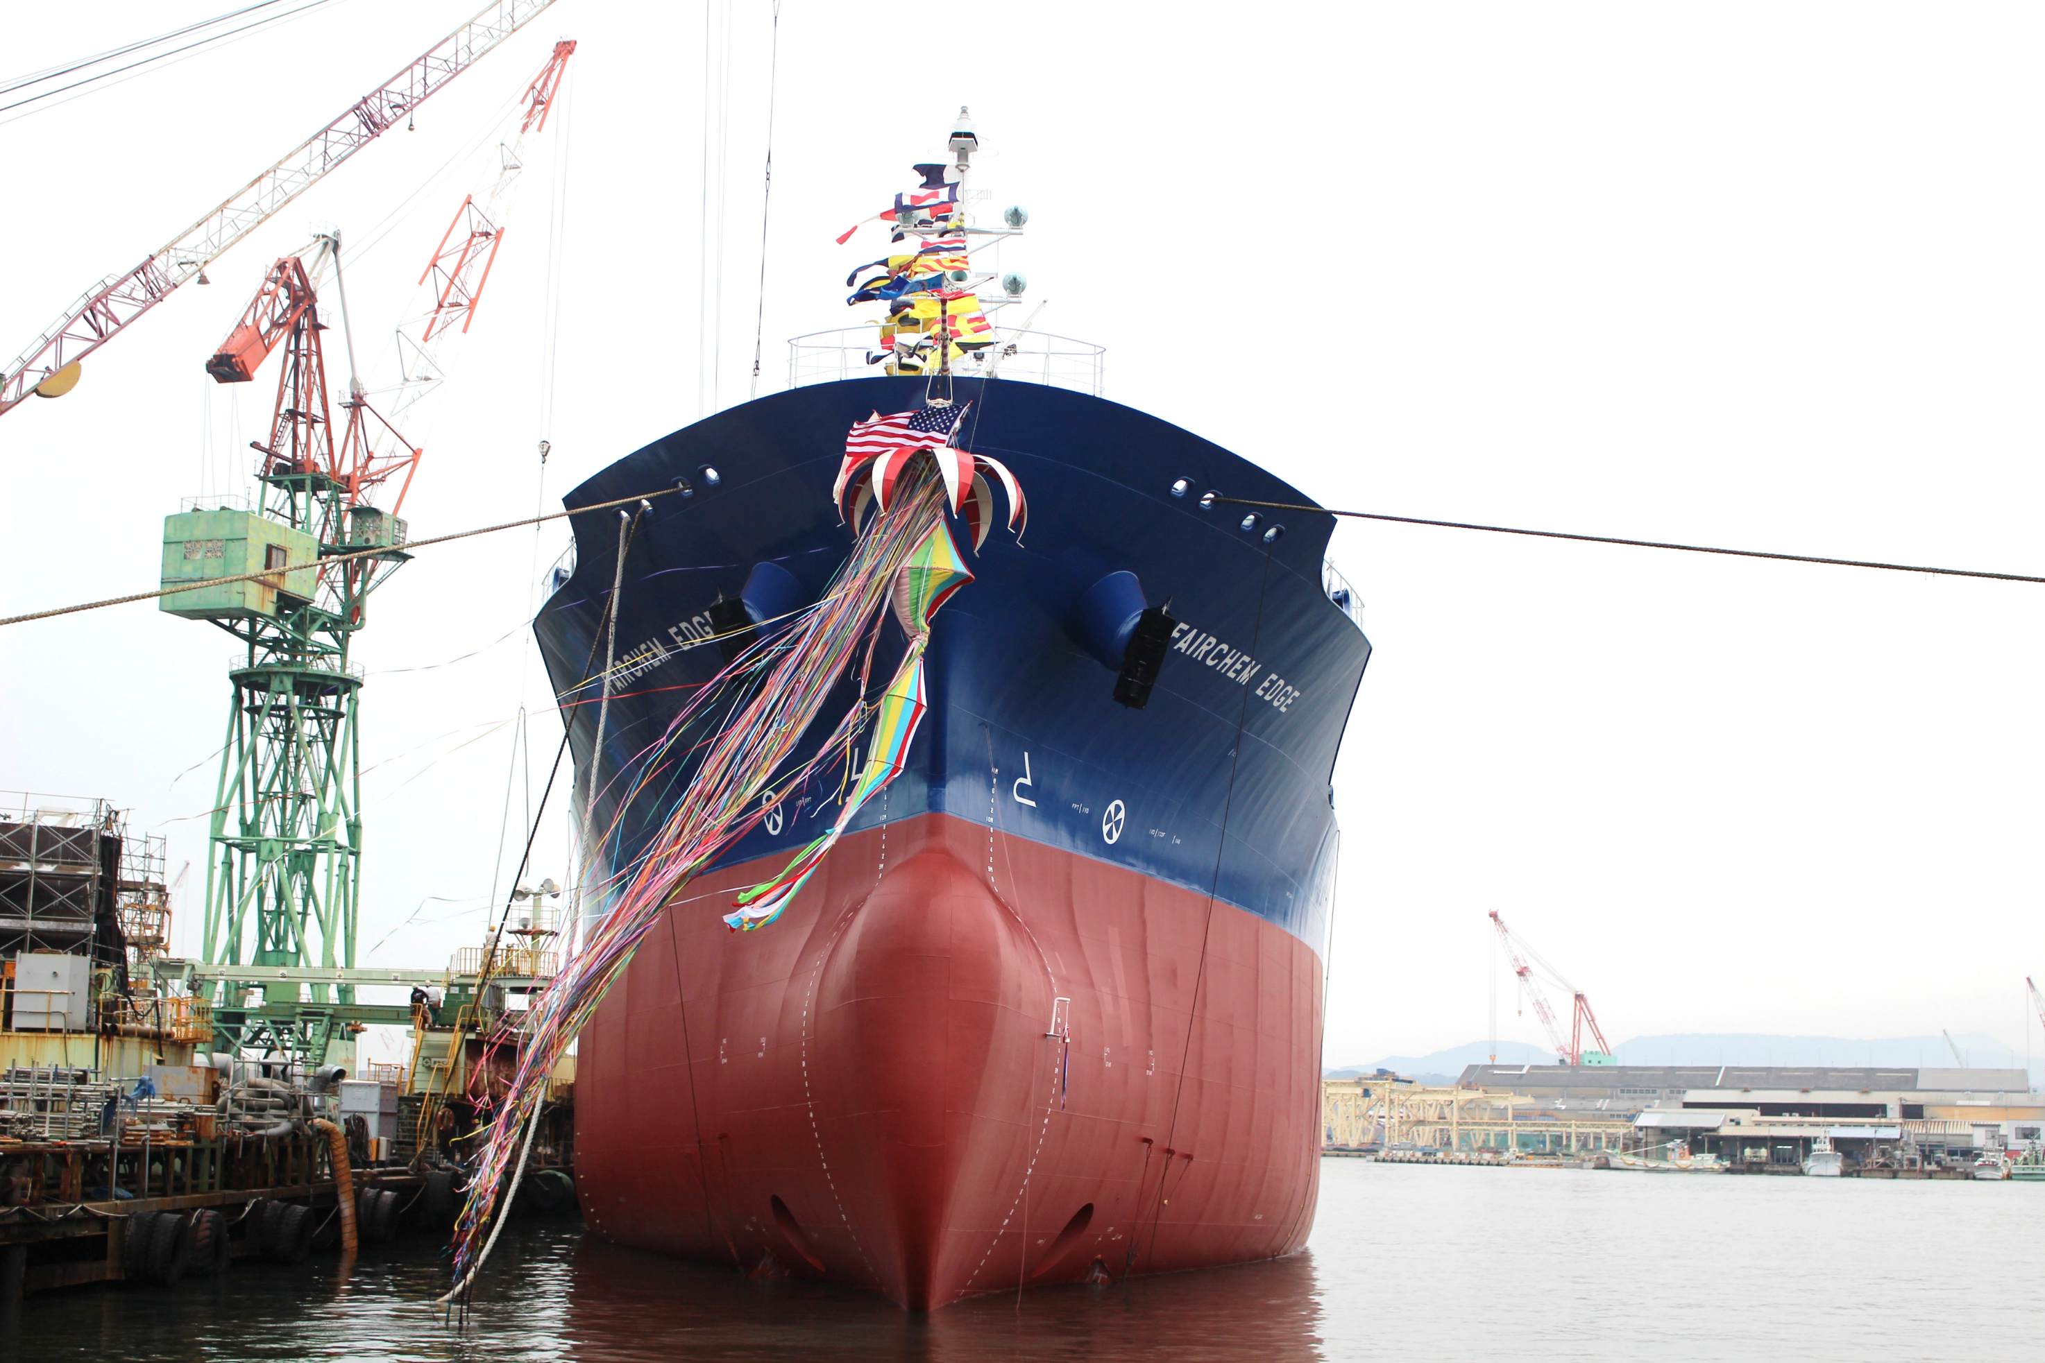


National Maritime
Safety at Sea Conference
May 21, 2020
Presented by:
Stephen Kozlowski
Stuart Klapprott

Slide 2
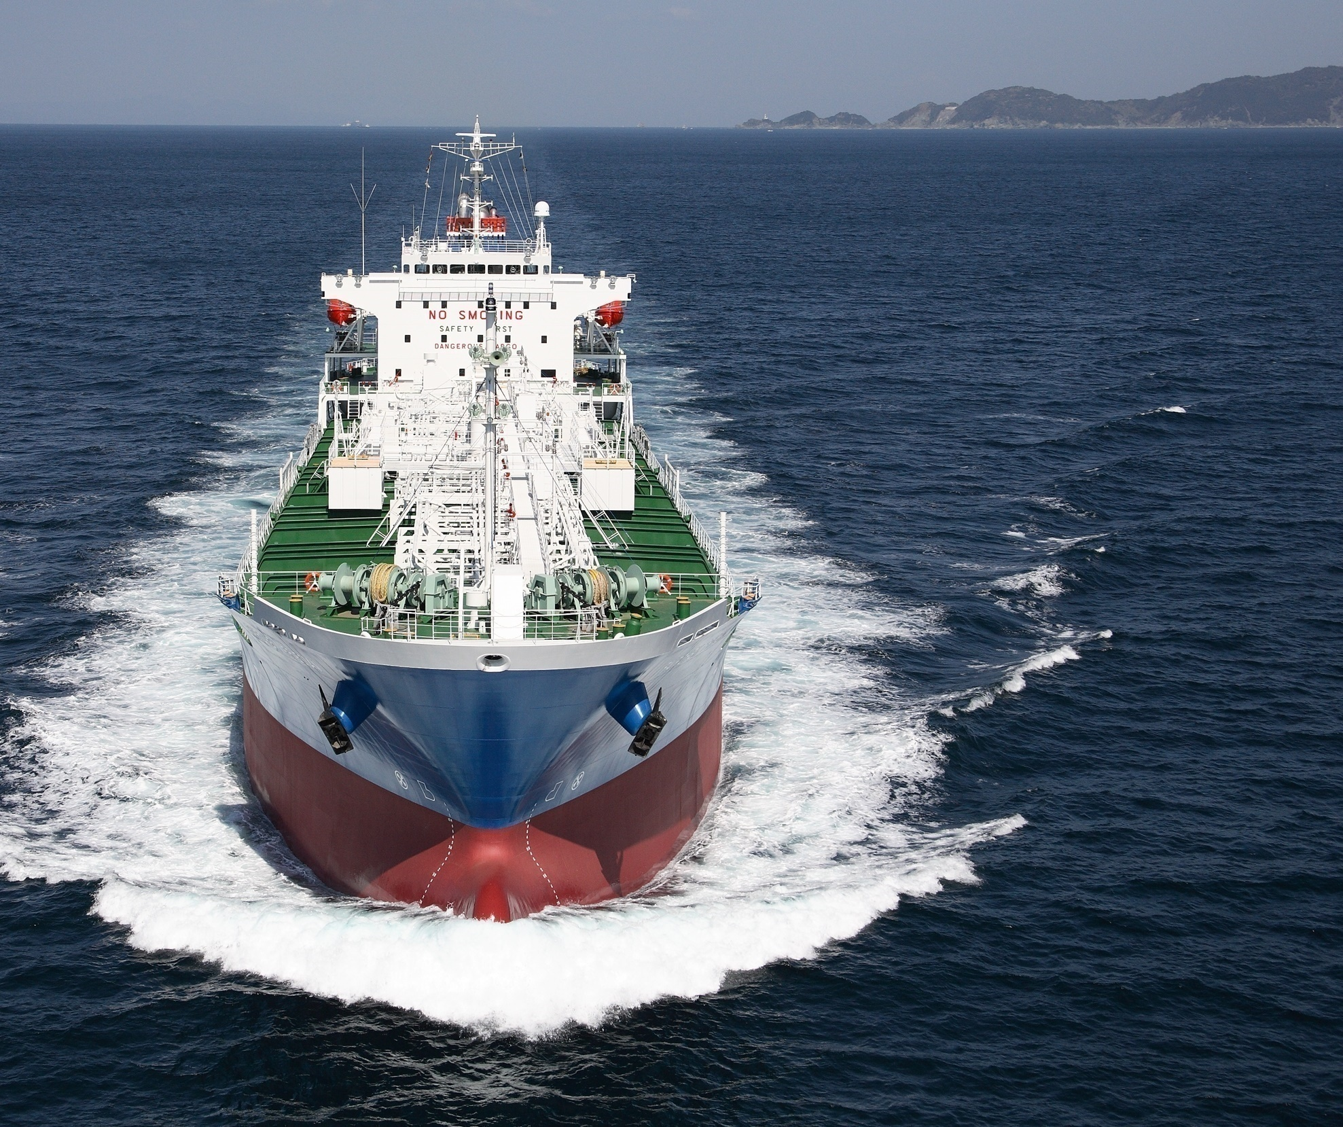
FLEET PROFILE
www.fairfieldchemical.com
Average Vessel Age 4.1 years
Vessel Total 41
Total (S)DWT 887,494 mts
Tank Coating 100% Stainless
IMO Ship Type II/III
Segregations 20 to 26
Nitrogen Equipped Full Fleet
Notes:
WHO WE ARE: FAIRFIELD CHEMICAL CARRIERS
Fairfield Chemical Carriers controls a fleet of modern fully stainless-steel chemical tankers
trading worldwide transporting a broad spectrum of bulk liquid parcel cargoes.
The Company is managed and staffed by highly experienced professionals committed to offering innovative and reliable logistics solutions.
A commitment to safety & Dedication to exceeding customer expectations form the cornerstones of Fairfield’s business philosophy.

Slide 3
Main Tradelines
GLOBAL COVERAGE
COMMON TRADE LANES
Notes:
- Some of the more common tradelanes shown in the slide above.
With headquarters being in Wilton, CT FCC has offices worldwide, including Singapore, Rotterdam, Houston, and Durban

Slide 4
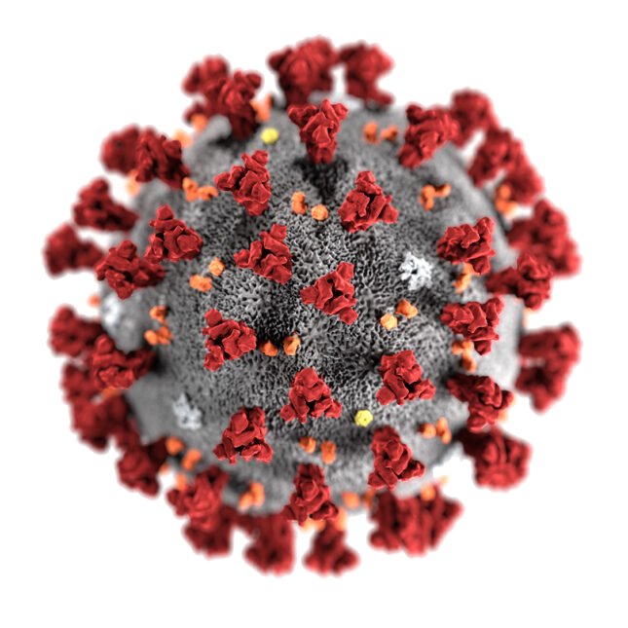
MARINERS AND THE RESPONSE TO COVID-19
Many factors are considered when evaluating the response to COVID-19
Minimize disruptions to supply chains
Networks may be halted
Crew cannot stay onboard indefinitely
Impacts to the well-being and ship safety
Notes:
The US relies on efficient and safe shipping to minimize disruptions to supply chains.
Safety at sea depends getting crews changed- otherwise these networks will come to a halt
There is a humanitarian issue in getting crews changed, they cannot stay onboard indefinitely
Service periods cannot be extended indefinitely as this has impacts on the well-being of the ship crew and, most importantly, safe ship operations
The IMO in the May 5, 2020 Circular letter no.4204/Add.14

Slide 5
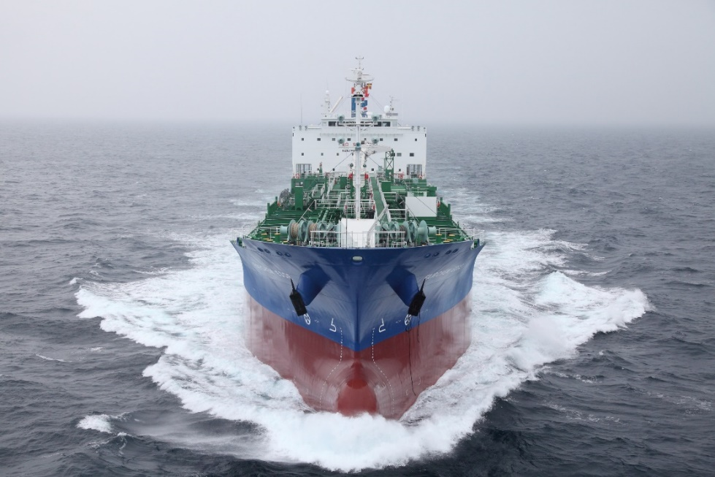
FCC CREW CHANGES & THE EFFECTS FROM COVID-19
Crew Change Locations
India and China - only Indian and Chinese Crew members
Korea for Korean crew. Other nationalities allowed, but subject to 14-day quarantine
Hong Kong (if vessel calls for cargo operations)
Support for Ship’s Crews
Support Network for Seafarers
Connecting to families / internet allowances
WE CARE Bulletin
Additional monetary allowance
Reaching out to family members of the crew
Notes:
Covid kits being supplied to the ships including Hydrocholoroquine and remdesiver and Rapid test kits
WE CARE Bulletin -The Corona virus pandemic has brought the whole world to a standstill ,with schools closed and all outdoor activities suspended due to lockdown, it has become very difficult for seafarer’s family members to pass their time and stay indoors all the time. During the current lock-down period our MGMT companies have reached out to our seafarers & their family to share their stories, articles, photographs, poems, graphic artwork, etc. The tech MGMT is continuously establishing a long and fruitful relationship with our seafarers and their families. WE CARE Bulletin is being published by our parent company FML, Hongkong.
Extra engagement/attention to details of shipping dangerous products such as Styrene Monomer or acrylo – looking for daily temperature logs instead of sitting back thinking the ship has it covered? It is not much but this is a All Hands on Deck situation. Protect the crew = protect the environment

Slide 6
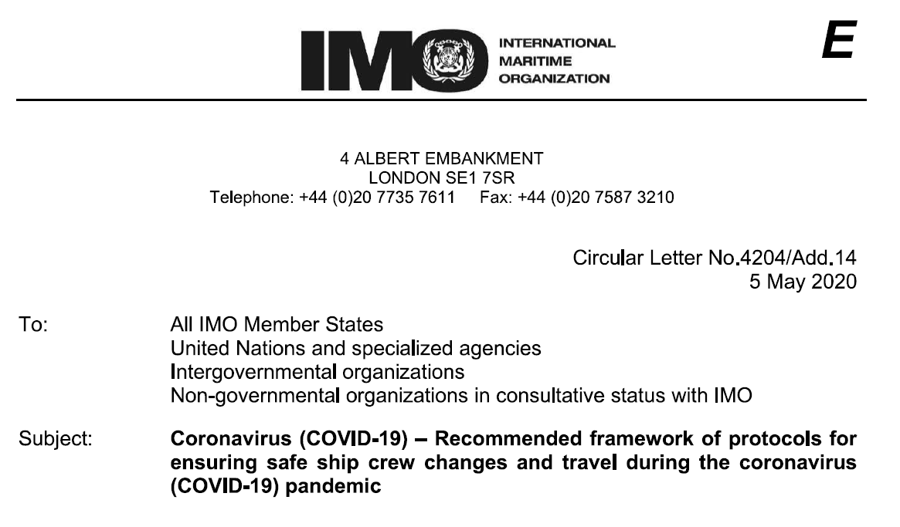
MARINERS AND THE RESPONSE TO COVID-19
The IMO recommendations to Governments and National Authorities are:
Recognize seafarers as “key workers”
Provide seafarers with appropriate exemptions to facilitate joining and leaving ships.
Accepts appropriate documentation as evidence of being a professional seafarer e.g. discharge books, STCW Certificates, employers’ letters of employment.
Permit seafarers to disembark in port and transit to airports for crew changes and repatriation
The IMO in the May 5, 2020 Circular letter no.4204/Add.
Notes:
The IMO recommendations to Governments and National Authorities are:
Recognize seafarers as ‘key workers’
Provide seafarers with appropriate exemptions to facilitate joining and leaving ships.
Accepts appropriate documentation as evidence of being a professional seafarer e.g. discharge books, STCW Certificates, employers letters of employment.
Permit seafarers to disembark in port and transit to airports for crew changes and repatriation
The IMO in the May 5, 2020 Circular letter no.4204/Add.

Slide 7
MARINERS AND THE RESPONSE TO COVID-19
The IMO in the May 5, 2020 Circular letter no.4204/Add.14 sets out a framework of protocols to facilitate crew changes during the COVID-19 pandemic.
  Protocols for Joining a Ship (P1-P6)
  Protocols for Leaving a Ship and repatriation (P7-P12)
  The full letter can be found on the following link:
  http://www.imo.org/en/MediaCentre/HotTopics/Documents/COVID%20CL%204204%20adds/Circular%20Letter%20No.4204-Add.14%20-%20Coronavirus%20(Covid-19)%20-%20Recommended%20Framework%20Of%20Protocols.pdf
                …Or by putting ‘”IMO Circular No. 4204/ad.14” in your search engine
Notes:
FRAMEWORK OF PROTOCOLS
Protocols for joining a ship
From a seafarer's place of ordinary residence in one country via aircraft to join a ship in a seaport in another country
Protocols for leaving a ship and repatriation From a ship in a seaport in one country via aircraft to a seafarer's place of ordinary residence in another country
Please click on the link to open a tab with the IMO circular

Slide 8
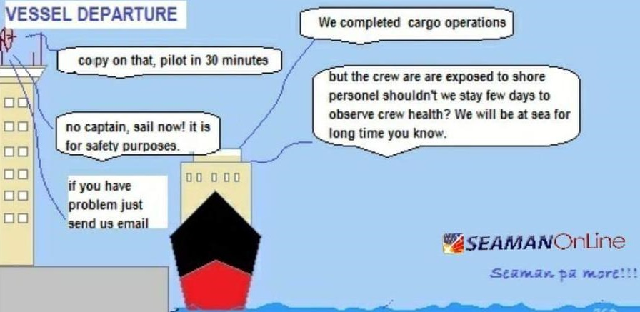
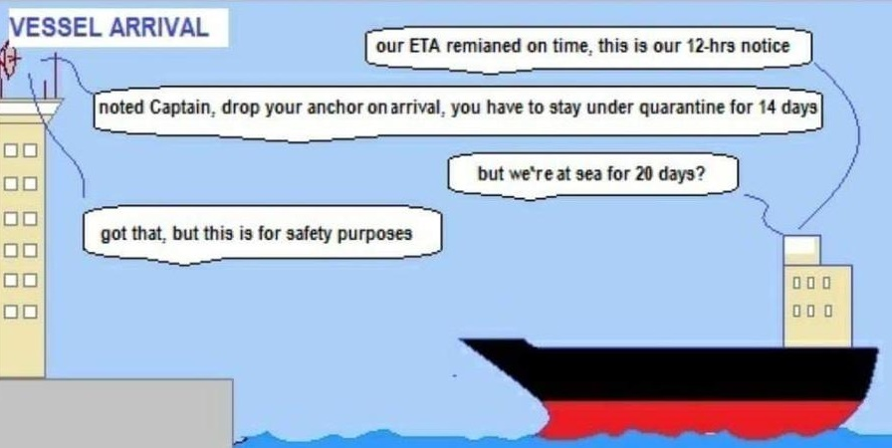
Present Situation in Ports WORLDWIDE
Notes:
Granted that shipping can spread coronavirus from country to country, and region to region but cargo ships can self isolate better than anybody.
We accept that crews present a risk to the community, but very often we from ashore present a greater risk to the ship’s crews than they do to us.
After 9/11 crew shore leave and even crew changes became very difficult.
Terminals over-corrected with security pertaining to shore leave and seafarers access when ISPS code was introduced
About 10 years ago on Houston it was credit to the USCG COTP-Sector Houston-Galveston; industry and local seaman's misisons who pushed for seafarers to get ashore at no cost to themselves
I fear that COVID we will face the same setbacks to what has been quite a good situation for crew shore leave over the past 10 years
We hope that crew changes will be facilitated by Port States using the IMO protocols. With industry and NGO’s pushing for these to keep industry moving

Slide 9
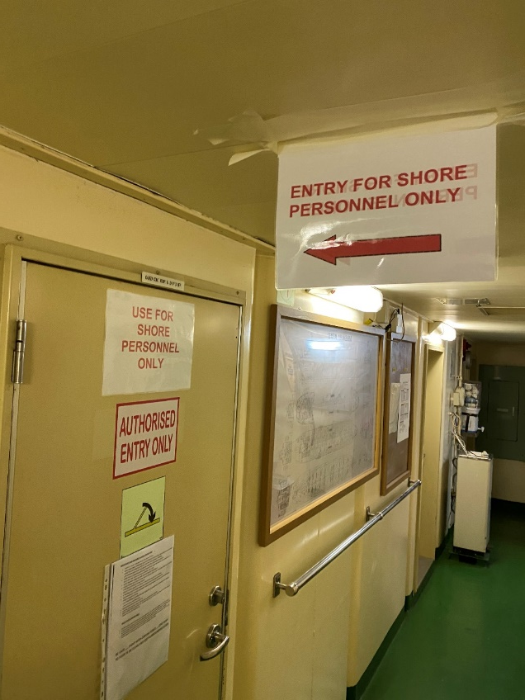
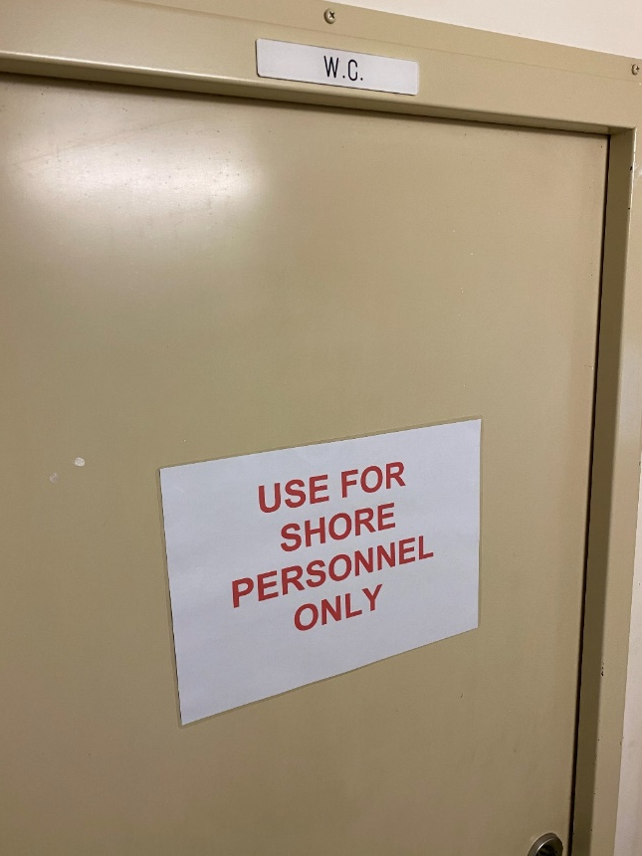
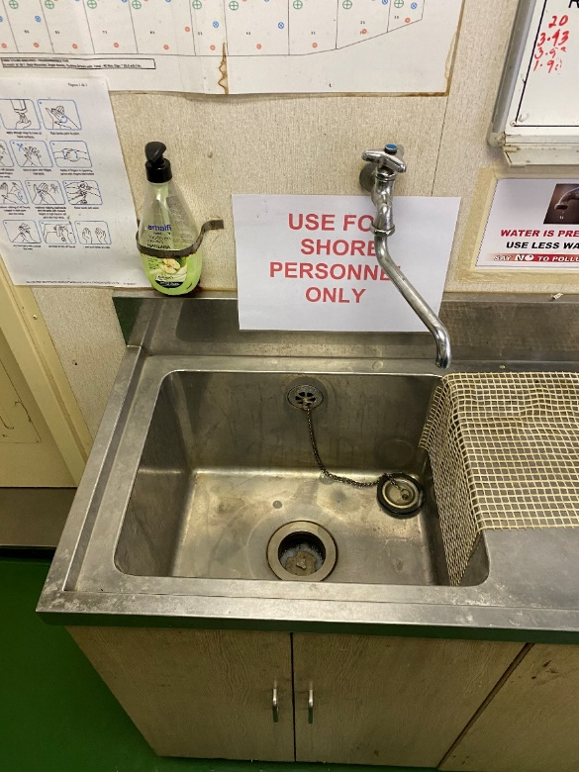
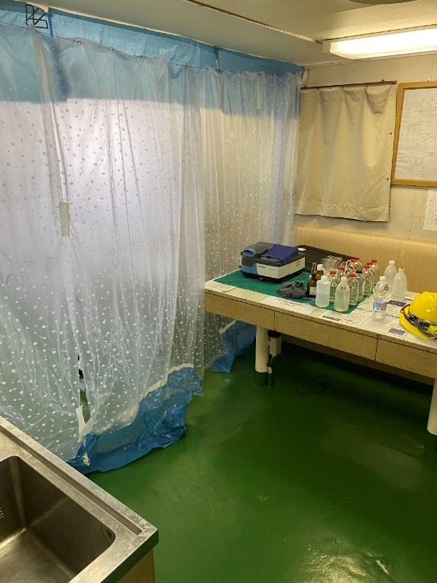
What to expect when coming onboard…
Notes:
Ship has COVID procedures in his ISM SMS.
Wear a face mask
the facemask more represents the attitude that you aren’t spreading the virus; than preventing the wearer from contracting the virus)
You may be asked to sanitize your hands at the gangway.
You may be asked to wear gloves.
You will fill in a COVID declaration form and have your temperature taken.
Pre-transfer conferences may be done on the open deck, or even at a picnic table on the dock
be mindful on tankers of non-intrinsicially safe equipment on deck
Previously if facing a long cargo ops over several days in port we would take a spare cabin, we now use shoreside hotels close to the ship instead.
Be prepared that shore side visitors will be limited to one space closest to the accommodation entrance- CCR.
You will also be given access to your own restroom facilities and handwashing station.
If the master invites you to eat please politely decline to join them in the messroom, the messman can always bring a plate to the CCR
The ships crew will adhere to any guidance from flag state as well as Pilot Association protocols, terminal protocols, and governmental protocols (USCG, CBP).
requirements from local Pilots, wiping down equipment, wearing masks, social distancing

Slide 10
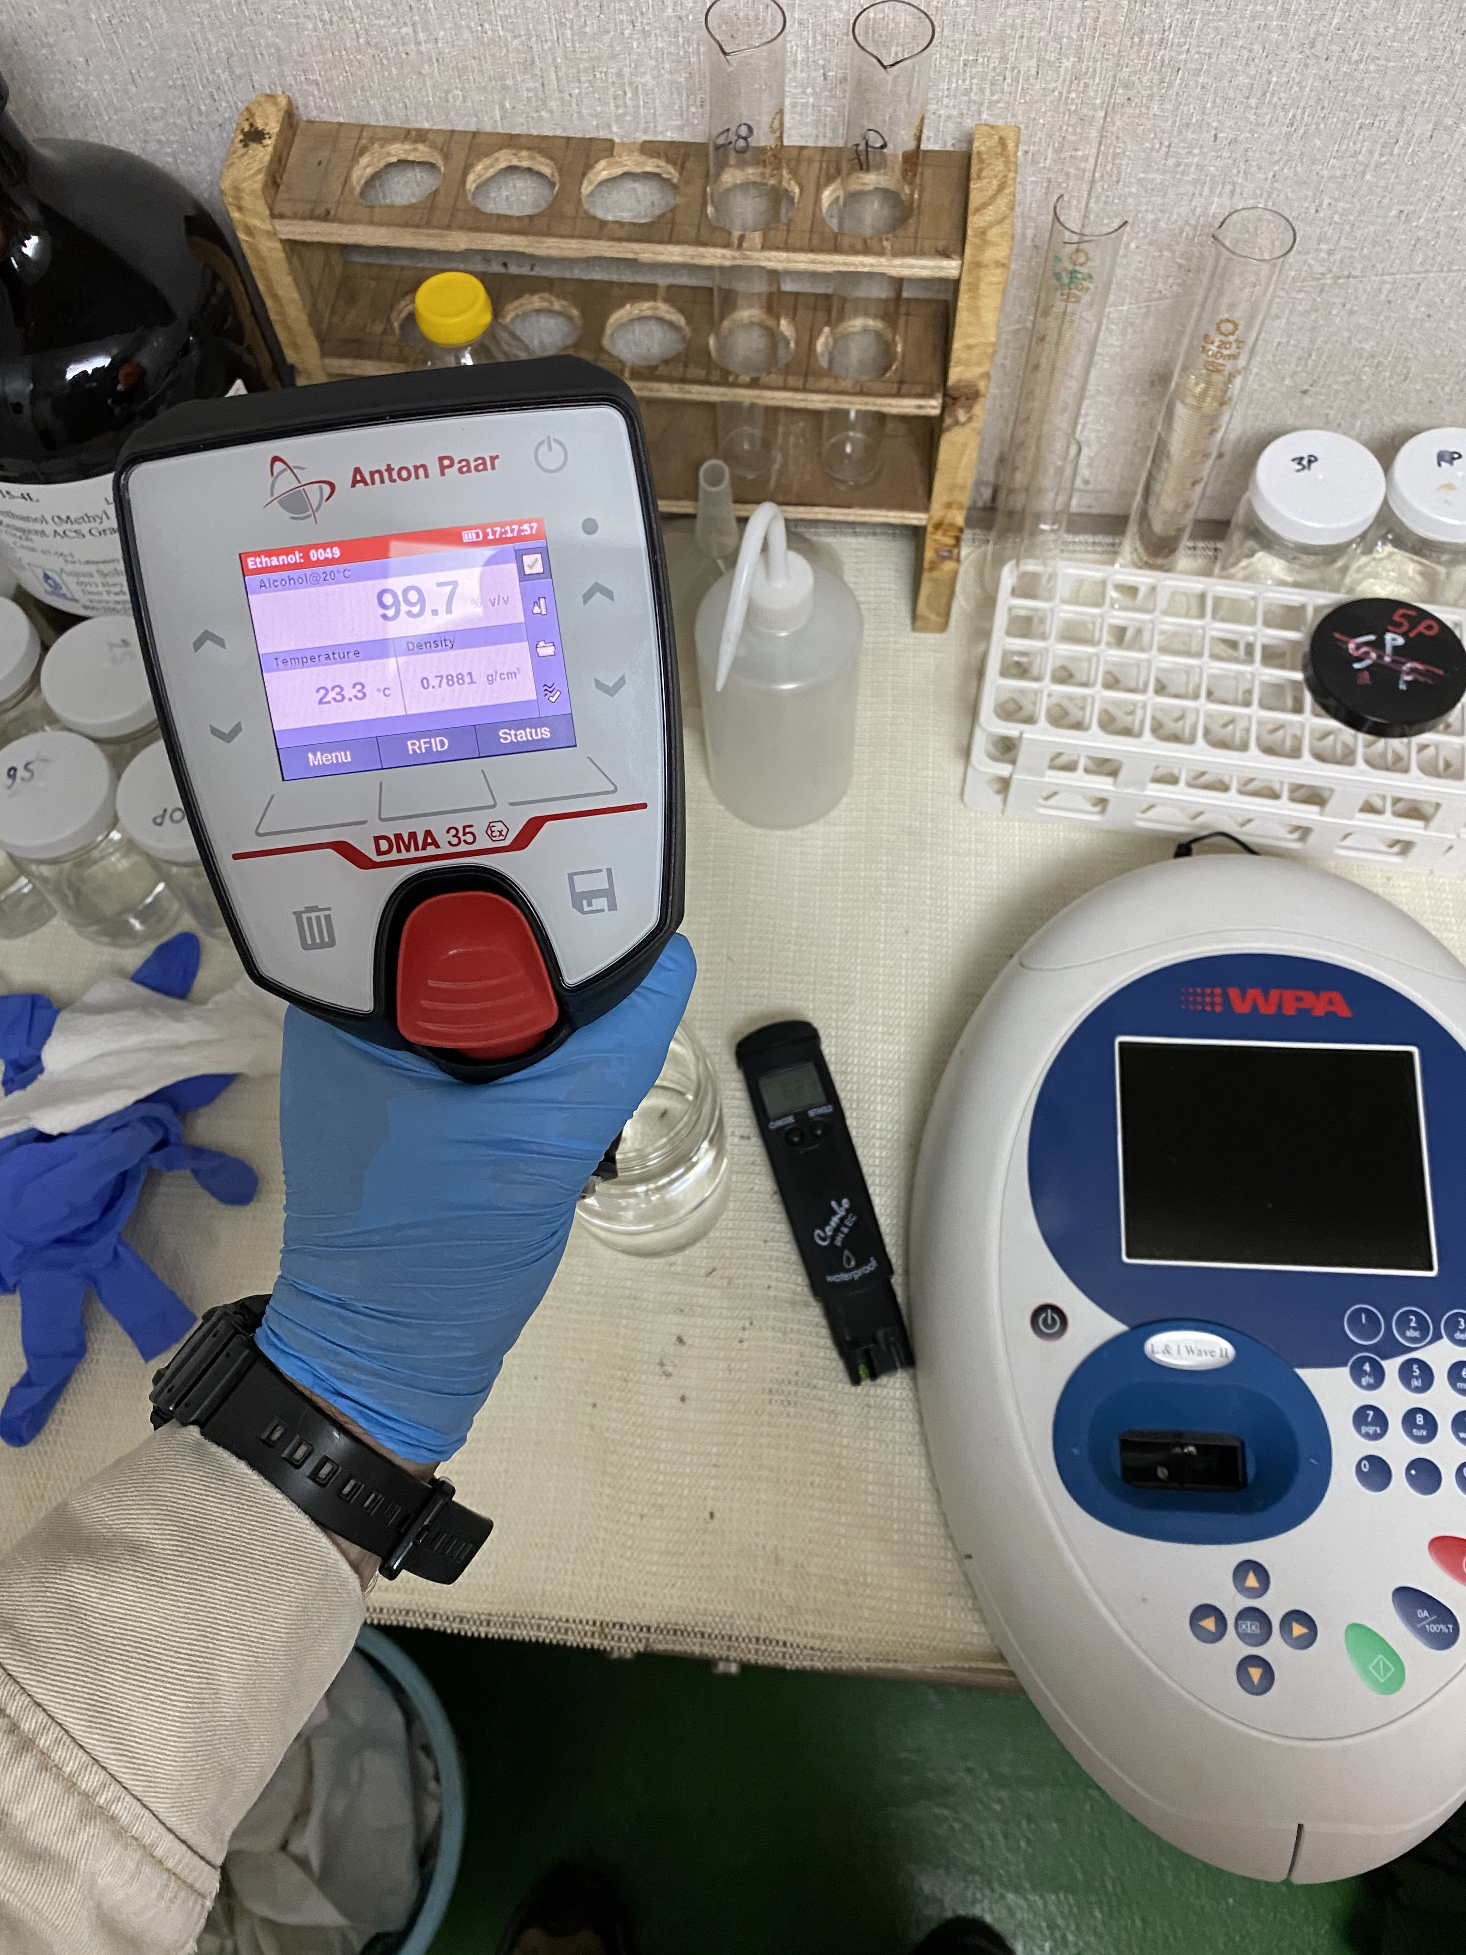

SOCIAL DISTANCE
Increasing Social Distancing
Further
Think Outside the Box
Notes:
Recently FCC worked on getting one of our customers to approve the loading of ethanol without surveyor attendance
This to increase social distancing still further using new procedures and technology
Surveyors are independent companies present as quality control for the customer
They verify tank cleanliness, cargo quality and quantity
All of our ships are equipped with Spectrometers so the master can verify tank cleanliness
We added some extra equipment- densimeter , conductivity and pH meter
The ship was able to load witout surveyors or terminal personnel coming onboard
This reduces risk of exposure of the crew to shore personnel
We are active

Slide 11
UNEXPECTED CIRCUMSTANCES
When things don’t go as planned…
urgent message to management
“Slopchest supplies didn’t arrive to the ship this call USA. Crew have been onboard a long time without sign off due to lockdown. Also no shore leave to go shopping due to COVID. They are all short of toothpaste, deodorant, shampoo, candy bars and chips. Morale issue may affect future performance.”
Notes:
In cases like this normally a few people would get shore leave and go to Walmart and get essential supplies
The ship management terminal and CBP aren’t allowing shore leave. All quite rightly so
there’s no safe transportation (and no protocols , seafarers centers have shut down services.)

Slide 12
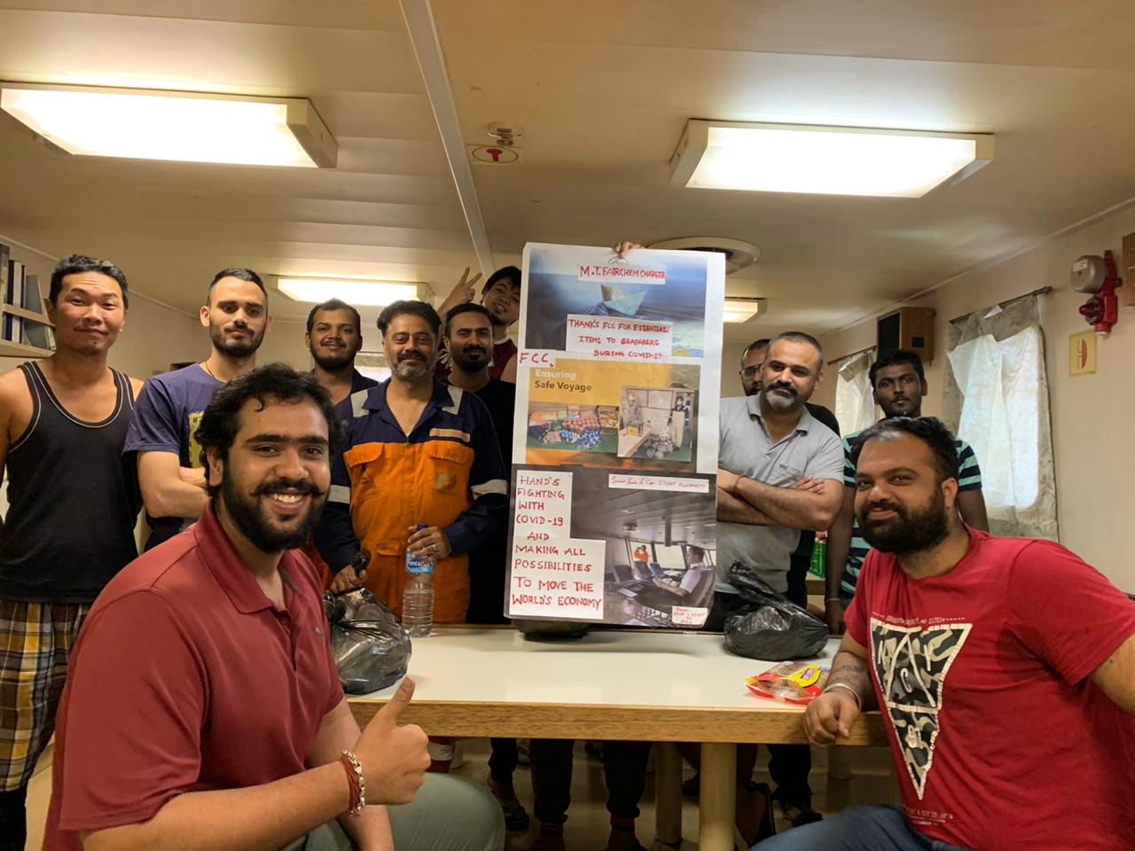
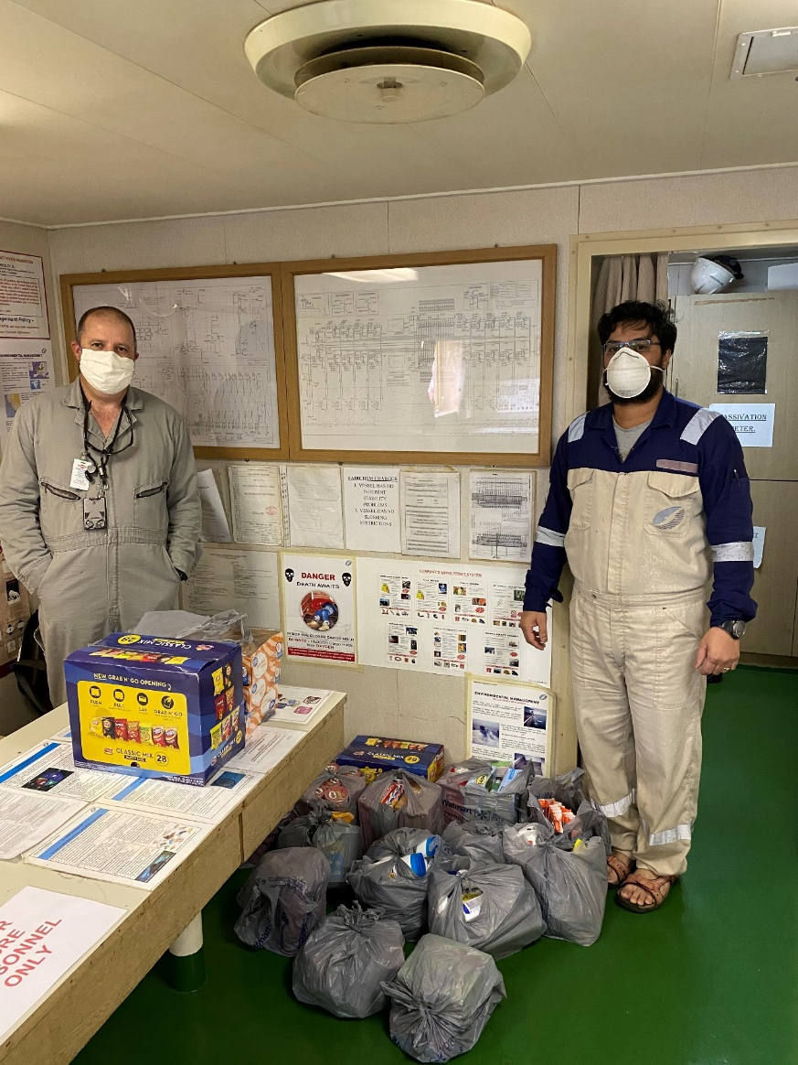
The Solution…
Notes:
Visiting the ship anyway I swung by Walmart and loaded a shopping cart with some essential supplies…
Note the collage by the crew

Slide 13
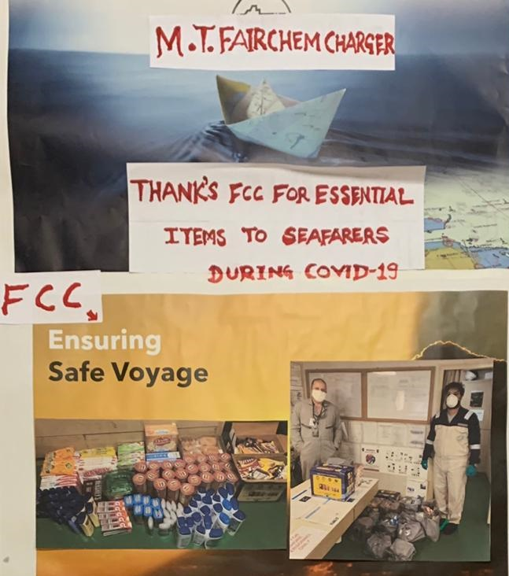
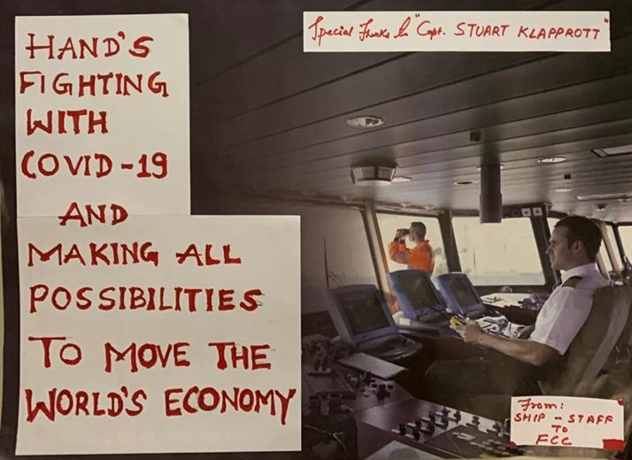
MT FAIRCHEM CHARGER
Thank you to FCC for essential items to seafarers during Covid-19
FCC-Ensuring Safe Voyage
Hands Fighting with COVID-19 and making all possibilities to move the world’s economy
Notes:
Visiting the ship anyway I swung by Walmart and loaded a shopping cart with some essential supplies…
Note the collage by the crew

Slide 14
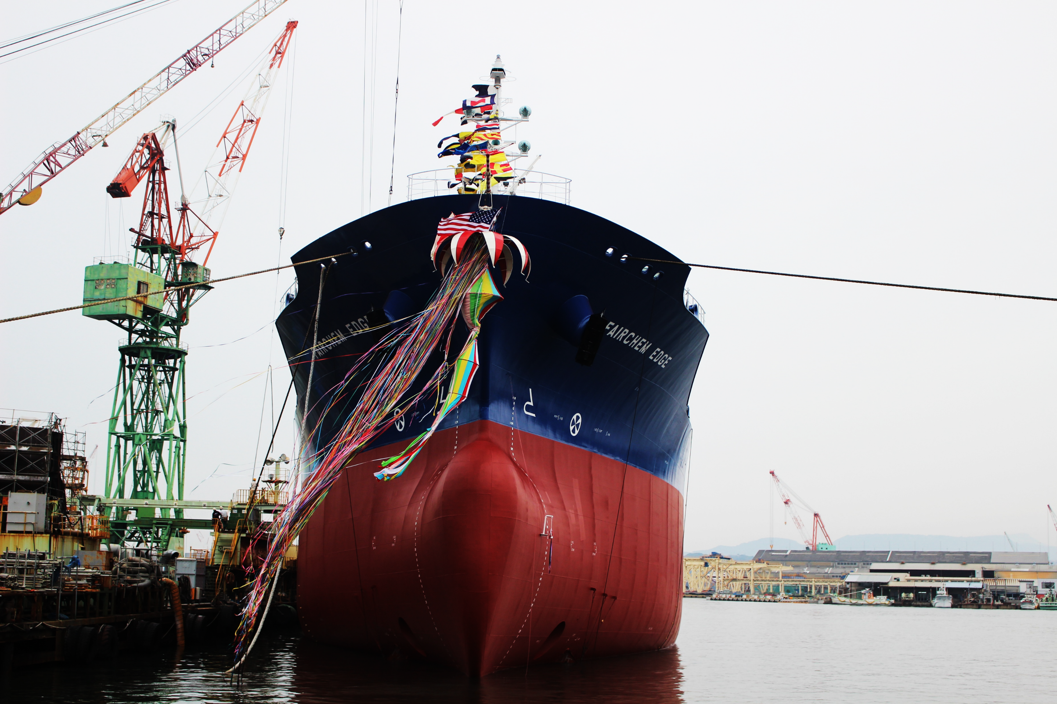
THANK
YOU

