Slide 1

Welcome Back!
Notes:
SAY: Welcome back everyone & thank you for joining us today! In case you forgot, my name is ___________ and I am the __________ with the North American Marine Environment Protection Association, always known as NAMEPA.

Slide 2
Last week!
We looked at three distinct coastal habitats
  Wetlands
  Coral Reefs
  Mangroves
Each habitat hosts a variety of species - biodiversity
In order for organisms to thrive in these habitats they have unique adaptations
  Wetlands: Able to survive in salt water at various times with little oxygen present
  Coral Reefs: Protection from predators!
  Mangroves: Strong, salt tolerant roots for structure and support
Notes:
SAY: So let’s break down what we discussed last week.
SAY: First, we looked at three distinct coastal habitats - wetlands, coral reefs, and mangroves. Each of these unique coastal habitats have what we call biodiversity. This is a way to say there are many different types of species that can live in these habitats.
Then, we looked at what these organisms need to thrive in these habitats. We discussed adaptations that these species may have. In wetlands we saw species having the ability to survive in salt water at various times with little oxygen. In coral reefs we saw the different ways they can protect themselves from predators and the symbiotic relationships they have. For mangroves, we saw strong, salt tolerant roots for structure and support.

Slide 3


Solve It - Riddle Review
As we get ready to begin today’s lesson, let’s try these riddles!
I stop by wetlands for food or to rest a bit. I do not live there year round. What am I?
I am a type of relationship where both species benefit. What am I?
Notes:
SAY: Alright, let’s look at these two riddles and see if we can figure out the answer!
A migratory or visitor species
Symbiotic relationship

Slide 4
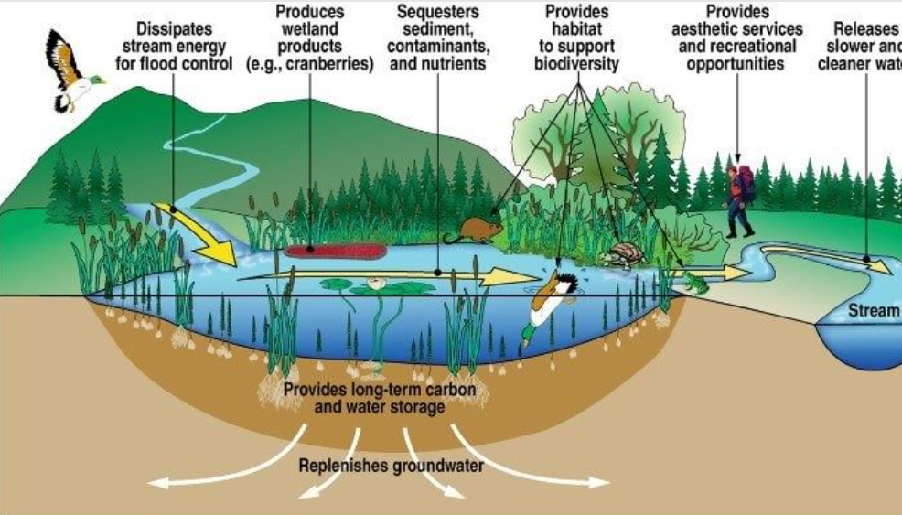
Wetlands: Environmental Importance
Protect coastlines from damaging storms
Purify water
Provide a habitat for many different species
Notes:
SAY: Let’s first talk about the importance of wetlands. Wetlands play a vital role for humans and other species. They provide ecosystem services which is a fancy way to say the living and nonliving things interact together to provide a variety of solutions. Some of these services include purifying water, protecting coastlines from damaging storms, and providing a habitat for the different species!

Slide 5
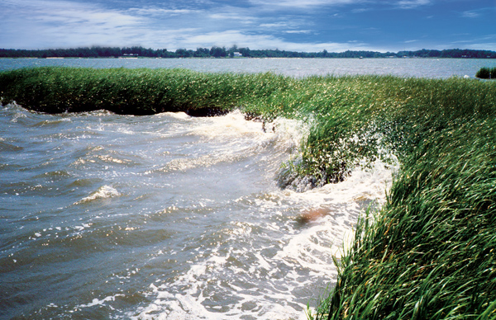
How Do Wetlands Protect the Coastline?
Notes:
ASK: Looking at this picture, how do you think a wetland protects the coastline? (guide to answers → wave crashes on the wetland, the wetland breaks the wave strength (energy))

Slide 6
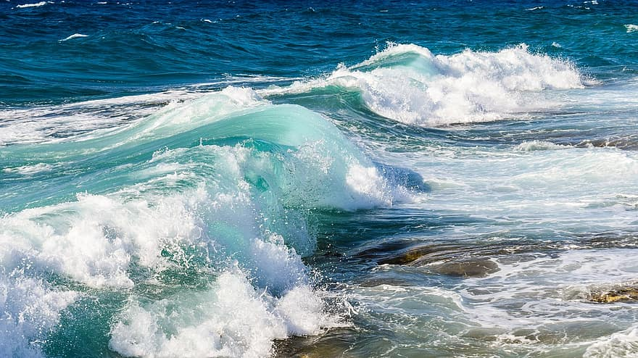
Wetlands: Protect the Coastlines
Natural defense barrier
Soaks up and stores the water
Slows wind wave action and storm surges created by tropical storms and hurricanes
Notes:
SAY: Great answers! So wetlands act as a natural defense barrier. They actually soak up some of that water and store it. This breaks the wave action, especially during strong storms. We can see the waves in the first photo crashing against the grass we see in wetlands. In the second photo we see some stronger waves.
ASK: Do you think the wetland grasses can break this wave energy too?

Slide 7
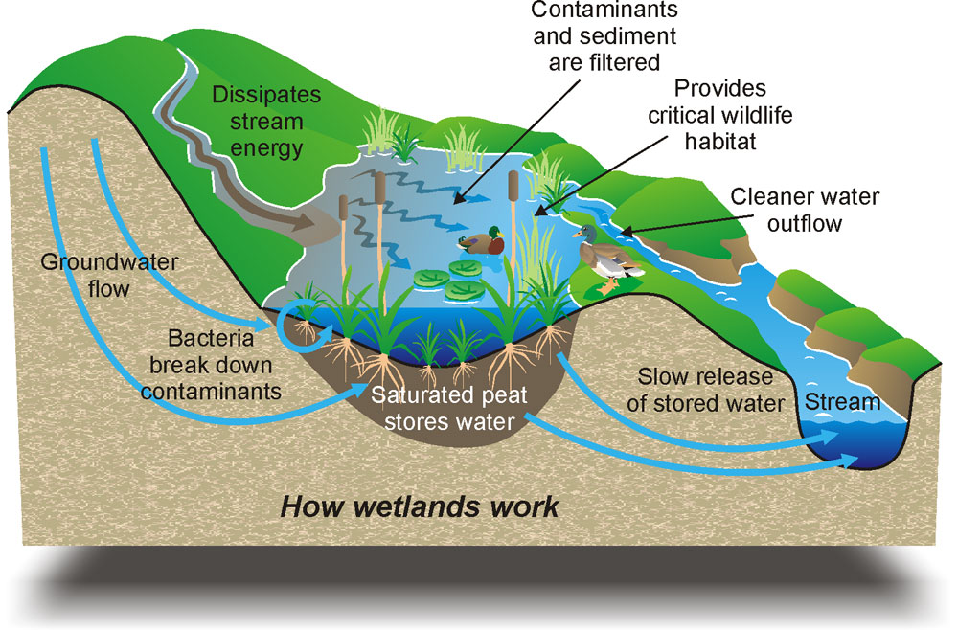
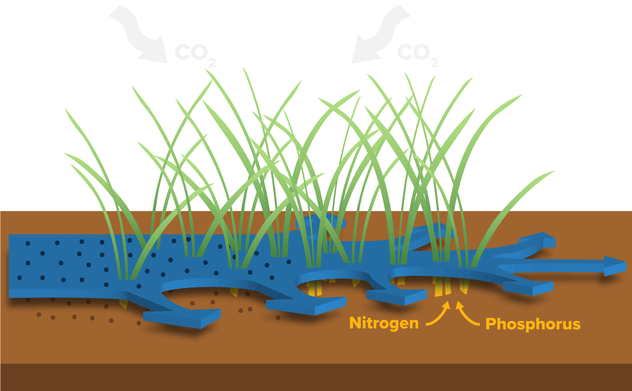
Wetlands: Purify Water
Wetland plants slow the flow of water
Takes up nutrients in its roots
Traps sediment
Collects and stores carbon
Notes:
SAY: First, let’s look at how wetlands protect the coastlines. We looked at some adaptations last week of wetland plants. Remember, they must be able to adapt to thrive in the presence and absence of water.
Wetland plants slow the flow of water. This prevents erosion, and the slowing allows roots to absorb more nutrients
ASK: What kind of nutrients do you think we see? (this is a hard question probably!) (nitrogen & phosphorus)
SAY: Nitrogen and phosphorous are absorbed by the roots of the plants. They collect these nutrients and hold on to them. So step 1 is they remove the nutrients.
In step 2, the plants hold onto sediment, like sand or dirt, in place. This means the sediment has time to settle to the bottom and be trapped between the plants. As the water flows, it is purified (or cleaned) of nutrients and sediment like sand!
In step 3, wetlands store carbon dioxide through that fancy process we talked about briefly - photosynthesis
Remember, photosynthesis is when plants convert sunlight energy into usable energy. The usable energy contains an element called Carbon.
Finally, in step 4, the plants die and are broken down by decomposers (bacteria!), the decaying plant which has carbon gets locked away in the sediment (soil) for many years.
ASK: Does anyone know what this carbon locked away for millions of years becomes? (hinst: humans use it → humans use it in their vehicles → it’s an energy source)

Slide 8
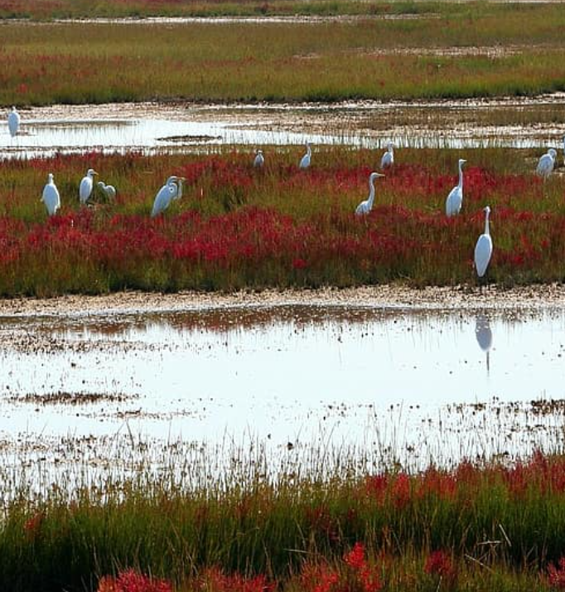
Wetlands: Habitat for Species
Highly productive ecosystems
43% of USA’s endangered or threatened species’ are connected to wetlands
Spawning site and nursery for juvenile species
Notes:
SAY: Wetlands are highly productive ecosystems for species. The many species of fish, birds, shellfish, mammals, reptiles, and amphibians all have intricate food webs that wetlands can support.
ASK: Anyone remember what we call an ecosystem that supports a variety of different species? (biodiversity)
SAY: Many different species rely on these wetlands for their survival. 43% of the United State’s endangered or threatened species’ rely on wetlands for their survival.
SAY: We’ll talk next time about why this statistic is important.
SAY: Wetlands provide a foraging environment with shelter and protection for smaller species, like juvenile fish. They are able to thrive in this protected area.

Slide 9
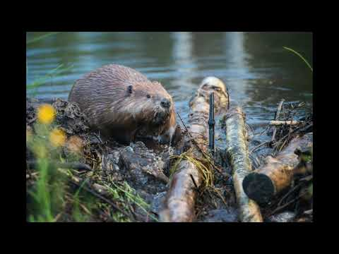
Notes:
SAY: Let’s watch this NAMEPA video about wetlands.

Slide 10
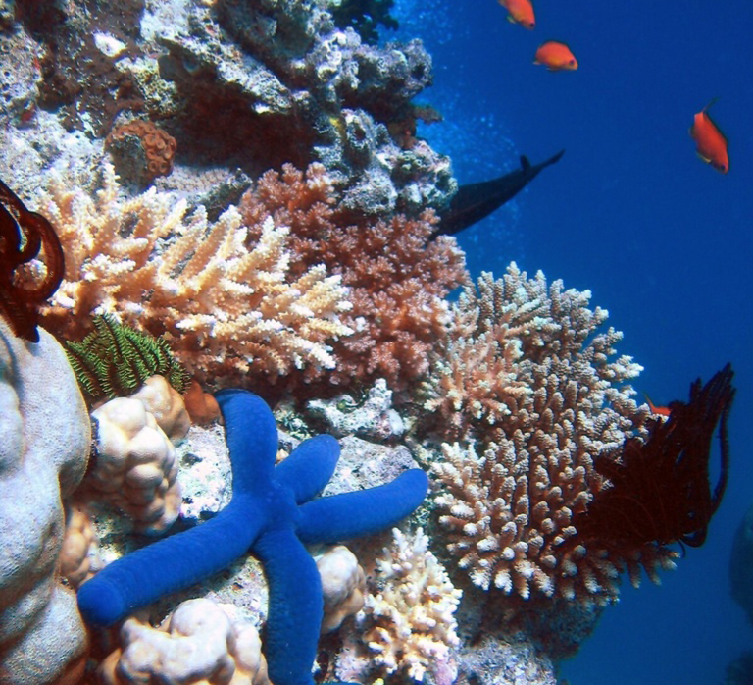
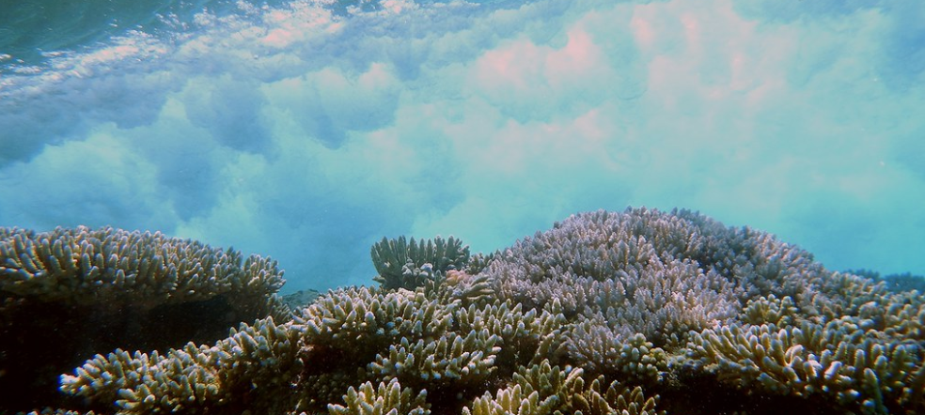
Coral Reefs: Environmental Importance
Most biologically diverse and complex structure in the marine environment!
Indicator Species: their presence, population size & health tell us the health of the reef!
¼ of all marine species depend on coral reefs food and shelter
Protect coastlines by absorbing storm energy
Notes:
SAY: Now that we talked about wetlands, let’s talk about coral reefs. Coral reefs are the most biologically diverse and complex structure in the marine environment. We like to call coral reefs the rainforest of the ocean. Coral reefs play an important role in determining the health of the reef and surrounding area. This is through what are called indicator species.
SAY: Not only that, but ¼ or 25% of marine species depend on coral reefs for food and shelter
SAY: They also protect the coastline by absorbing similar storm energy we saw for wetlands.

Slide 11
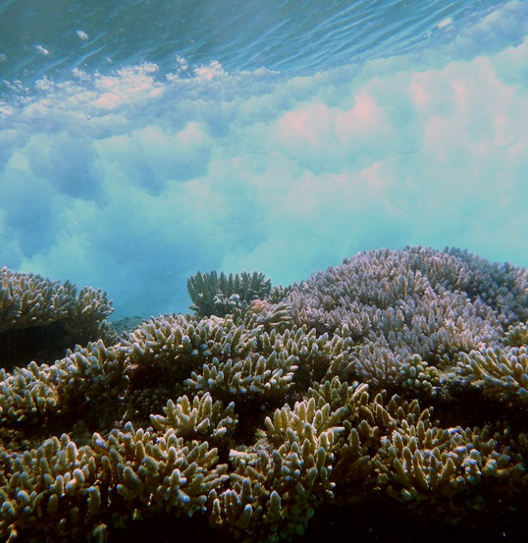
Coral Reefs: Protection of Coastline
Coral polyps build their calcium carbonate exoskeleton - large vertical structures in shallow waters
Natural defense to absorb wave energy
90% of wave energy is absorbed by coral reefs!
Notes:
ASK: How do coral reefs protect the coastline?
SAY: First, we need to know what make up coral reefs. Coral reefs are coral polyps that together create a calcium carbonate exoskeleton. Essentially, they are the long vertical structures we see. They need a lot of sunlight for photosynthesis, so they are found in shallow water.
SAY: Because they are close to the surface, they act as another natural defense to absorb wave energy. Can you believe that 90% of wave energy is absorbed by coral reefs!

Slide 12
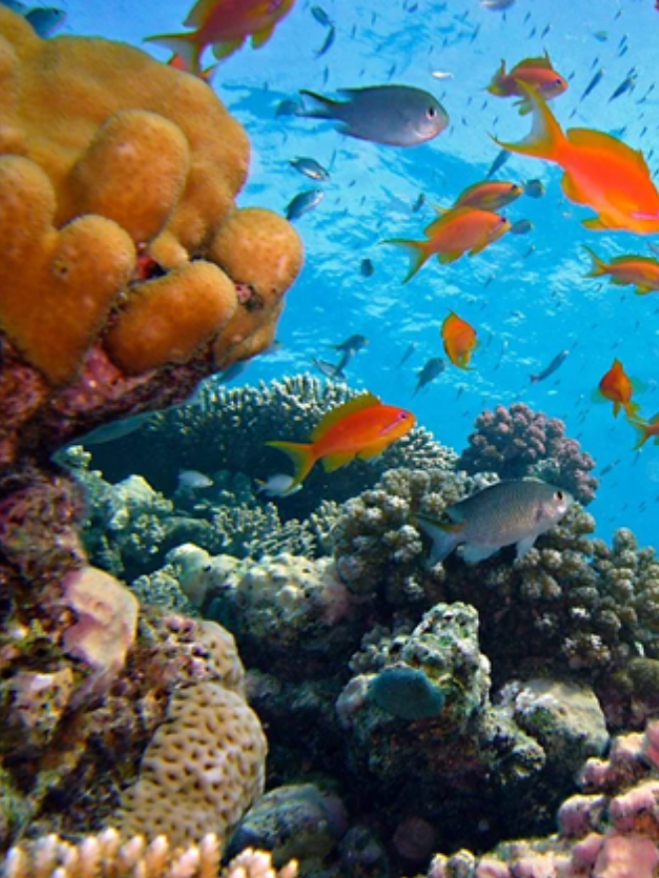
Coral Reefs: Indicator Species
What do you think an indicator species does?
Helps determine the health of their habitat!
Notes:
ASK: What do you think an indicator species does?
SAY: An indicator species helps determine the health of their habitat. Remember, we can look for their presence, the numbers, and overall health to help tell us how the reef is doing.

Slide 13
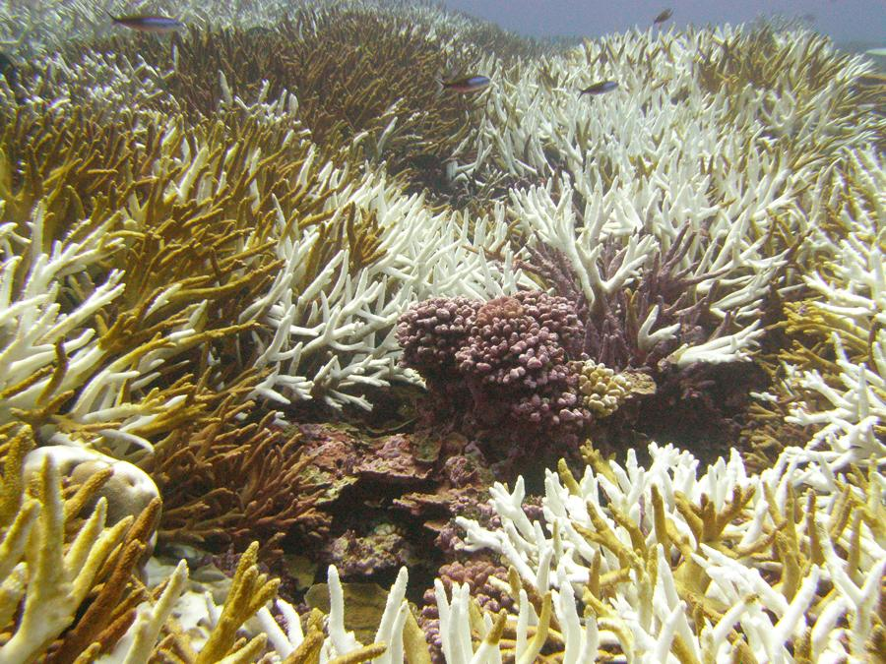
Coral Reefs: Indicator Species in Action
Do you know what this a picture of?
Coral bleaching is when coral expel zooxanthellae which make their food
Coral are sensitive to changes in temperature, pH, and water quality
Notes:
ASK: Do you know what is happening in this photo?
SAY: Coral bleaching is when coral expel zooxanthellae, which make up corals food.
SAY: coral are sensitive to changes in temperature, pH, and water quality, so when there is a change, the coral pushes out the zooxanthellae, and the coral ends up being unable to eat. We see bleaching as an effect.

Slide 14
Coral Reefs: Biodiversity
Coral reefs are the rainforest of the ocean!
25% of all marine species rely on coral reefs either directly or indirectly for survival
Notes:
SAY: Coral reefs are a hot spot for biodiversity. Collectively 25% of all marine species rely on coral reefs either directly or indirectly for survival.
ASK: What are some examples of species using coral reefs for survival?

Slide 15
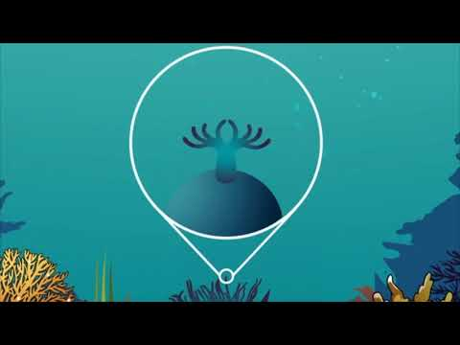
Notes:
SAY: Let’s watch this NAMEPA video on coral reefs to learn more.

Slide 16
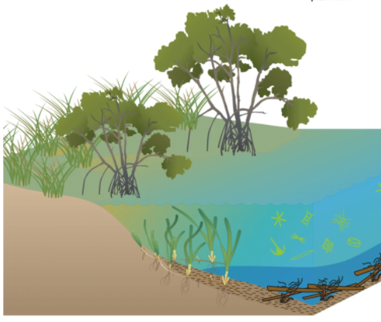
Mangroves: Environmental Importance
Coastal protection from erosion, storms and waves
Vital role in food cycles
Roots capture and hold on to carbon
Notes:
SAY: Now let’s talk about mangroves. Mangroves offer coastal protection from erosion, storms & wave energy. They provide a home & refugee for different species - lot’s of biodiversity here! Their roots are able to collect and hold onto carbon meaning they are a carbon sink! (they lock it in their roots!)

Slide 17
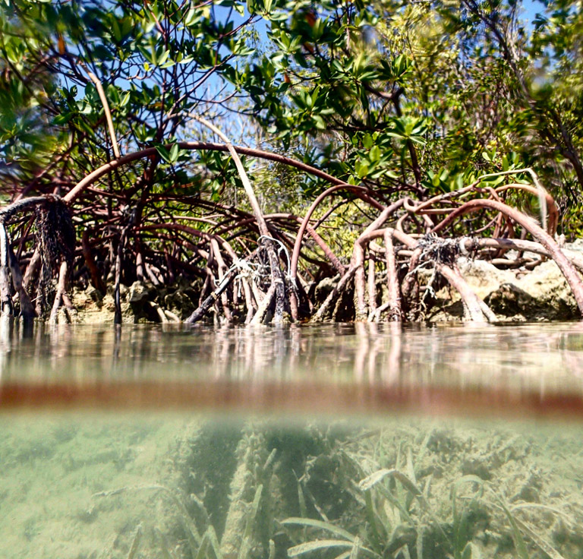
Mangroves: Protection of Coastline
Almost 2 million people live in coastal communities
Intricate root systems break wave energy from storms protecting those communities
Notes:
SAY: Like we saw with wetlands and coral reefs, mangroves protect the coastline. Looking at this photo we see their intricate or complex root systems both above and below the waterline. These roots break wave energy from storms.

Slide 18
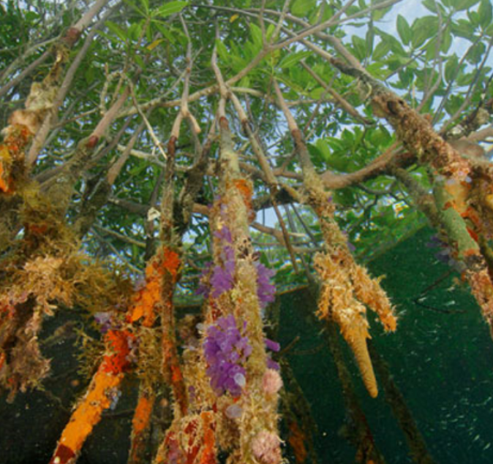
Mangroves: Vital Role in Food Cycle
Leaves fall into the water and are broken down by marine fungi and bacteria into detritus
Detris is organic matter that can be used as food by other organisms - the cycle of life!

Slide 19
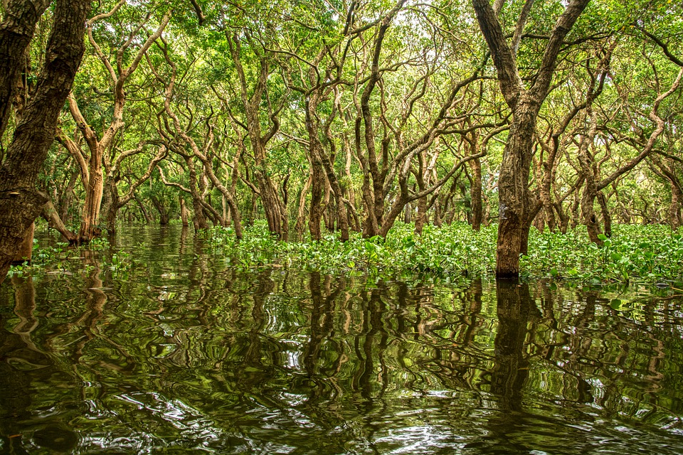
Mangroves: Carbon Sink
Mangrove forests cover 75% of tropical coastlines
Collect carbon dioxide in their roots and stored, similarly to wetlands
Notes:
ASK: Did you know that mangrove forests cover 75% of tropical coastlines?
SAY: Mangroves also act as what is called a carbon sink. This means they collect carbon dioxide and store it in their roots. This is something that wetlands do also.

Slide 20
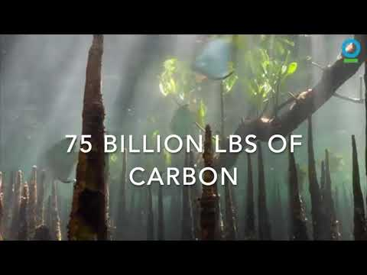

Slide 21
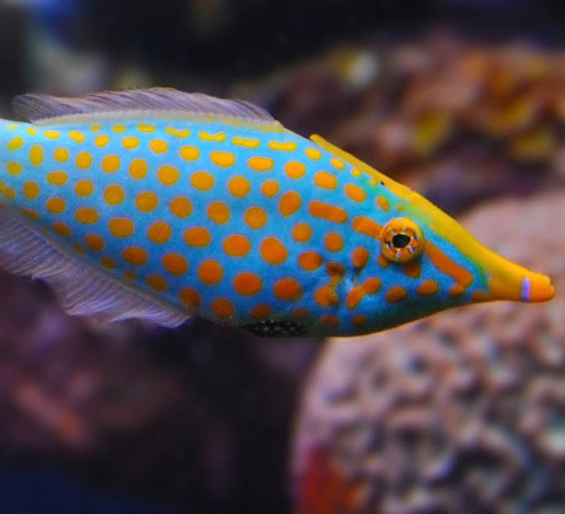
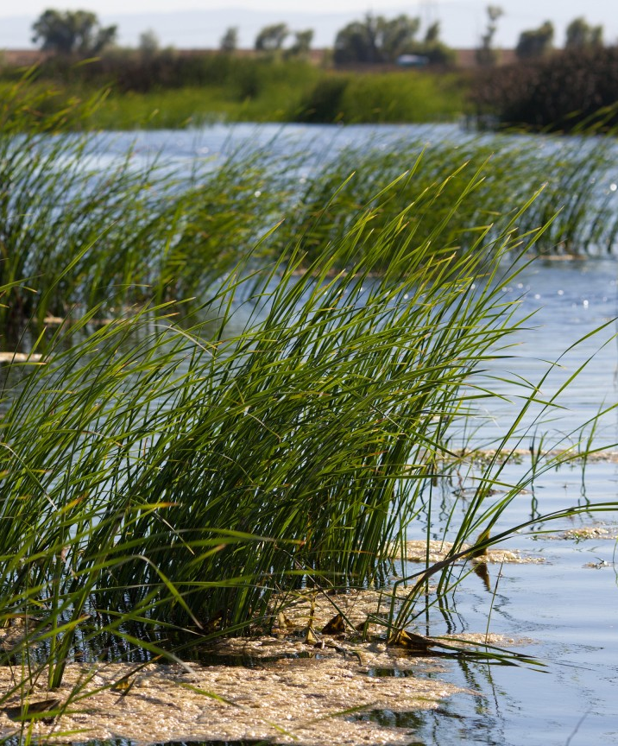
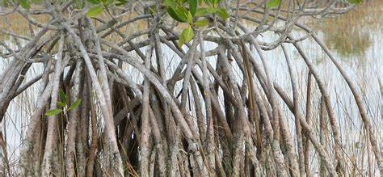
Matching: Coastal Habitat Environmental Importance!
I help purify water
¼ of all marine species depend on me for food and shelter
Which description matches the coastal habitat?
My unique roots help slow waves from storms
Coral Reef
Mangrove
Wetland

Slide 22
Summary of Lesson 3
Wetlands:
  Coastline protection
  Purify water
  Biodiverse habitat
Coral Reefs:
  Coastline protection
  Indicator species
  Biodiverse habitat
Mangroves:
  Coastline protection
  Vital role in food cycles
  Roots capture and hold on to carbon
Notes:
SAY: So let’s break down what we’ve discussed today.
ASK: Do you notice any common themes? What do you think would happen if we lost one of part of these habitats?
SAY: Next week we are going to look at some of the impacts we may see.

