Slide 1
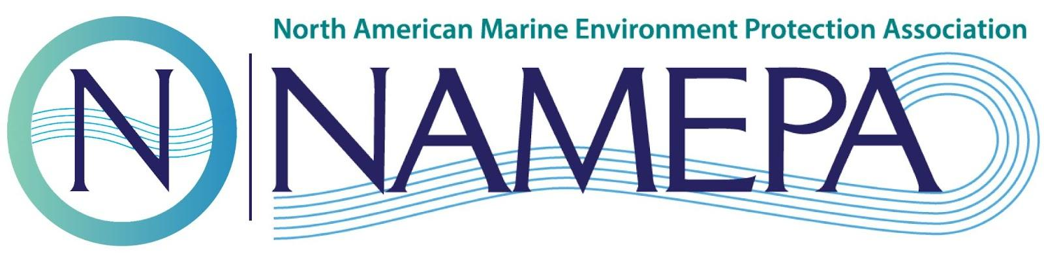
Welcome Back!
Notes:
SAY: Welcome back everyone & thank you for joining us today! In case you forgot, my name is ___________ and I am the __________ with the North American Marine Environment Protection Association, also known as NAMEPA.

Slide 2
Last Week!
Threats to Wetlands
  Sea level rise
  Decrease in biodiversity
  Superfund Sites
Threats to Coral Reefs
  Sea level rise
  Decrease in biodiversity
  Invasive species
Threats to Mangroves
  Sea level rise
  Deforestation, development
Threat to all three:
  MARINE DEBRIS
  Trashy Timeline: How long to break down specific items
Notes:
SAY: Last week we discussed threats such as. . .

Slide 3
Activity: Two Truths and A Lie
Wetlands can migrate inland as the sea level rises
Invasive species do not have natural predators like indigenous species do
Mangrove capture store carbon in their roots
Notes:
Let’s do a quick activity!
LIE! Many wetlands CAN NOT migrate inland as the sea level rises due to the development
TRUTH! Invasive species are invasive because they can adapt to the environment quickly so they do not have predators in that area.
TRUTH! Mangroves capture and store carbon in their roots

Slide 4
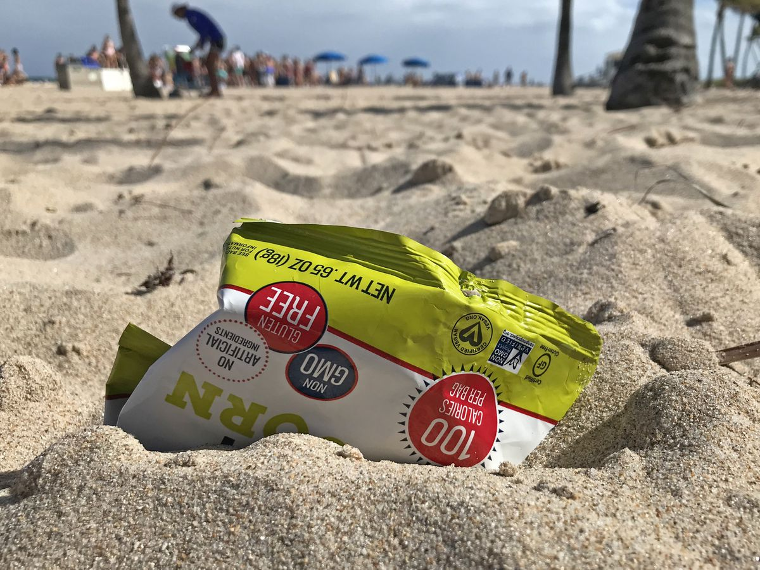
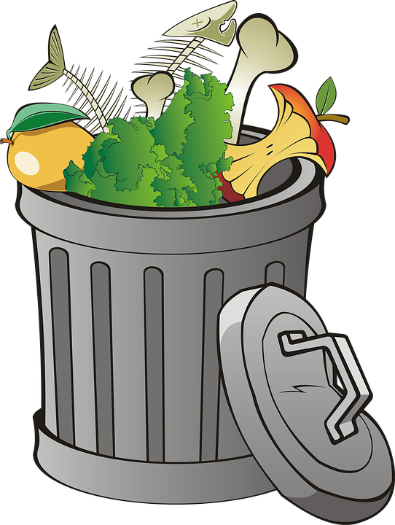
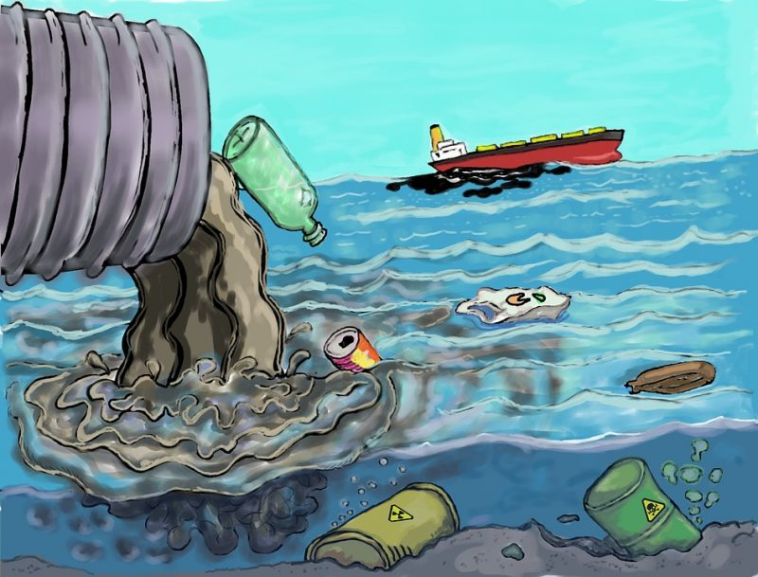

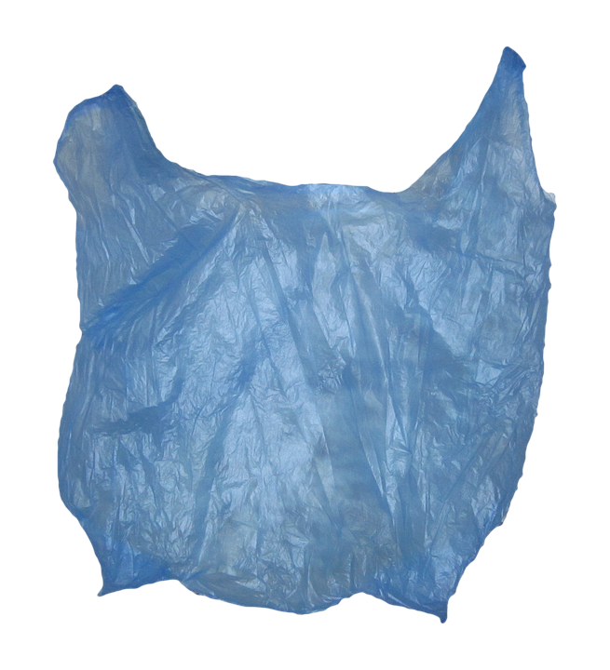
Let’s Talk Trash
Think about a time you visited a beach, the water, a river, or a stream.
Did you see any trash, how much?
Notes:
SAY: Let’s talk trash! I want each of you to take a moment and think about a time you visited a beach, maybe you were on the water, or you were near a river or stream.
ASK: Do you remember seeing anything that did not belong there? Where did these things come from? Are these things that could harm wildlife or people?

Slide 5
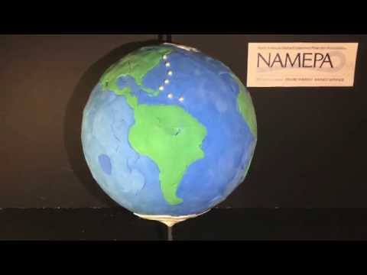
The Wayward Life of a Plastic Bag
Notes:
SAY: Let’s watch this claymation video that shows the life of a plastic bag once it enters the ocean.
After it’s over: So what did you think of that video? Did you see how far the plastic bag traveled?
ASK: Does anyone remember from last week how it approximately takes for the plastic bag to break down into microplastic? (~ 20 years)

Slide 6
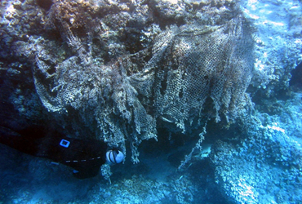
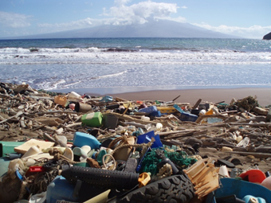
Where Can You Find It?
Marinas
Beaches
Inlets
Underwater
Above water
Currents
Rivers
Gyres
EVERYWHERE
Notes:
ASK: Where do you think we find marine debris?
SAY: We find it in marinas, beaches, inlets, underwater, above water, in currents, rivers, and even gyres. Essentially, we see marine debris EVERYWHERE. Even some uninhabited islands have marine debris on them. From the deepest trenches to the surface. Marine debris is found everywhere. Did you know that in Mariana’s Trench, the deepest part of the ocean, they found plastic?
SAY: Plastic makes its way all around the ocean because of currents, wind, and gyres. It can be found throughout the water column.
ASK: Does plastic belong there? Does plastic belong anywhere?

Slide 7
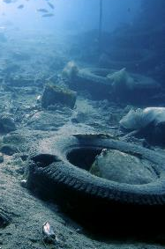
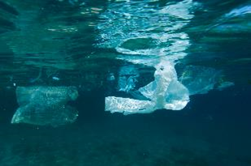
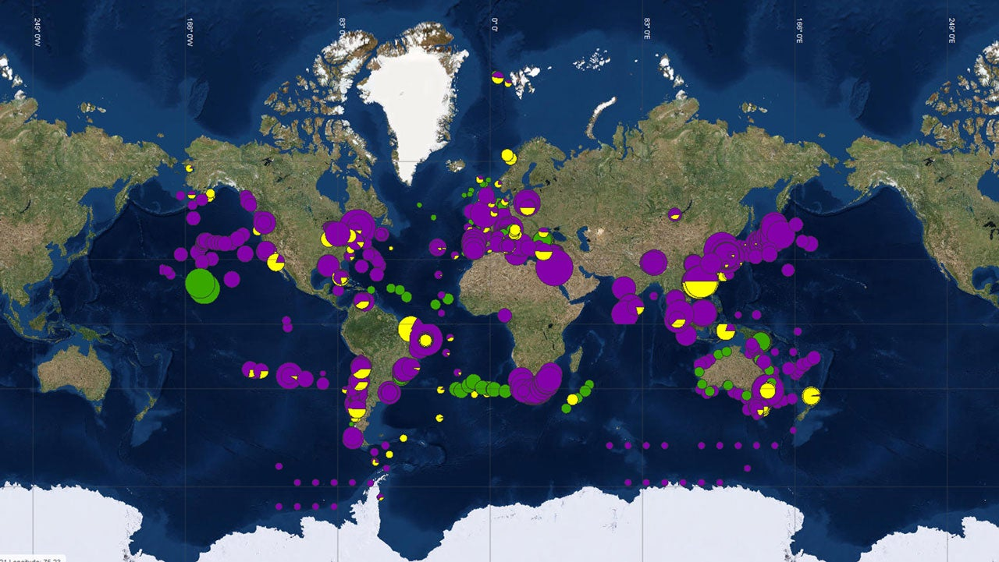
Why Do We Find Debris Everywhere?
Many pieces of debris have a positive buoyancy
The more buoyant an object is, the farther it can travel in the water!
What items are buoyant?
Notes:
ASK: Why do we find debris everywhere?
SAY: It has to do with what is called buoyancy.
ASK: Does anyone know what buoyancy is?
SAY: Another way to think of buoyancy is determining what items sink or float.
SAY: As we looked at previously currents cause the debris to float over the ocean. The map above shows where big patches of trash are in the ocean.

Slide 8
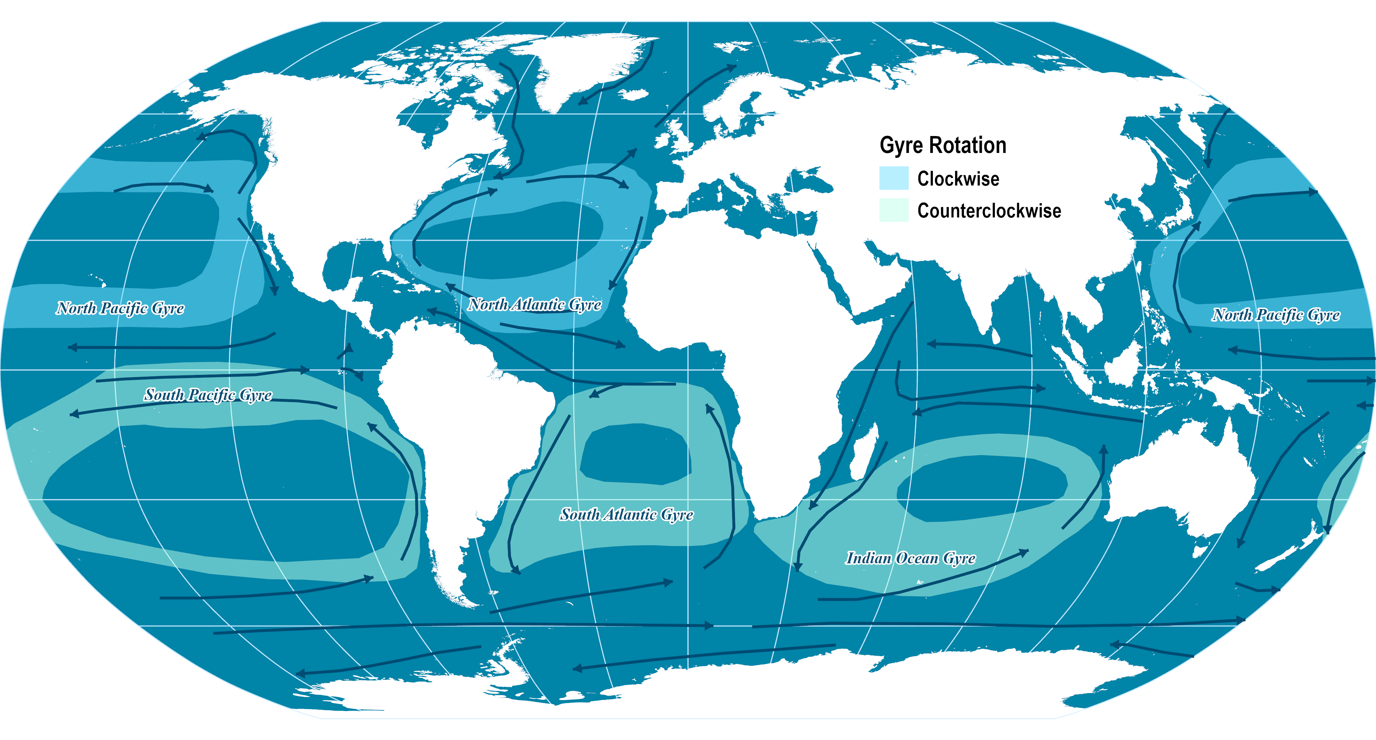
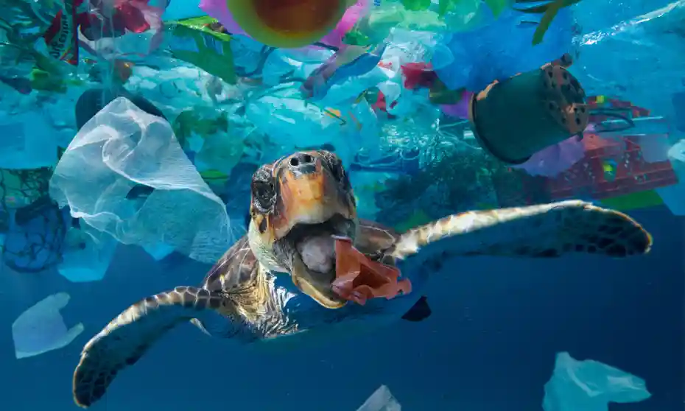
What is Marine Debris?
Anything man-made that ends up in the marine environment
80% of marine debris comes from land-based sources
Transported by runoff, wind, gyres, or dumping
Notes:
SAY: Let’s talk about what makes up marine debris.
SAY: Marine debris is anything that is man-made that ends up in the marine environment. Remember the marine environment includes the ocean, rivers, lakes, streams, even ponds.
80% of marine debris comes from land-based sources. This means it comes from the land and eventually finds its’ way to the ocean. As we increase our use of single throw-away plastic products, the trash in the ocean will increase.
SAY: The map shows the currents that transport the marine debris.

Slide 9
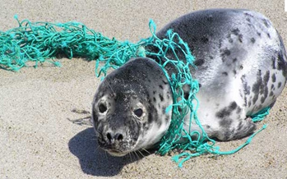
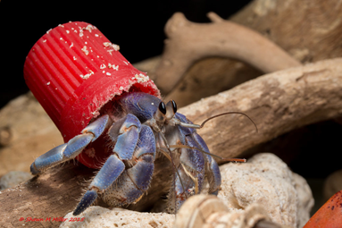
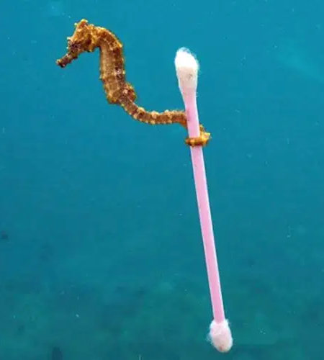
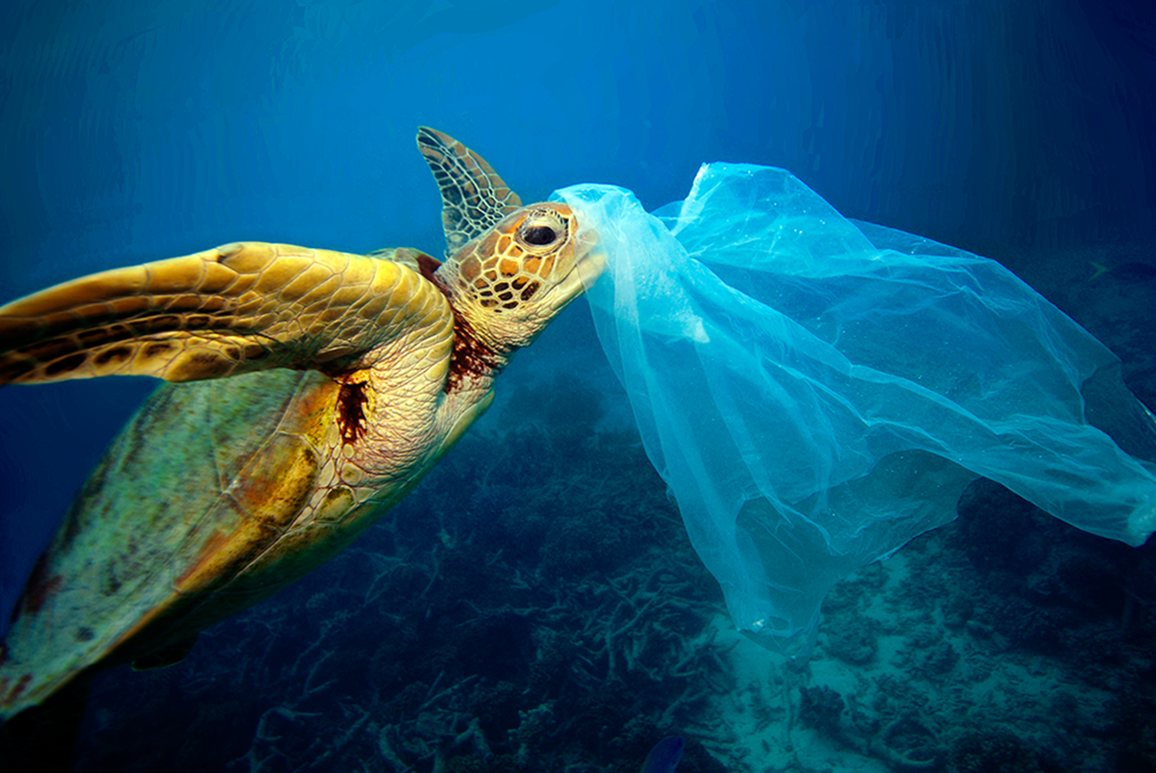
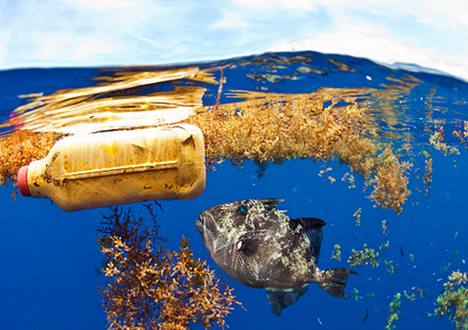
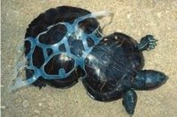
Does Marine Debris Impact Wildlife?
Notes:
ASK: Does Marine Debris Impact Wildlife? (kids will say yes)
ASK: How do you think marine debris impacts wildlife?
DO: Show them these photos - does marine debris belong in the water? (NO!)

Slide 10
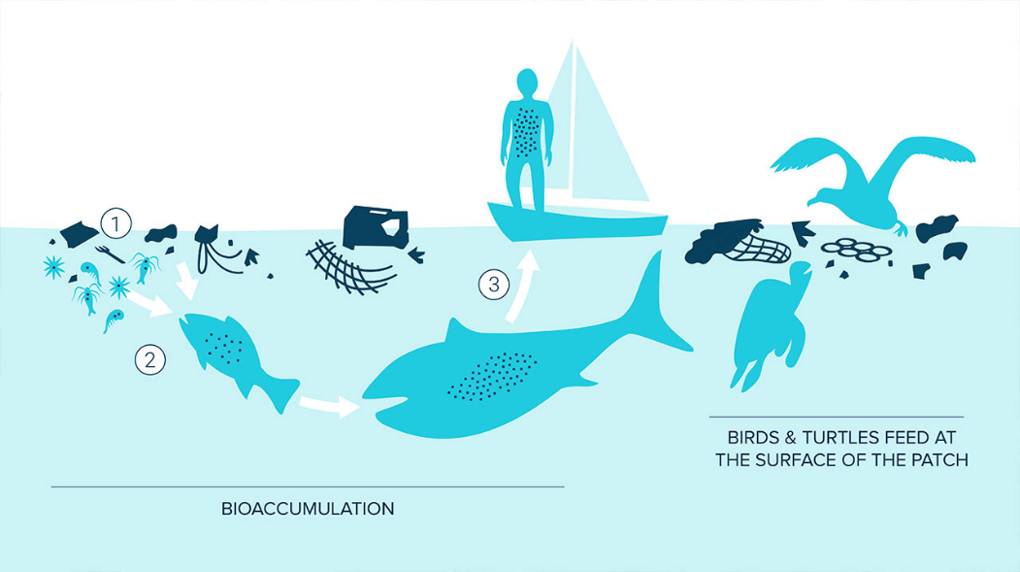
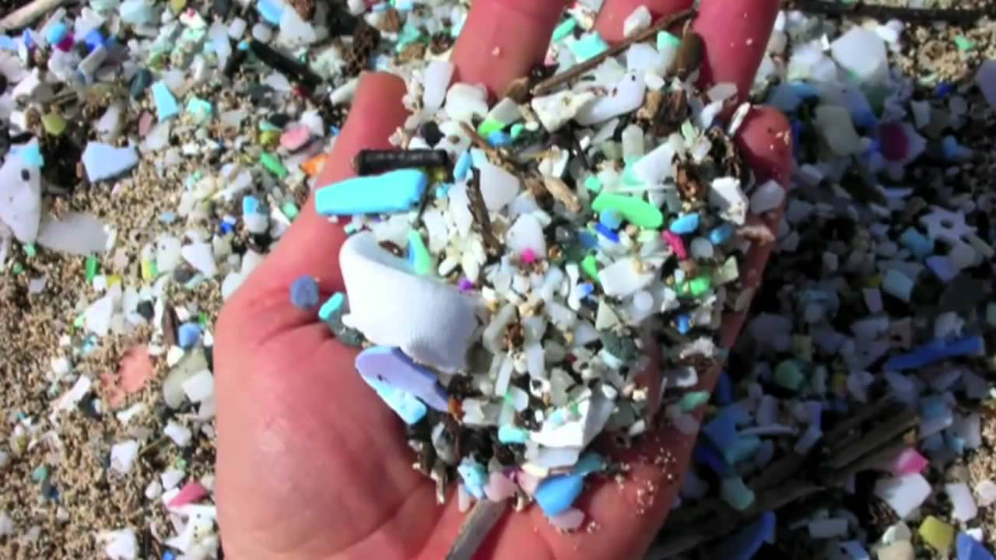
How is Marine Wildlife Impacted?
Mistaking debris for food causes malnutrition and starvation
Trapped in fishing line or beverage containers
Toxic materials can build up in species - bioaccumulation
Debris has been found in the stomachs of plankton
  What impact could this have?
Notes:
ASK: How is marine wildlife impacted?
SAY: Many animals will mistake debris for food can cause malnutrition and starvation. They aren’t getting the energy the need! For example, turtles prey on jellyfish. What debris item looks like a jellyfish floating in the water? (plastic bag!)
We see wildlife getting trapped in fishing nets, beverage containers, or other forms of plastic. For example, we have seen large species like turtles, sharks, whales, and rays get tangled inside fishing nets. Nets that have been discarded are called ghost fishing nets and they continue to fish long after they have detached from a vessel.
We also see what is called bioaccumulation. This is when toxic materials build up in species when they accidentally eat the debris. The toxins amount grow when they eat other things that have the toxin in them as well.
Some debris, called microplastics, has even been found in the stomach of plankton.
ASK: What impact could debris being found in plankton have?

Slide 11
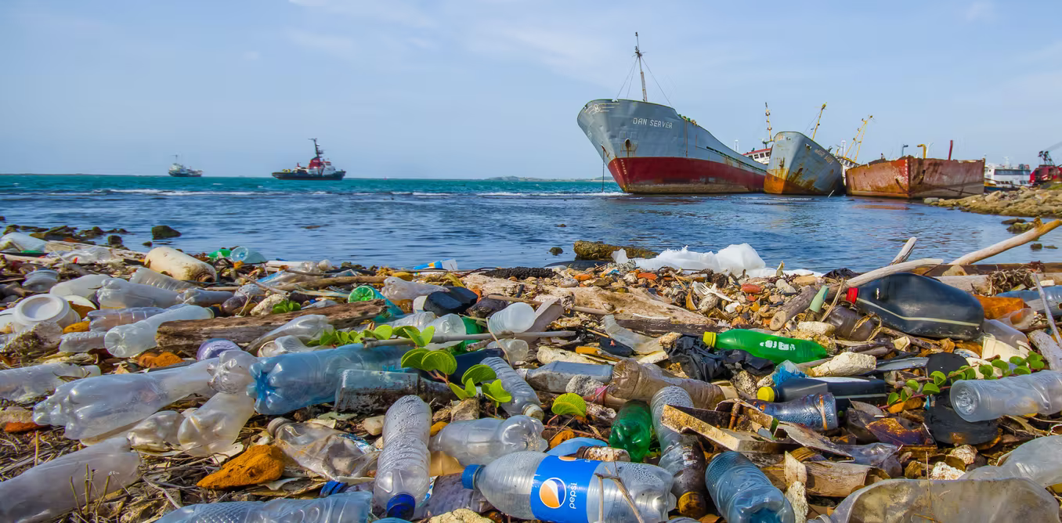
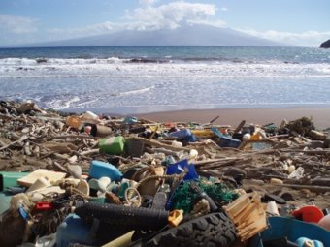
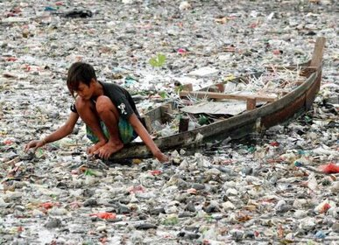
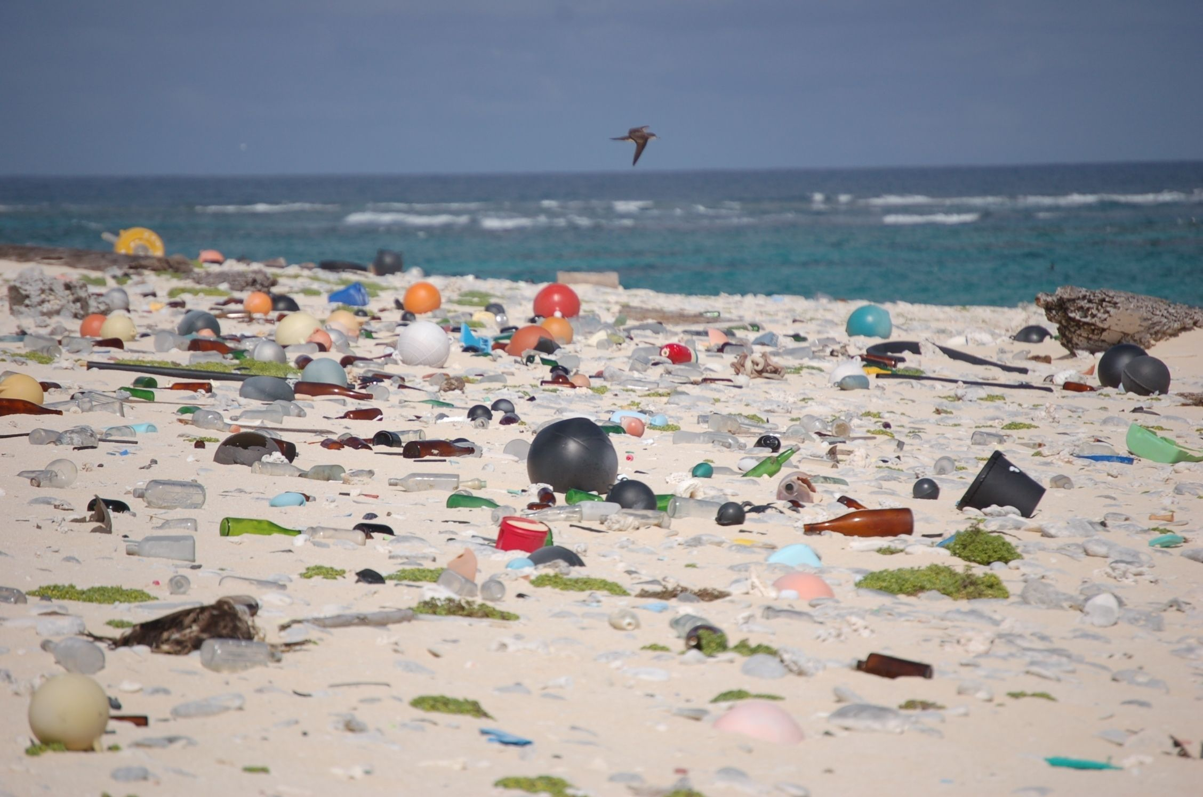
Are Humans Impacted?
Seafood economy is damaged
Tourism decreases
Navigation hazards
Notes:
ASK: Are humans impacted? How?
SAY: In the marine food web, we see larger species eat smaller species. We are at the top of the food chain consuming seafood. When we see toxic materials accumulating in marine species, we can ingest those toxins. This is why doctors warn not to consume too much seafood frequently (mercury!)
We also see tourism decreasing. Can you imagine visiting a beach like the images? Would this be a beach you want to vacation at?
Debris also can cause navigation hazards for small boats and even larger ones. They can cause damage to the prop or other parts of the boat.

Slide 12
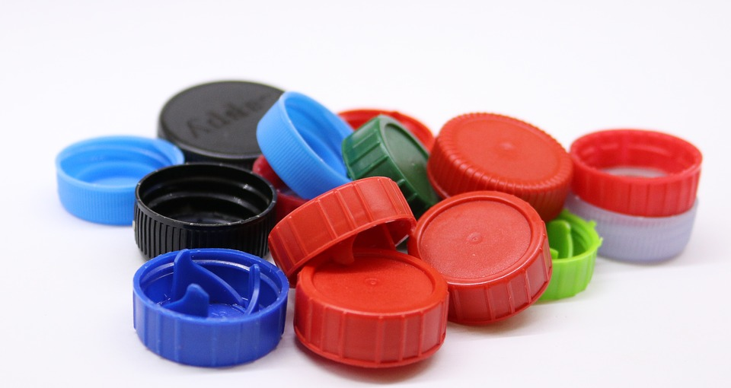
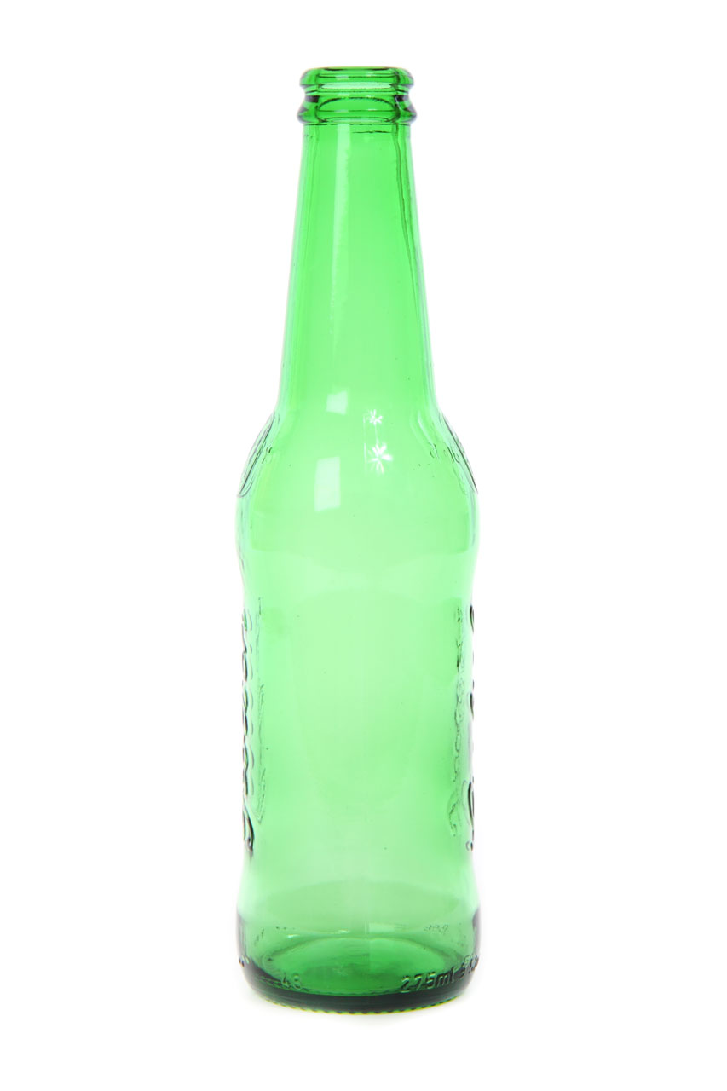
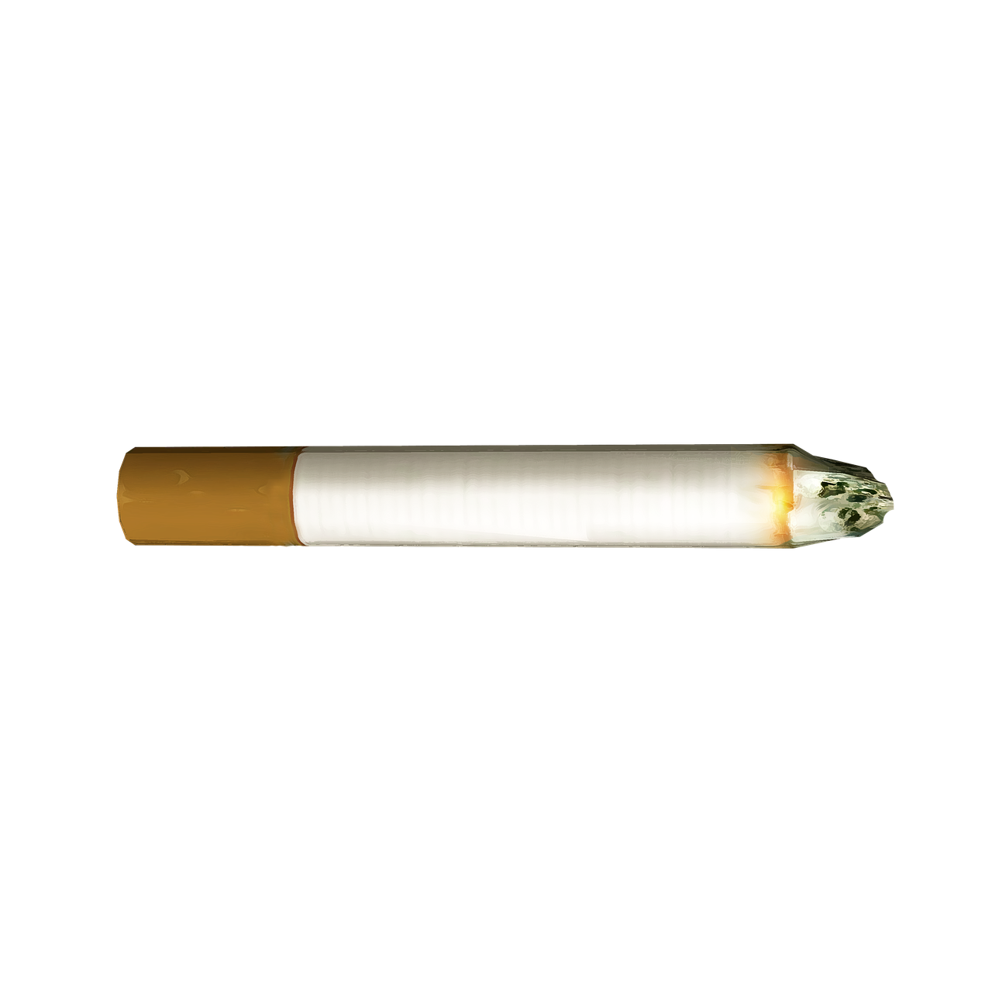
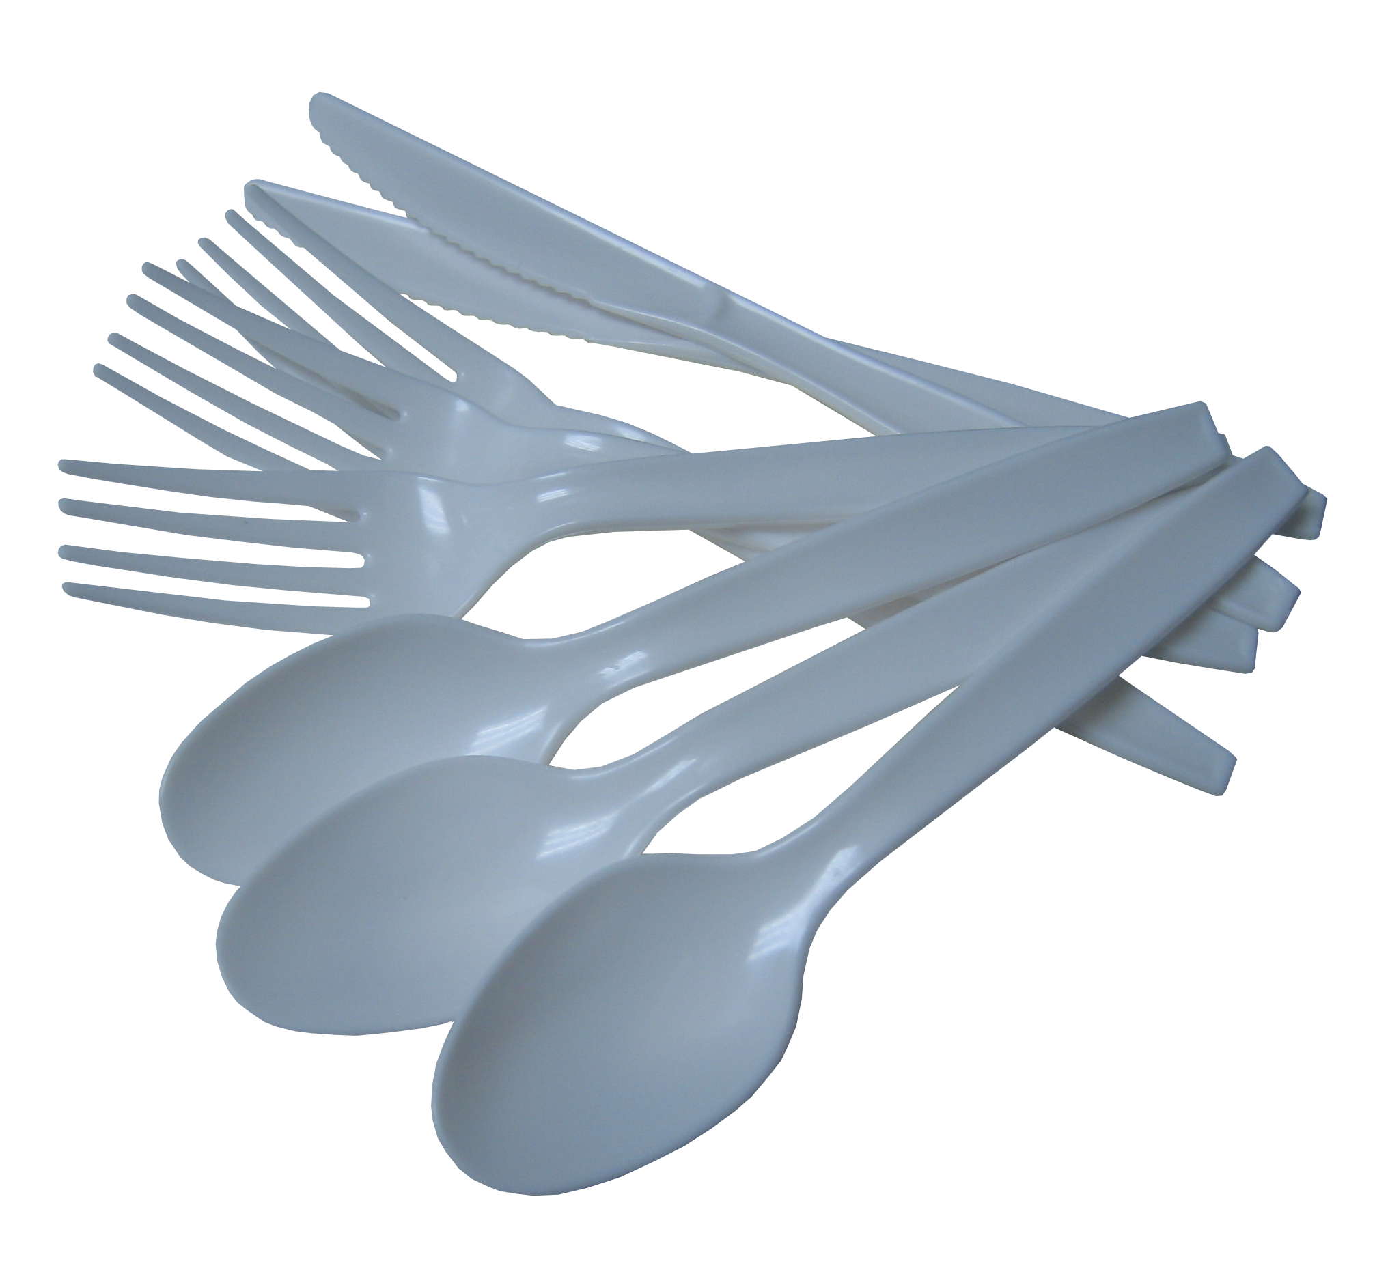
Top 10 Items Collected
What do you think the top 10 items collected are?
Cigarette butts
Food wrapping
Plastic beverage bottles
Plastic bottle caps
Straws and stirrers
Plastic bags
Plastic grocery bags
Glass beverage bottles
Other beverage cans
Plastic cups and plates
Notes:
ASK: What do you think the top 10 items collected are? (Let kids answer a few)
DO: Share the list with them.

Slide 13
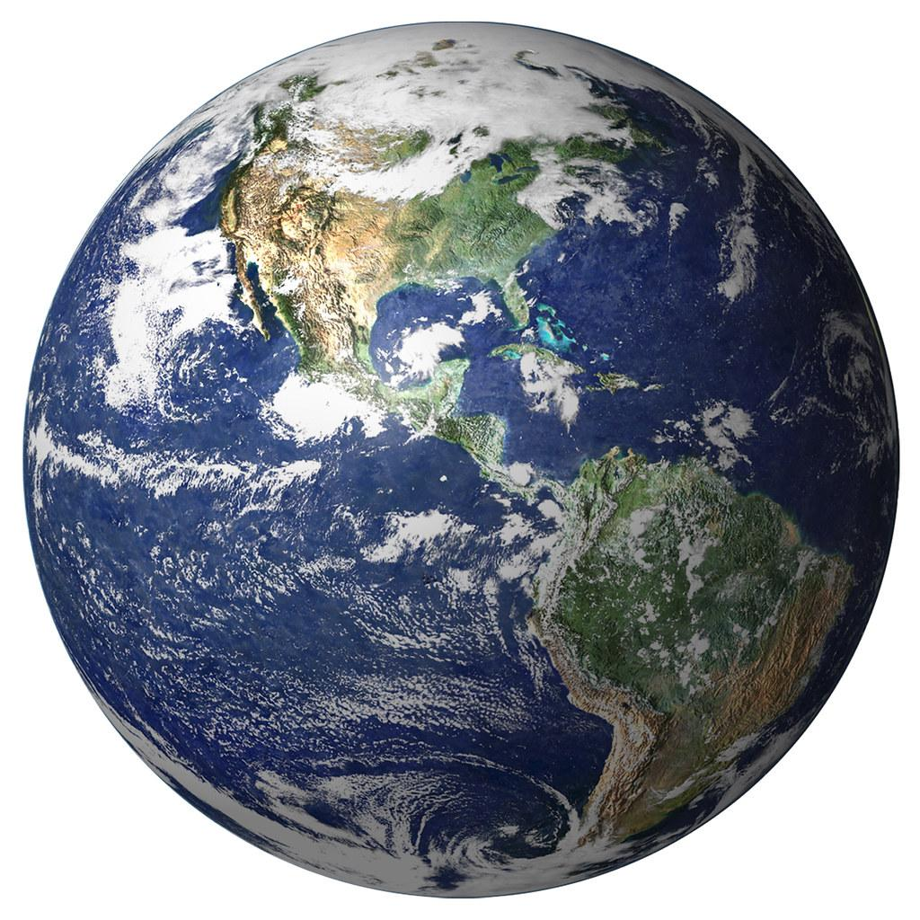

The Good News: A Global Effort
Banned Styrofoam: European Union, Maine, Costa Rica
Banned Single-Use Plastic Bags: California, Connecticut, Oregon, European Union, Columbia, and many more!
Banned Plastic Straws: Miami, Malibu, Seattle, Scotland, Taiwan
Notes:
SAY: There is good news though!!
SAY: Globally, we are seeing changes. For example, we have seen a ban of styrofoam in places like the European Union, Maine and Costa Rica. Some states and countries have even banned single-use plastic bags like California!!, Connecticut (where our headquarters is!), Oregon, the European Union, Columbia, and more!! Another remarkable feat has been banning plastic straws. Places like Miami, Malibu, Seattle, Scotland, and Taiwan have taken the initiative to ban plastic straws at restaurants and other foodservice locations.

Slide 14
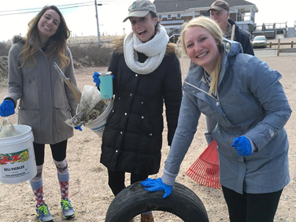
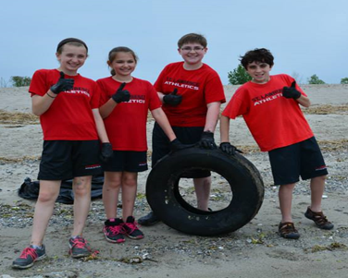
How Can You Help?
Advocate!
  Speak up about the importance of the ocean to your local officials and other leaders
Educate!
  Share with your friends and family ways to protect the marine environment
Activate!
  Conduct a beach or waterway clean up
  Volunteer with a local organization
Notes:
SAY: Looking at these photos, how can you help?

Slide 15
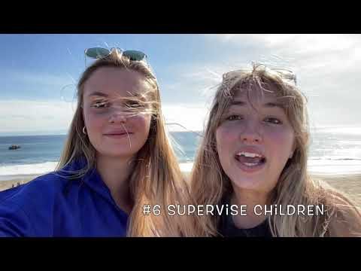
A Way To Help: Beach Cleanup Tips!

Slide 16
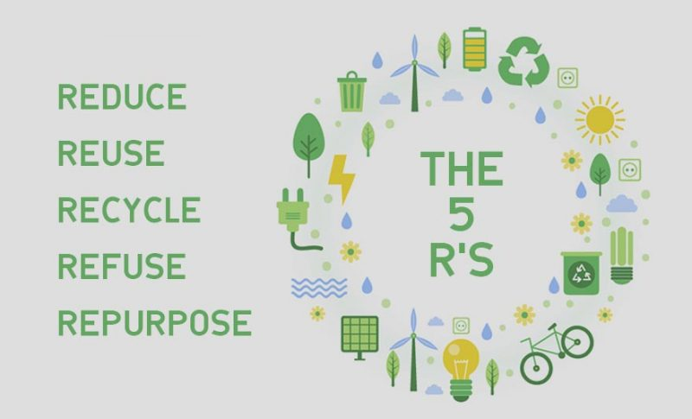

How Can You Help? The 5 R’s
Refuse what you do not need
Reduce what you do need
Reuse what you consume
Repurpose what you can not refuse, reduce or reuse
Recycle what you can not refuse, reduce, reuse, or repurpose
Notes:
Ask them for examples of what they can do for each

Slide 17
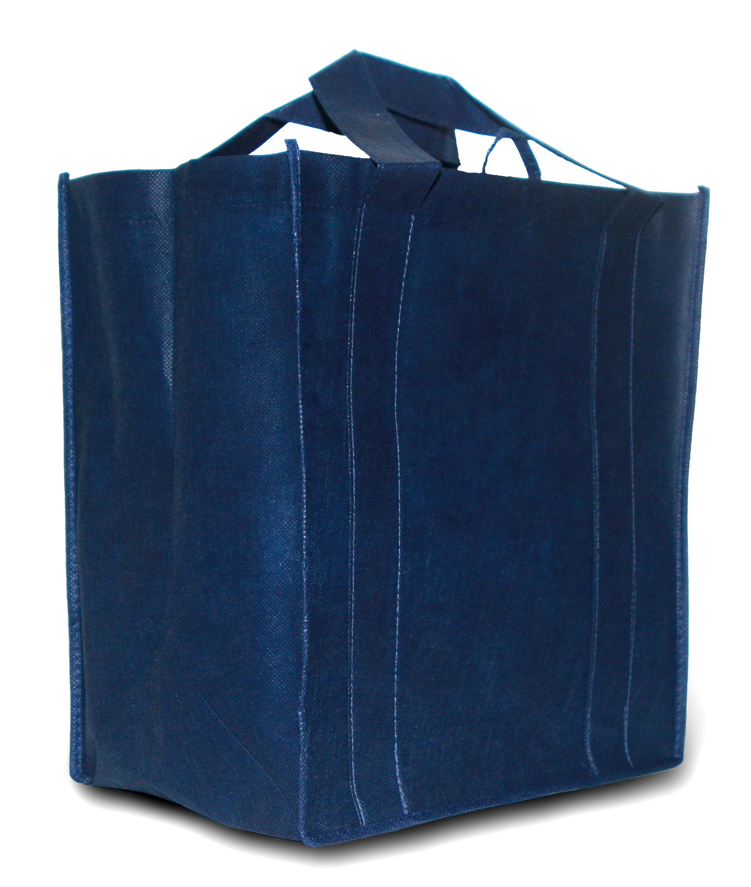
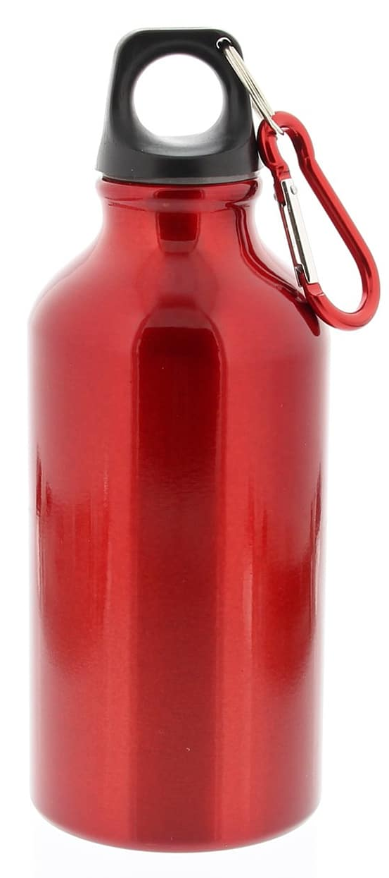
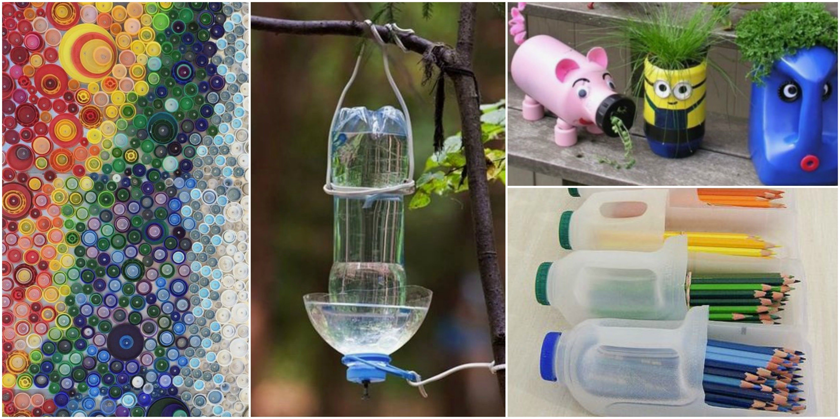

How Can You Help? Examples!
Refuse single-use plastics like plastic bags, cups, bottles, and containers
Reduce using non-recyclable products. This prevents them from entering landfills which ultimately lead to the water
Reuse products like a reusable water bottles, utensils, and bags
Repurpose items by finding a new way to use them! “Upcycling”
Recycle items properly and dispose of them in their proper places!
Notes:
SAY: Let’s look at some examples of how you can help!

Slide 18
Summary of Lesson 5
What is affecting the marine environment?
  Climate Change: rising sea level, ocean acidification, rising temperatures
  Pollution
How can you help protect the marine environment?!
  The 5 R’s
  Conduct your own beach clean up
  Make small choices like using reusable water bottles, or reusable bags
Notes:
SAY: Today we discussed the many ways we can help protect the marine environment and the things that are harming it. From reducing our consumption, to conducting our own clean ups! If we all work together to make these changes, we can protect the marine environment. Each of us as the feeling like we can save the world, don’t forget that you can!

Slide 19
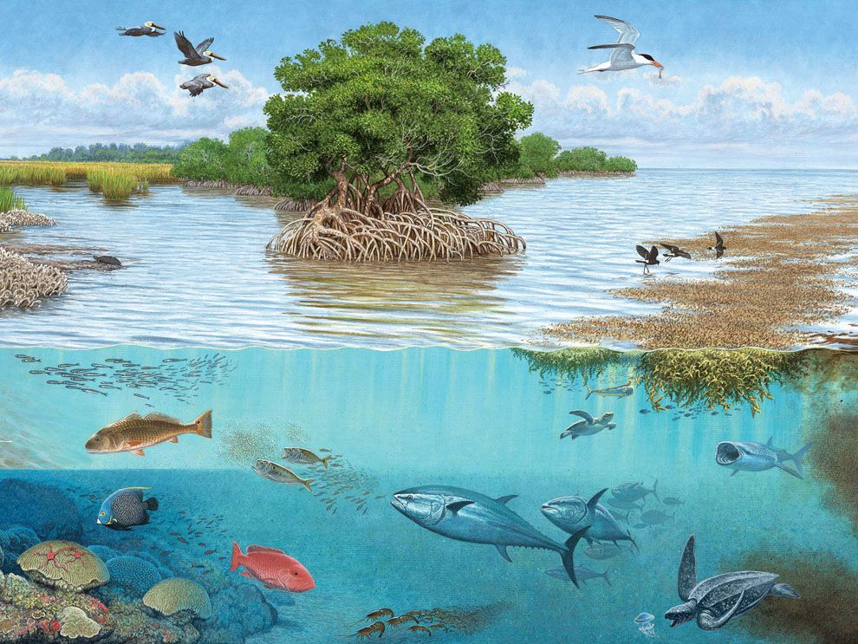
Review!
What is an ecosystem?
  Food webs and chains
Coastal habitats
  Wetlands, Coral Reefs, Mangroves
Adaptations!
  Behavioral, Structural, and Physiological
Importance & Threats to Coastal Habitats
Solutions - Change One Habit, Change the World!
Notes:
SAY: Let’s review some of the topics we have discussed together!

Slide 20
Survey Questions in the Chat!
I know how energy flows through an ecosystem.
(Yes or No)
I can list 5 species that live in either a wetland, coral reef or mangrove habitat.
(Yes or No)
I can identify 3 environmental important functions of coastal habitats.
(Yes or No)
I know one positive change I can make to protect coastal habitats.
(Yes or No)
Notes:
SAY: Let’s do a quick activity to see how much you remember!

Slide 21
THANK YOU!
Notes:
SAY: From our Team at NAMEPA, we wanted to say THANK YOU to you!!! It has been our pleasure to spend these last few weeks with you guys!! We hope that you learned a lot about the marine environment and ways you can help make it better! You can change the world!

