Slide 1

Welcome Back!
Notes:
SAY: Welcome back everyone & thank you for joining us today! In case you forgot, my name is ___________ and I am the __________ with the North American Marine Environment Protection Association, always known as NAMEPA.

Slide 2
Last week!
We looked at three distinct coastal habitats
  Wetlands
  Coral Reefs
  Mangroves
Each habitat hosts a variety of species - biodiversity
In order for organisms to thrive in these habitats they have unique adaptations
  Wetlands: Able to survive in salt water at various times with little oxygen present
  Coral Reefs: Protection from predators!
  Mangroves: Strong, salt tolerant roots for structure and support
Notes:
SAY: So let’s break down what we discussed last week.
SAY: First, we looked at three distinct coastal habitats - wetlands, coral reefs, and mangroves. Each of these unique coastal habitats have what we call biodiversity. This is a way to say there are many different types of species that can live in these habitats.
Then, we looked at what these organisms need to thrive in these habitats. We discussed adaptations that these species may have. In wetlands, we saw species having the ability to survive in saltwater at various times with little oxygen. In coral reefs, we saw the different ways they can protect themselves from predators and the symbiotic relationships they have. For mangroves, we saw strong, salt-tolerant roots for structure and support.

Slide 3


Solve It - Riddle Review
As we get ready to begin today’s lesson, let’s try these riddles!
I stop by wetlands for food or to rest a bit. I do not live there year round. What am I?
I am a type of relationship where both species benefit. What am I?
Notes:
SAY: Alright, let’s look at these two riddles and see if we can figure out the answer!
A migratory or visitor species
Symbiotic relationship

Slide 4
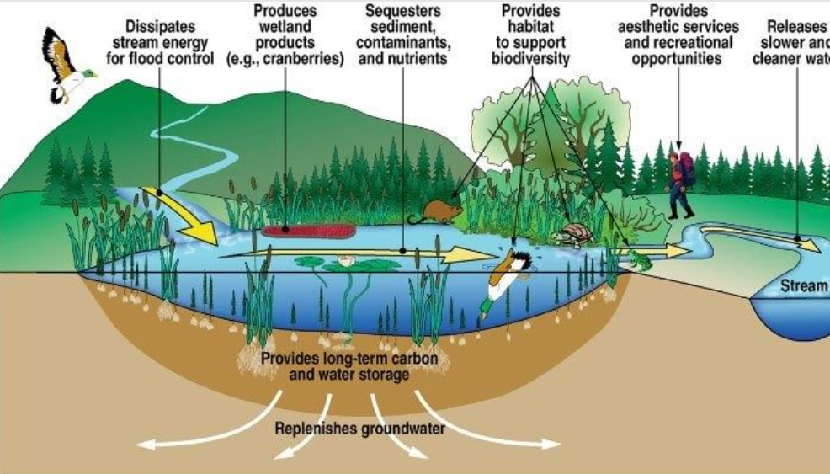
Wetlands: Environmental Importance
Protect coastlines from damaging storms
Purify water
Provide a habitat for many different species
Notes:
SAY: Let’s first talk about the importance of wetlands. Wetlands play a vital role for humans and other species. They provide lots of different ecosystem services. Some of these services include purifying water, protecting coastlines from damaging storms, and providing a habitat for the different species! They are also a great way to get outside and see an ecosystem’s inner workings up close.

Slide 5
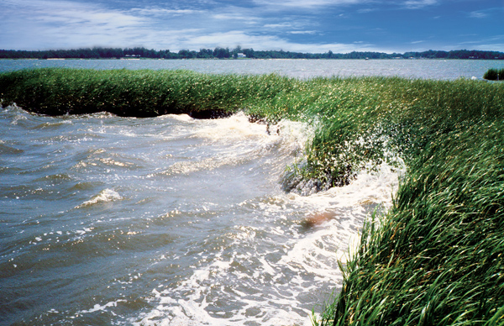
How Do Wetlands Protect the Coastline?
Notes:
ASK: Looking at this picture, how do you think a wetland protects the coastline? (guide to answers → wave crashes on the wetland, the wetland breaks the wave energy)

Slide 6
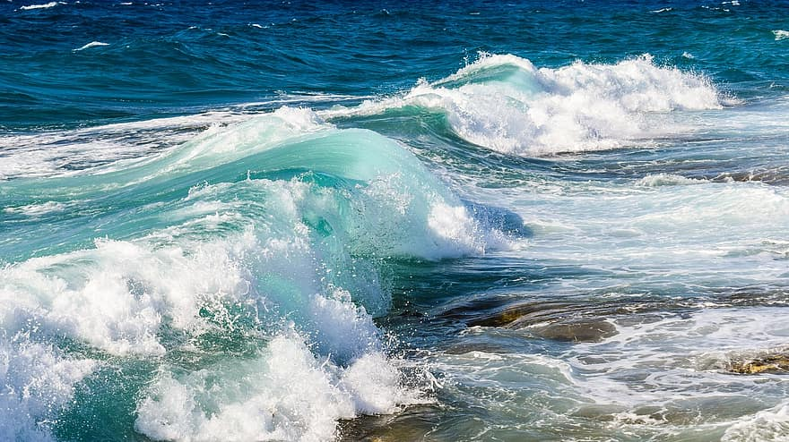
Wetlands: Protect the Coastlines
Natural defense barrier
Soaks up and stores the water
Slows wind wave action and storm surges created by tropical storms and hurricanes
Notes:
SAY: Great answers! So wetlands act as a natural defense barrier. They soak up some water, wave energy, and disperse it through the wetland. This breaks the wave action, especially during strong storms. We can see the waves crashing against the grass we see in wetlands.
ASK: Why would breaking up the wave energy be important? (guide to answer- erosion protection, habitat protection, protection for coastal homes.)

Slide 7
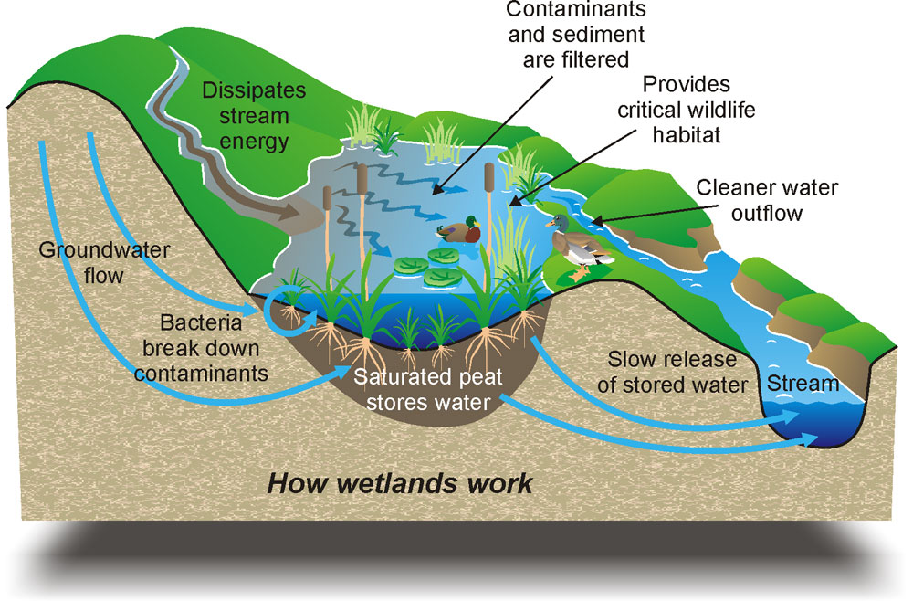
Wetlands: Purify Water
Hydrophytes (plants) slow the flow of water
Clears up water quality and takes out toxins/pollutants from the water
Hydrophytes recycle nutrients such as nitrogen and phosphorus
Captures CO2 from the atmosphere through photosynthesis
Notes:
SAY: First, let’s look at how wetlands protect the coastlines. We looked at some adaptations last week of wetland plants. Remember, they must be able to adapt to thrive in the presence and absence of water.
Wetland plants slow the flow of water allowing for sediments to fall out of the water column. This prevents erosion, and the slowing allows roots to absorb more nutrients and create a habitat for several species of animals.
ASK: What is the importance of these nutrients? (nitrogen & phosphorus provide food for the plants and keep the soil healthy)
SAY: Nitrogen and phosphorous are absorbed by the roots of the plants.
SAY: Lets go through the photo:
- Water comes from runoff of roads or from streams and is brought into the wetlands.
The plants hold onto sediment, like sand or dirt, in place with their roots. The plants slow down the flow of water and the sediment has time to settle to the bottom and be trapped between the plants. As the water flows, it is purified (or cleaned) of nutrients and sediment like sand!
Wetlands store carbon dioxide through that process we talked about briefly - photosynthesis
Remember, photosynthesis is when plants convert sunlight energy into usable energy. The usable energy contains an element called Carbon.
Finally, the plants die and are broken down by decomposers (bacteria!) into detritus. The decaying plant which has carbon gets locked away in the sediment for many years.
ASK: Does anyone know what this stored carbon after millions of years becomes? (hints: humans use it → humans use it in their vehicles → it’s an energy source)

Slide 8
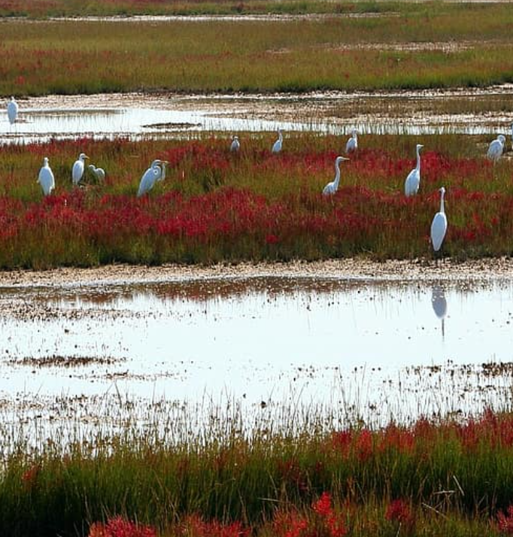
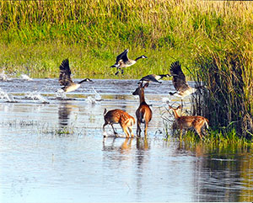
Wetlands: Habitat for Species
Highly productive ecosystems
43% of USA’s endangered or threatened species’ are connected to wetlands
Spawning site and nursery for juvenile species
Notes:
SAY: Wetlands are highly productive ecosystems for species. The many species of fish, birds, shellfish, mammals, reptiles, and amphibians all have intricate food webs that wetlands can support.
ASK: Anyone remember how we describe an ecosystem that supports a variety of different species? (biodiverse)
SAY: Many different species rely on these wetlands. 43% of the United State’s endangered or threatened species rely on wetlands for their survival for the inconnectivennes that the wetlands provide. Migratory birds use wetlands as a place to rest and refuel before continuing their journey.
SAY: We’ll talk next time about why this statistic is important.
SAY: Wetlands provide a foraging environment with shelter and protection for smaller species, like juvenile fish. They are able to thrive in this protected area.

Slide 9
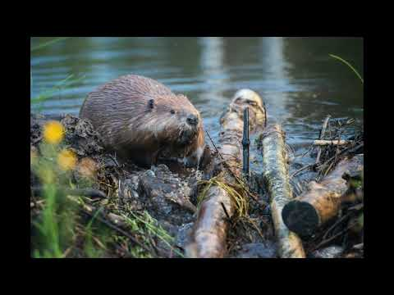
Notes:
SAY: Let’s watch this NAMEPA video about wetlands.

Slide 10
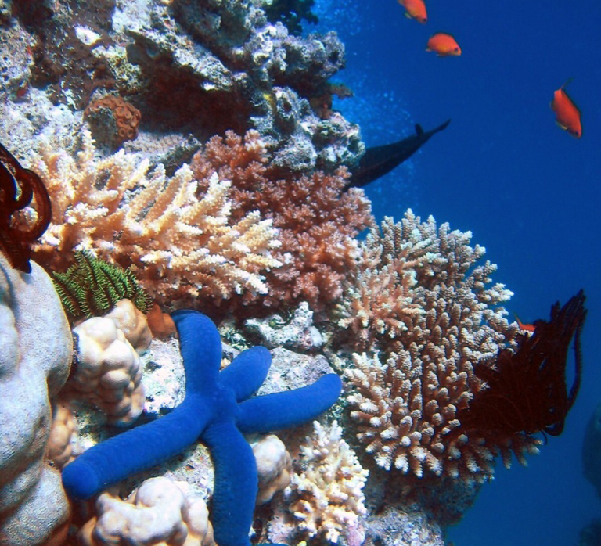
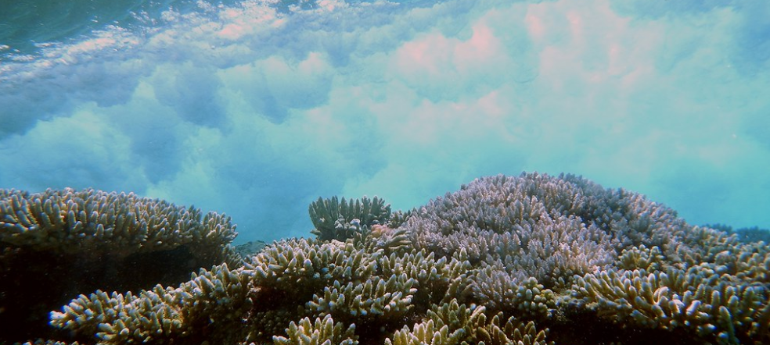
Coral Reefs: Environmental Importance
Most biologically diverse and complex structure in the marine environment!
Indicator Species: their presence, population size & health tell us the health of the reef!
¼ of all marine species depend on coral reefs food and shelter
Protect coastlines by absorbing storm energy
Notes:
SAY: Now that we talked about wetlands, let’s talk about coral reefs. Coral reefs are the most biologically diverse and complex structure in the marine environment. We have previously referred to coral reefs as the rainforest of the ocean. Corals play an important role in determining the health of the reef and surrounding area. This is called indicator species.
SAY: Not only that, but ¼ or 25% of marine species depend on coral reefs for food and shelter
SAY: They also protect the coastline by absorbing similar storm and wave energy that we saw for wetlands. The immense structures of the reefs act as breakers absorbing the energy and mitigating the amount of surge that could hit the coastline.

Slide 11
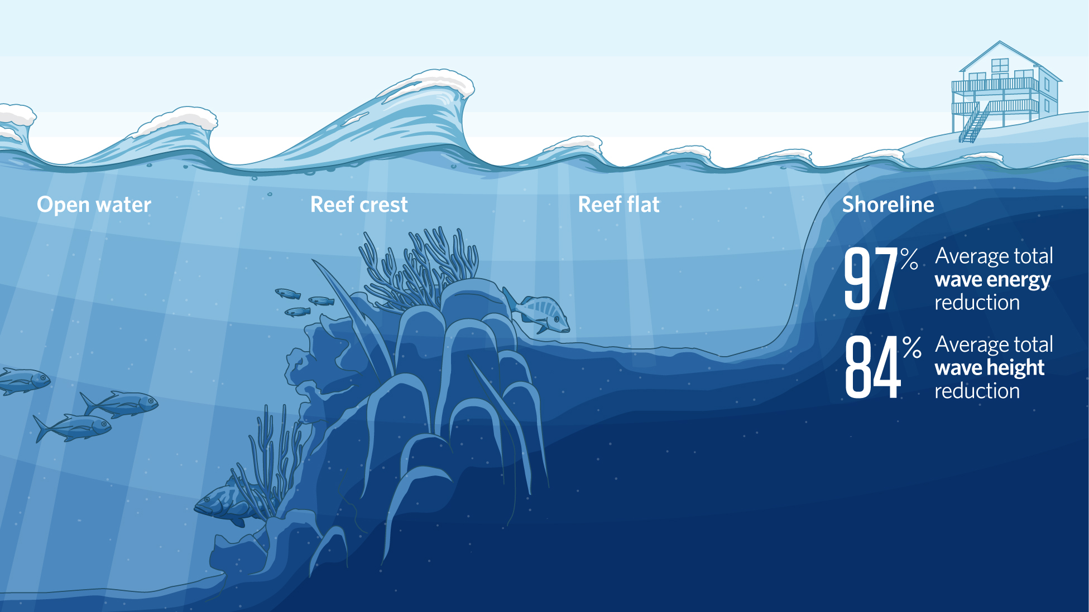
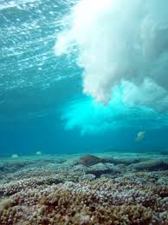
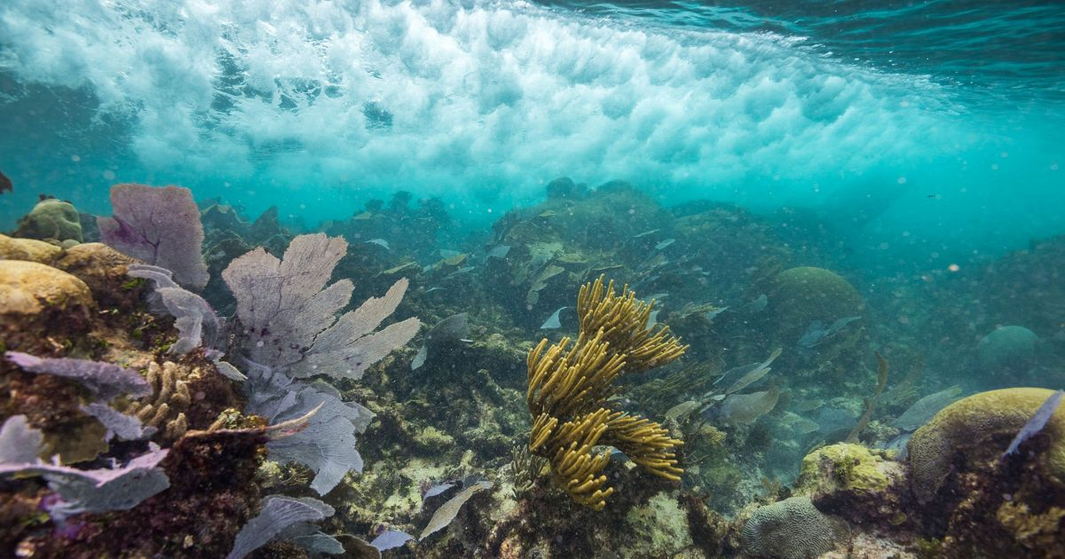
Coral Reefs: Protection of Coastline
Coral polyps build their calcium carbonate exoskeleton
Natural defense to absorb wave energy
90% of wave energy is absorbed by coral reefs!
Notes:
ASK: How do coral reefs protect the coastline?
SAY: First, we need to know what make up coral reefs. Coral reefs are coral polyps that together create a calcium carbonate exoskeleton. They build upon previous generations of corals creating large structures. Essentially, they are the long vertical structures we see. They need a lot of sunlight for photosynthesis, so they are found in shallow water.
SAY: Because they are close to the surface, they act as another natural defense to absorb wave energy. Can you believe that 90% of wave energy is absorbed by coral reefs! This reduces erosion and coastal flooding.

Slide 12
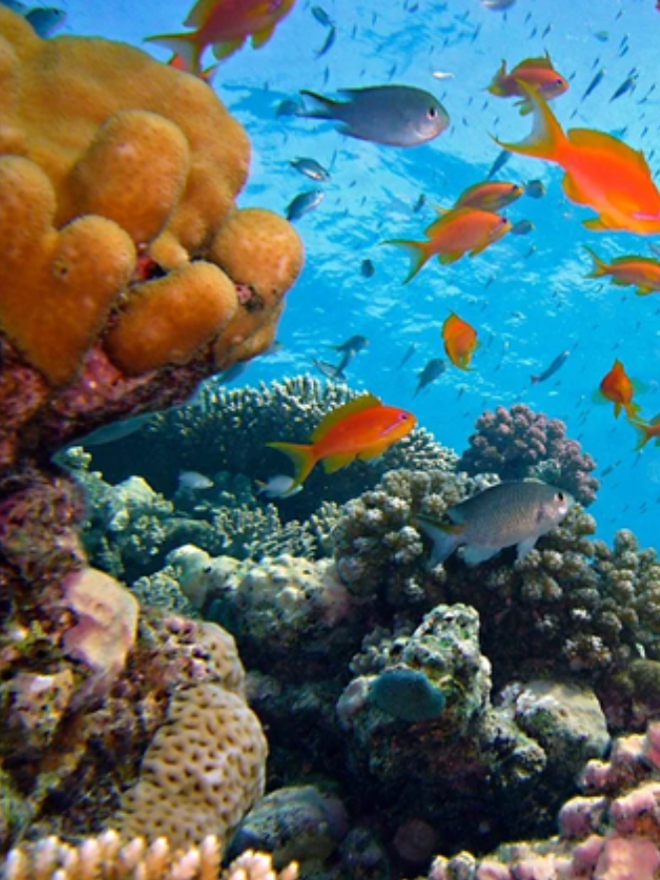
Coral Reefs: Indicator Species
How does an indicator species show the health of the habitat?
Notes:
ASK: What do you think an indicator species does?
SAY: An indicator species helps determine the health of their habitat. They do this by their health reflecting the health of the surrounding environment. Remember, we can look for their presence, the numbers, and overall health to help tell us how the reef is doing. Corals bleaching events occur when the water temp shifts, they lose their color and this indicates that something is wrong with the reef. We will discuss it more on the next slide.

Slide 13
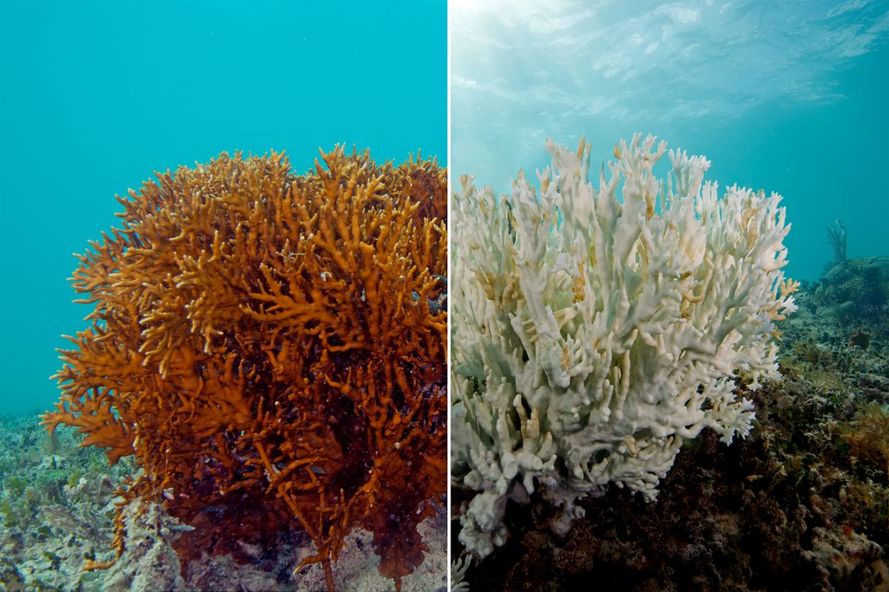
Coral Reefs: Indicator Species in Action
Do you know what this is a picture of?
Coral bleaching is when coral expel zooxanthellae which make their food
Coral are sensitive to changes in temperature, pH, and water quality
Notes:
ASK: Do you know what is happening in this photo?
SAY: Coral bleaching is when coral expel zooxanthellae, which make we saw before is essential for corals. On the left you can see what a healthy coral looked like before it became bleached.
SAY: coral are sensitive to changes in temperature, pH, and water quality, so when there is a change, the coral pushes out the zooxanthellae, and the coral ends up being unable to eat. We see bleaching as an effect.
SAY: this is due to a process called ocean acidification. The ocean aborbs 1/3 of anthropogenic atmospheric CO2 which changes the pH of the ocean water. The increased acidity in the water makes it difficult for marine organisms to create an exoskeleton.

Slide 14
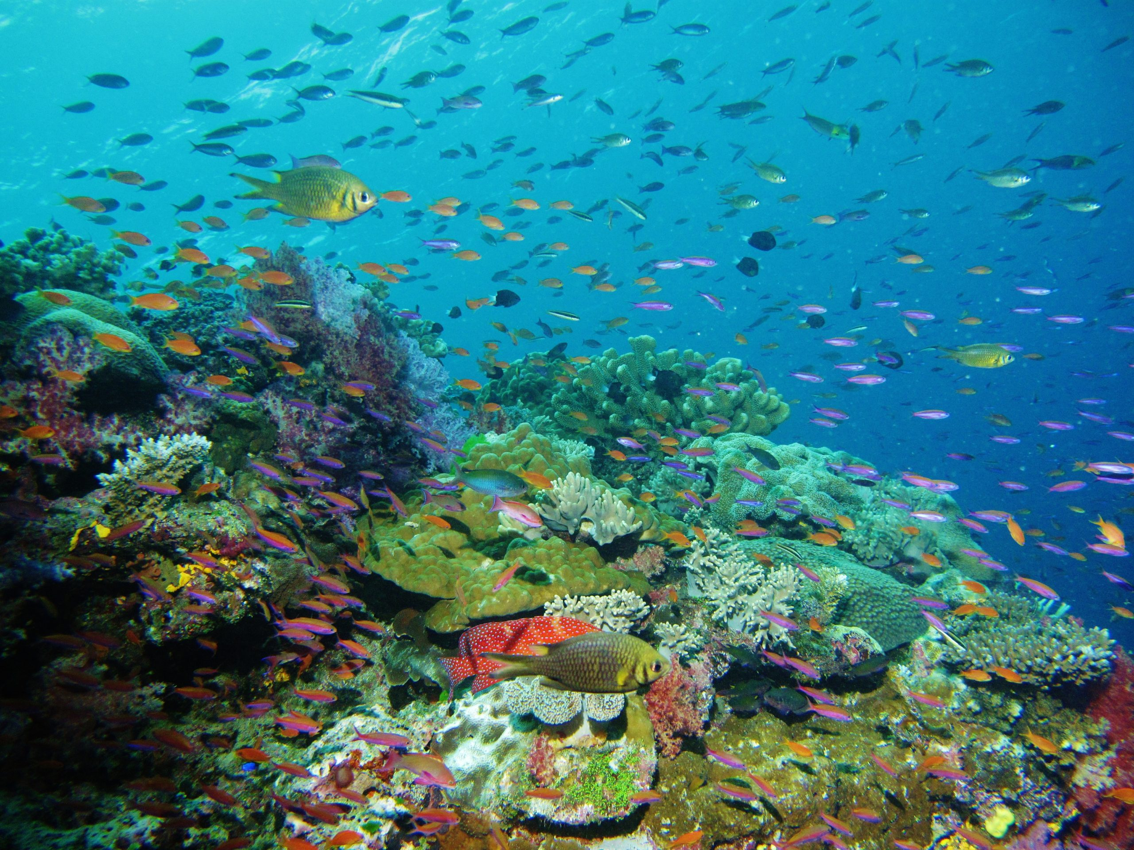
Coral Reefs: Biodiversity
Coral reefs are the rainforest of the ocean even though occupy less than 1% of the ocean floor!
25% of all marine species rely on coral reefs either directly or indirectly for survival
Notes:
SAY: Coral reefs are a hot spot for biodiversity. Collectively 25% of all marine species rely on coral reefs either directly or indirectly for survival.
ASK: What are some examples of species using coral reefs for survival?
ASK: How do we use coral reefs for our benefit (answers- economy, tourism, food, pleasure)

Slide 15
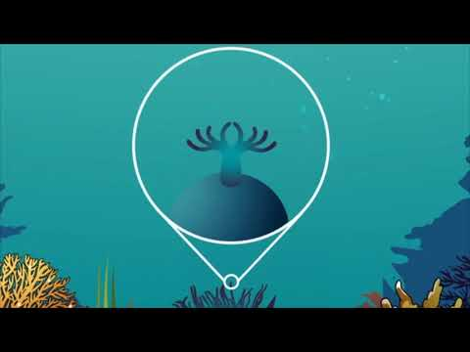
Notes:
SAY: Let’s watch this NAMEPA video on coral reefs to learn more.

Slide 16
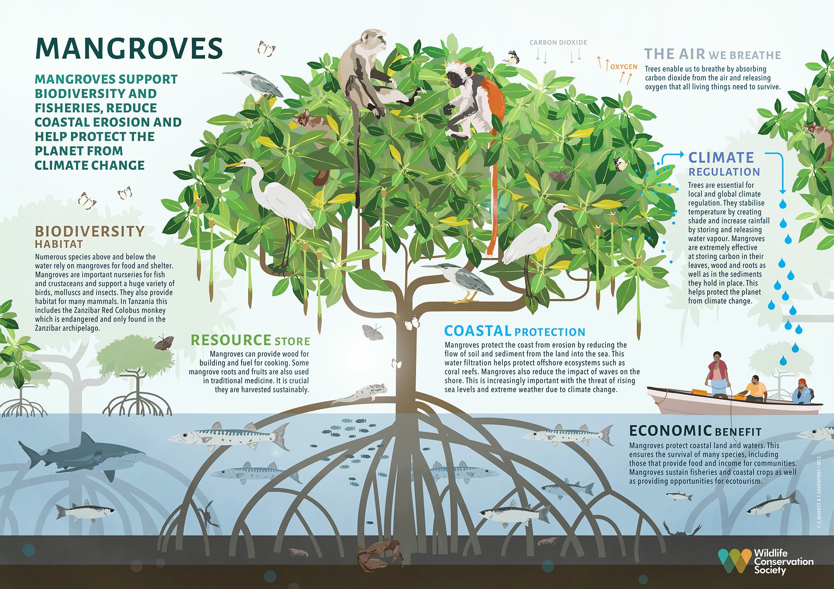
Mangroves: Environmental Importance
Coastal protection from erosion, storms, and waves
Vital role in food cycles
Roots capture and hold on to carbon
Notes:
SAY: Now let’s talk about mangroves. Mangroves offer coastal protection from erosion, storms & wave energy. They provide home & refuge for different species - lots of biodiversity! Their roots are able to collect and hold onto carbon meaning they are a carbon sink! The richness and diversity in these ecosystems allows for an excellent source of income and food for remote islands.

Slide 17
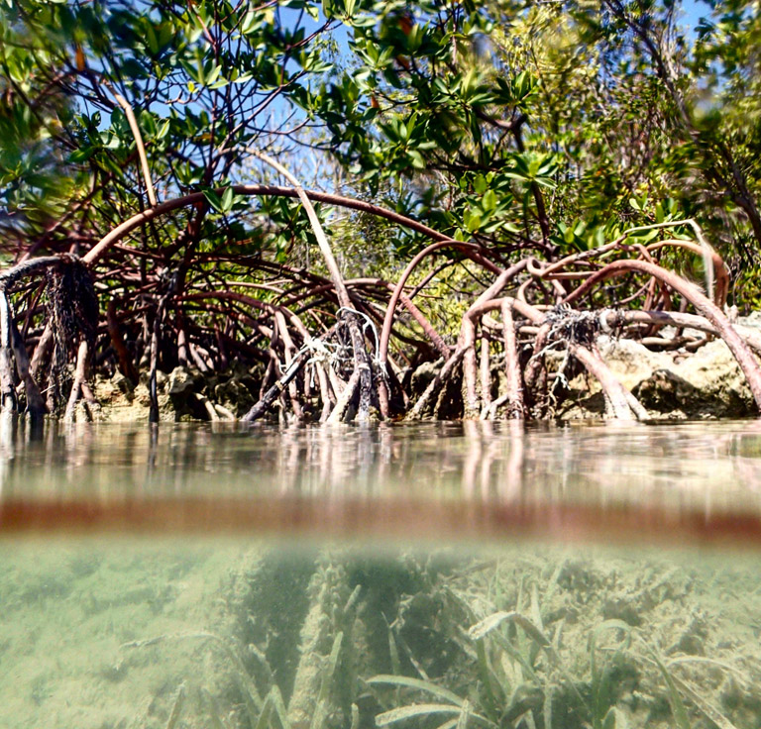
Mangroves: Protection of Coastline
Almost 2 million people live in coastal communities
Intricate root systems break wave energy from storms protecting those communities
Notes:
SAY: Like we saw with wetlands and coral reefs, mangroves protect the coastline. Looking at this photo we see their intricate or complex root systems both above and below the waterline. These roots break wave energy from storms. Those roots hold onto sediment preventing erosion and keeping the coast protected.

Slide 18
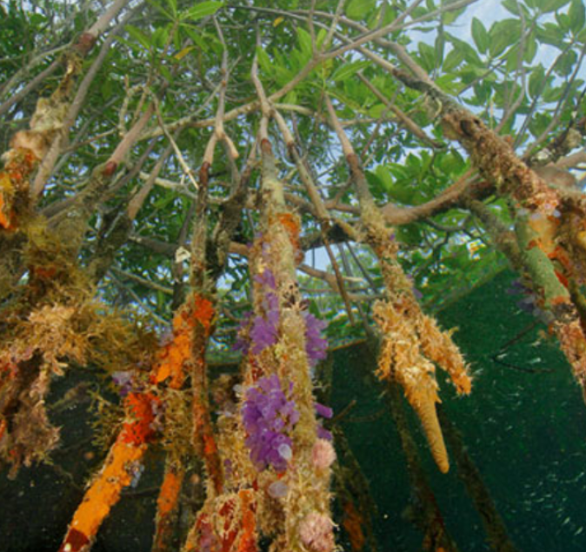
Mangroves: Vital Role in Food Cycle
Leaves fall into the water and are broken down by marine fungi and bacteria into detritus
Detris is organic matter that can be used as food by other organisms - the cycle of life!
Notes:
SAY: The mangroves provide a home for fungi and bacteria who in turn break down detritus recycling nutrients back into the environment. The detritus can also be food for marine worms, shrimp, or even snails that live in the sands of the intertidal. Larger fish come in and eat the animals that are living in and around the Mangrove roots and cycle continues.

Slide 19
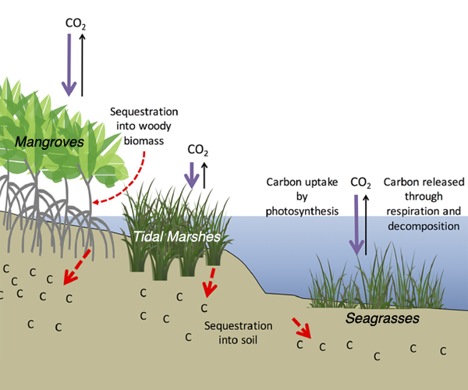
Mangroves: Carbon Sink
Mangrove forests cover 75% of tropical coastlines
Collect carbon dioxide in their roots
They can hold as much as 22.8 million metric tons of carbon
Notes:
ASK: Did you know that mangrove forests cover 75% of tropical coastlines?
SAY: Mangroves also act as what is called a carbon sink. This means they collect carbon dioxide and store it in their roots. They can extract up to 22.8 million metric tons of carbon from the atmosphere every year. Converting 10% of the terrestrial dissolved organic CO2 that is then exported to the ocean for other marine animals to use.
ASK: What other ecosystem acts as a carbon sink? (answer- wetlands)

Slide 20
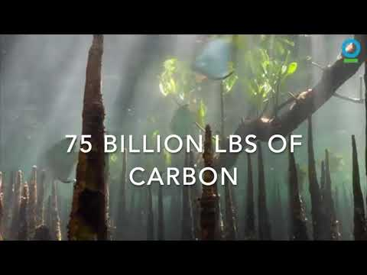
Notes:
SAY: Lets watch this video about mangroves and carbon

Slide 21
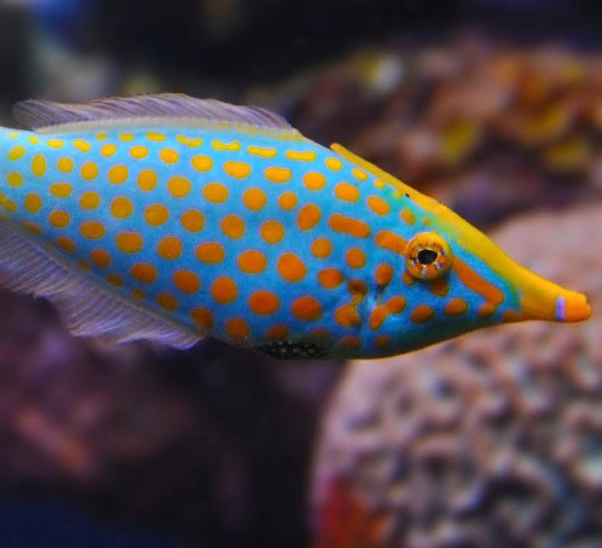
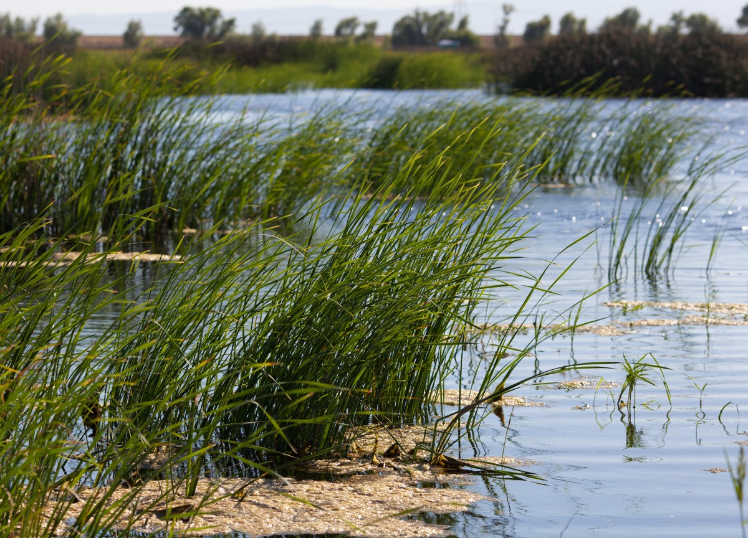
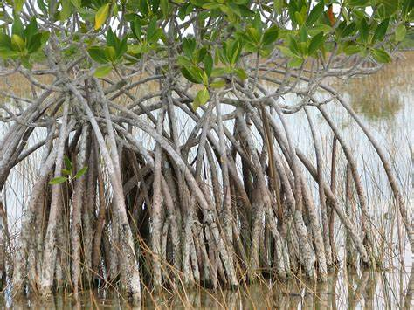
Matching: Coastal Habitat Environmental Importance!
I help purify water
¼ of all marine species depend on me for food and shelter
Which description matches the coastal habitat?
My unique roots help slow waves from storms
Coral Reef
Mangrove
Wetland

Slide 22
Summary of Lesson 3
Wetlands:
  Coastline protection
  Purify water
  Biodiverse habitat
Coral Reefs:
  Coastline protection
  Indicator species
  Biodiverse habitat
Mangroves:
  Coastline protection
  Vital role in food cycles
  Roots capture and hold on to carbon
Notes:
SAY: So let’s break down what we’ve discussed today.
ASK: Do you notice any common themes? What do you think would happen if we lost one of part of these habitats?
SAY: Next week we are going to look at some of the impacts we may see.

