Slide 1

Welcome Back!
Notes:
SAY: Welcome back everyone & thank you for joining us today! In case you forgot, my name is ___________ and I am the __________ with the North American Marine Environment Protection Association, always known as NAMEPA.

Slide 2
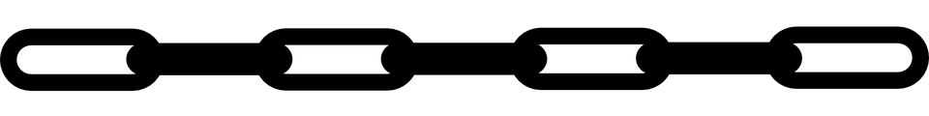
Solve It - Riddle Review
As we get ready to begin today’s lesson, let’s try these riddles!
What consumes but does not have a mouth, grows but will not stop and dies to live again?
2. What is the only chain we eat?
Notes:
An Ecosystem!
A food chain!

Slide 3
Last Week Recap
An ecosystem is a community of biotic and abiotic things in an environment
  Organisms only survive when their needs are met (food, water, space, shelter)
Energy flows in an ecosystem
  A food chain shows how energy is passed between each trophic level.
  A food web shows the interconnectedness of the feeding between organisms in an ecosystem
  Interdependence: species depend on each other for survival
Notes:
SAY: Last time we collaborated on what an ecosystem is and the parts that make it up. We talked about how a species or population within an ecosystem can only survive when their needs are met. Then, we looked at how energy flows in an aquatic ecosystem through food chains and food webs. We analyzed how species interact with each other using food webs and predicted what might happen if we remove a species from the chain. We concluded by describing these interactions as the interdependence we see in ecosystems. Today we are going to dive deeper into three specific coastal ecosystems.

Slide 4
Vocabulary
Adaptations:
  An evolved trait that helps organisms survive in the environment.
Biodiversity:
  The variety of life in the world or a particular ecosystem.
Resilience:
  The ability of an ecosystem to respond to a disturbance by resisting damage and recovering.
Notes:
SAY: First, let’s go over some vocabulary words to help us with this lesson. Some of these words may be familiar to you, or it may be the first time you are hearing them.
ASK: Does anyone have any ideas what these words mean? Or have an example? (guide to potential answers below)
Adaptations → species adapt to help them survive in their environment (color, shape, sounds and more)
Biodiversity → lot of different species
Resilience → come back, strong

Slide 5

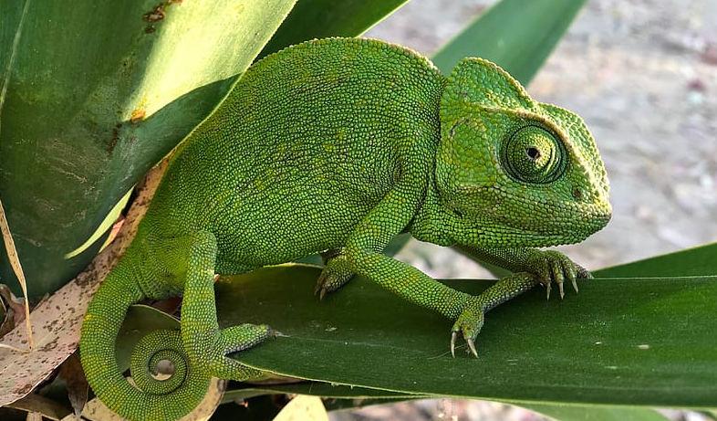
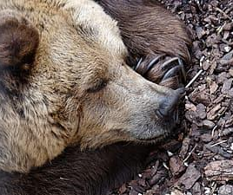
Matching: Adaptations!
Shivering to generate heat
Coloring changing to help blend in
Which description matches the kind of adaptation?
Physiological
A bear hibernating
Behavioral
Structural
Notes:
SAY: Let’s match the adaptation to the species!! What do you think shivering to generate heat may be? What about color changing to help blend in? And what about a bear hibernating?
DO: Move the words over into the text boxes (Shivering → Physiological, Hibernating → Behavioral, and Color Changing → Structural adaptation)

Slide 6
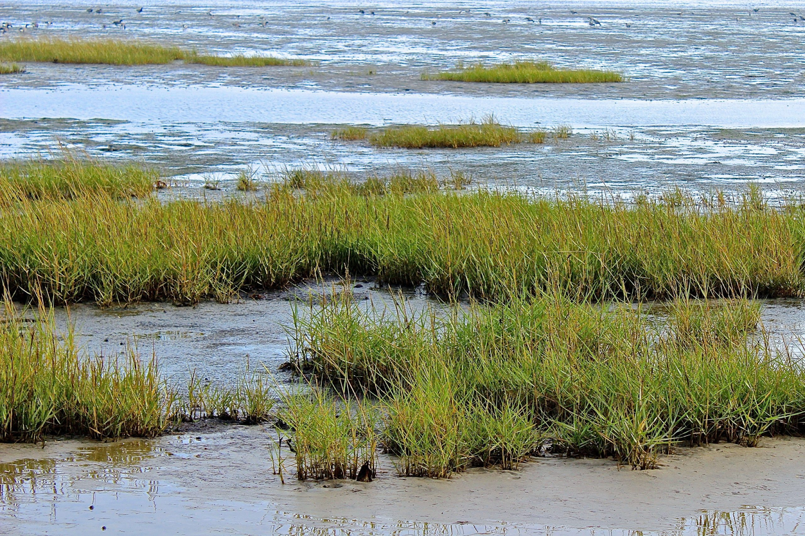
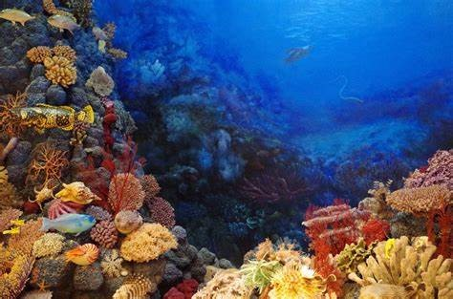
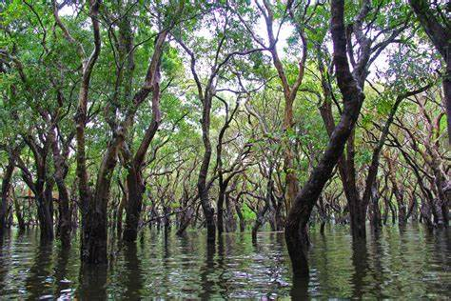
Coastal Ecosystems
We will look at three (3) coastal ecosystems
  Wetlands
  Coral Reefs
  Mangroves
How are these coastal ecosystems connected?
Wetlands
Coral Reefs
Mangroves
Notes:
SAY: Great job with those adaptations! Now that we know more about adaptations, let’s talk about coastal ecosystems!!! We’re going to look into the adaptations we may find here.
SAY: The three aquatic systems we are going to look at are wetlands, coral reefs, and mangroves.
ASK: What do you know about these coastal ecosystems? (guide to answers → may talk about local areas to them, coral reefs and how biodiverse they are)
ASK: What do the three coastal ecosystems have in common? (guide to possible answers → aquatic system, have specific roles in supporting the different species found, structure is important for humans, niches filled)

Slide 7
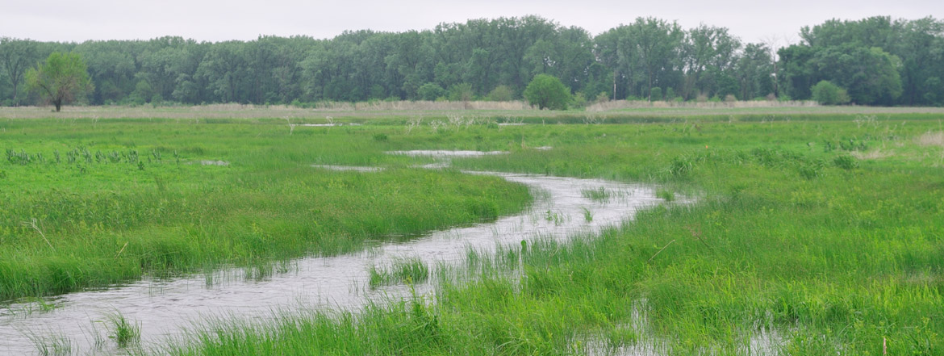
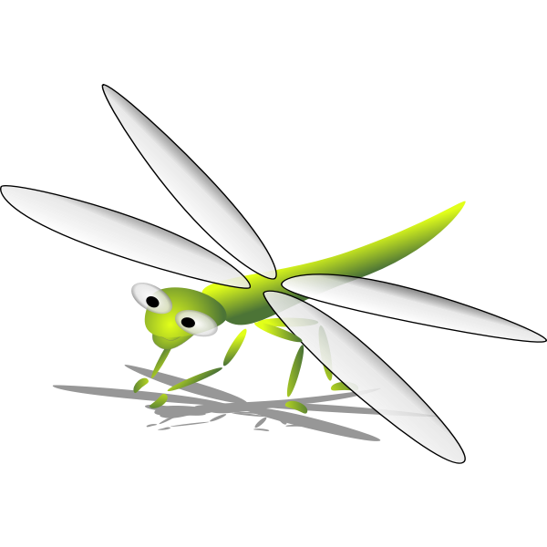
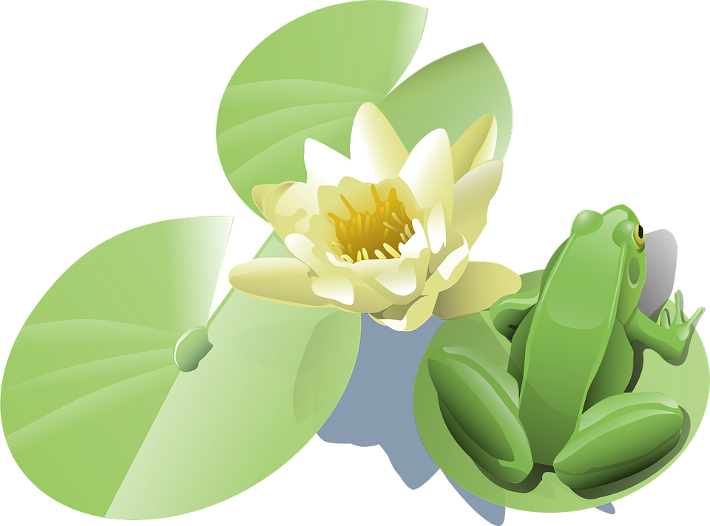
Wetlands
Wetland: a flooded ecosystem where water saturates the soil for varying amounts of time of time
They are transitional zones between water and land that protect the land from storms and protect the water from toxins.
What kind of species and their adaptations might we find in a wetland?
Notes:
SAY: So let’s talk about wetlands.
ASK: What exactly is a wetland? (guide to answers → wet, lots of water or full of water, swamps or bogs may be mentioned)
SAY: A wetland is a flooded ecosystem. This means it’s an area where the land where water covers the soil for different lengths of time. The vegetation (mention the word flora again), or plants, act as natural filters in streams and lakes. It’s also important to know that there is little to no oxygen present. This is critical because it limits the kinds of species that can thrive in wetlands.
ASK: If this is an ecosystem that has different amounts of water at different times, what kind of species do we expect to find here? Hint: vegetation (guide to answer → plants!!, fish, birds and insects).
ASK: What kind of adaptations would we expect to see? Hint: remember there is limited oxygen found here. (guide to answer → we can expect species being adapted to not need oxygen, plants (photosynthesis!).

Slide 8
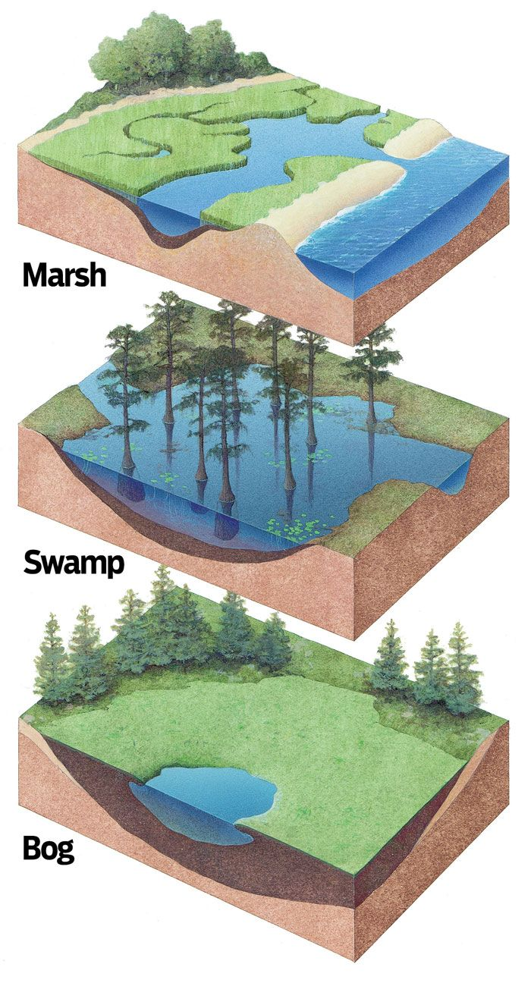
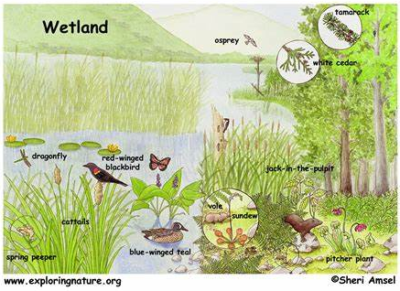
Characteristics of Wetlands
Different types of wetlands
Biodiversity of species in a wetland!
Notes:
SAY: Let’s look at some images of wetlands. First, let’s look at the different types of wetlands we may come across. We have marshes, swamps, and bogs. Remember, a wetland is an ecosystem where water covers the soil for varying amounts of time. In a marsh, we can see high tide and low tides that cover the soil in cycles. Wetlands can be flooded in water at different times of day, or over weeks or even seasonally. In swamps and bogs for example, the water levels may increase or decrease periodically.
ASK: Can you think of any wetlands near you? Or maybe you’ve visited a place where there is a wetland? You may have even seen a wetland in a movie!
SAY: There are many different species we see in wetlands - Plants like cattails are common, insects like dragonflies, amphibians like spring peepers frogs, and birds like osprey and ducks. We’ll look at more species in a moment.
Source:
https://th.bing.com/th/id/OIP.iNr_UXv3Zzhf2HBIlqO5SwHaFu?pid=ImgDet&rs=1
https://i.pinimg.com/originals/ee/dd/dc/eedddcd024bcd0abc5f0083833e9c058.jpg

Slide 9
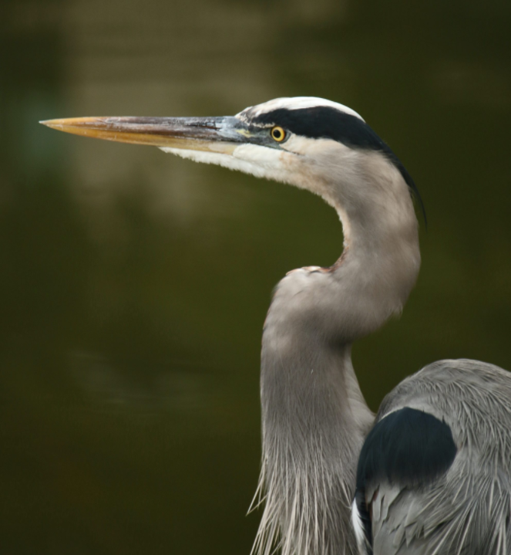
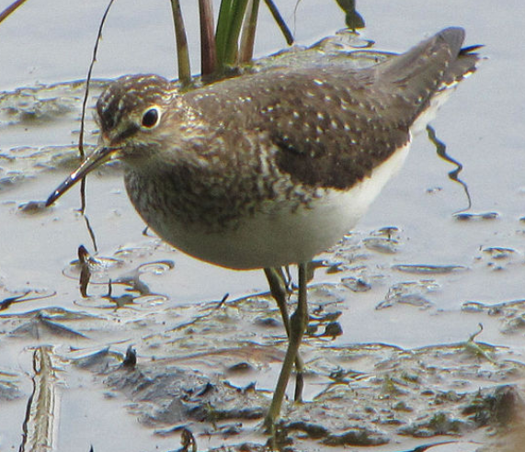
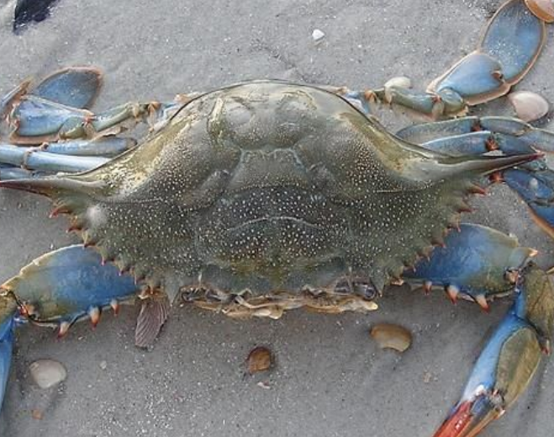
Wetland Species
Year-round Residents
Use the area for fishing and nesting year-round
Migratory Species
Depend on the wetlands for a place to stay
Nursery Grounds
Many species rely on the ecosystem for juveniles to hide, to forage, and for shelter
Notes:
SAY: Wetlands can support many insects, reptiles, amphibians, and fish. But birds thrive the most in this ecosystem. More than 1,900 bird species in North America use wetlands at some point in their lifetime. Spoonbills, herons, ducks, geese, swans and egrets are just some of the species who thrive in wetlands. They take full advantage of the resources available like open air to travel, water for fishing, and the land for their nests.
Migratory species depend on wetlands as a place to stay overnight or for a few days to rest and refuel. They depend on other species like fish, amphibians, insects and crustaceans for their fuel. Think about a food web in a wetland! In this photo we see the Solitary Sandpiper which spends the winter in South American near the Amazon basin and then fly north to Canada to breed!
Nursery grounds are paramount for various species which include waterfowl, fish, invertebrates, mammals, amphibians, insects, and reptiles as a food source and for hiding spaces. The interconnected roots and plants under the water provide hiding spaces for juvenile species from predators and protection from storm wave energy.

Slide 10
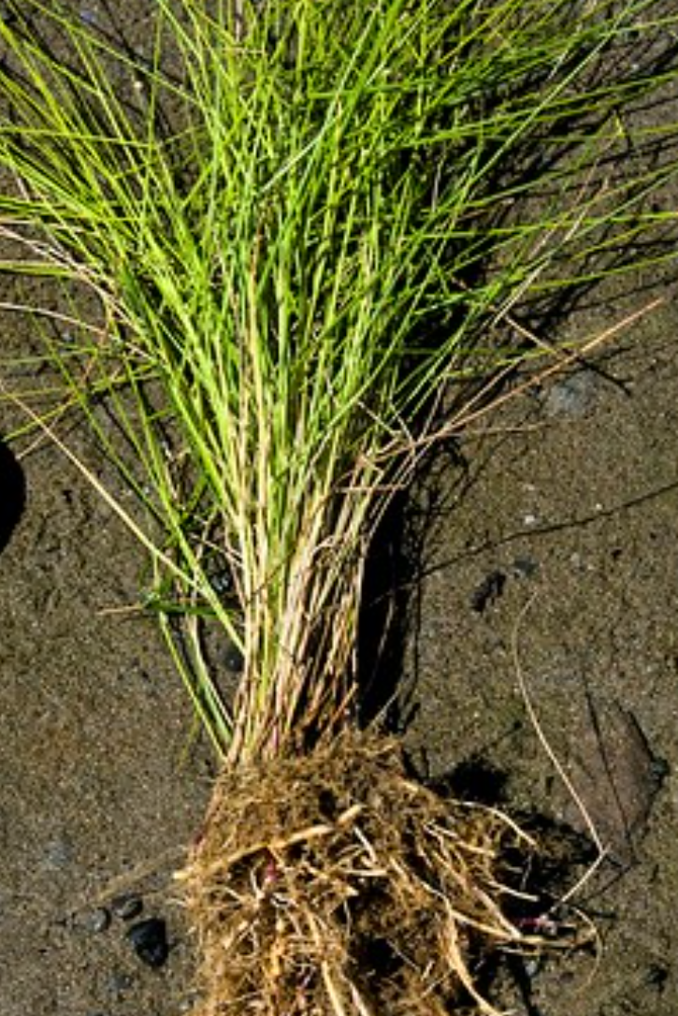
Wetland Adaptations
Flora Adaptations
Long stems
Longer than usual stems with special air pockets to deliver more oxygen to the roots
Root systems of these aquatic plants have special adaptations that allow them to gain the oxygen necessary and still live in hydric conditions.
Roots
Notes:
SAY: Wetlands provide a link between aquatic and terrestrial ecosystems. They are not always submerged underwater like the open ocean is and they aren’t always on dry land. This means the flora and fauna require adaptations that can support their unique needs.
ASK: Looking at the photo - what kind of adaptations do you think this plant found in a wetland may have? (guide to answers - look at how long the stems are!)
SAY: The stems are longer than usual terrestrial plants. Adaptations are not always something we can physically see. Many adaptations happen inside an organism. Inside these long stems are special air pockets that deliver more oxygen to the roots. In addition, they have complex root systems that allow them to stabilize themselves in the soil and collect sediment from the water.
ASK: Is this a behavioral, structural, or physiological adaptation?

Slide 11
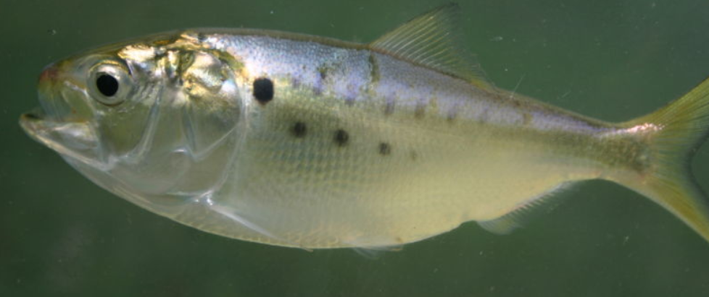
Wetland Adaptations
Hemoglobin is a type of protein that carries oxygen in our red blood cells throughout our body!
Fauna Adaptations
Wetlands have changing tidal levels and water temps.
Stagnant water has less dissolved oxygen
  Fish & crustaceans have special gills and skin allowing them to extract the O2.
They also have more hemoglobin which carries the O2 in their blood.
Special gills
Breathable skin!
Notes:
SAY: Remember, species that live in wetlands are not always underwater and not always in dry land. The water is usually stagnant or at a stand-still. This kind of water is not ideal because the amount of oxygen is limited. Just like humans, fish and crustaceans need oxygen for respiration or to “breathe.”
ASK: What kind of adaptations do you think a fish would have to increase or have more oxygen?
SAY: Some fish have special gills and breathable skin to extract available oxygen. Similarly to the air pockets inside the stem of wetland plants, some fish have high concentrations of hemoglobin, a protein, which carries oxygen.
ASK: Is this a behavioral, structural, or physiological adaptation?

Slide 12
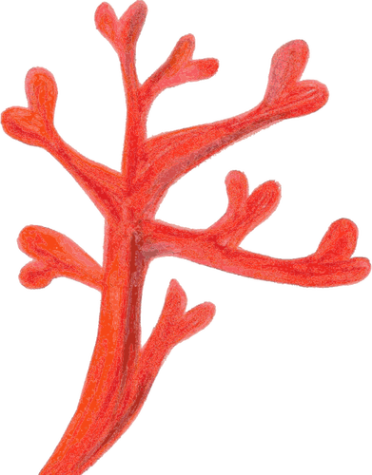
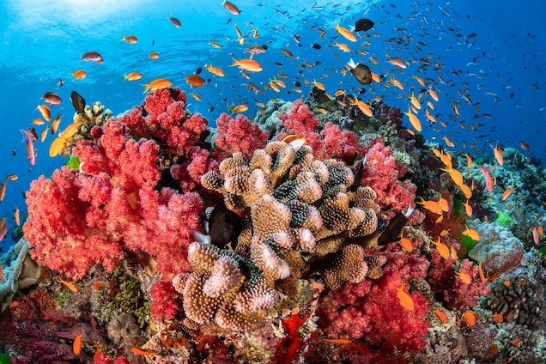
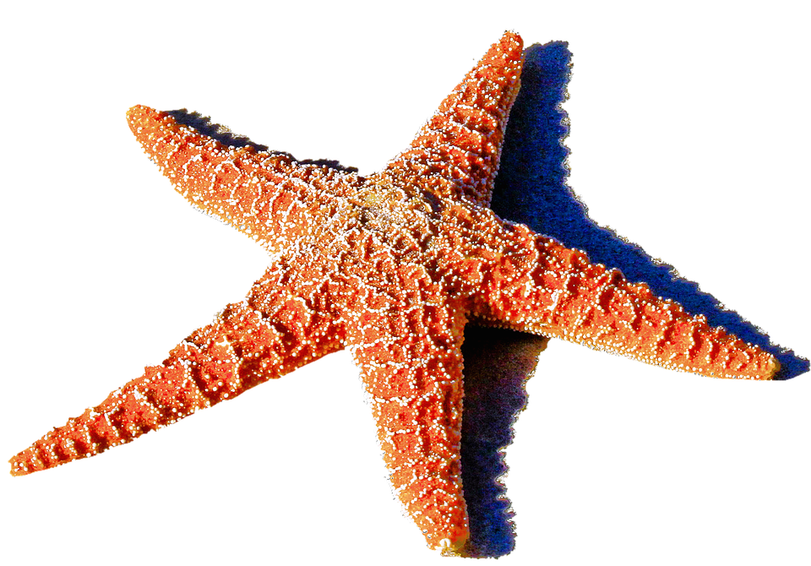
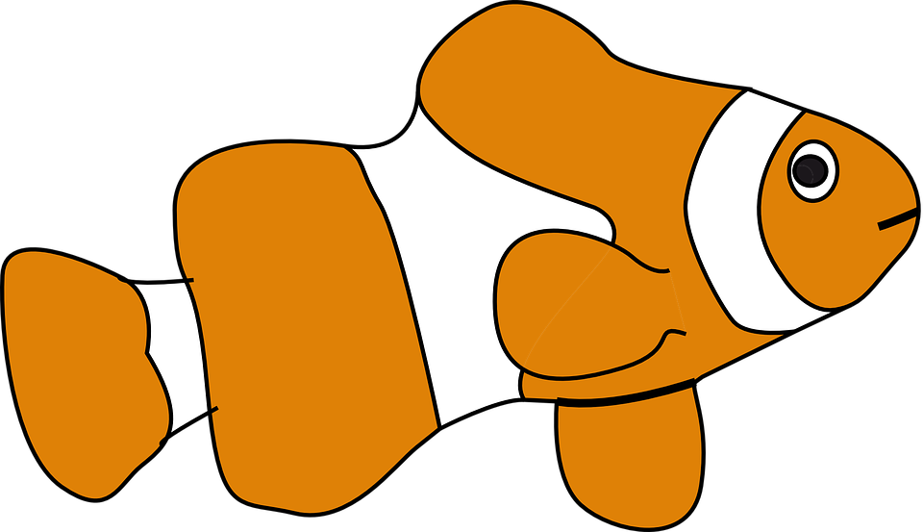
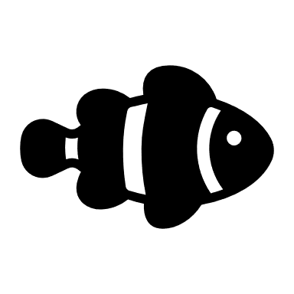
Coral Reefs
Coral Reef: large underwater structures made of an exoskeleton called calcium carbonate (CaCO3).
Coral reefs are made of individual corals called polyps which is an invertebrate.
How do polyps adapt to the reefs?
Notes:
SAY: Now let’s talk about Coral Reefs.
ASK: What do you know about Coral Reefs? It can be anything! (guide to answers → Finding Nemo, clownfish and anemones, lots of color, Great Barrier Reef, Coral bleaching, corals are dying, biodiversity, fixed in one place, grow slowly)
SAY: Coral reefs are large underwater structures made of a material called calcium carbonate which they extract from the surrounding seawater. These reefs are made of individual corals (animals) which we call polyps. They use calcium carbonate to build the cup-like structures that surround them. There are 2 types of corals that can be found in reefs. You have your reef builders which are stong stoney corals like brain corals. Than we have our soft corals like sea fans, sea whips, and sponges that enhance the reef.
ASK: What kind of other organisms do you think we may find in coral reefs? (guide to answer → fish, sharks, rays, algae, octopus, crabs, seastars, shrimp, schools of fish)

Slide 13
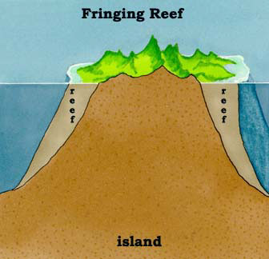
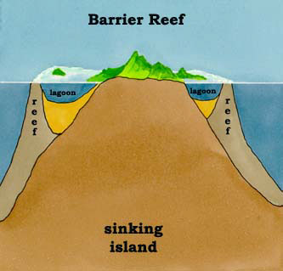
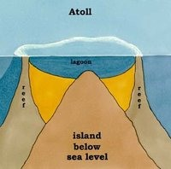
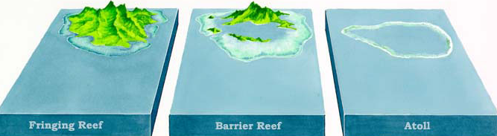
Formation Types of Coral Reefs
What are the differences between these three types of coral reefs?
Notes:
SAY: Let’s look at the different formations of coral reefs. First we have a fringing reef, then a barrier reef, and finally an atoll.
ASK: What is the difference between these three types of coral reefs? (guide to answer→ if the island is above or below sea level, maybe where they are found)
SAY: Fringing reefs are the most common and grow in a narrow band (also called a fringe) near the shore. They sort of “surround” an island. Barrier reefs are found along the coast but are typically farther out and separated by a deep lagoon. Atolls are a ring of coral reefs that surround one central lagoon and are usually found far from land. Atolls can be found on top of a submerged island or volcano.
https://th.bing.com/th/id/OIP.Hm7vDXxJ19oYhg3wnWReGgHaHJ?w=189&h=180&c=7&o=5&dpr=1.5&pid=1.7
https://o.quizlet.com/i/Mn4UWn1KvGzQHYZ-zmheWA_m.jpg

Slide 14
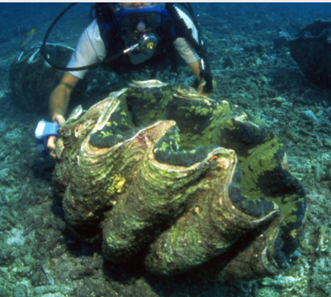
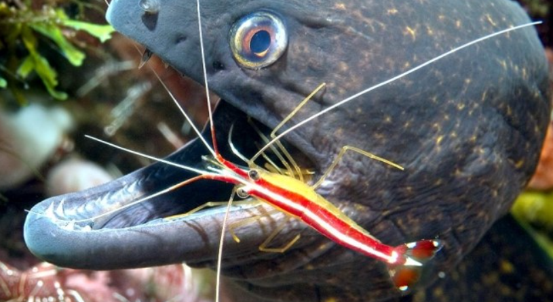
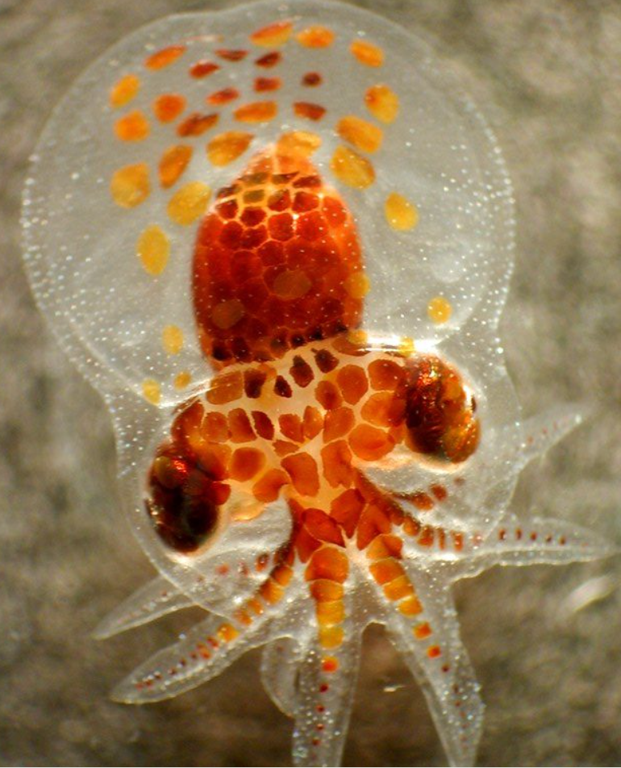
Coral Reef Species
Year-round Residents
Sessile species.
Visitor Species
Some species visit for a cleaning, to forage, or for shelter
Nursery Grounds
Reef fish rely on coral reefs to provide a safe space for their juveniles
Notes:
SAY: As we’ve already discussed, coral reefs are diverse aquatic ecosystems. Some species live there year-round, some use it as nursery grounds, and some pop in for a cleaning or to feed on prey.
SAY: Similar to the wetlands, there are species that live there year-round. Often these species are sessile meaning they are unable to move. Examples are this giant clam which is the largest bivalve. Let’s break this word down. First, think of the difference between a bicycle and a unicycle. The bicycle has 2 wheels and a unicycle has 1. So a bivalve doesn’t have wheels but has something else, (wait a few seconds and let them think…) Shells, that’s right!! Bivalves are invertebrates that have 2 shells that are hinged together such as oysters, clams, mussels, and scallops.
ASK: Where have you seen bivalves?! Has anyone tried a bivalve?
SAY: The vast biodiversity of coral reefs allows different niches, to be filled. Sometimes, these niches are filled by species just visiting the reef. Eels and turtles frequent reefs to get a good cleaning from parasites, algae, bacteria, and other nuisances from cleaner fish and cleaner shrimp. This is an example of a mutual symbiotic relationship. The eel in the photo is getting a cleaning from the shrimp who ends up getting a free meal!
SAY: Coral reefs like wetlands are also a nursery ground for many reef fish. Reef fish spawn over coral reefs using chemical cues in the water column and moon phases to know when to release their eggs. Young fish and many other juvenile species rely on the nooks and crannies of reefs for hiding spots from predators and for shelter.

Slide 15
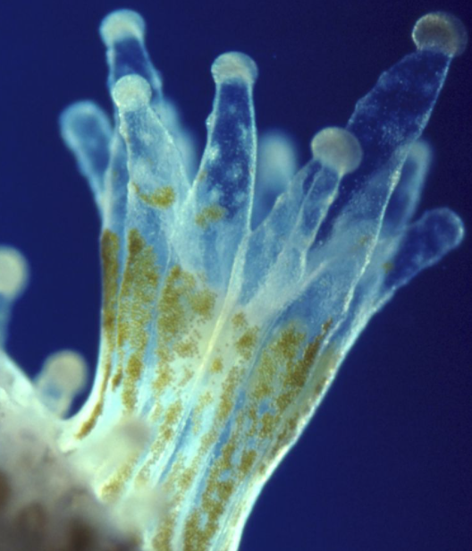
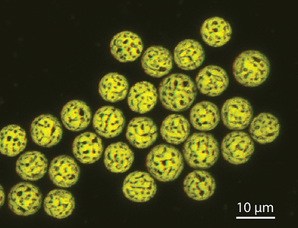
Coral Reef Adaptations
What kind of symbiotic relationship is this?
Flora Adaptations
Zooxanthellae provide corals with up to 60% of their nutrition from photosynthesis
The corals provide protection, CO2, and other nutrients
Zooxanthellae
Coral polyp
Notes:
SAY: Coral reefs often are referred to as the rainforest of the sea. This is due to the diverse habitat that corals create. These species must be adapted to live in shallow, low nutrient waters*. One adaptation we see is found in zooxanthellae. Zooxanthellae are microscopic photosynthetic symbiotic algae and provide nutrition to the coral. They need the sun to perform photosynthesis and corals need shallow clear water. The coral structure provides the zooxanthellae with a structure to grow in.
ASK: What kind of symbiotic relationship is this? (guide to answer → they both benefit mutually so this is an example of mutualism) Who benefits?
ASK: What kind of adaptation is this?
*the clear waters of the tropics where corals live have less nutrients than say coastal waters that have a murky/cloudy look to them.

Slide 16
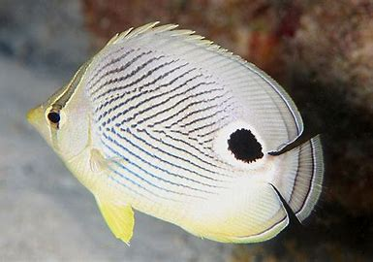
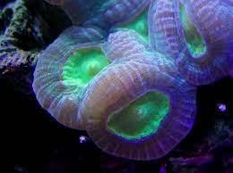
Coral Reef Adaptations
What other adaptations might we see for protection?
Fauna Adaptations
Reef fish have evolved to have flatter bodies which allow them to maneuver in the crevices
Reef fish vibrant colors camouflage them from predators
Butterfly fish have a false eye on their dorsal fin to confuse predators to think it’s their head
Fluorescent pigment acting as a sunscreen
Notes:
SAY: We just saw Zooxanthellae and their relationship to Coral Reefs, but what about other species that use the coral reefs?
ASK: What kind of adaptations do you think we may see??
SAY: We could see reef fish that have flatter bodies so they can maneuver between the coral. They also tend to be bright, and vibrant colors. This allows them to camouflage into the reef!!
ASK: What kind of adaptation would vibrant coloration be? (STRUCTURAL!)
SAY: The butterflyfish has a dot on its dorsal fin. And the dot actually tricks predators into thinking it’s their head.
ASK: What kind of adaptation would this be? (STRUCTURAL)
SAY: The corals themselves have evolved to survive coral bleaching by producing a special fluorescent pigment similar to us using sunblock.

Slide 17
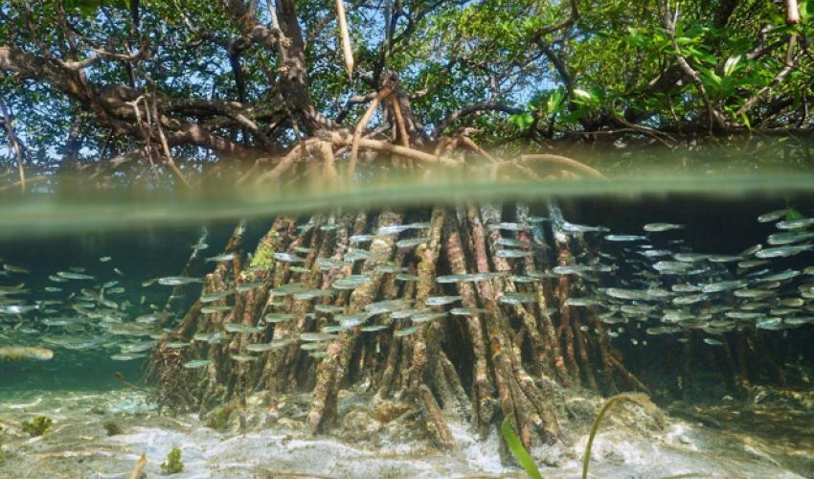
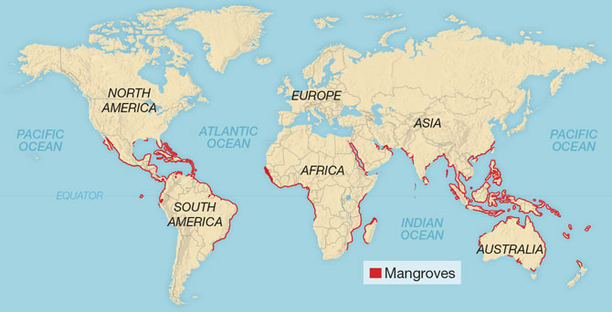
Mangroves
Mangroves: the species of a tree that makes up a Mangrove Forest. They are trees or shrubs that grow in coastal swamps
Bi-daily following with high tide, intense sun exposure, and roots overwhelmed with salt
There are about 80 different species of mangrove trees
Notes:
SAY: So let’s talk about mangroves!
ASK: What exactly is a mangrove?
SAY: A mangrove refers to the actual species of a tree that make up a Mangrove Forest. Mangroves can be trees or shrubs that grow in coastal “swamps” that have bidaily flooding with high tide. They are found between 25 degree north and 25 degrees south of the equator. Mangrove forests are located along the coasts of tropical and subtropical countries. Nearly 75% of tropical coastlines have mangroves.
SAY: These trees live in some of the harshest environments on earth with strong tides, intense sun, and being overwhelmed by saltwater. They grow in low oxygenated soil and areas with slow-moving water that allow for fine sediment buildup and with very little freshwater influence they have many adaptions for get rid of excess salt and holding onto the fresh water.
ASK: What kind of species and adaptations do we think we might find in a mangrove?

Slide 18
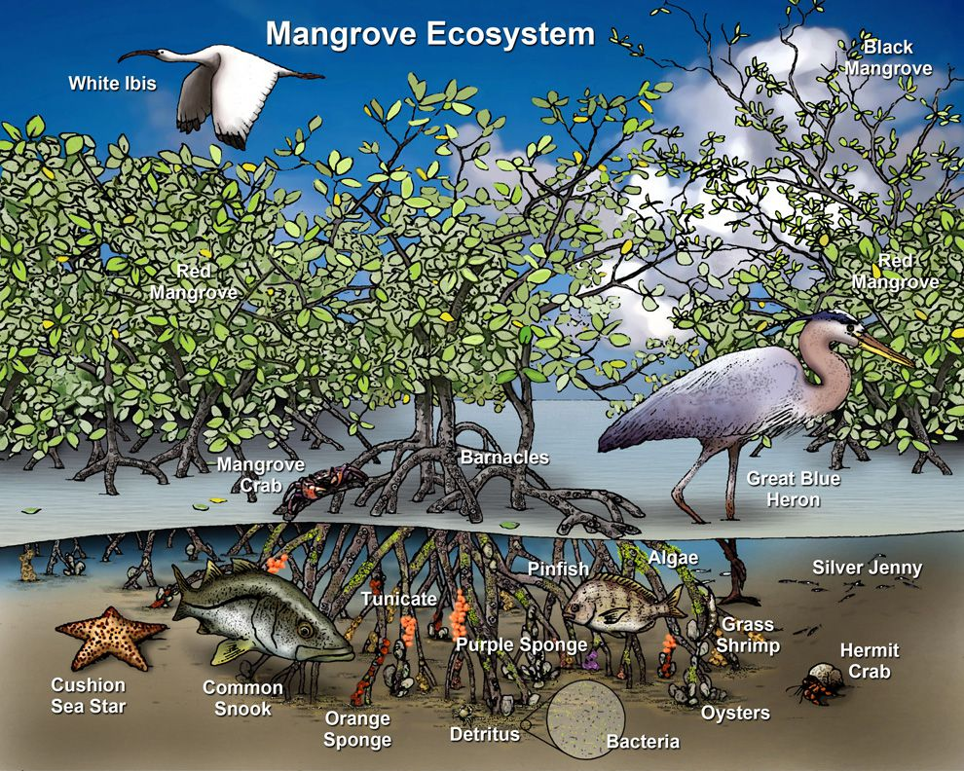
Characteristics of Mangroves
What kind of characteristics do we see?
Notes:
SAY: Let’s look at this example of a mangrove ecosystem.
ASK: What kind of characteristics do we see? (guide to answer → look at those unique roots and different species living and foraging in the roots and on top of the mangroves!)
ASK: What kind of relationships do we see? (mutalism-** smbiotic**

Slide 19
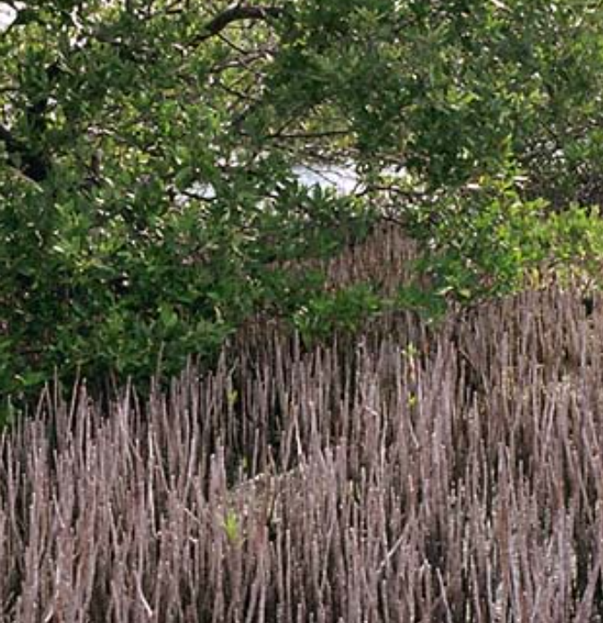
Mangrove Adaptations
Snorkel Roots
Peg like roots extending to be above the waterline
Also called pneumatophores
Allow the mangrove to breath
Seen mainly with the White Mangrove (Laguncularia racemose)
Notes:
SAY: Mangroves have complex root systems.
ASK: Why are roots so important? (a guide to answer → nutrients, water, food, sugar, structure, and support)
SAY: Roots are used for the uptake and supply of things like nutrients, freshwater, and oxygen. They also are used for structure and support. First let’s look at Snorkel Roots.
ASK: These roots have an interesting name - what do we think it might mean? (guide to answer → Humans use snorkels when they go snorkeling. It’s a special tube that allows us to breathe with our faces underwater)
SAY: Snorkel roots similarly extend from the underwater root to above the water level and provide a way for the mangrove to breathe.
ASK: What kind of adaptation is this?

Slide 20
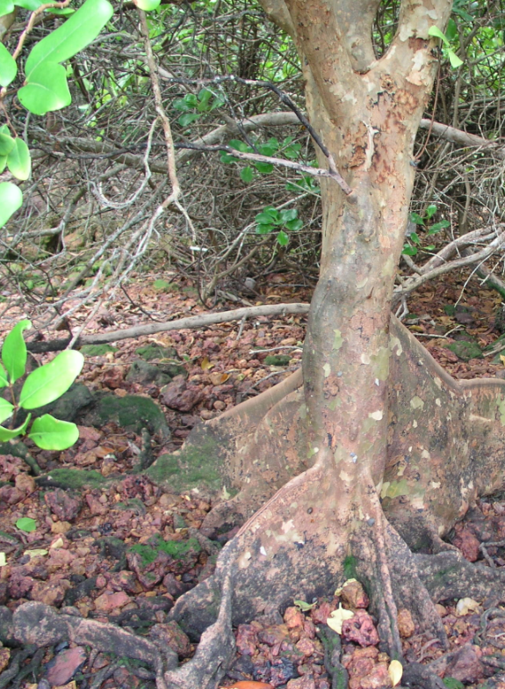
Mangrove Adaptations
Buttressing Trunks
Large wide trunks extending out on all sides
Provide stability in shallowly rooted trees and provides defense against storms
Also serves as a long-distance conduit for nutrients and water
Seen in taller mangroves (not shrubs)
Notes:
SAY: Now let’s look at our next mangrove adaptation.
ASK: Looking at the picture, what is unique about it? How do these roots project from the bottom of the tree? (guide to answer- stability, wide base, may be seen in modern architecture).
SAY: These trunks have shallow roots, but the large trunk provides the stability needed for the mangrove to be resilient against strong storms*.
ASK: What does this structural adaption tell us about where these live and what might have caused them to adapt this way?
*mangroves typically are found in shallow sandy or muddy bottoms so these buttressing trunks help to stabilize the tree

Slide 21
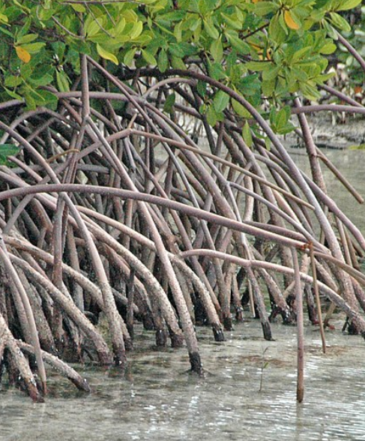
Mangrove Adaptations
Prop Roots
Grow from the branches of the tree down to the water and sand/mud
Provide support to the higher center of gravity needed during the strong storms
Seen typically with the Red Mangrove which is found in Florida
They also absorb nutrients and water
Notes:
SAY: Now, let’s look at our final adaptation - prop roots
ASK: What stands out to you looking at this photo? (guide to answer → we see long, narrow roots coming out of the water)
SAY: Prop roots grow from the branches of the tree and extend down into the water and sand or mud. Plants we are familiar with typically grow up, not down so there must be a reason for this!
SAY: It’s to provide structure and support, especially during tropical storms and hurricanes.
DO: Have the kids stand up. Ask them to imagine they are on a boat with lots of waves coming. How do you keep stable? (guide to answer → arms and legs used for stability - wide stance, knees bent)
ASK: What is different about this adaption and what is this adaption?

Slide 22
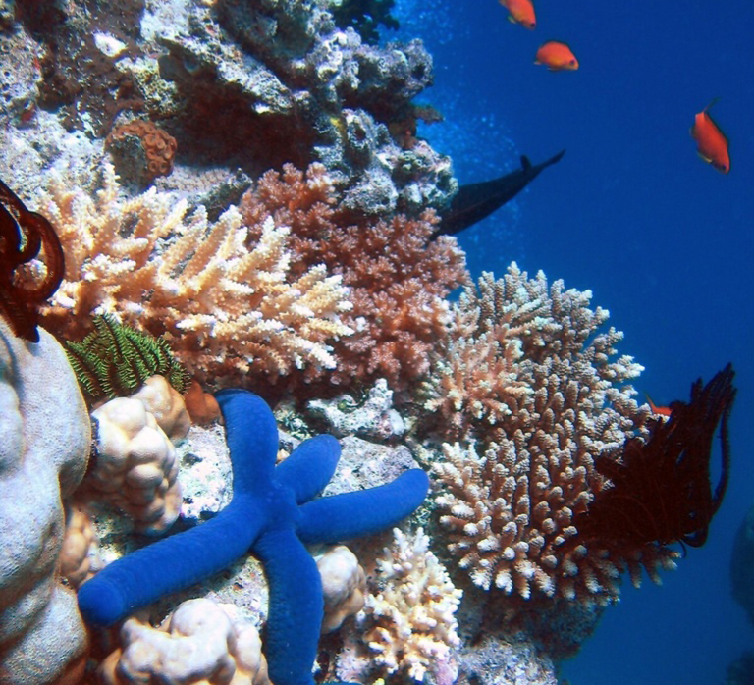
Matching: Coastal Habitat Adaptations!
Prop roots help during intense weather for mangroves
Fish hiding in a reef to protect itself from predators
Fish being able to carry more hemoglobin for oxygen
Which description matches the kind of adaptation?
Physiological
Behavioral
Structural
Notes:
SAY: Awesome job!!! So now that we know about coastal habitat adaptations, let’s take a deeper look at the specific adaptations we may find.
ASK: What kind of adaptation do you think prop roots have that help during intense weather for mangroves?
ASK: What about reef fish? Is their adaptation physiological, behavioral, or structural?
ASK: And finally, the fish in wetlands. Their ability to carry more hemoglobin, is this physiological, behavioral or structural?

Slide 23
Summary of Lesson 2
We looked at three distinct coastal habitats
  Wetlands
  Coral Reefs
  Mangroves
Each habitat hosts a variety of species - biodiversity
In order for organisms to thrive in these habitats they have unique adaptations
  Wetlands: Able to survive in salt water at various times with little oxygen present
  Coral Reefs: Protection from predators!
  Mangroves: Strong, salt tolerant roots for structure and support
Notes:
SAY: So let’s break down what we’ve discussed today.

