Slide 1
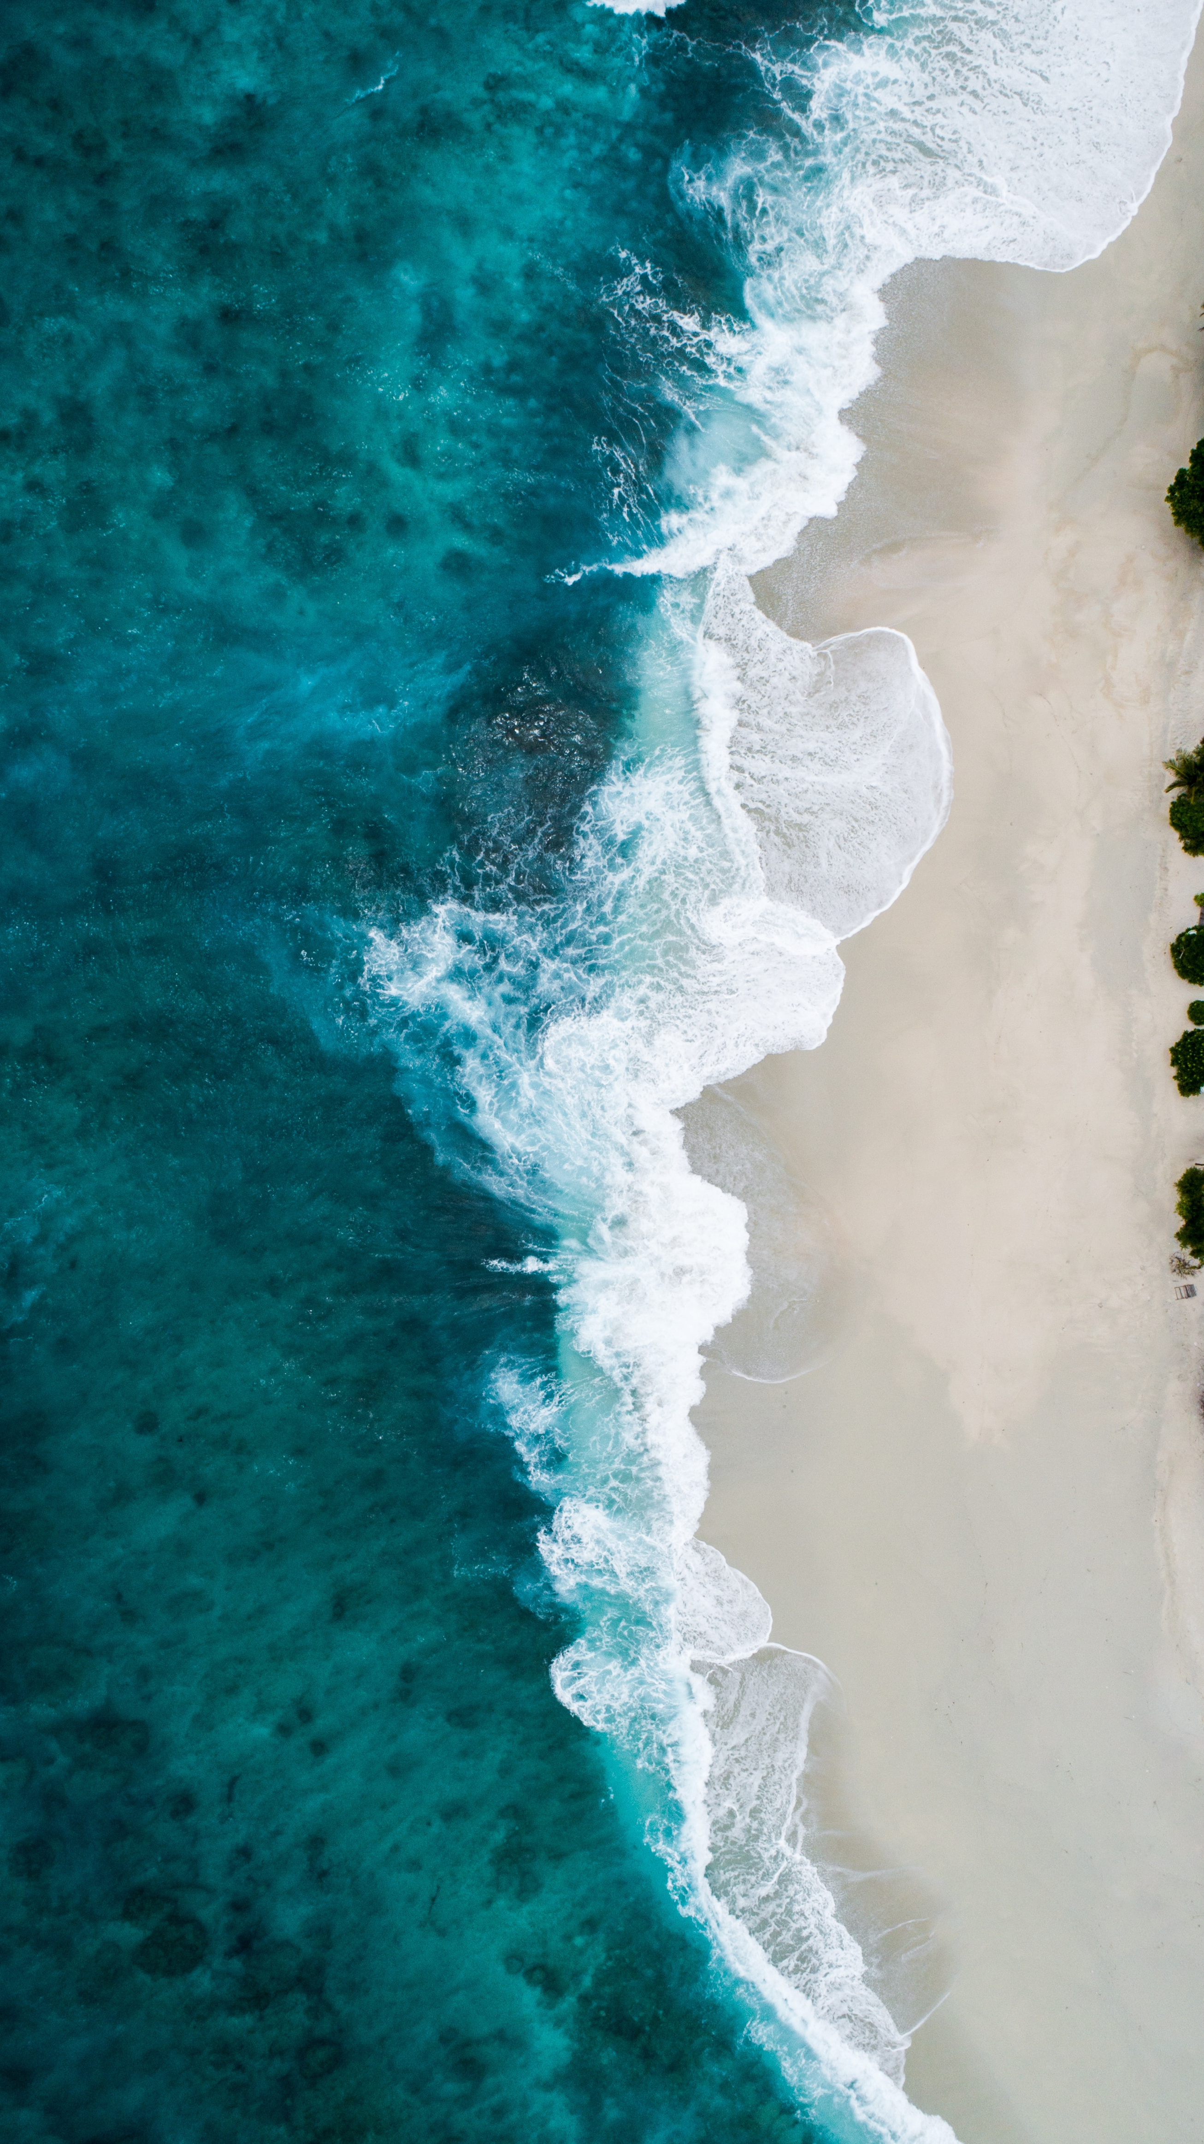

Maritime Workforce Development
Marine Environment
Responsibility
Leadership
Educate
Collaboration
Awareness
Development
Activate
Marine Debris
Transparency
Protection
K-12
Advocate
Commitment
Marine Debris
OUR MISSION
#SAVEOURSEAS
Support
Transparency
Preserving the marine environment by promoting sustainable maritime industry practices and educating the public to Save Our Seas
Values
Action
Educate
Conservation
Collaboration
Development
Sustainable
Protection
K-12
Maritime

Slide 2
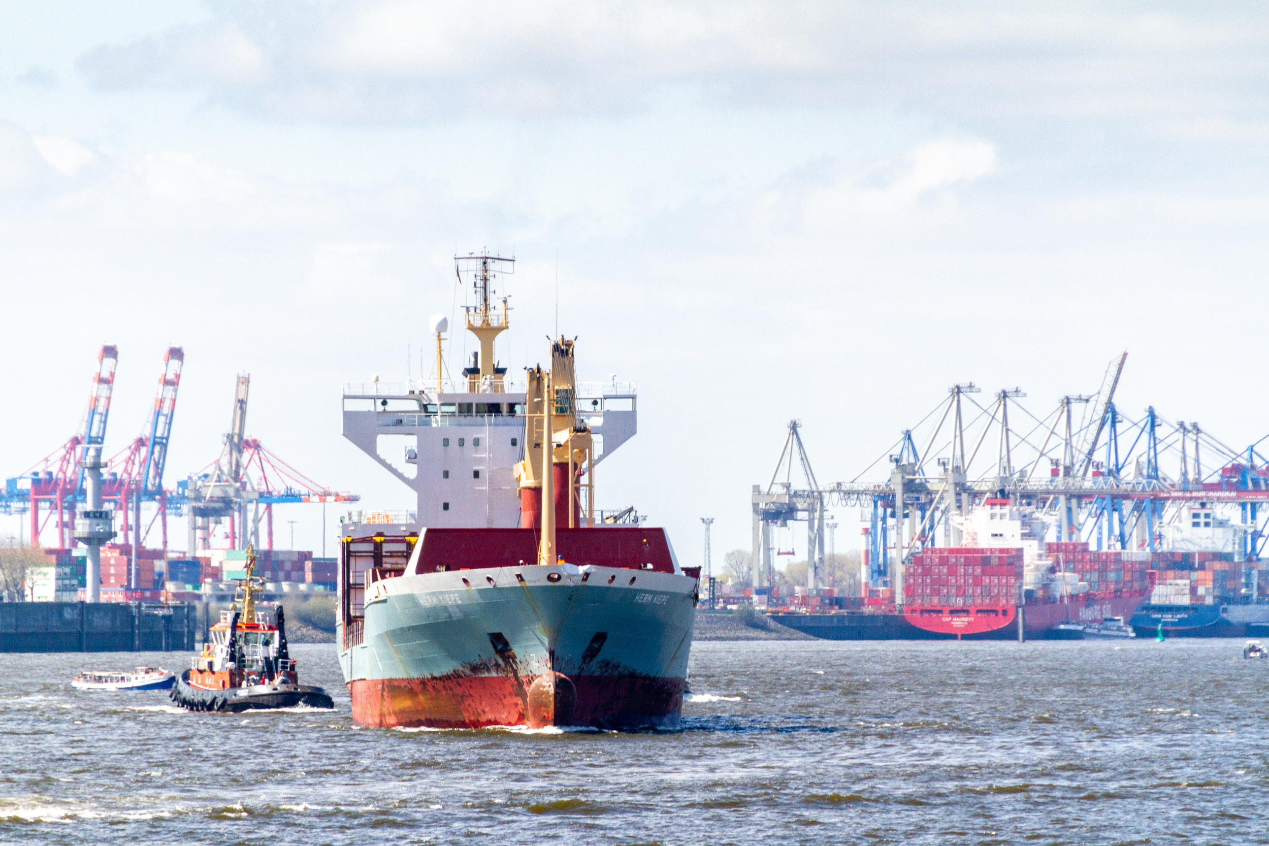

MARITIME
WORKFORCE
DEVELOPMENT

Slide 3



WHY MARITIME
A career in maritime offers global opportunities for travel and exploration, providing individuals with the chance to work in diverse countries and cultures. The industry provides job security, as it is a vital component of international trade and transportation, ensuring a consistent demand for skilled maritime professionals.
ADVENTURE
JOB SECURITY
COMPETITIVE SALARIES
TRAVEL
GROWTH
CULTURAL DIVERSITY
EXPLORATION
TECHNOLOGY
ENVIRONMENTAL
STEWARDSHIP

Slide 4
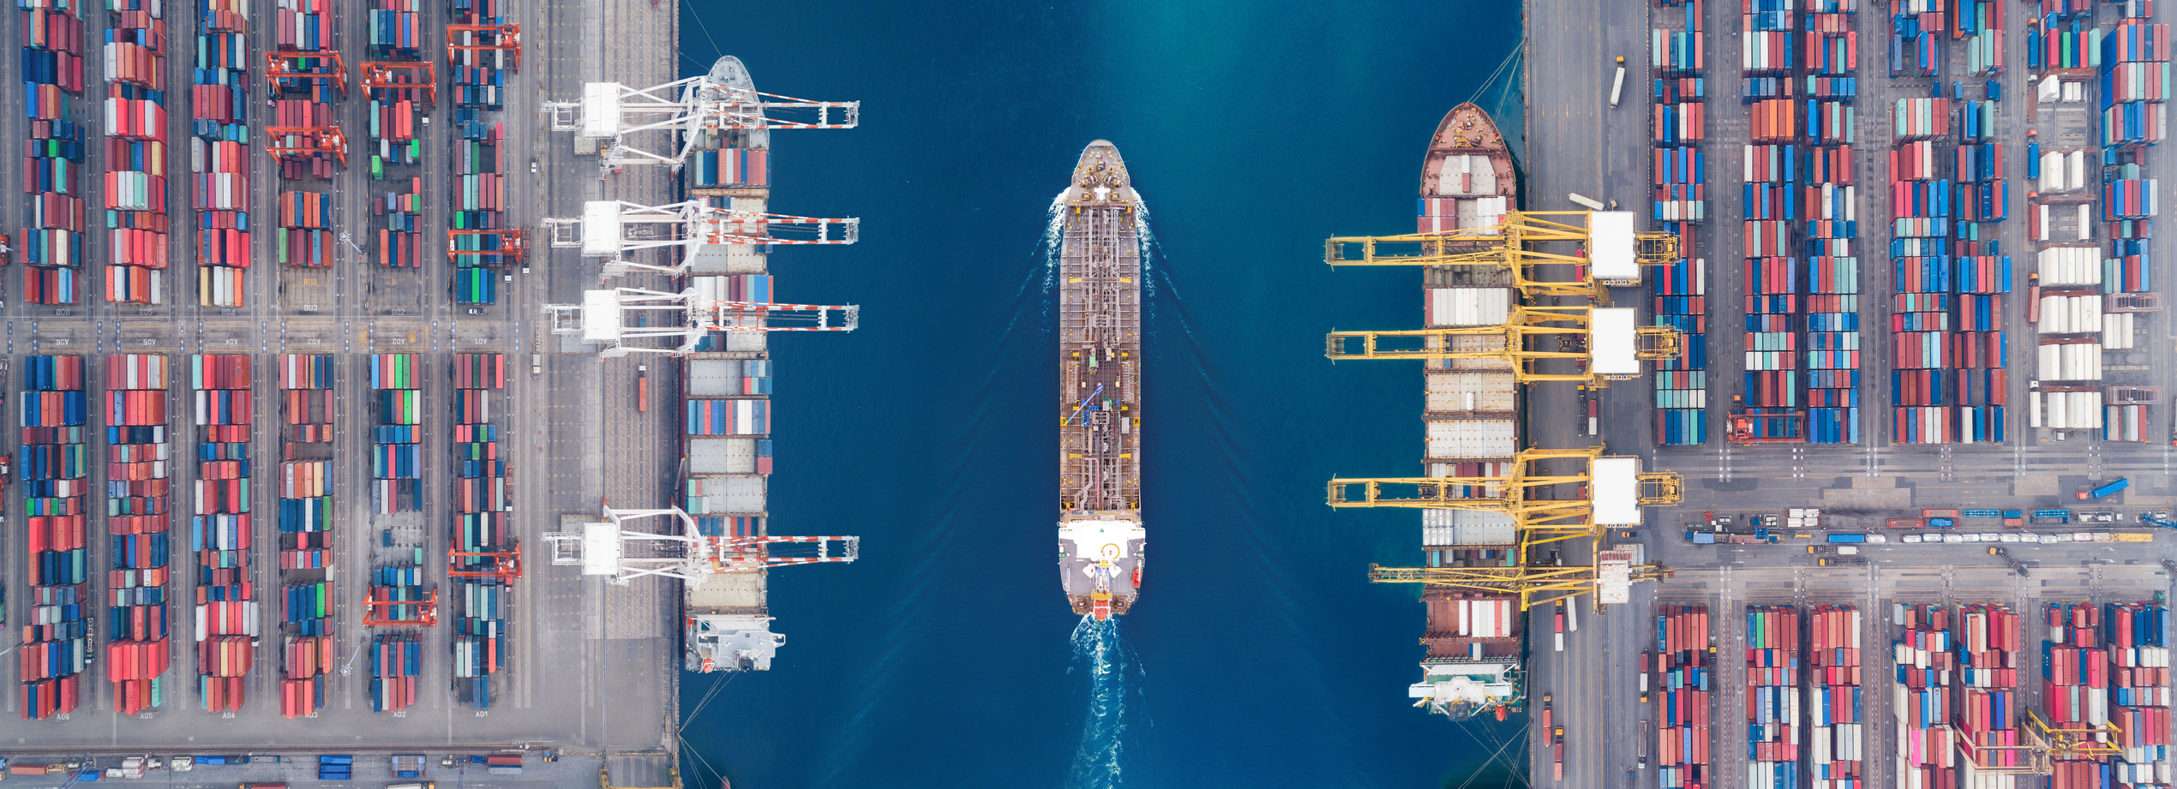
TYPES OF CAREERS
OFFSHORE
INSHORE
ONSHORE
  Travel by bringing goods from port to port, or away from the shoreline.
  Land-based and hands-on with the ability to work on the water.
  Land-based careers supporting the maritime industry.

Slide 5
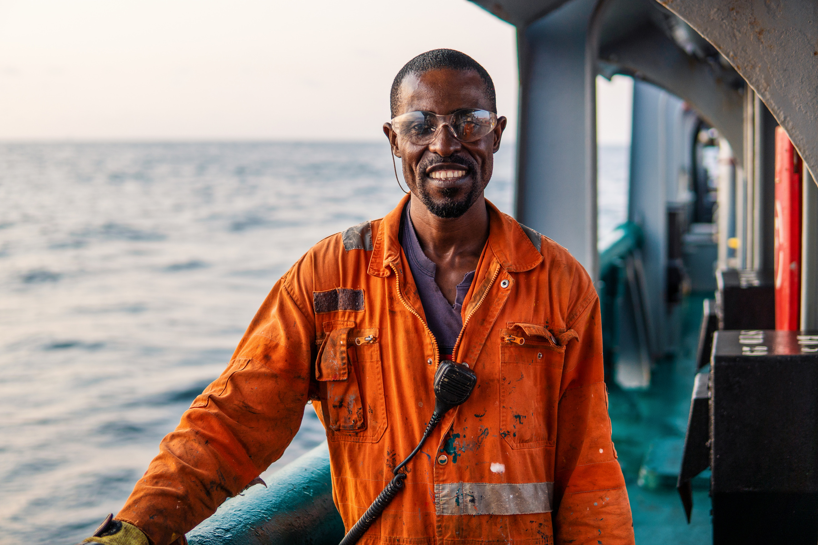
OFFSHORE
  Involves careers working in open waters, away from the shoreline.
  Seafarers on vessels.
  Includes offshore wind farms, deep-sea fishing, marine research, or oil and gas exploration.
  Often requires extended stays on vessels or offshore platforms for several weeks or months at a time.

Slide 6
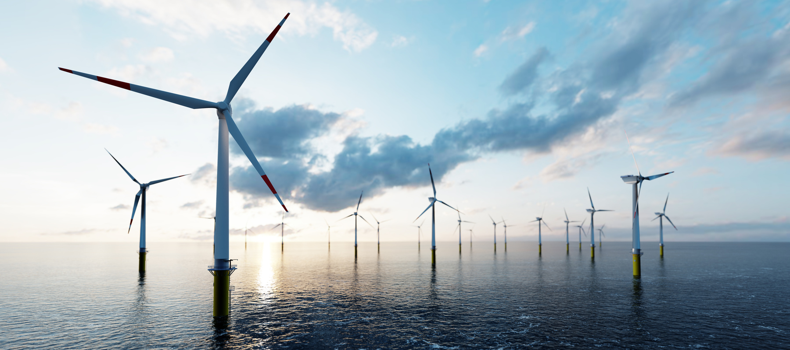


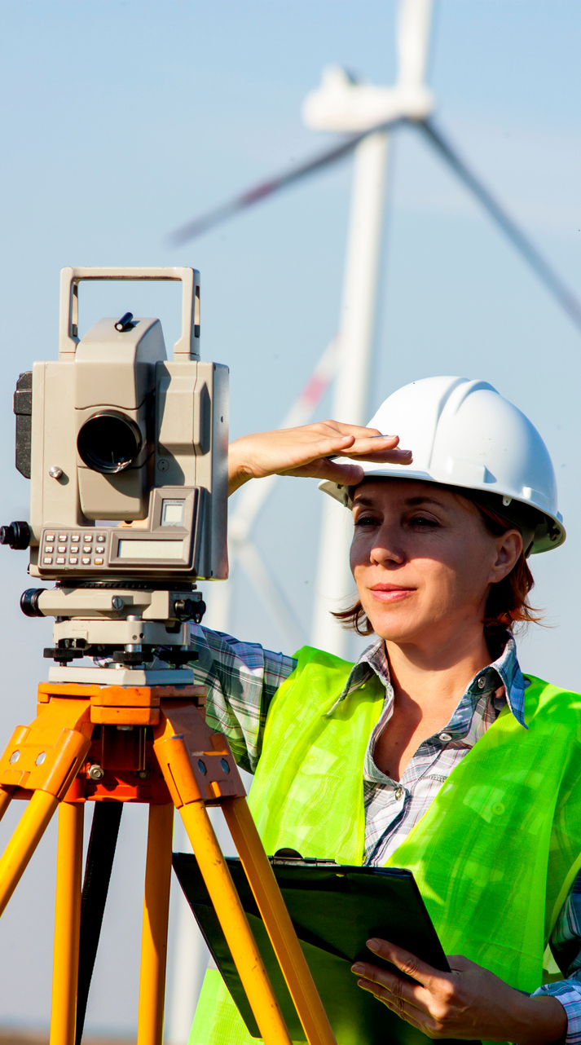
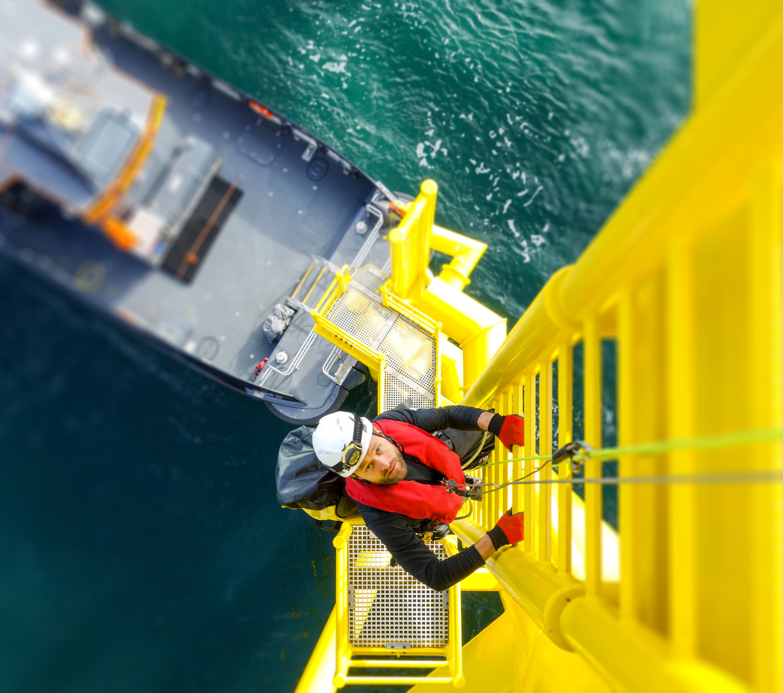
Offshore:
Wind Technician
Description: Wind technicians install, inspect, maintain, operate, and repaired wind turbines. They are capable of diagnosing and fixing any problem that would cause the turbine to be show down unexpectedly or fail to operate.
Salary Range: $46,420 - $77,810
Education & Training Level: High School Diploma or equivalent
Training: To learn the trade, most technicians attend technical school followed by employer training
Source: Office of Energy Efficiency & Renewable Energy

Slide 7
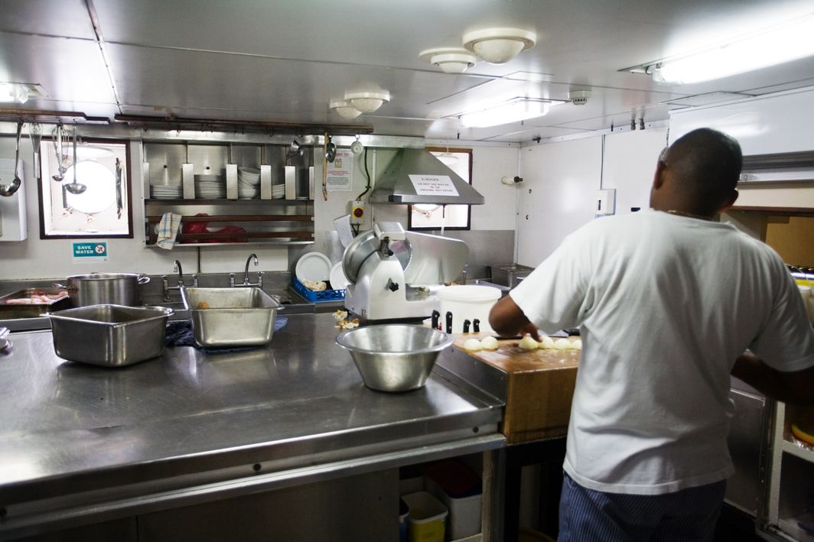


Offshore:
Cook
Description: Responsible for preparing and serving nutritious & well-balanced meals to the crew and any guests. Cooks are responsible for maintaining the galley, dining room, and associated equipment in a clean and sanitary condition at all times.
Salary Range: $44,000 - $63,000
Education & Training Level: High School Diploma or equivalent, ServSafe Certification
Note: Requires you to live abroad on a vessel for your rotation. Schedules vary but can be 28 days on and 28 days off.
Source: RiverWorks Discovery

Slide 8
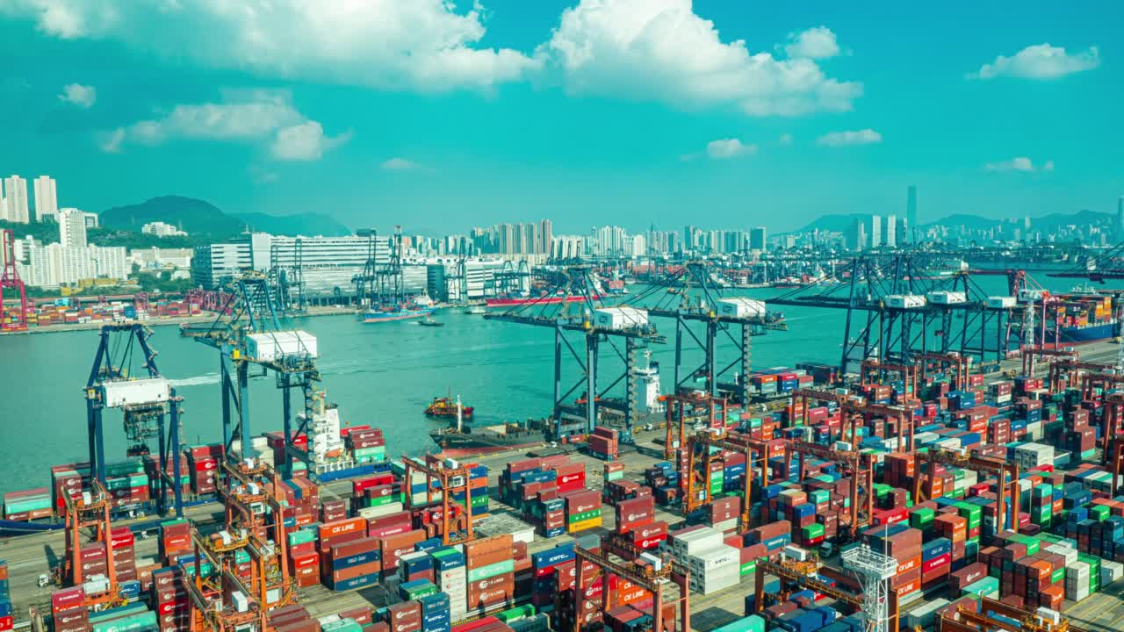
INSHORE
  Involves work in coastal waters, within a few miles from the shoreline.
  Jobs are associated with ports, harbors, and coastal areas.
  Responsible for vessel operations, safe navigation, port management, and maintain infrastructure.

Slide 9
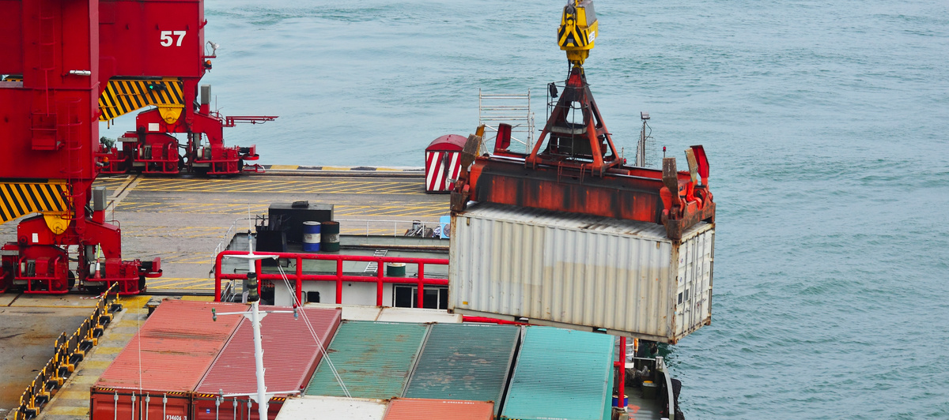

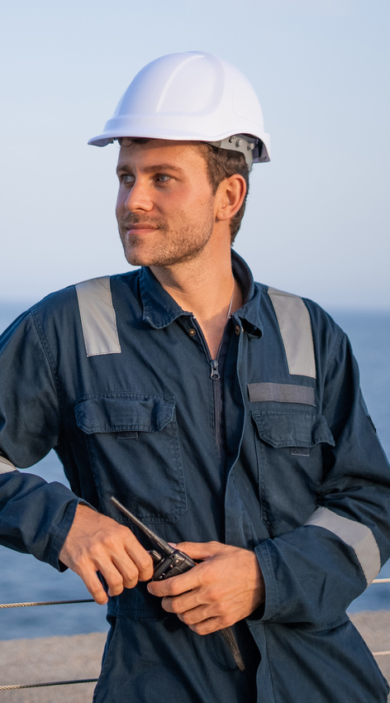

Inshore:
Dock Operator
Description: Serves as the person in charge of the dock and assists with the safe transfer of oil products and chemicals to and from barges and/or ships. No experience is required, there is on-the-job training.
Pay Range: $17 to $22 per hour
Education & Training Level: High School Diploma or equivalent
Note: Must follow OSHA safety standards
Source: RiverWorks Discovery

Slide 10


Inshore:
Electrician
Description: Installs, services, repairs, replaces and maintains all electric writing and electrical equipment such as cranes, public address systems, and electric motors. They also install lights, power lines, electrical outlets, electrical fixtures and hook up disconnects shore power and compressors, welding banks, etc.
Salary Range: $58,000 - $90,000
Education & Training Level: High School Diploma or equivalent
Note: Some employers require vocational training.
Source: RiverWorks Discovery

Slide 11
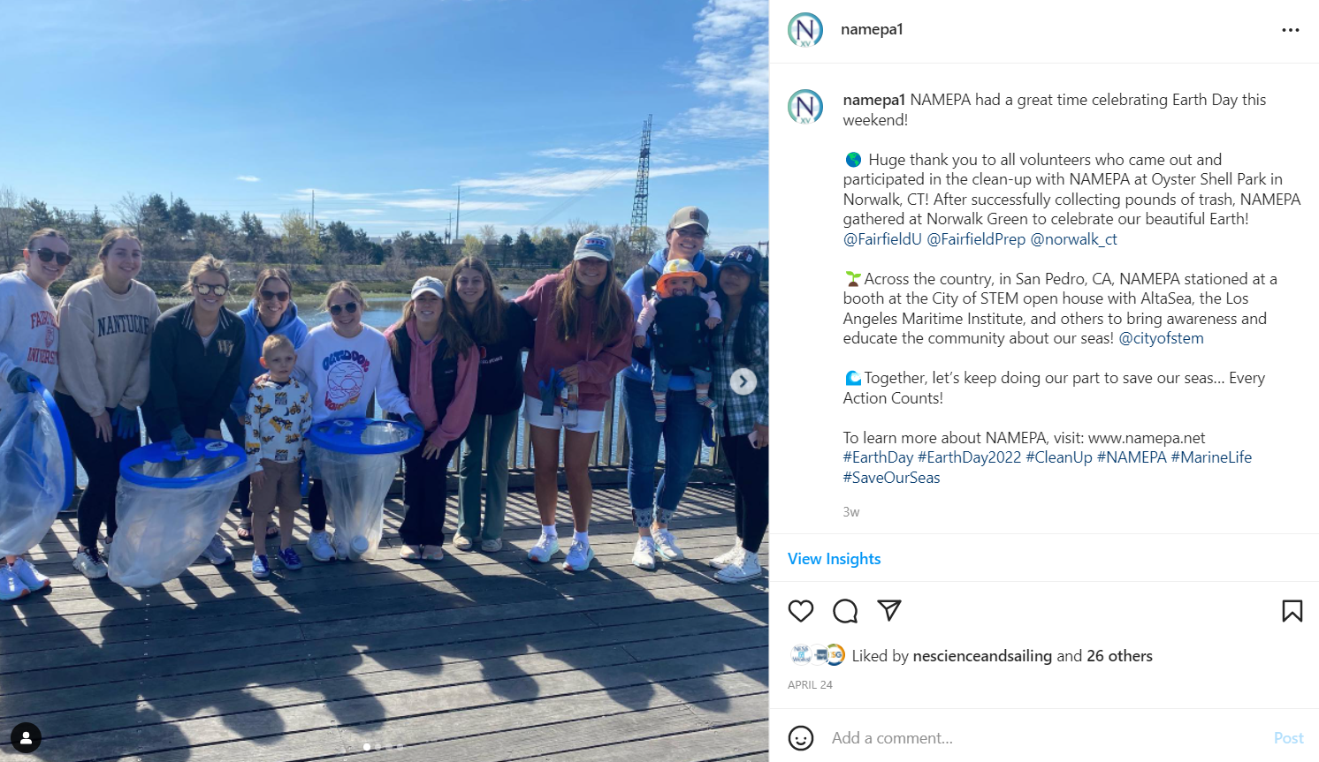
ONSHORE
  Land-based careers
  Support the maritime industry without directly being on vessels or offshore.
  May work in offices, research facilities, education institutions, law firms, and more!

Slide 12
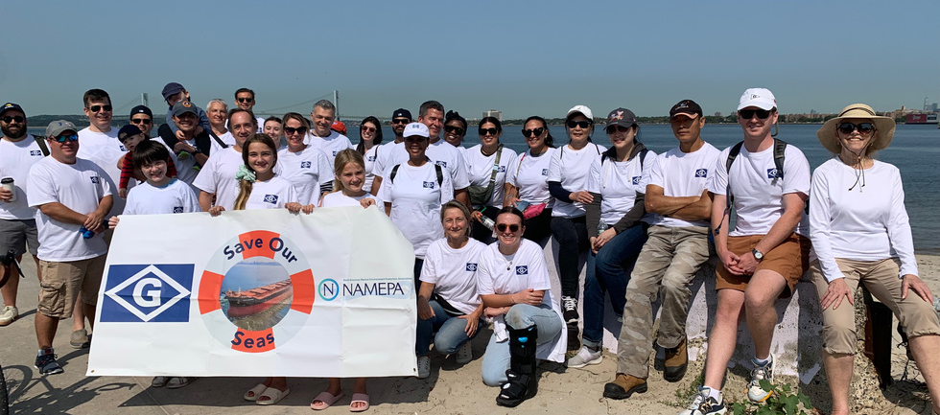
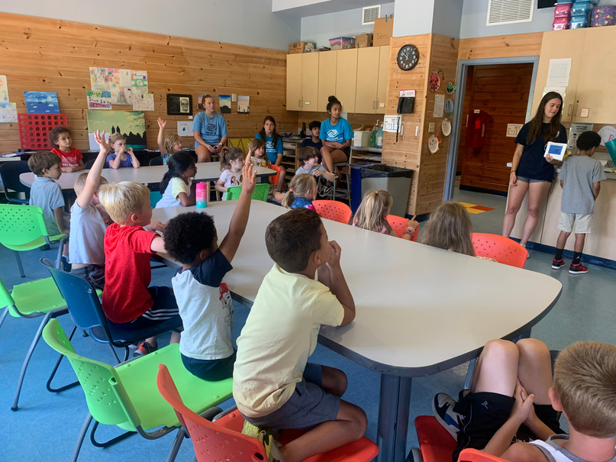
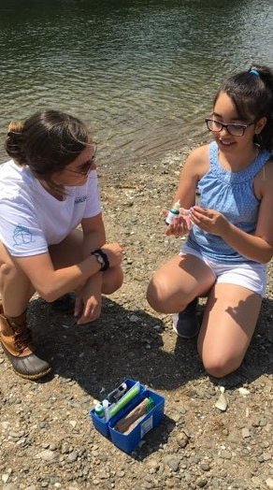
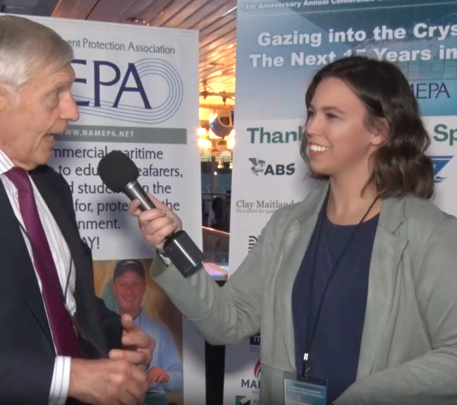
Onshore:
Educator
Description: Teaches people of all ages about a subject or variety of subjects. Educators often put on programs or share information relative to the message of the organization.
Salary Range: $40,000 - $60,000
Education & Training Level: High School Diploma or equivalent
Note: Educators can work with museums, zoos, aquariums, nonprofits, conservation, or other organizations.
Source: RiverWorks Discovery

Slide 13
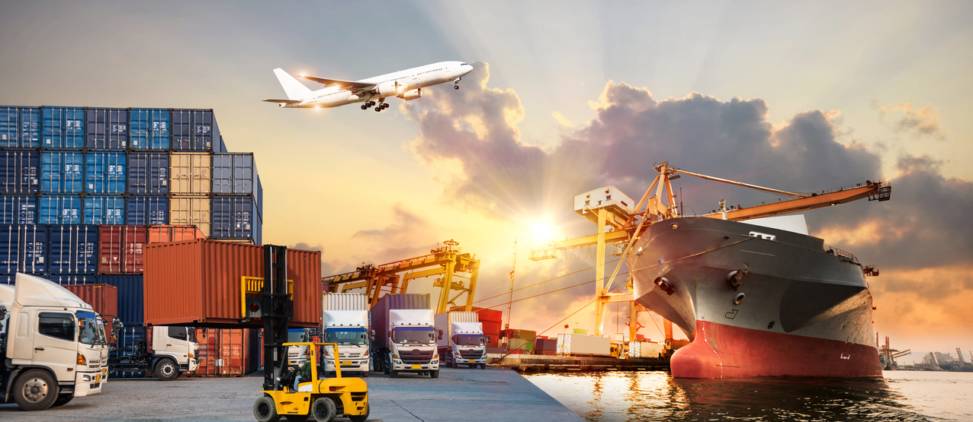


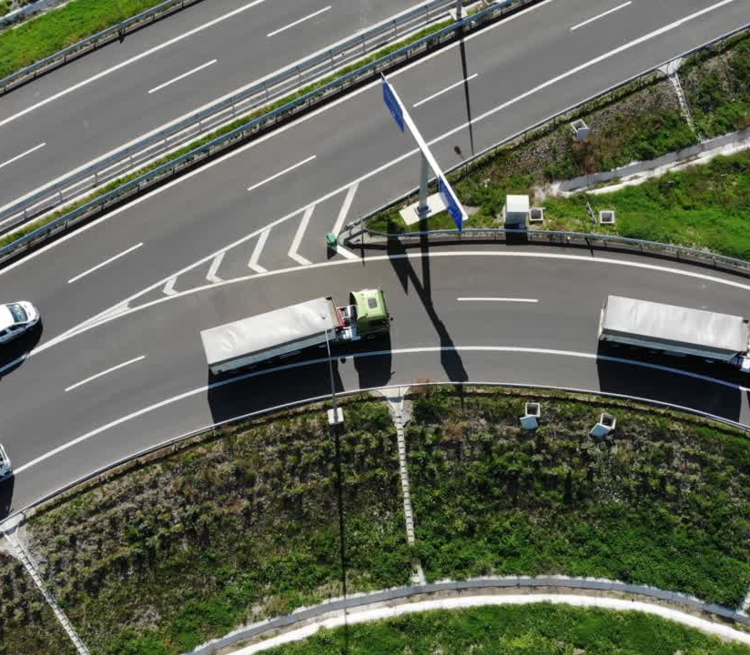
Onshore:
Freight Broker
Description: Facilitates the transportation of goods between shippers and carriers (truck drivers and transportation companies).
Salary Range: $40,000 - $100,000
Education & Training Level: High School Diploma or equivalent, Transportation Broker Certification
(pass exam)
Note: Relies heavily on practical skills, industry knowledge, and building of contacts.
Source: Transporation Intermediaries Association

Slide 14

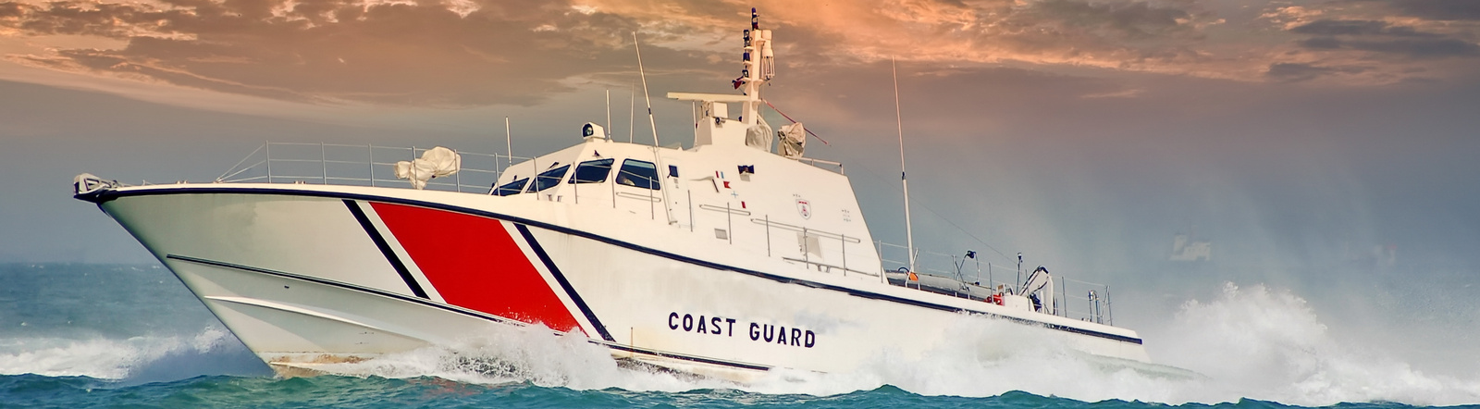
HOW DO I BEGIN?
  Certifications:
    Take licensing courses at seamanship institutions
  Education:
    Maritime Academies: Massachusettes, Maine, New York, Texas, California, Great Lakes, USMMA
  Service:
    Enlist in the United States Coast Guard or Navy
Maritime Majors
    Maritime Business
    Marine Engineering
    Maritime Law
    Naval Architecture
    USCG License Training
    Maritime Safety
    Environmental Compliance
    Maritime Transportation & Logistics

Slide 15
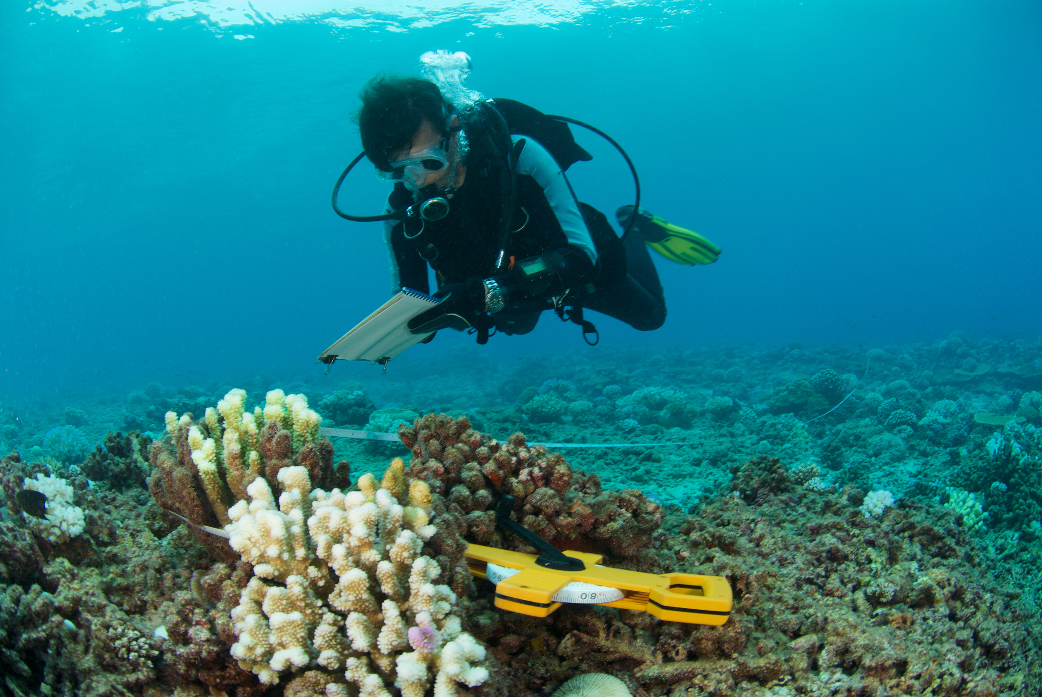
WHY MARINE SCIENCE
A career in marine science offers global exploration, with opportunities to study diverse marine ecosystems and make exciting discoveries. It offers unique chances to experience different cultures, contributes to global scientific efforts, and broadens your horizon, all while contributing to environmental stewardship.
EXPLORATION
RESEARCH
STEWARDSHIP
DISCOVERY
FIELDWORK
SUSTAINABILITY
INNOVATION
TECHNOLOGY
DIVERSITY

Slide 16
TYPES OF CAREERS
RESEARCH
ACADEMIA
EDUCATION
  Conduct investigations, collect & analyze data, and study aspects of the marine environment to understand marine ecosystems, biodiversity& the impacts of human activities.
  Teach, conduct research, publish journals and papers, communicate research, and mentor students to advance knowledge of the marine environment.
  Educate students of all ages about marine ecosystems, conservation, and sustainability through classroom instruction, field trips, workshops, outreach programs, & engaging resources.

Slide 17
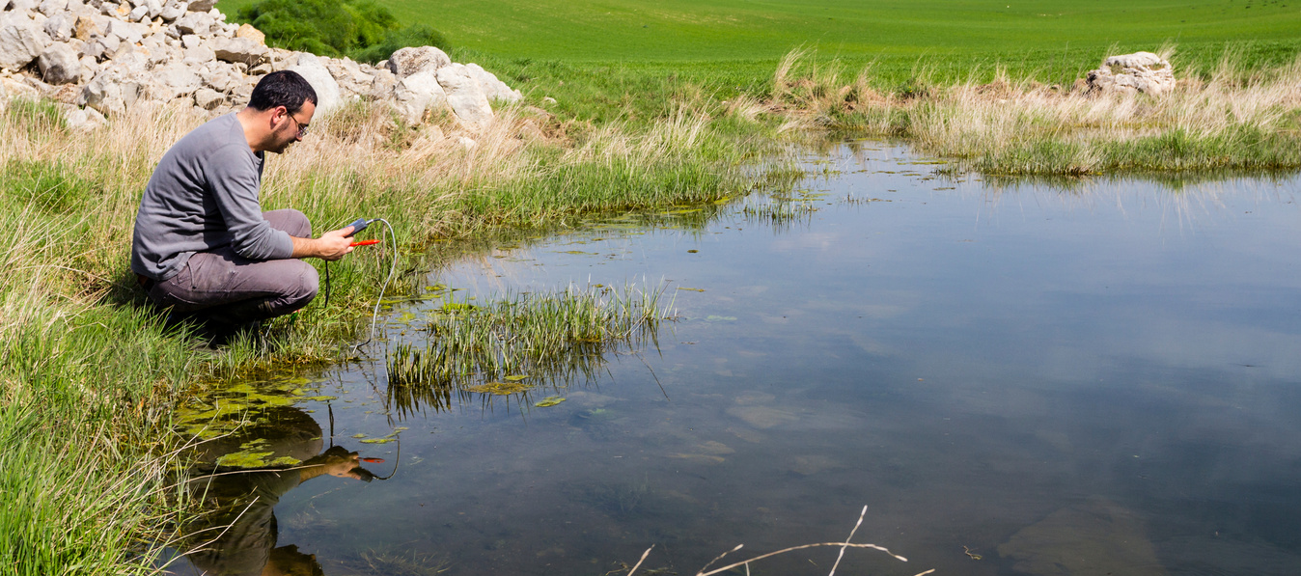


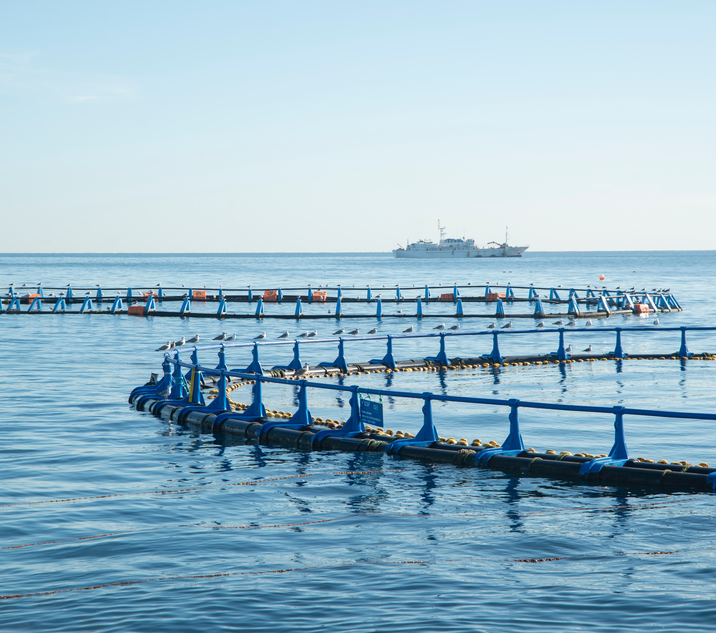
Research: Fisheries / Wildlife Scientist
Description: Study & manage fishery resources to ensure sustainability and productivity. This can include research on fish populations, habitats, ecosystems, and developing strategies for effective management.
Salary Range: $50,000 - $90,000
Education & Training Level: Minimum of Bachelor's Degree often required
Note: Coursework includes zoology, comparative anatomy & physiology, ecology, oceanography and others.
Source: U.S. Fish & Wildlife Service

Slide 18
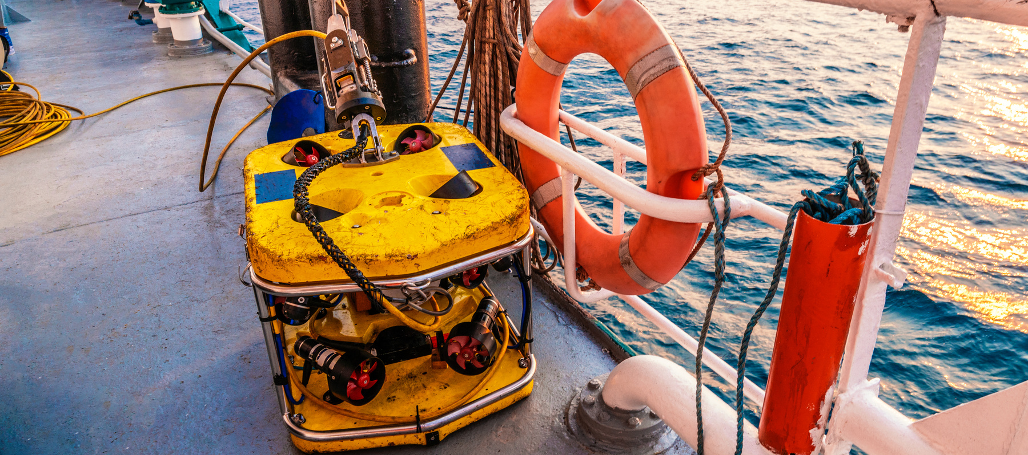
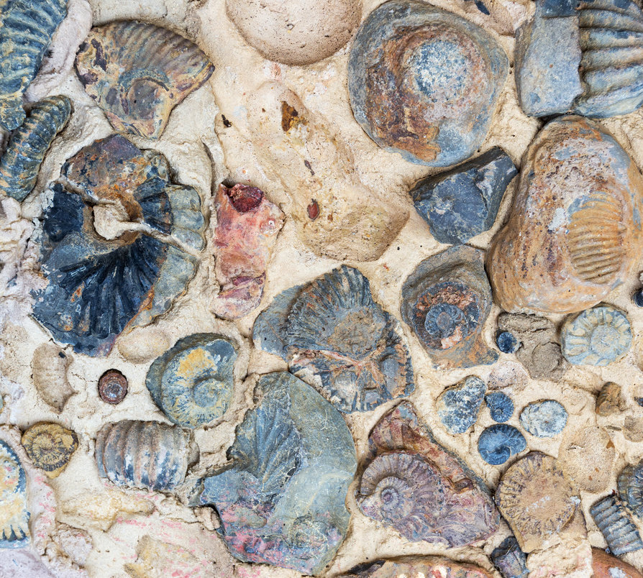
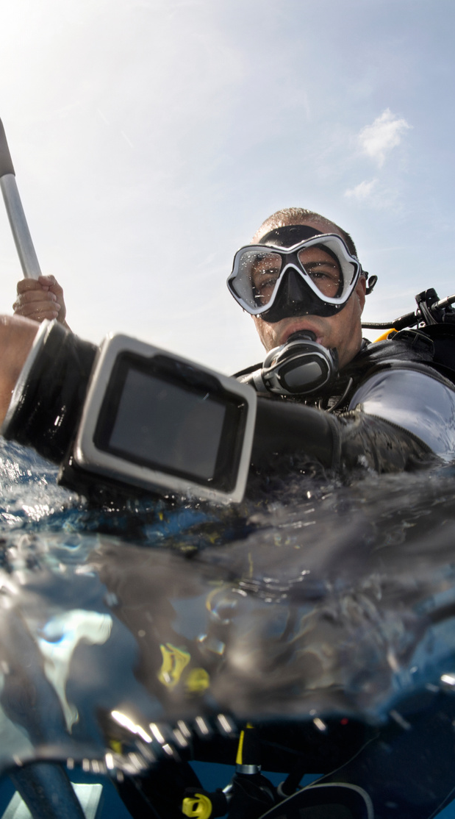

Academia: Research Scientist / Professor
Description: Conduct scientific research in areas such as marine ecology, marine biology, oceanography, or marine geology. Design and carry out experiments, collect & analyze data. publish findings and seek funding for projects while also delivering lectures and mentoring students.
Salary Range: $50,000 - $120,000
Education & Training Level: Minimum of a Master's Degree, likely a Ph.D. is required.
Source: National Oceanic & Atmospheric Administration

Slide 19
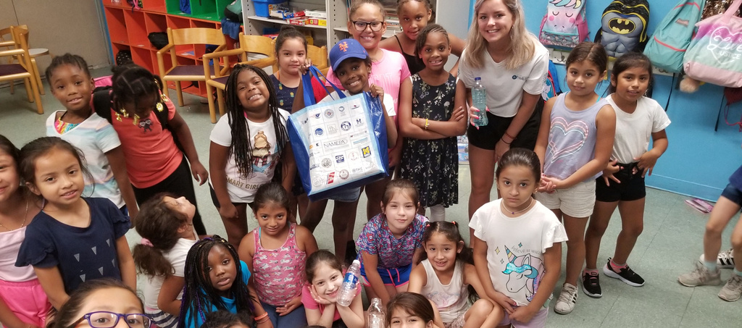
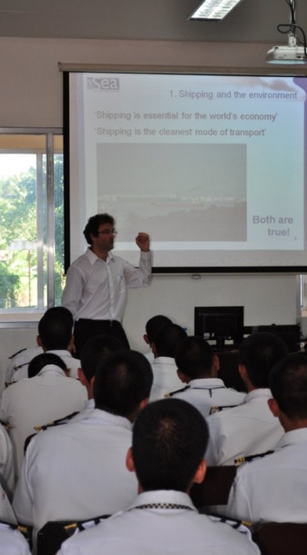
Education:
Outreach
Description: Raise awareness about marine conservation through education and inspire the public about marine ecosystems through educational programs and activities.
Salary Range: $30,000 - $70,000
Education & Training Level: High School Diploma with practical experience gained in internships, volunteer work, or fieldwork.
Note: Salary ranges often vary depending on funding availability
Source: North American Marine Environment Protection Association

Slide 20
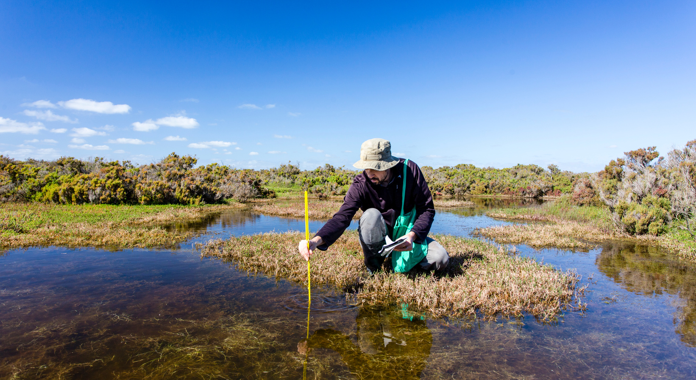
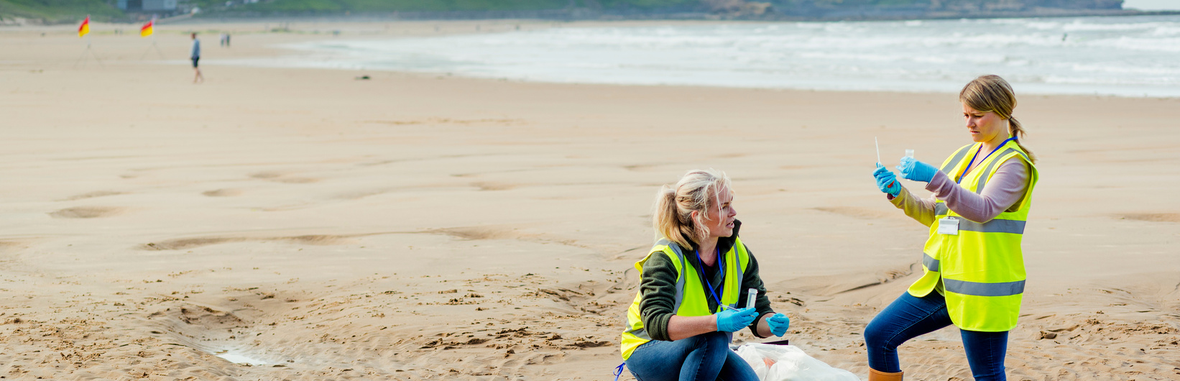
HOW DO I BEGIN?
  Volunteer:
    Opportunities with aquariums, conservation organizations, or local groups for hands-on experience.
  Fieldwork:
    Seek out fieldwork to gain experience alongside professionals.
  Education:
    Pursue a degree program that aligns to your interest or goals.
Marine Science Majors
    Marine Biology
    Oceanography
    Marine Geology
    Marine Chemistry
    Marine Ecology
    Fisheries Ecology
    Marine Conservation
    Marine Policy

Slide 21
Questions?
ADVOCATE | EDUCATE | ACTIVATE
Carleen Lyden Walker
Co-Founder & Executive Director
ceo@namepa.net
Lyn Harris
Chief Operating Officer
l.harris@namepa.net
OUR MISSION
Preserving the marine environment by promoting sustainable maritime industry practices and educating the public to Save Our Seas
Molly Dushay
Education & Outreach Director
m.dushay@namepa.net

