Slide 1
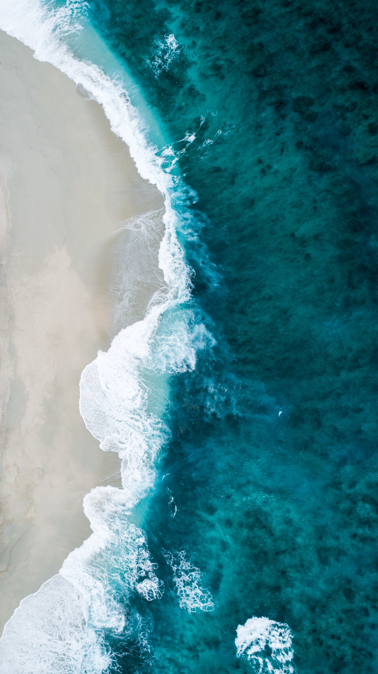
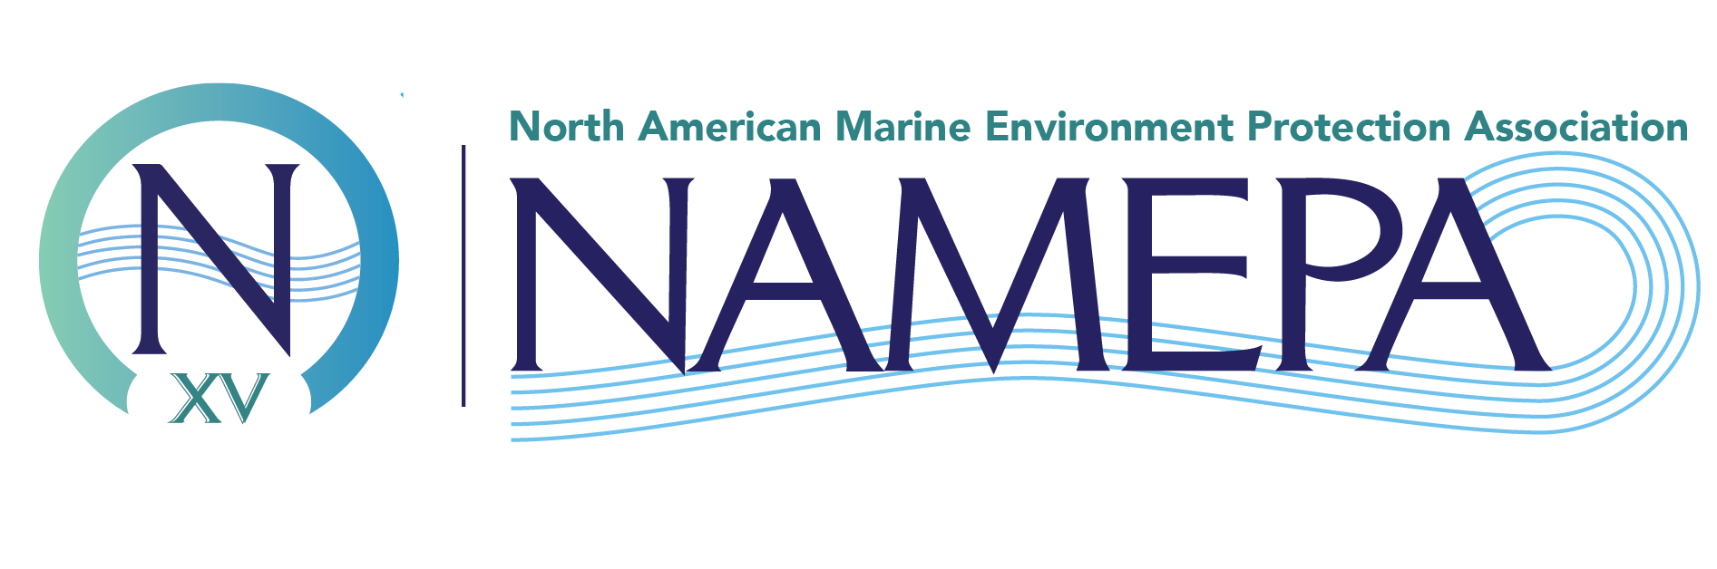
Planet & Ocean Discovery Series
Marine Debris
Marine Environment
Responsibility
Advocate
Leadership
Collaboration
Development
Educate
Activate
Change
K-12
Sustainability
Awareness
Maritime Industry
Environment
Commitment
Advocate
Advocate
Marine Debris
Our Mission
Action
#SAVEOURSEAS
Educate
Community
Preserving the marine environment by promoting sustainable maritime industry best practices and educating the public to Save Our Seas
Support
Leadership
Values
Collaboration
Conservation
Sustainable
Protection
K-12
Maritime

Slide 2

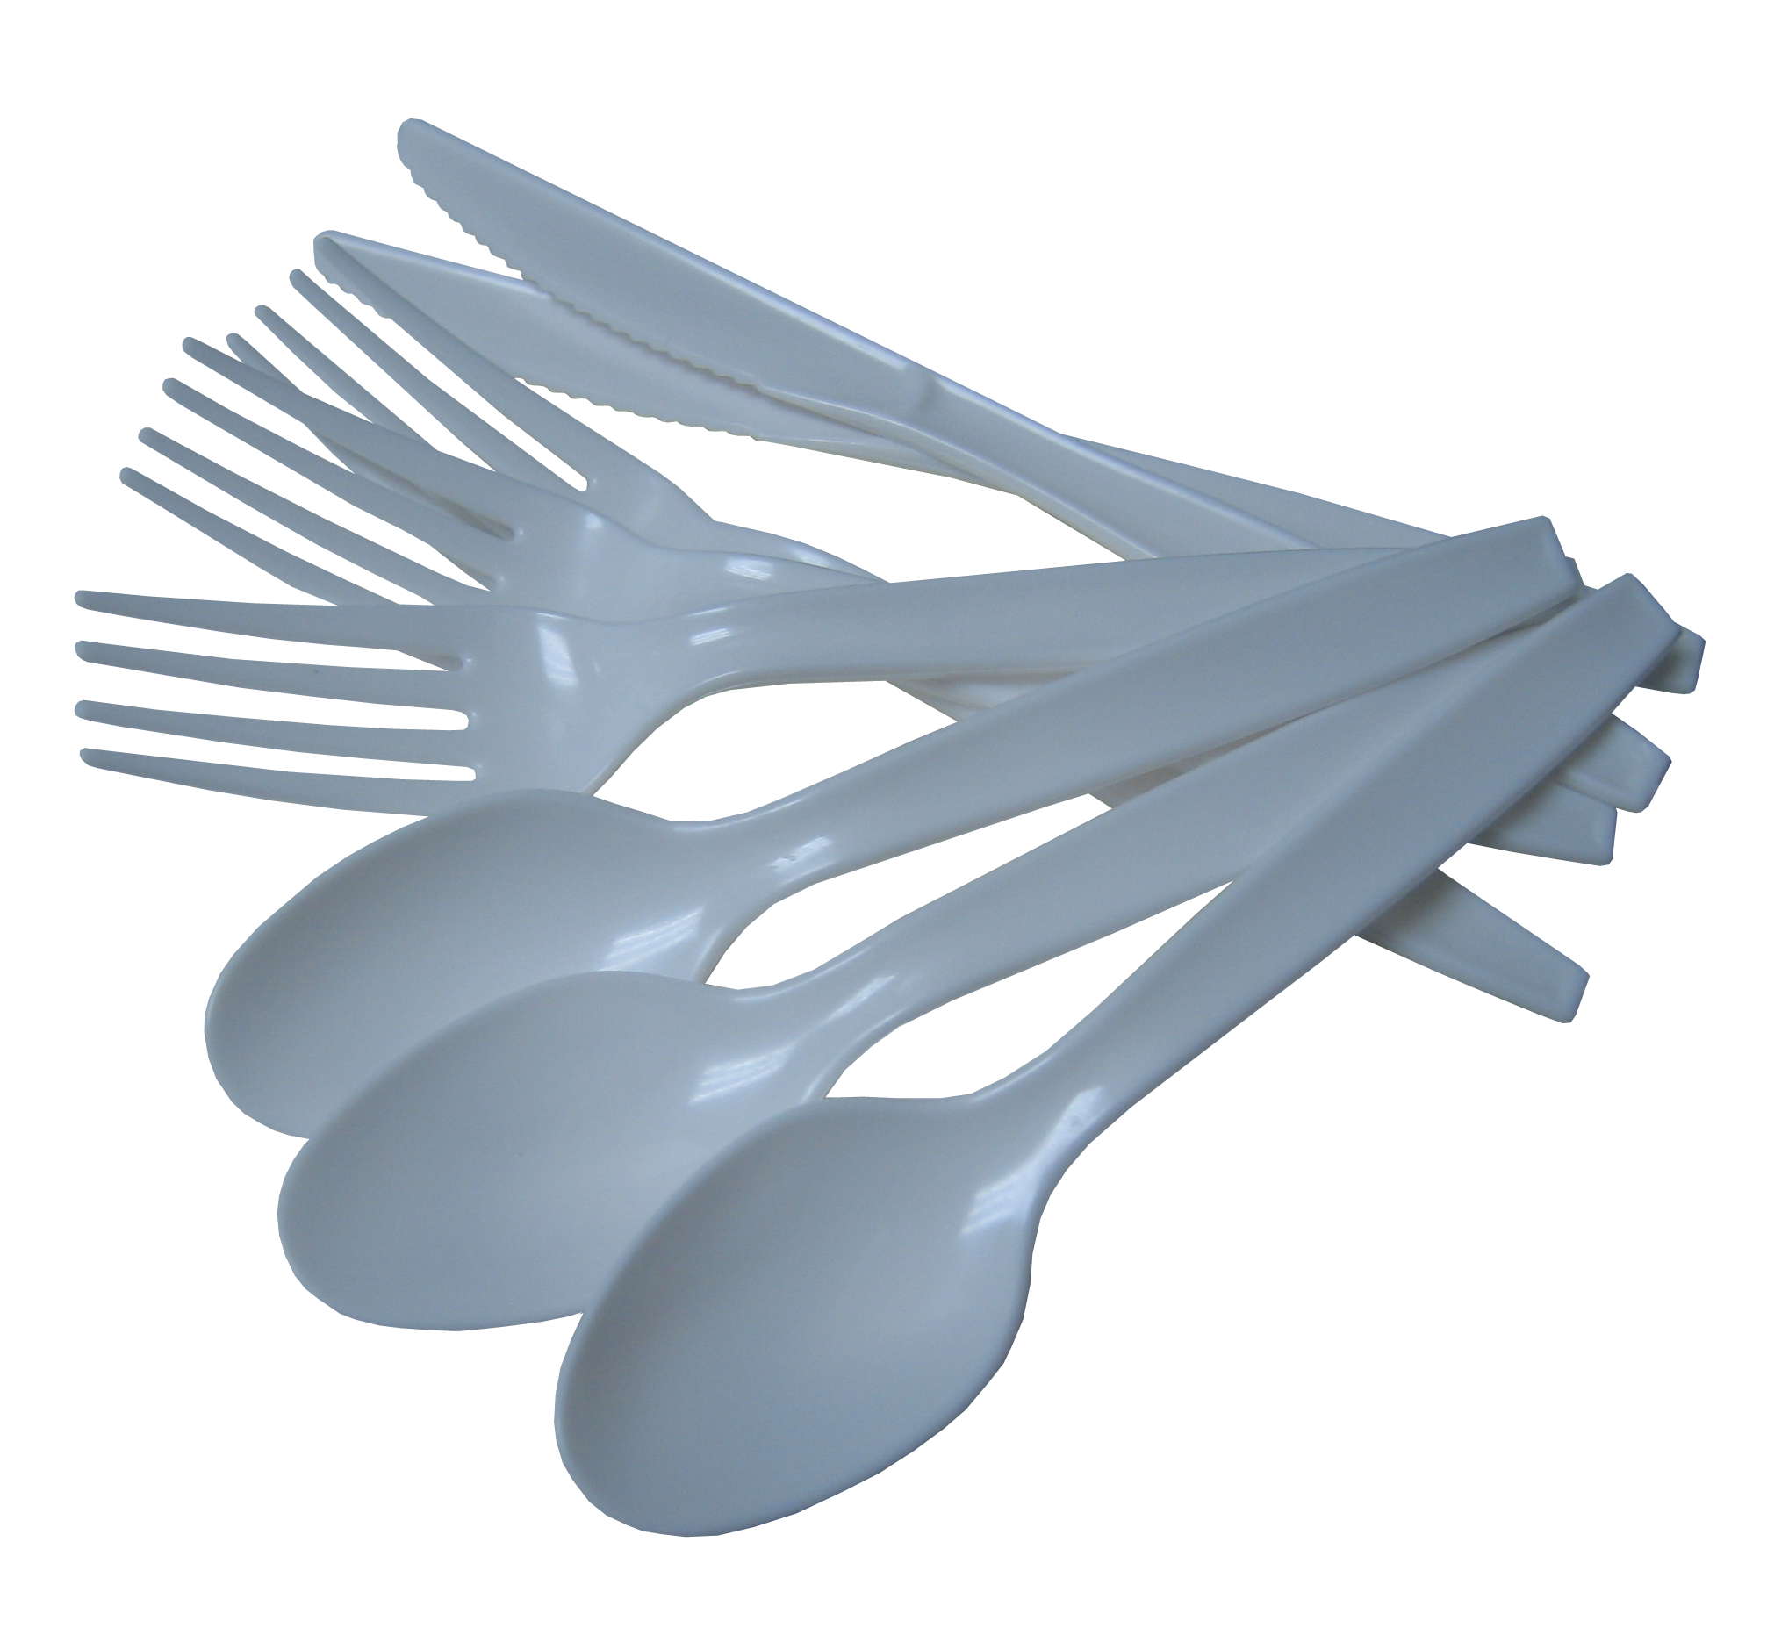

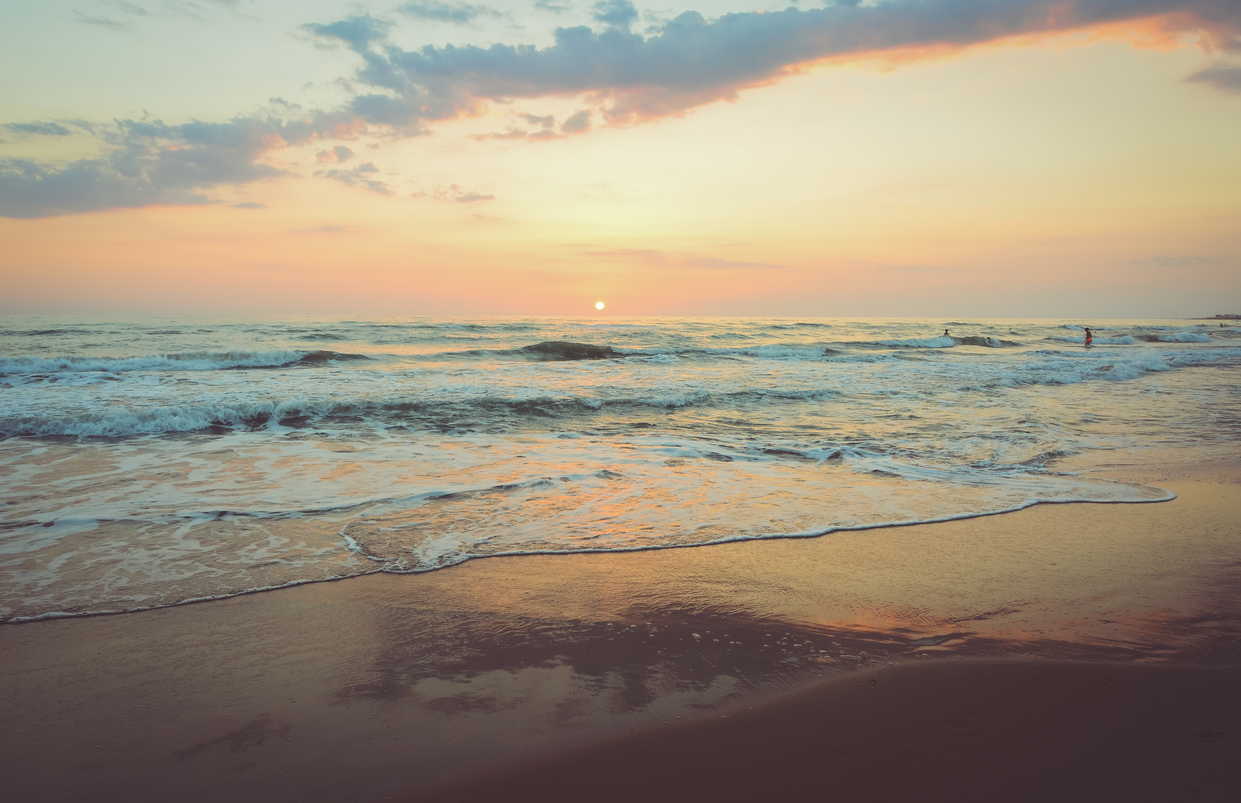
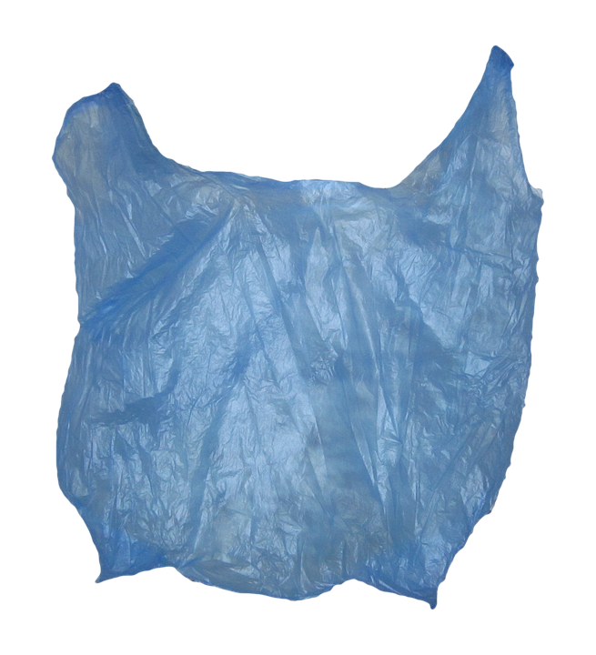

Agenda
Let’s Talk Trash
Think about a time you visited a beach, the water, a river, or a stream.
Do you remember seeing anything that did not belong there?
Introduction
Let’s Explore!
Marine Debris
Solutions
Review

Slide 3
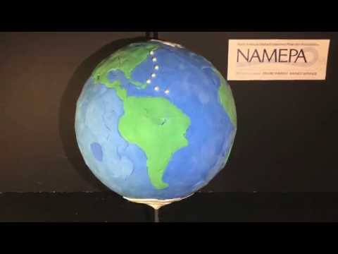
Agenda
The Wayward Life of a Plastic Bag
Introduction
Let’s Explore!
Marine Debris
Solutions
Review

Slide 4
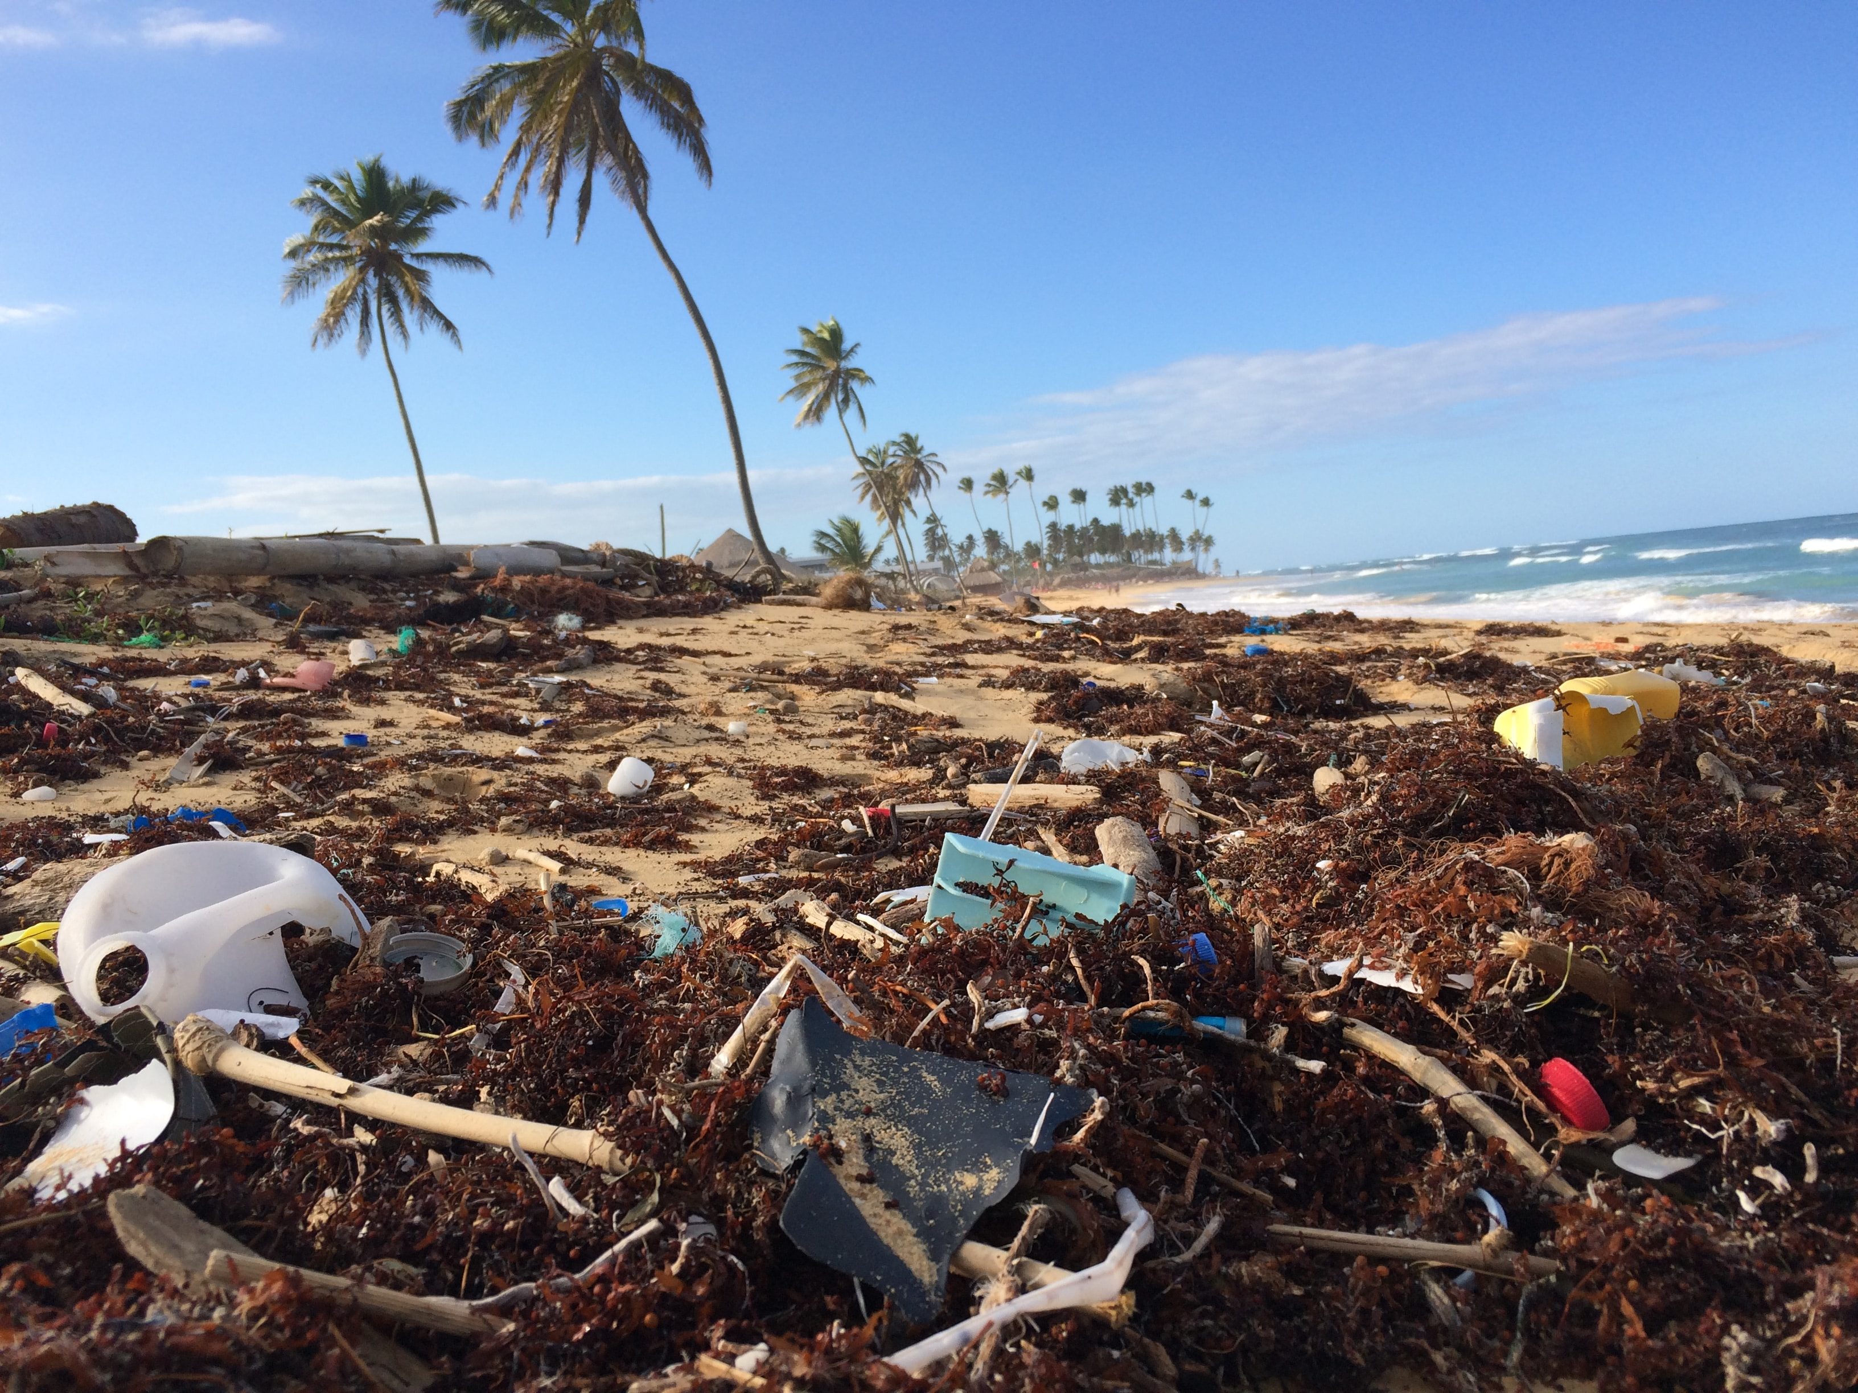
Agenda
Where Can You Find Trash?
Introduction
Let’s Explore!
Marine Debris
Solutions
Review
Marinas
Beaches
Inlets
Underwater
Above water
Currents
Rivers
Gyres
EVERYWHERE

Slide 5
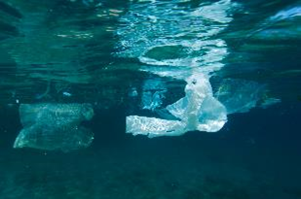
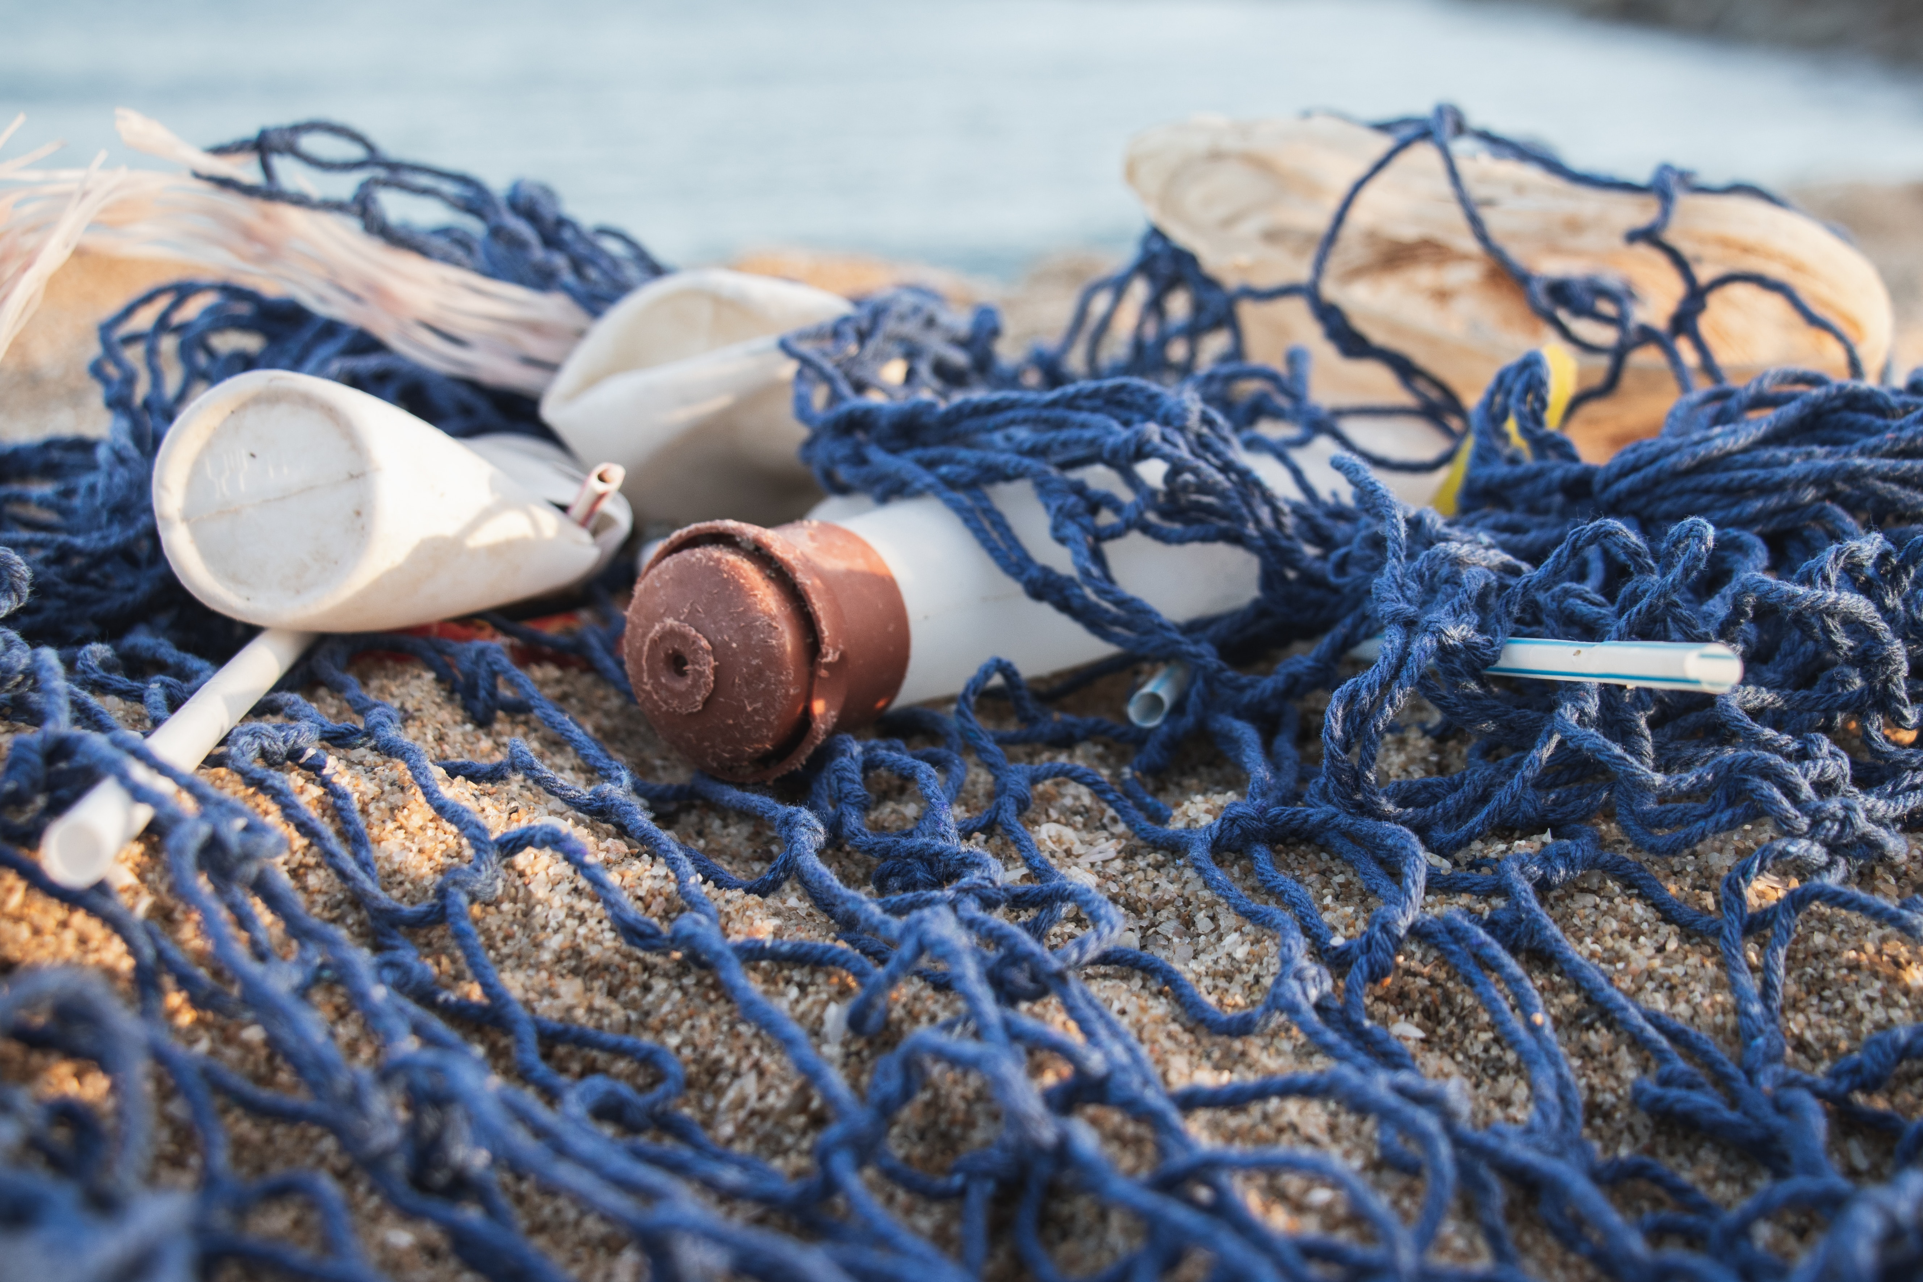
Agenda
Why Do We Find Debris Everywhere?
Buoyancy is the ability to float in water
The more buoyant an object is, the farther it can travel in water!
What items are buoyant?
Introduction
Let’s Explore!
Marine Debris
Solutions
Review

Slide 6
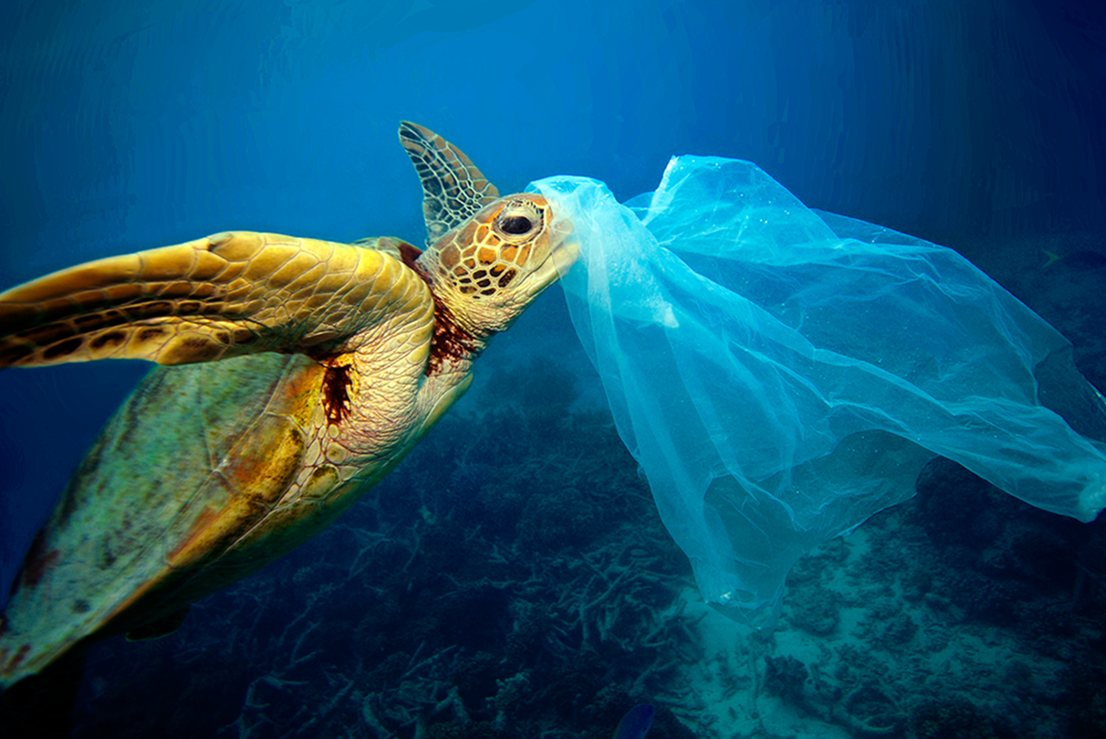
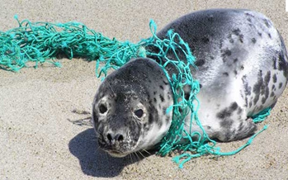
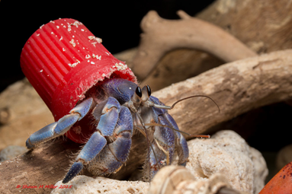
Agenda
What is Marine Debris?
Anything man-made that ends up in the marine environment
Introduction
Let’s Explore!
Marine Debris
Solutions
Review
80% of marine debris comes from land-based sources
Transported by runoff, wind, or dumping

Slide 7
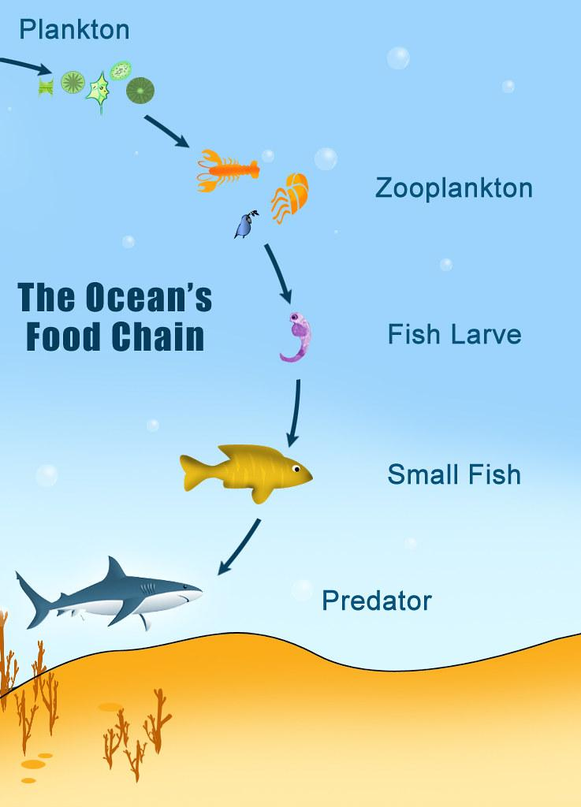
Agenda
How is Marine Wildlife Impacted?
Mistaking debris for food causes malnutrition and starvation
Trapped in fishing line or beverage containers
Toxic materials can build up in species - bioaccumulation
Debris has been found in the stomachs of plankton
  What impact could this have?
Introduction
Let’s Explore!
Marine Debris
Solutions
Review

Slide 8
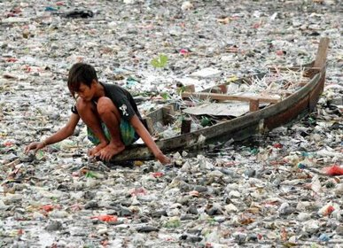
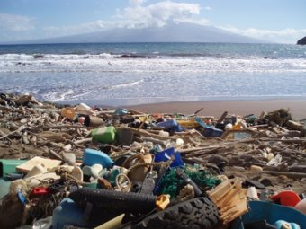
Agenda
Are Humans Impacted?
Seafood economy is damaged
Tourism decreases
Navigation hazards
Introduction
Let’s Explore!
Marine Debris
Solutions
Review

Slide 9
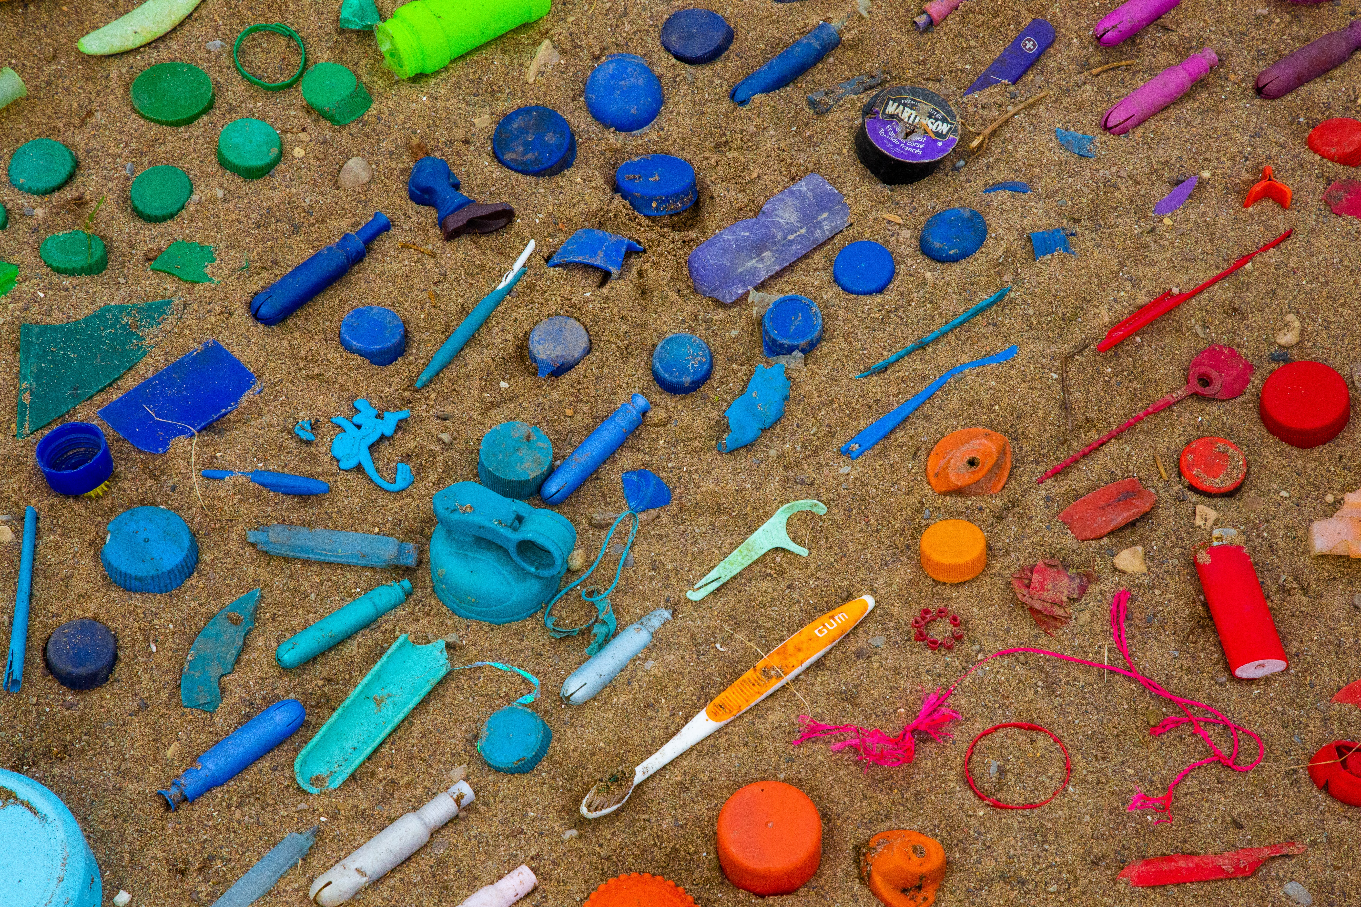
Agenda
Top 10 Items Collected
What do you think the top 10 items collected are?
Introduction
Let’s Explore!
Marine Debris
Solutions
Review
Cigarette butts
Food wrapping
Plastic beverage bottles
Plastic bottle caps
Straws and stirrers
Plastic bags
Plastic grocery bags
Glass beverage bottles
Other beverage cans
Plastic cups and plates

Slide 10

Good News: The Global Effort
Agenda
Banned Styrofoam: European Union, Maine, Costa Rica
Banned Single-Use Plastic Bags: California, Connecticut, Oregon, European Union, Columbia, and many more!
Banned Plastic Straws: Miami, Malibu, Seattle, Scotland, Taiwan
Introduction
Let’s Explore!
Marine Debris
Solutions
Review

Slide 11
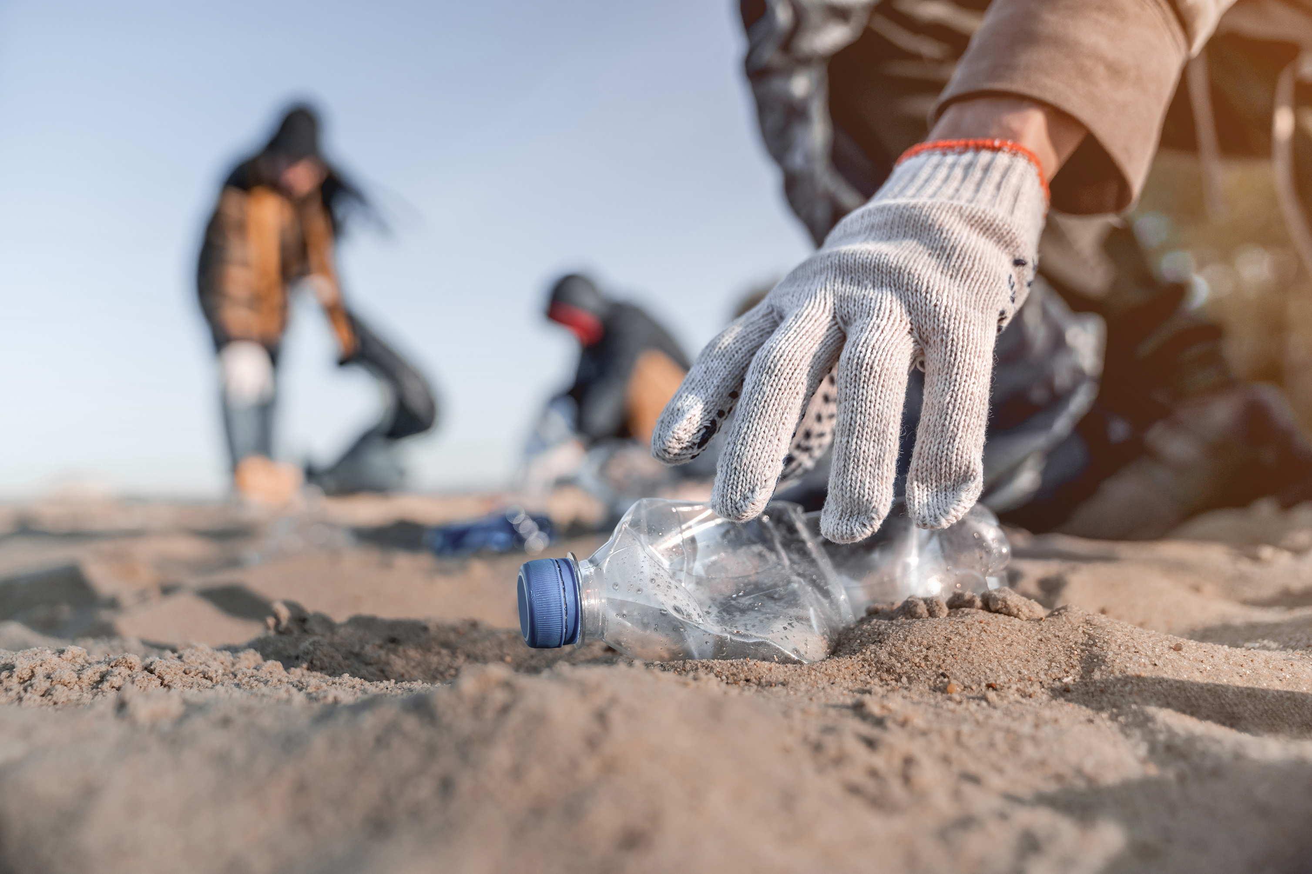
What Can You Do to Help?

Slide 12

What Can You Do to Help?
Agenda
Advocate!
  Speak up about the importance of the ocean to your local officials and other leaders
Educate!
  Share with your friends and family ways to protect the marine environment
Activate!
  Conduct a beach or waterway clean up
  Volunteer with a local organization
Introduction
Let’s Explore!
Marine Debris
Solutions
Review

Slide 13
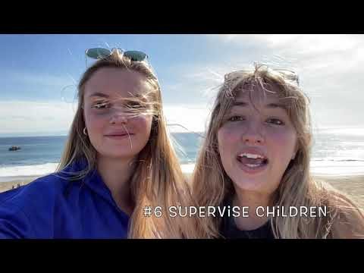
Beach Clean Up Tips!
Agenda
Introduction
Let’s Explore!
Marine Debris
Solutions
Review

Slide 14
Beach Clean Up Tips!
Agenda
Refuse what you do not need
Reduce what you do need
Reuse what you consume
Repurpose what you can not refuse, reduce or reuse
Recycle what you can not refuse, reduce, reuse, or repurpose
Introduction
Let’s Explore!
Marine Debris
Solutions
Review
Notes:
Refuse single use plastics like plastic bags, cups, bottles and containers
Reduce using non-recyclable products. This prevents them from entering landfills which ultimately lead to the water
Reuse products like a reusable water bottle, utensils, and bags
Repurpose items by finding a new way to use them! “Upcycling”
Recycle items properly and dispose of them in their proper places!

Slide 15
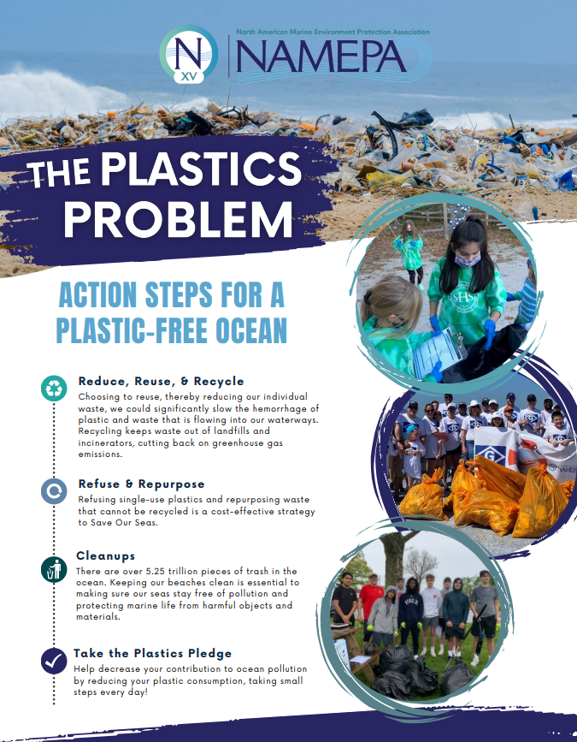
Summary
Agenda
How can you help protect the marine environment?!
The 5 R’s
Conduct your own beach clean up
Make small choices like using reusable water bottles, or reusable bags
Introduction
Let’s Explore!
Marine Debris
Solutions
Review
Notes:
SAY: Today we discussed the many ways we can help protect the marine environment. From reducing our consumption, to conducting our own clean ups! If we all work together to make these changes, we can protect the marine environment. Each of us as the feeling like we can save the world, don’t forget that you can!

Slide 16





Planet & Ocean Discovery Series
Marine Debris
ADVOCATE | EDUCATE | ACTIVATE
Carleen Lyden Walker
Chief Executive Officer
ceo@namepa.net
Lyn Harris
Chief Operating Officer
l.harris@namepa.net
Our Mission
Molly Dushay
Education & Outreach Director
m.dushay@namepa.net
Preserving the marine environment by promoting sustainable maritime industry best practices and educating the public to Save Our Seas
Meghan Reilly
Education & Outreach Associate
m.reilly@namepa.net
www.namepa.net

