Slide 1

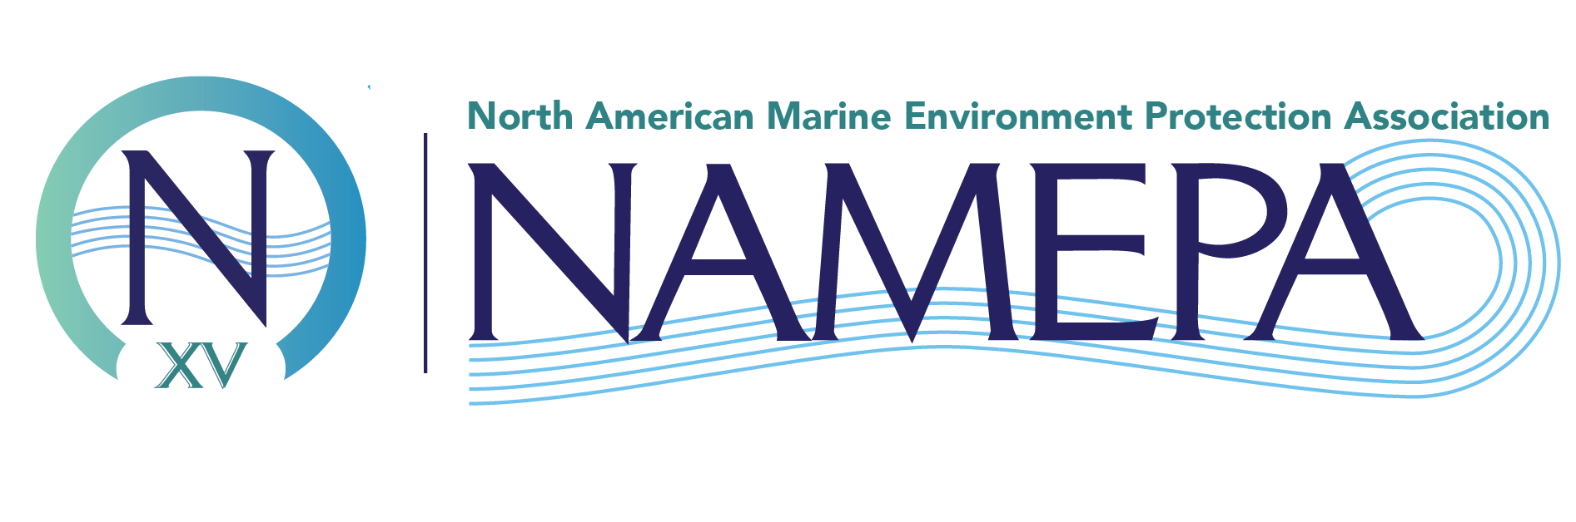
Chemistry of Plastic Plastic degradation and what this means for our oceans
Marine Environment
Responsibility
Advocate
Leadership
Collaboration
Development
Educate
Activate
Change
K-12
Sustainability
Awareness
Environment
Maritime Industry
Commitment
Advocate
Advocate
Marine Debris
Our Mission
Action
#SAVEOURSEAS
Educate
Community
Preserving the marine environment by promoting sustainable maritime industry best practices and educating the public to Save Our Seas
Support
Leadership
Collaboration
Values
Conservation
Sustainable
Protection
K-12
Maritime

Slide 2
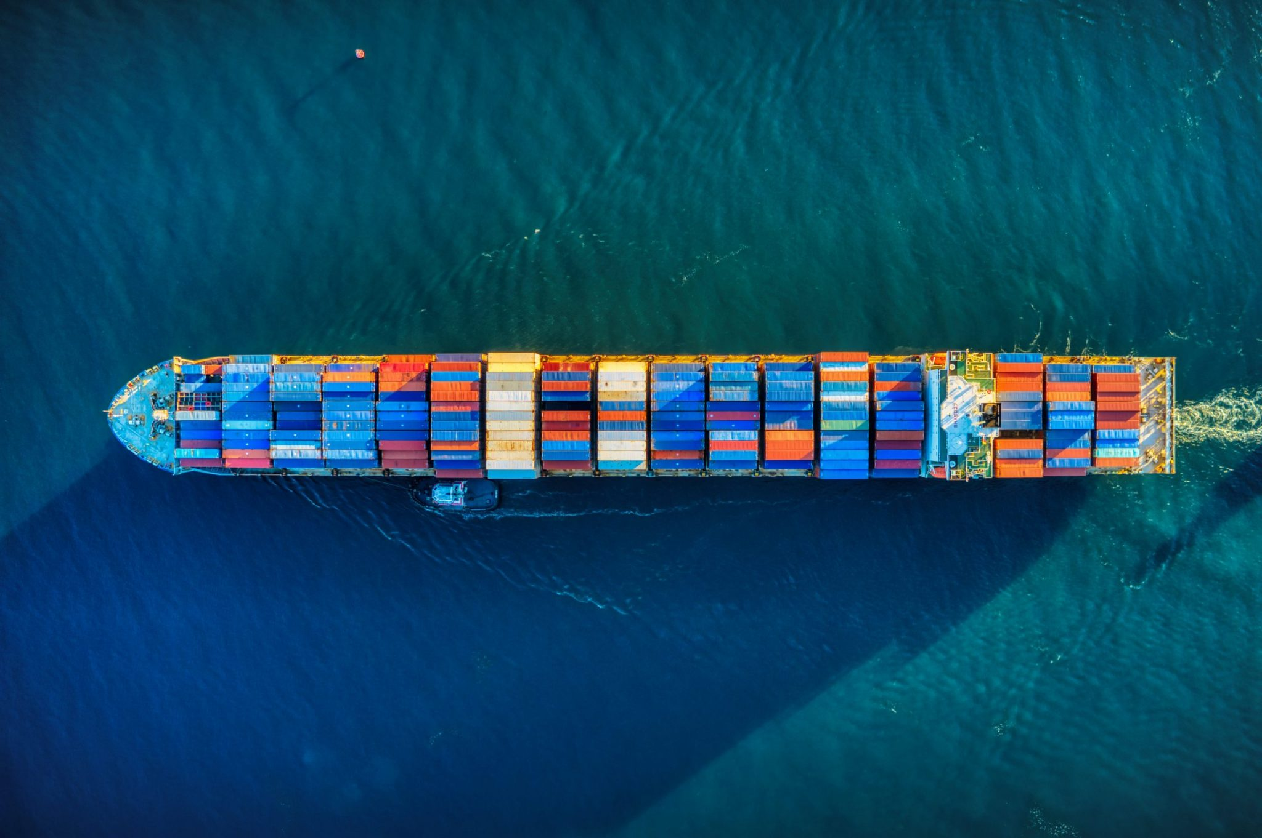

Supporting the Maritime Industry
NAMEPA brings together industry, government, regulatory, conservation and educational organizations to provide access, collaboration and participation in preserving the marine environment.

Slide 3
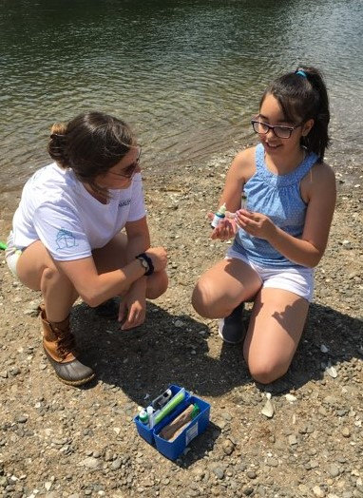
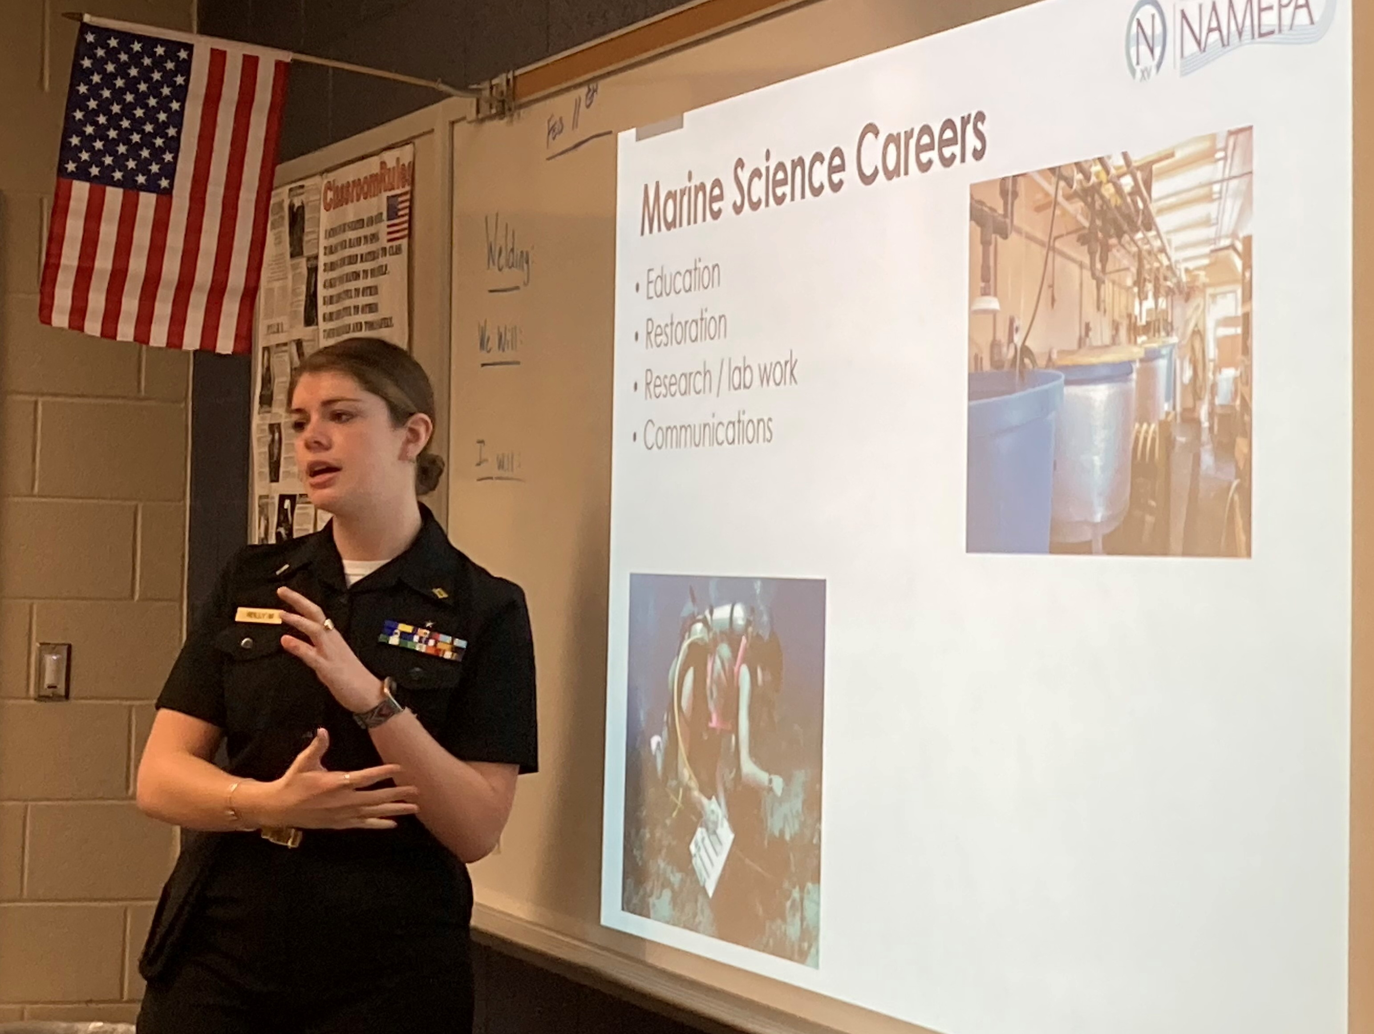
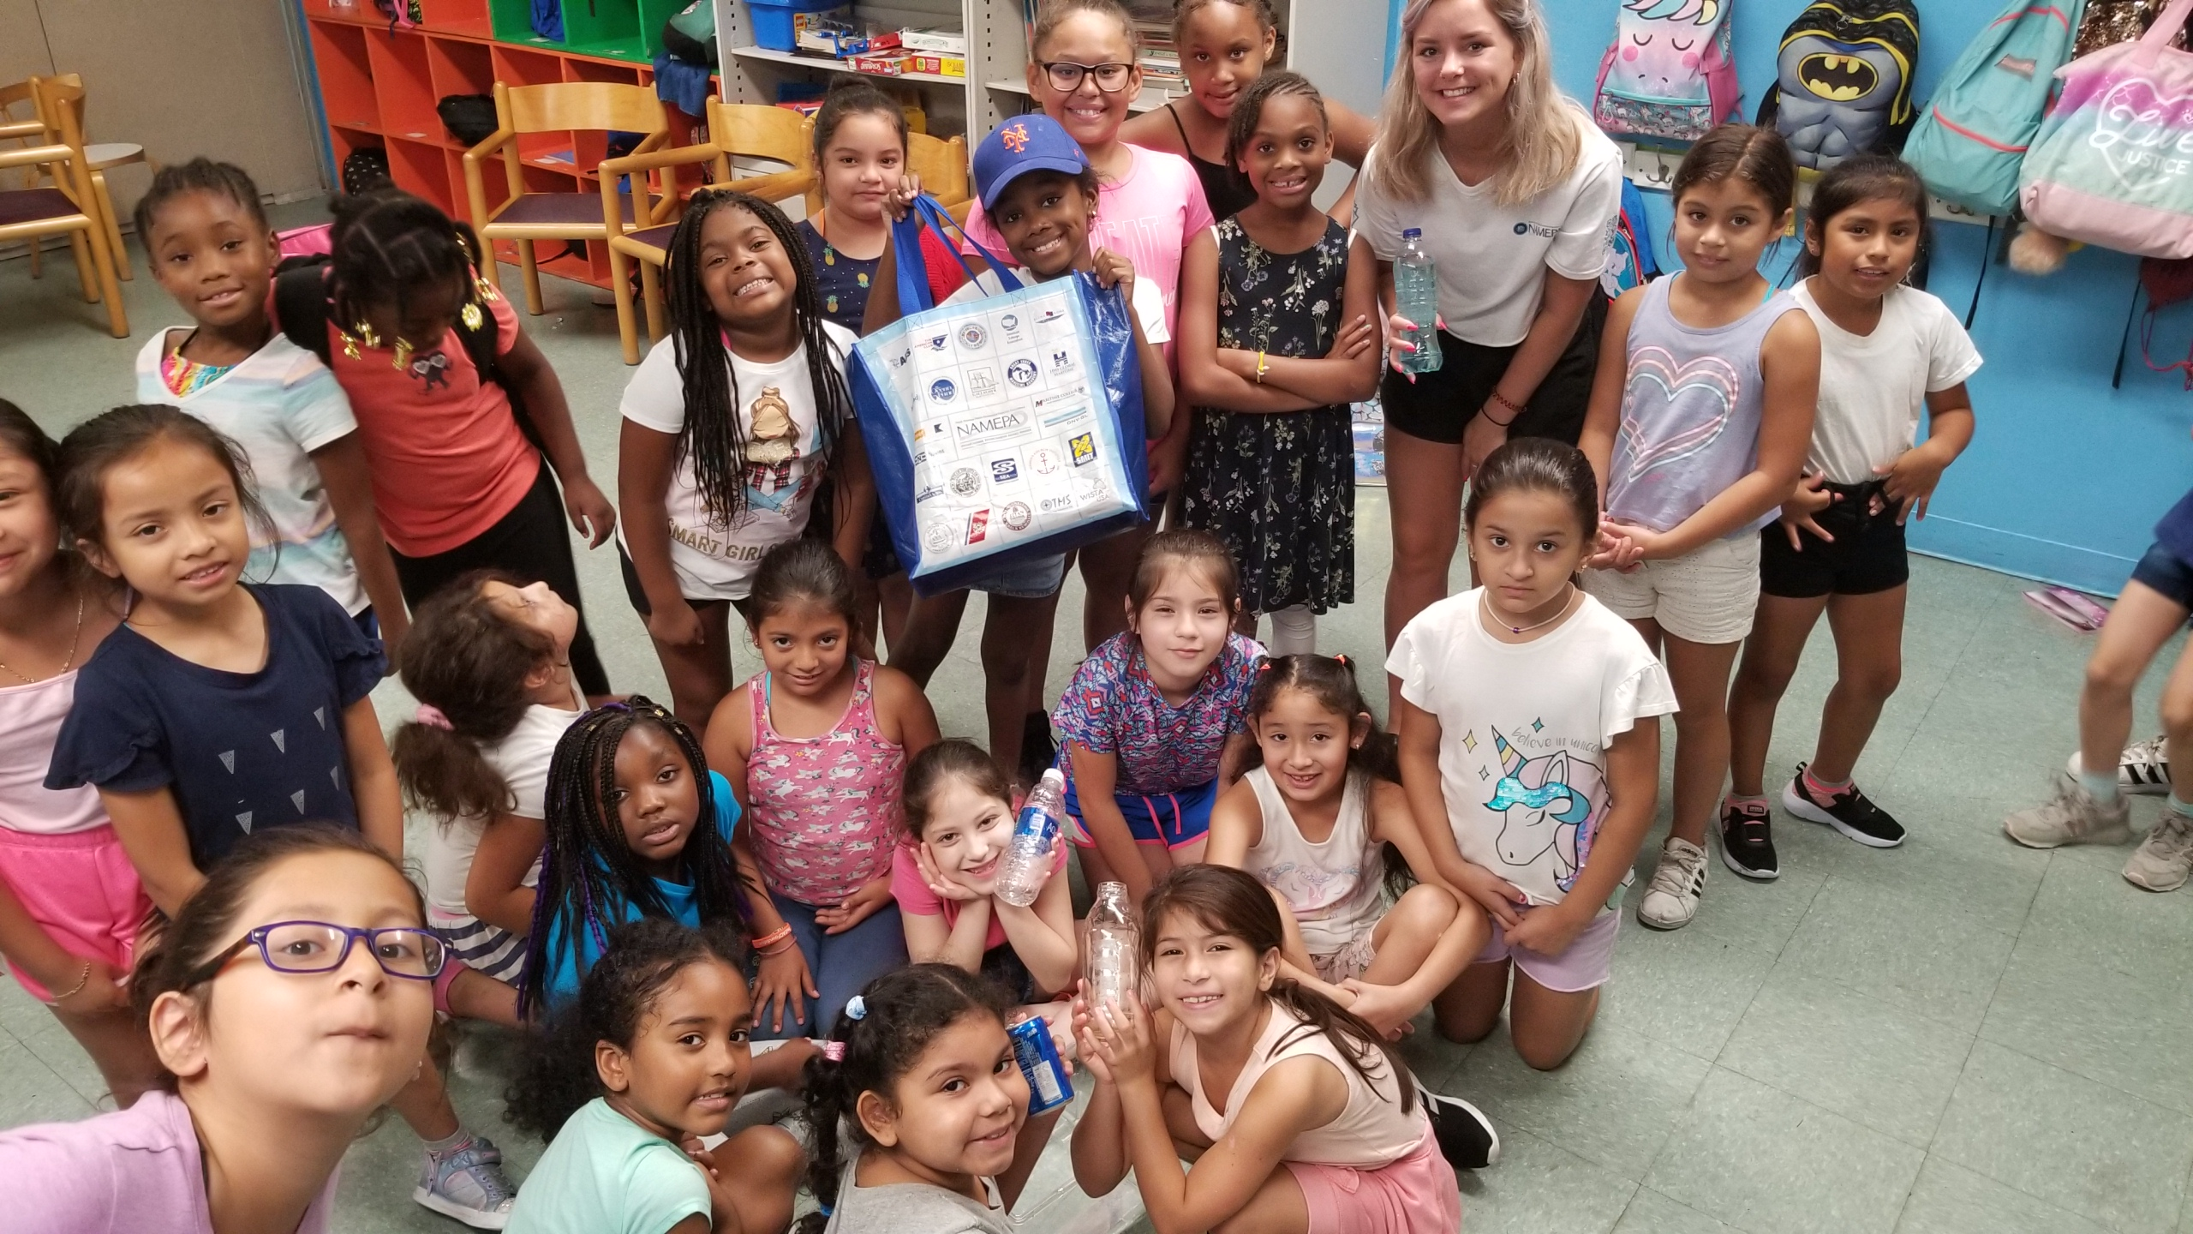
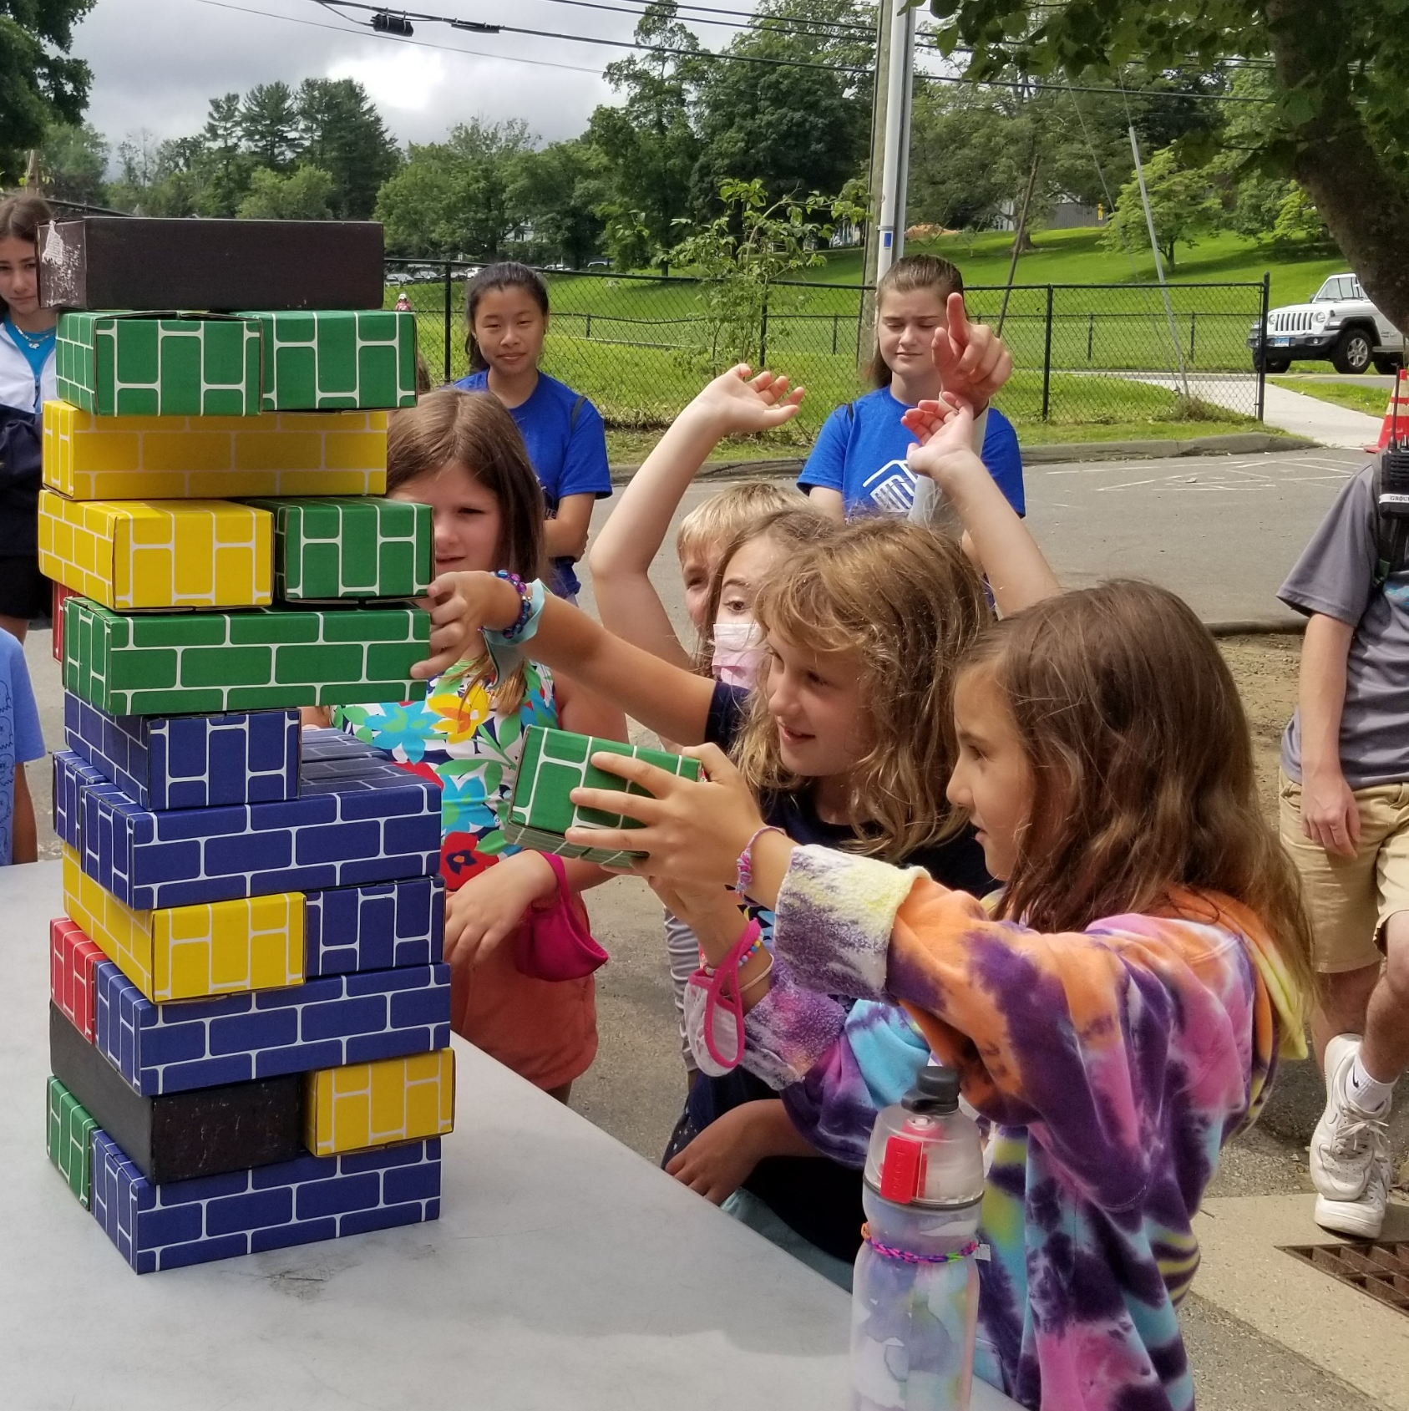
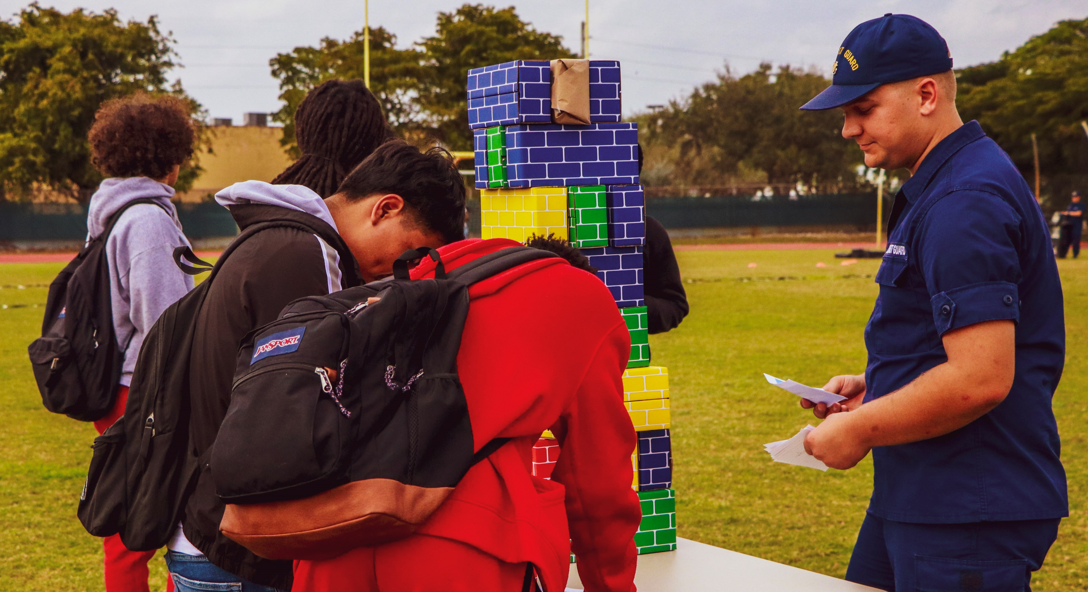
Educating the Public
Through educational materials, virtual lessons, and opportunities for leadership, NAMEPA's mission is to teach the public on the importance of the maritime industry & protecting the marine environment.

Slide 4
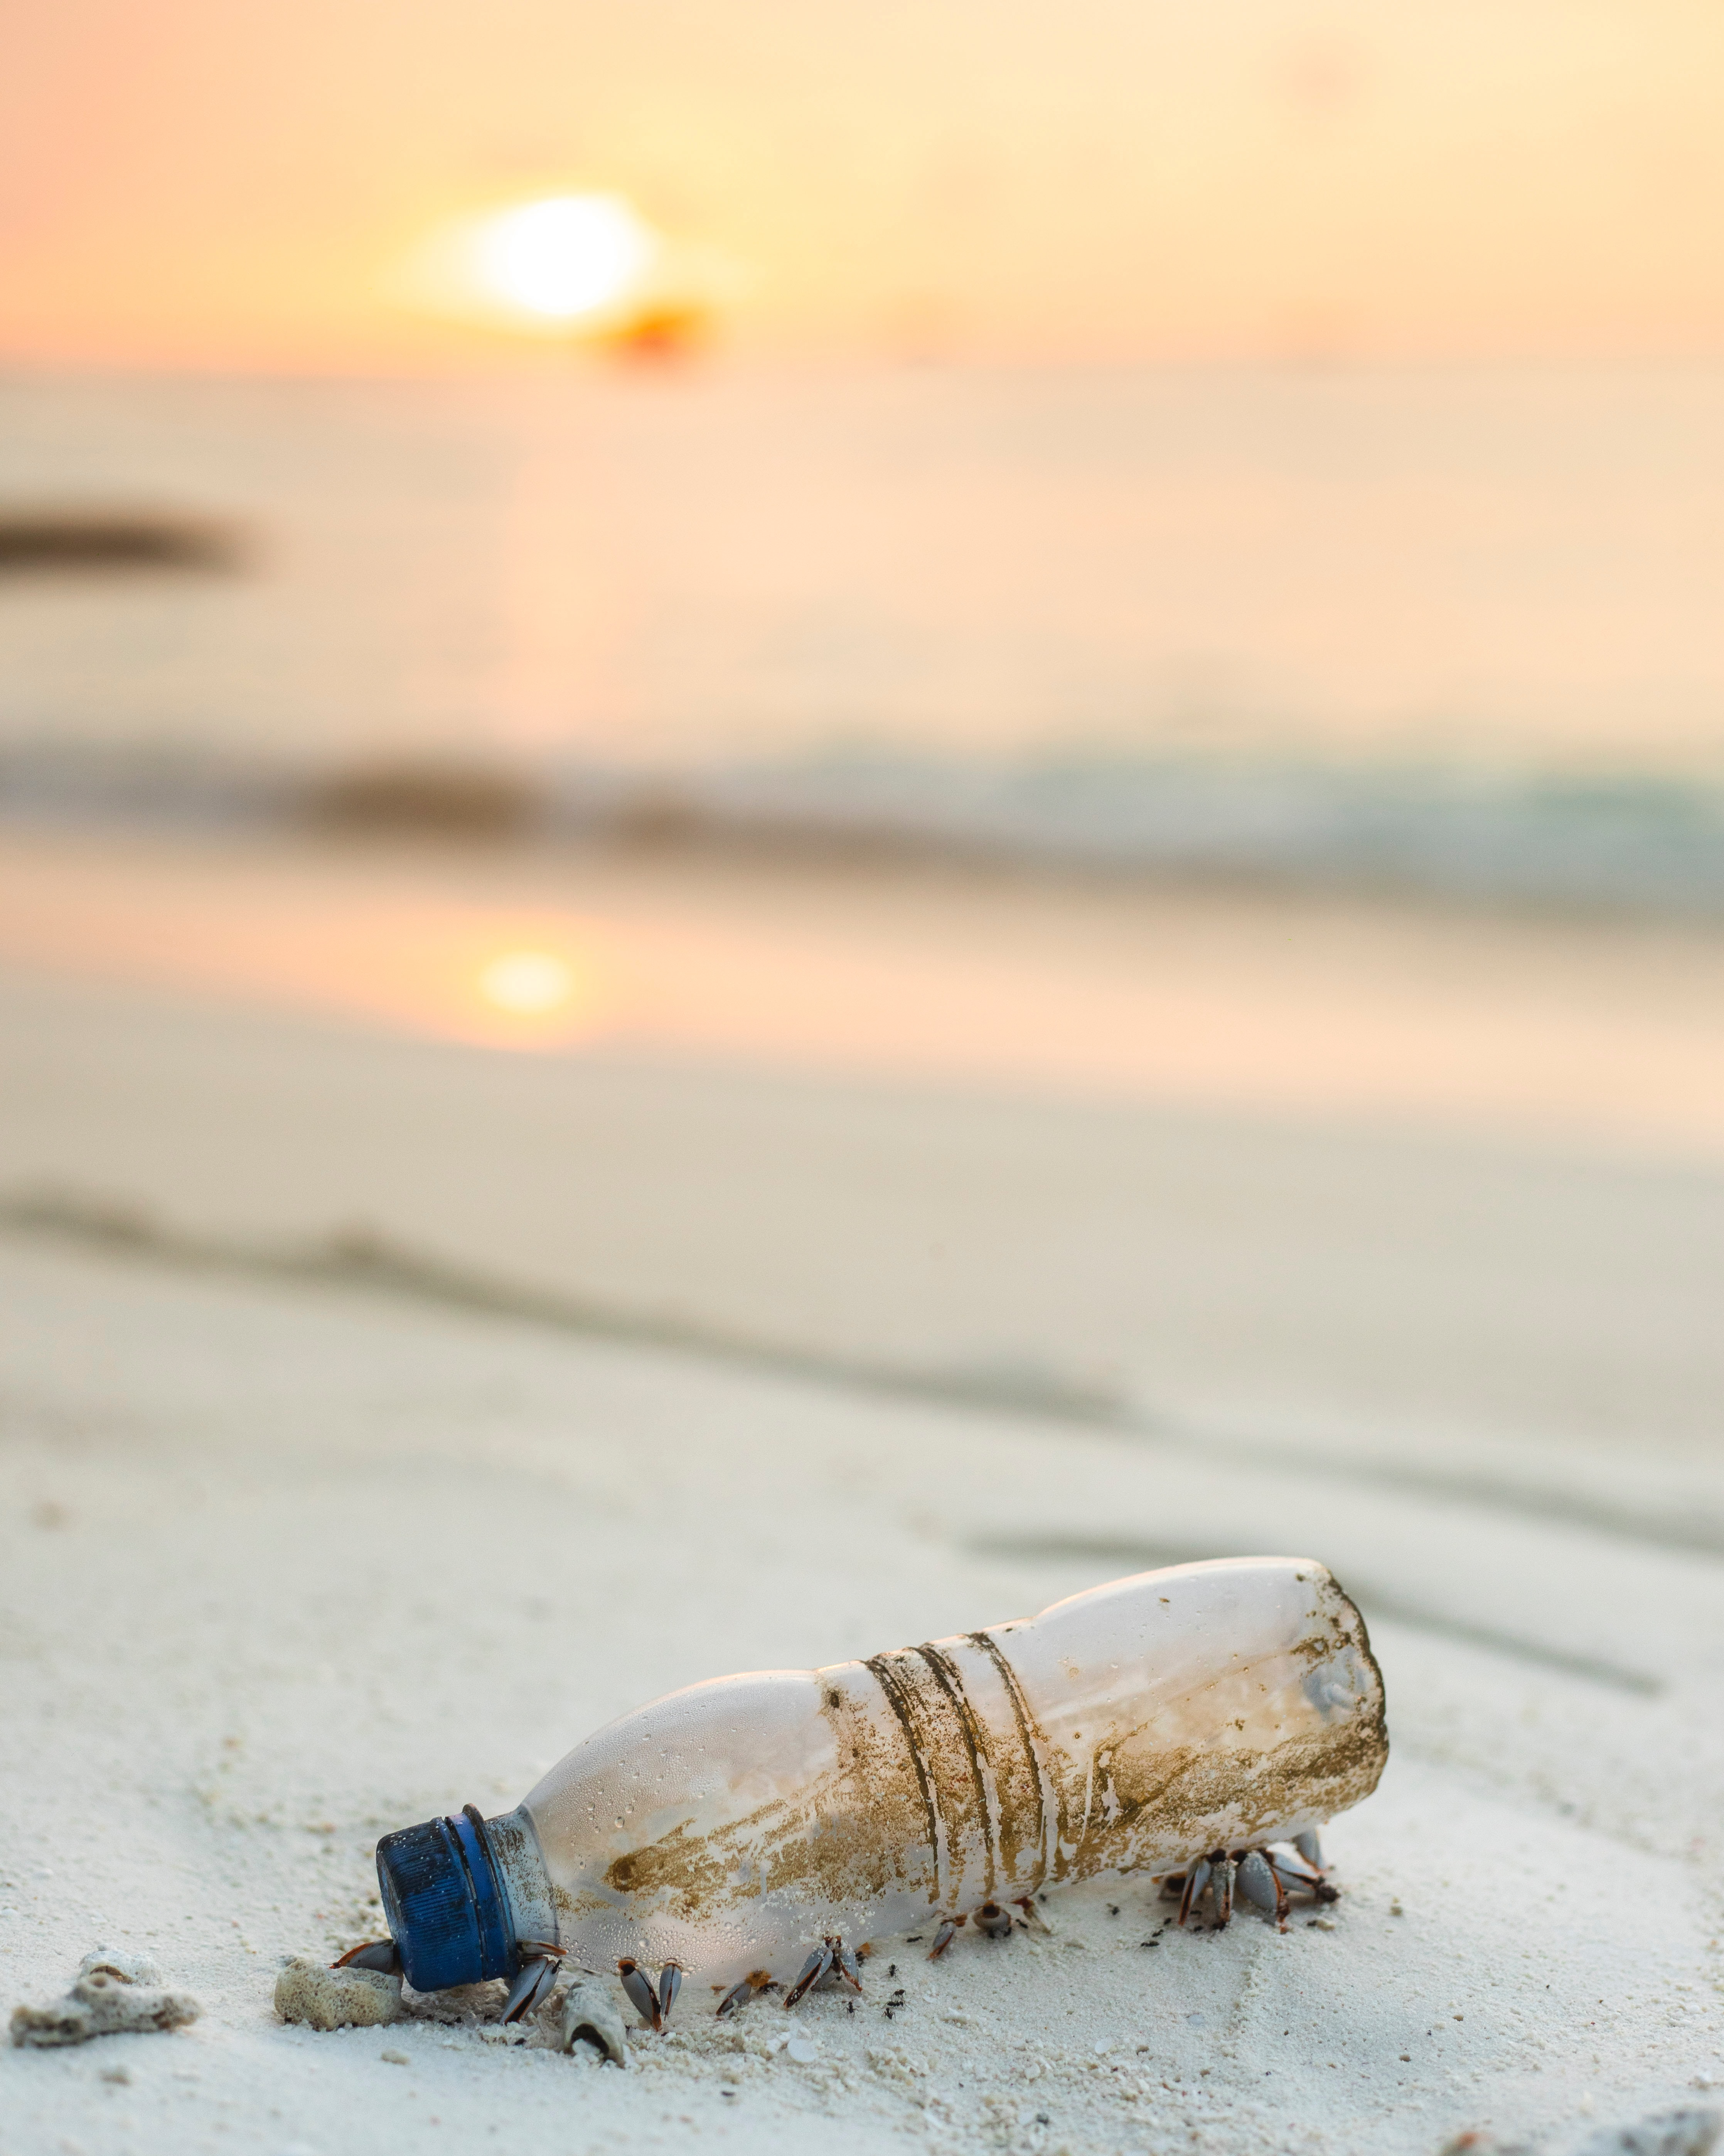
Every Action Counts to
SAVE OUR SEAS
With 71% of our planet comprised of water, the ever-increasing issue of marine pollution is of great concern to all life – and can only be successfully addressed by action at every level – from the individual up through global coordination.

Slide 5
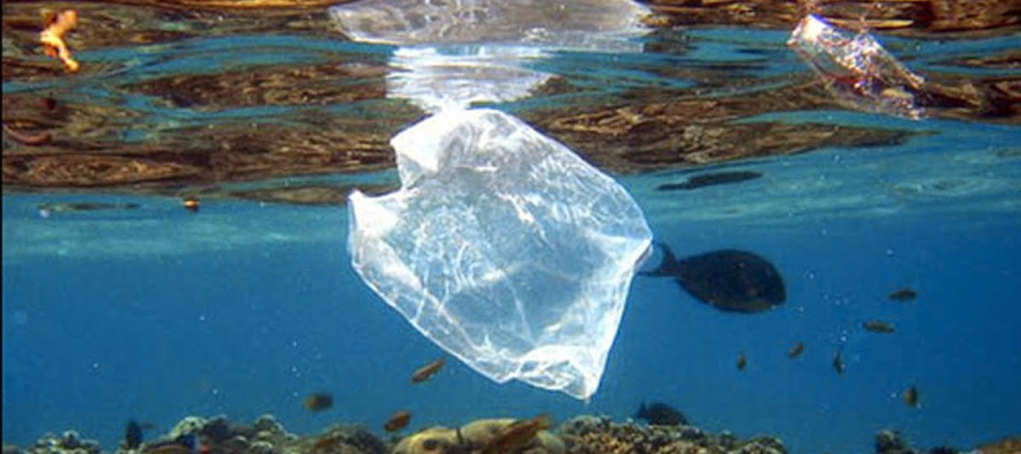
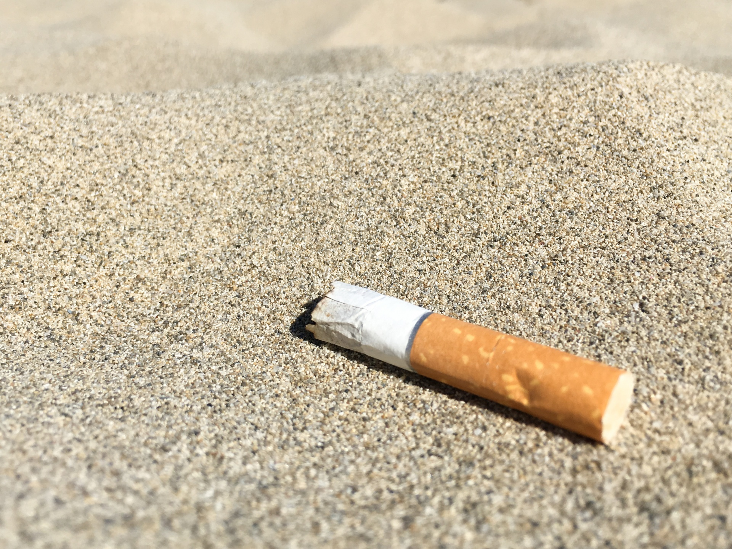
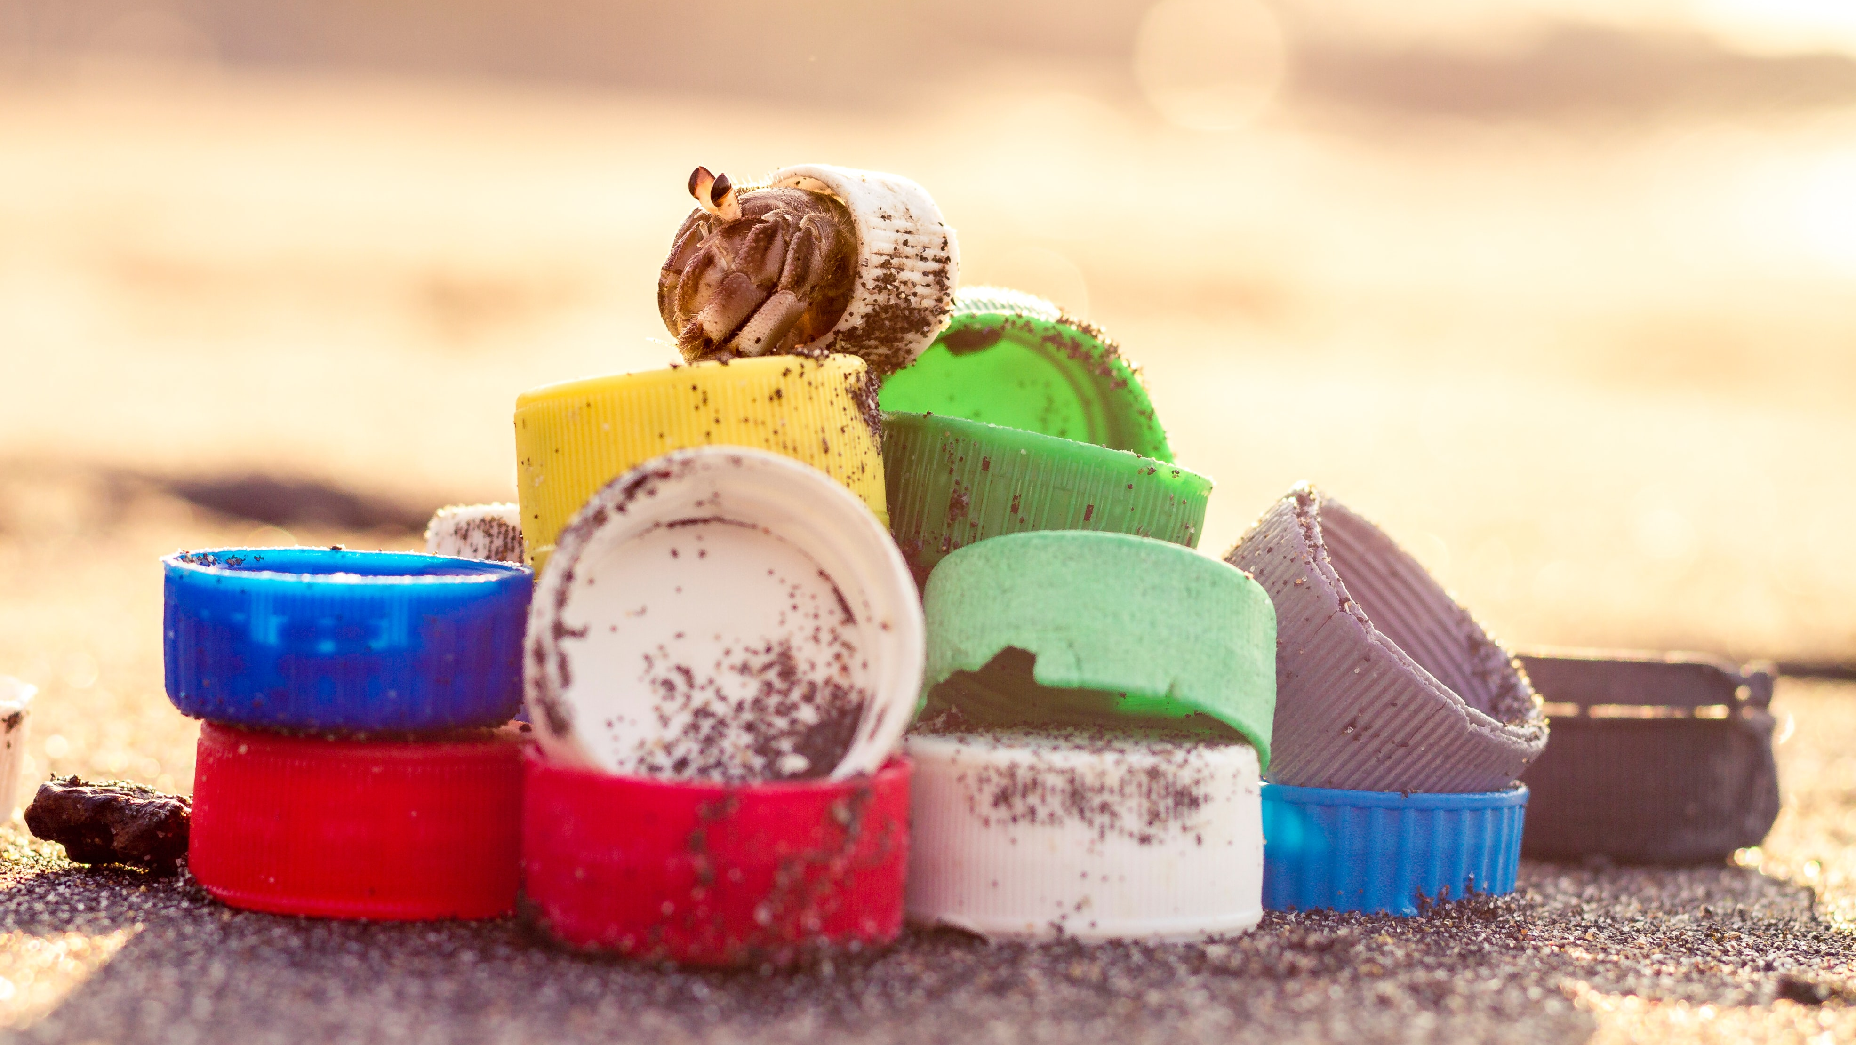
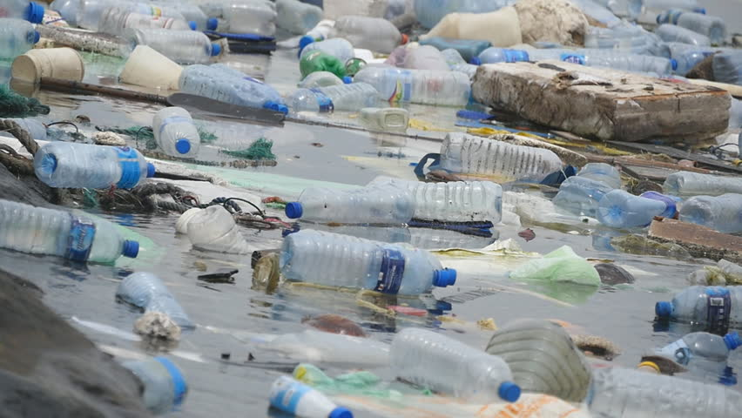
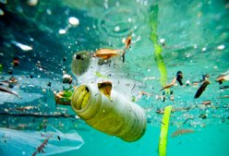

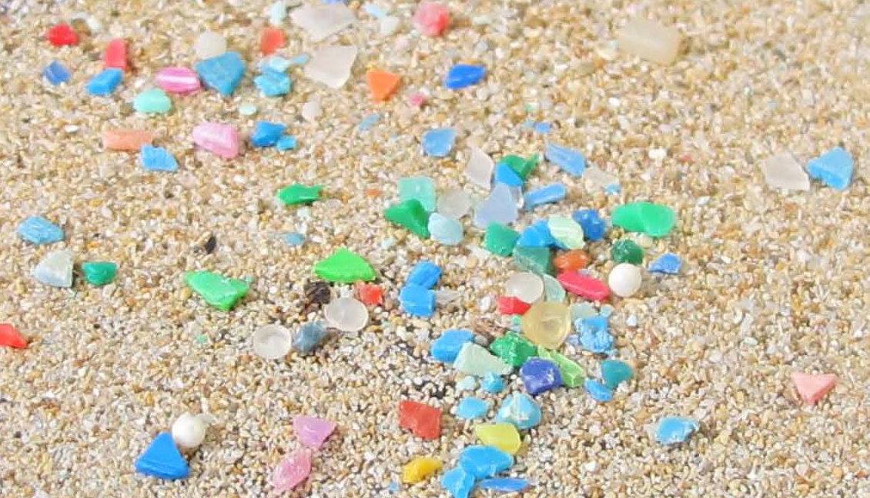
Let’s Talk Plastic

Slide 6
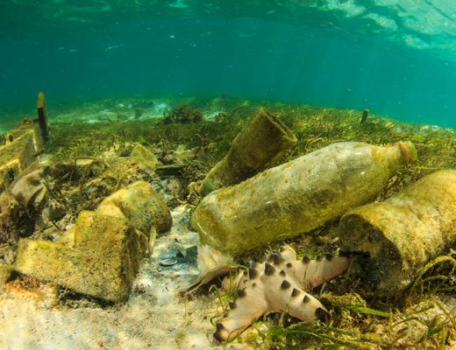
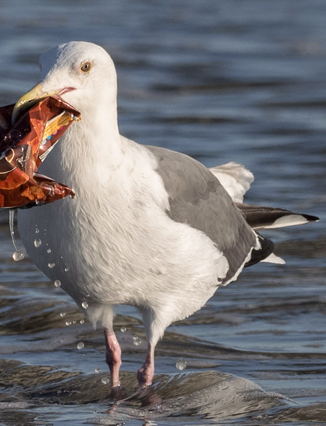
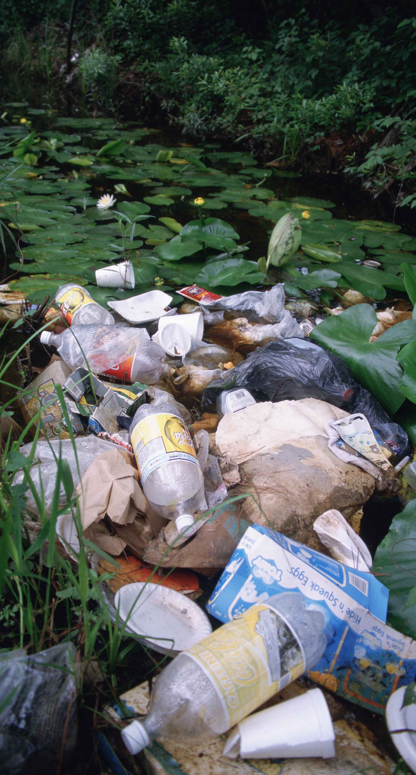
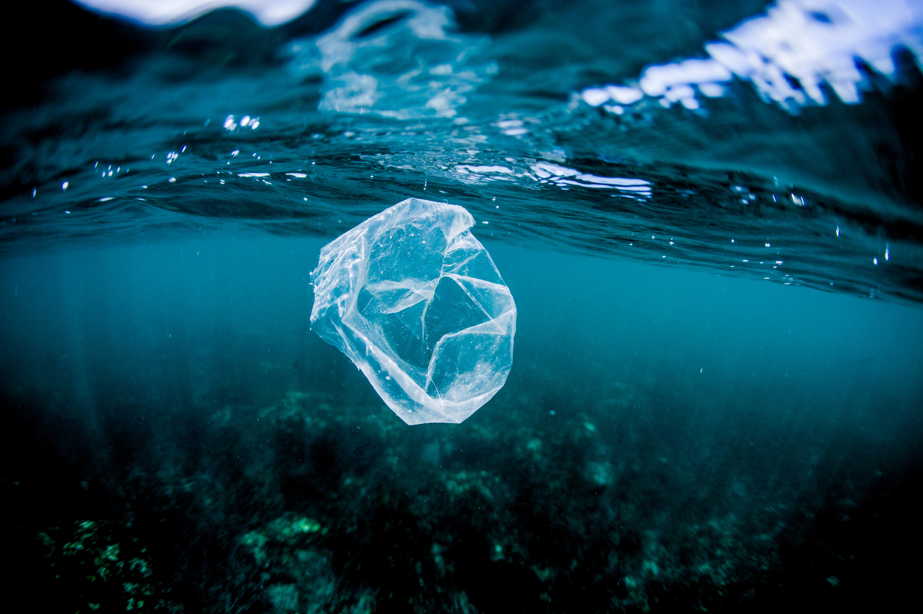
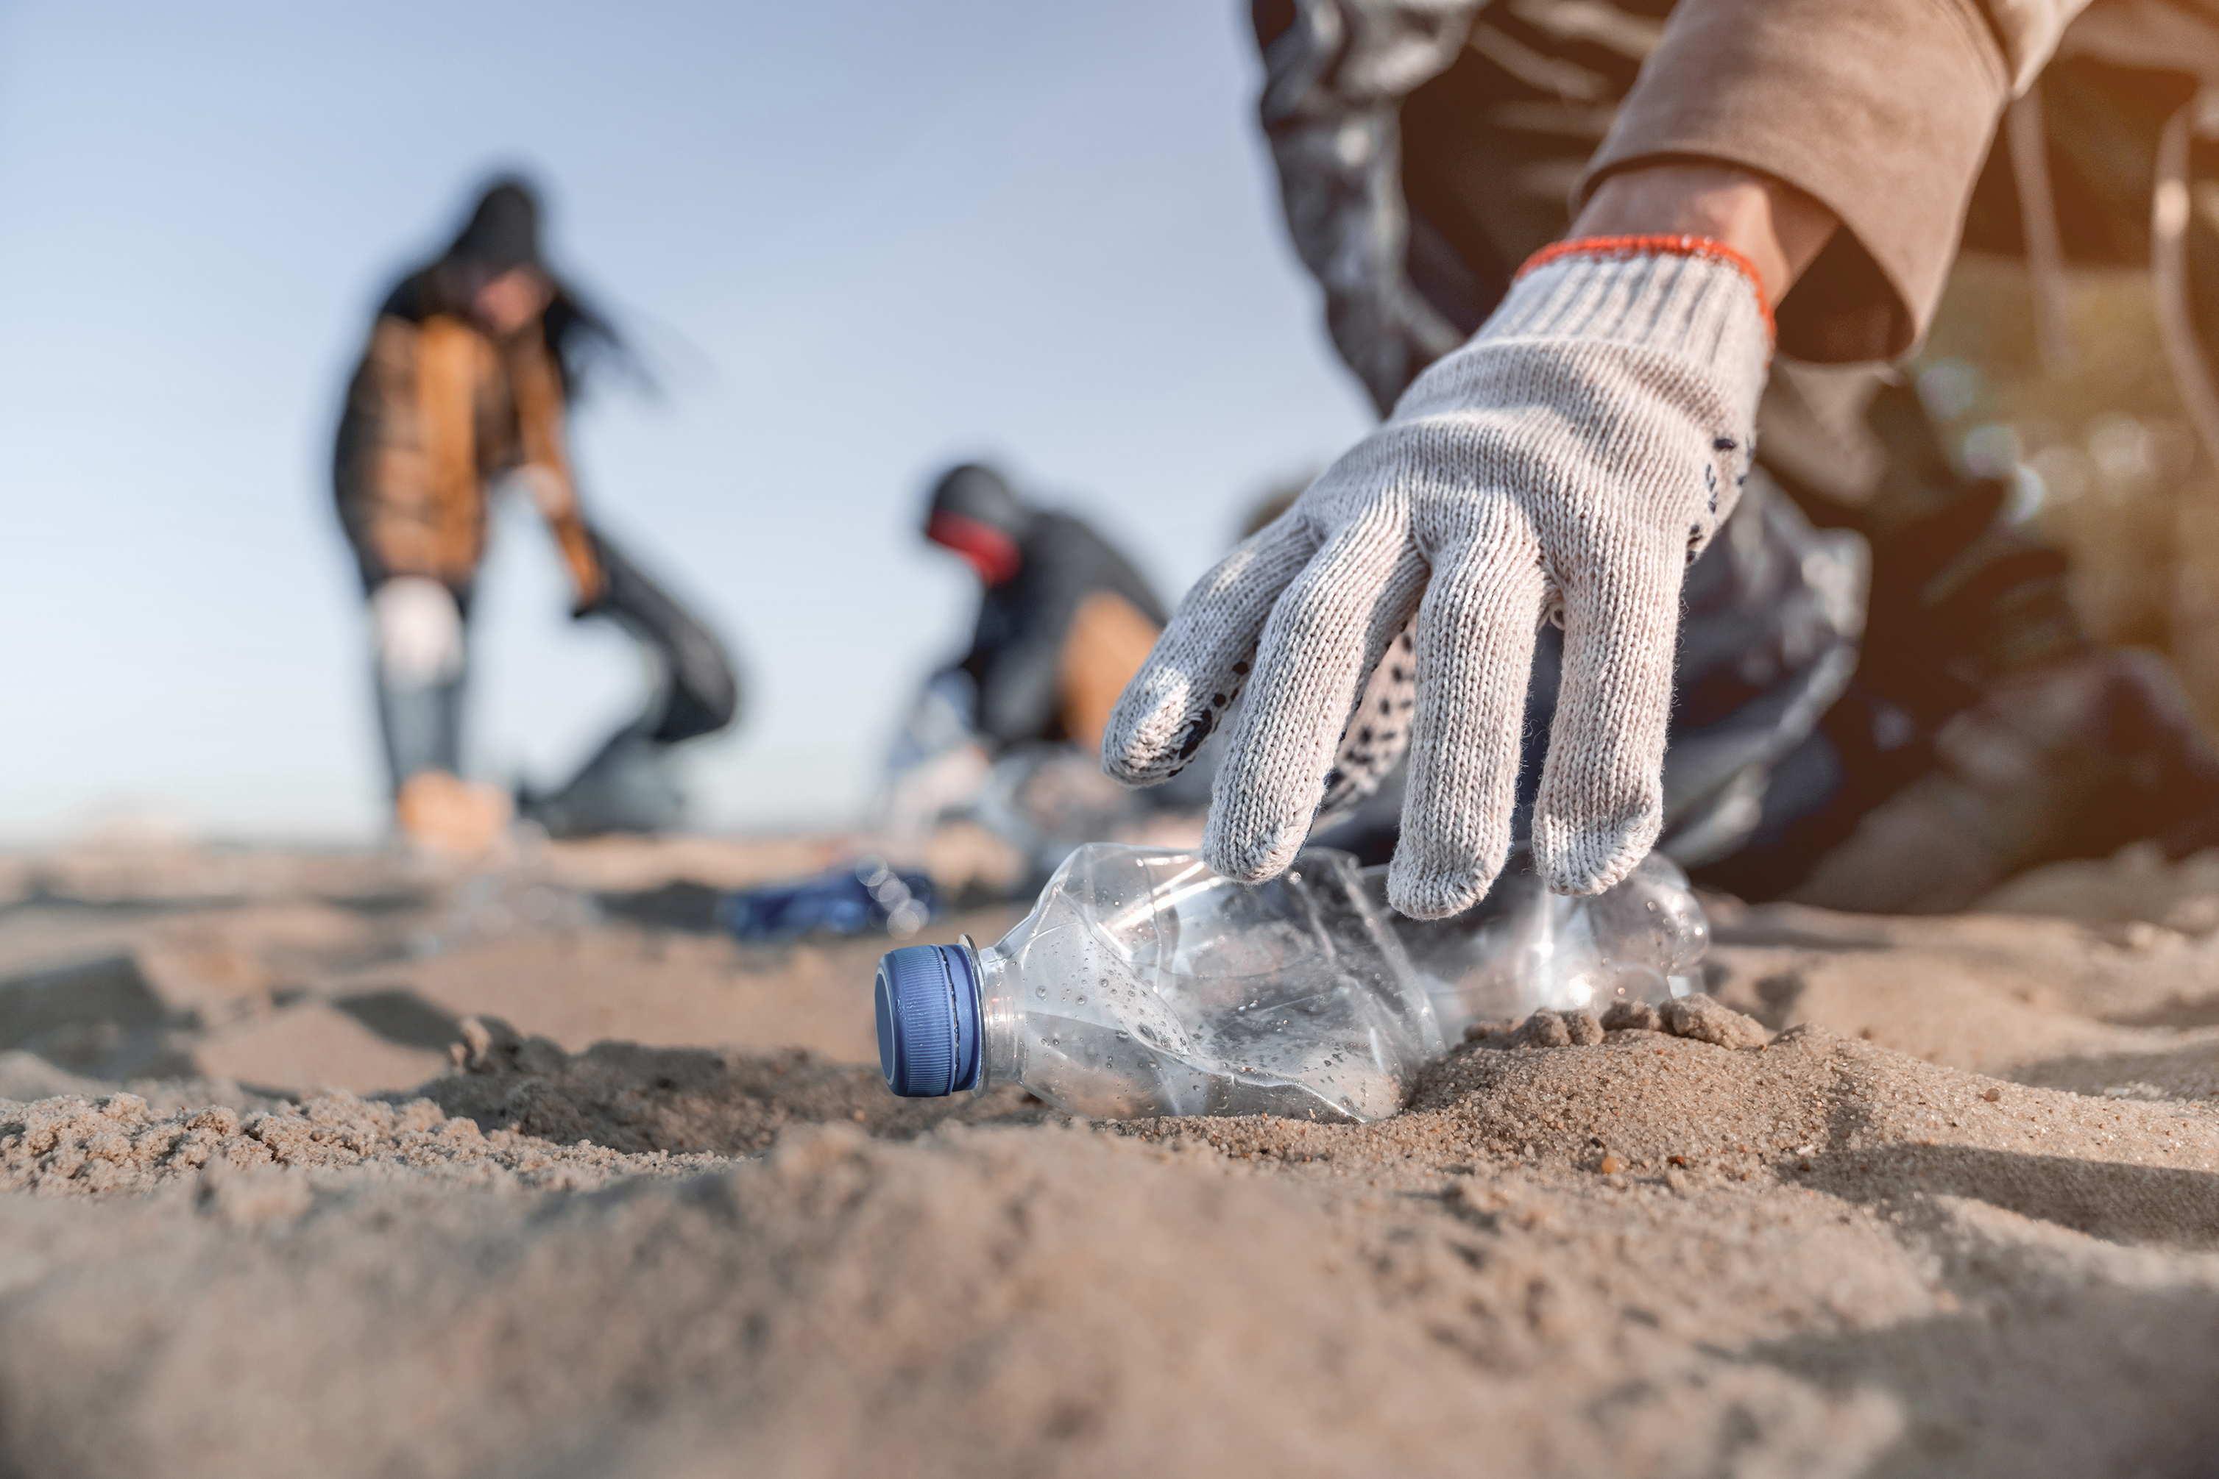
Where can you find it?
EVERYWHERE!

Slide 7
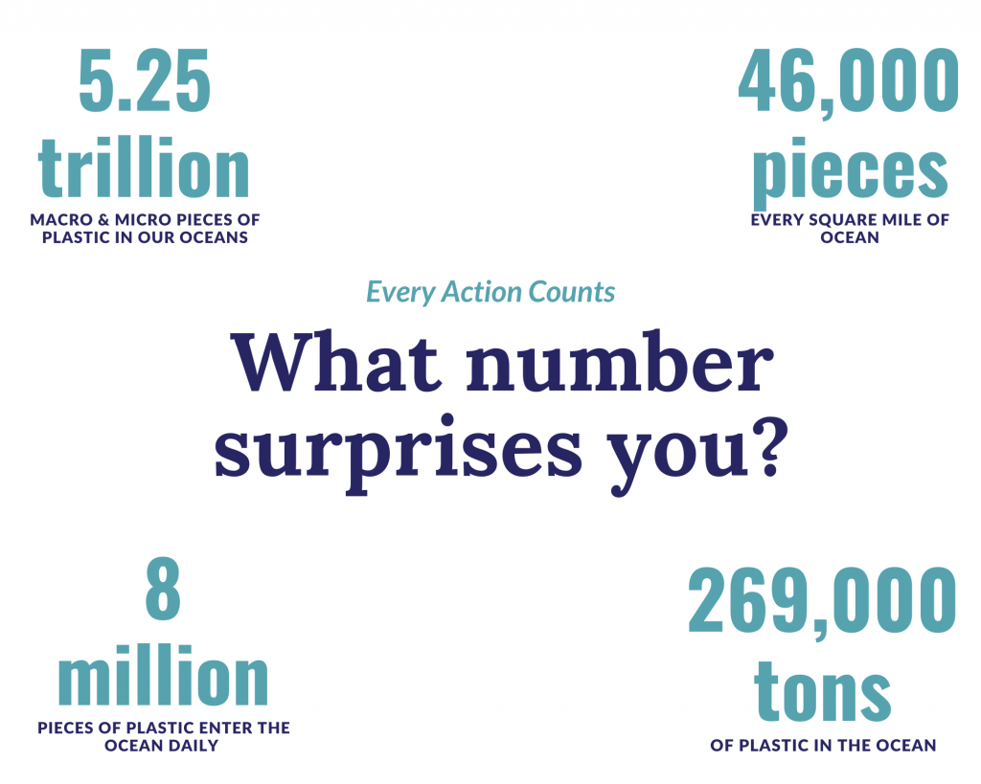

Slide 8
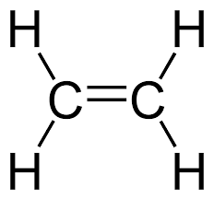
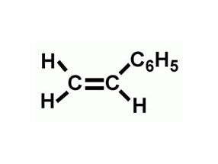
Plastic Structure
Polyethylene | Polystyrene | Polyethylene Terephthalate
H₂-C=C-H₂ | H₂-C=CH(C₆H₅) | C=O(C₆H₄)-O-CH₂-CH₂-O
Most widely produced | Most versatile | Most useful
Ex: Plastic gas, rope, plastic tubing | Ex: Styrofoam, plastic cups, petri dishes | Ex: Plastic bottles, plastic tupperware

Slide 9
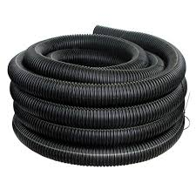
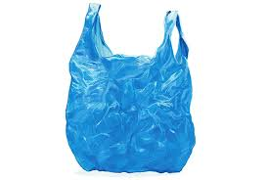
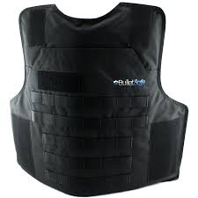
Polyethylene
Most widely used plastic in the world
Thermoplastic → softened and melted when heated, but sets again when cooled
When temperature increases, the chains become weakened & yields a liquid with high viscosity
Relatively low melting point (110 – 130°C)

Slide 10
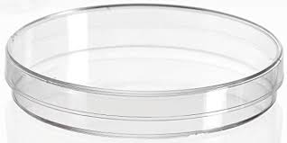
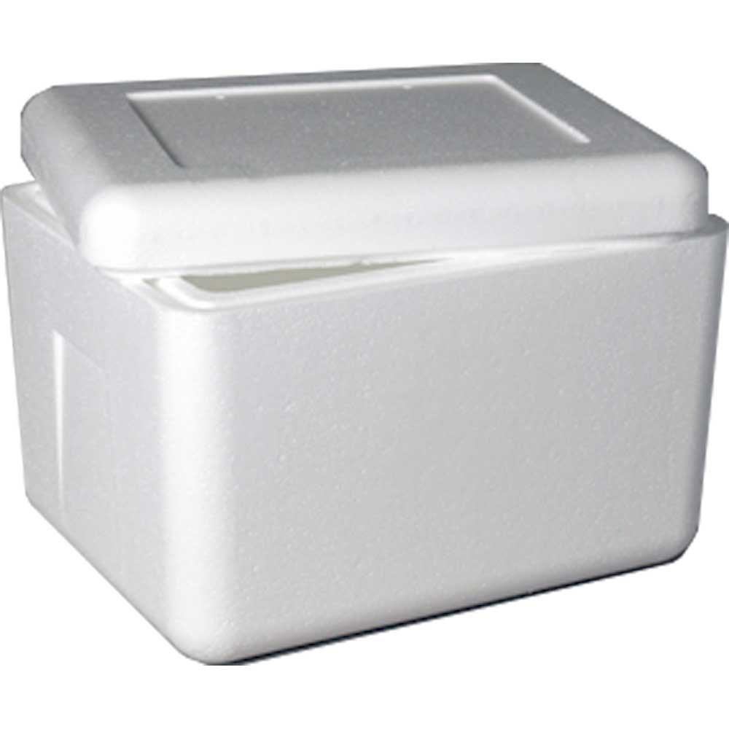
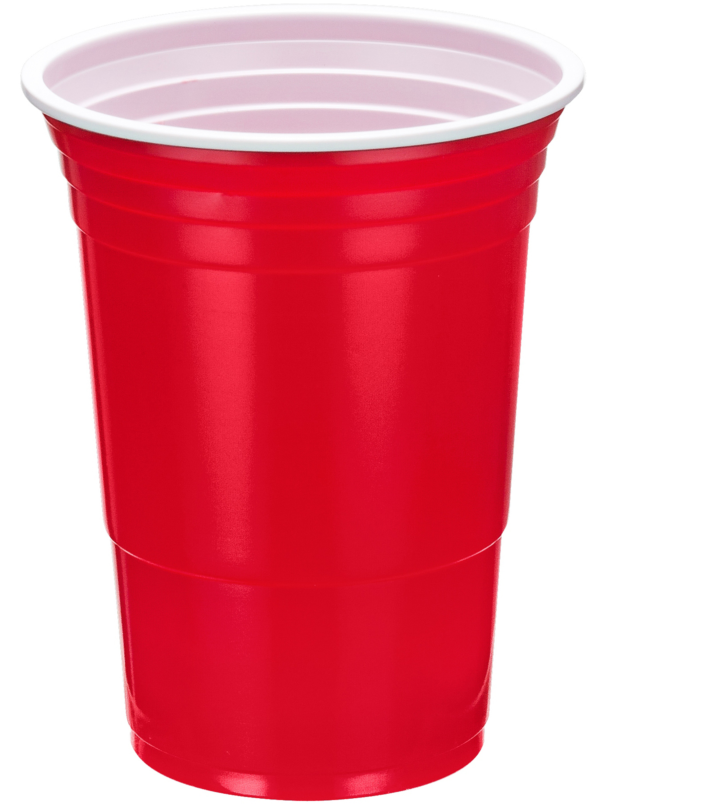
Polystyrene
Foam and transparent plastic
Thermoset material → rigid, heat resistant, little degradation
Styrofoam is a thermal insulator
High melting point (210 – 249°C)

Slide 11

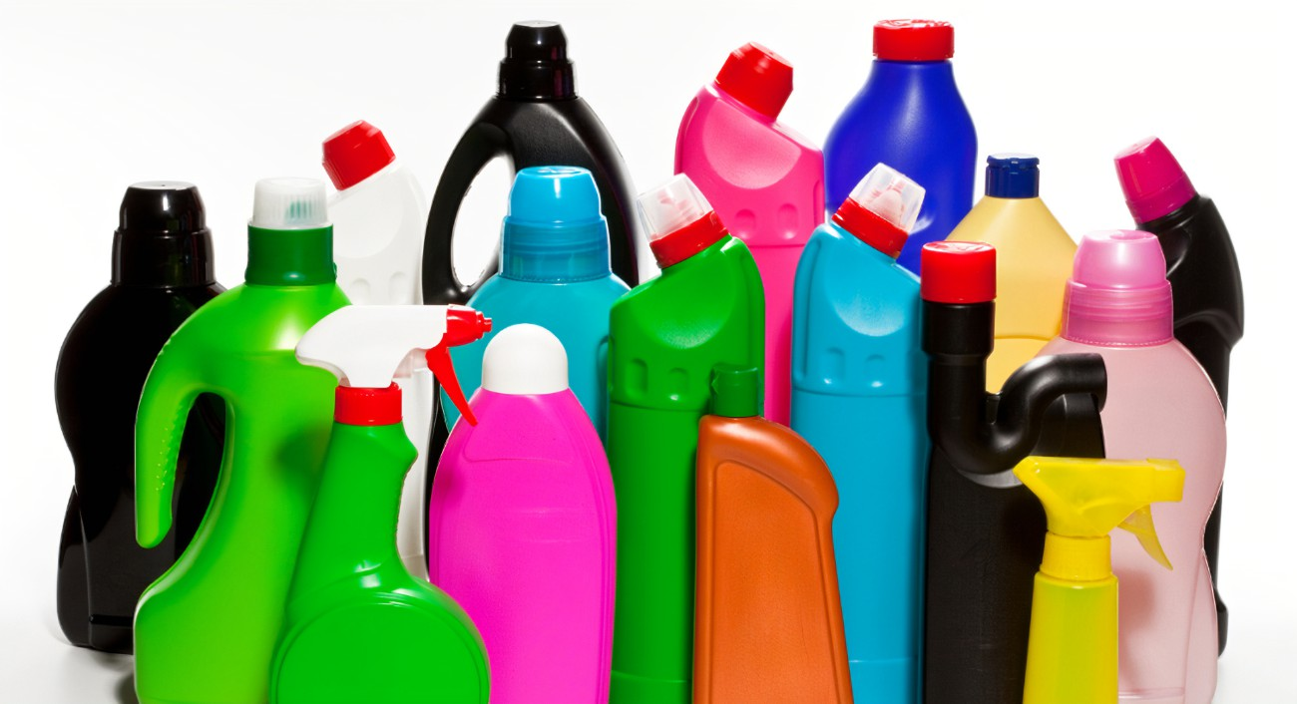
Polyethylene Terephthalate
The world’s most useful plastic
Naturally transparent & semi-crystalline
Resistant to water
High strength to weight ratio
3D printing
High melting point (260°C)

Slide 12

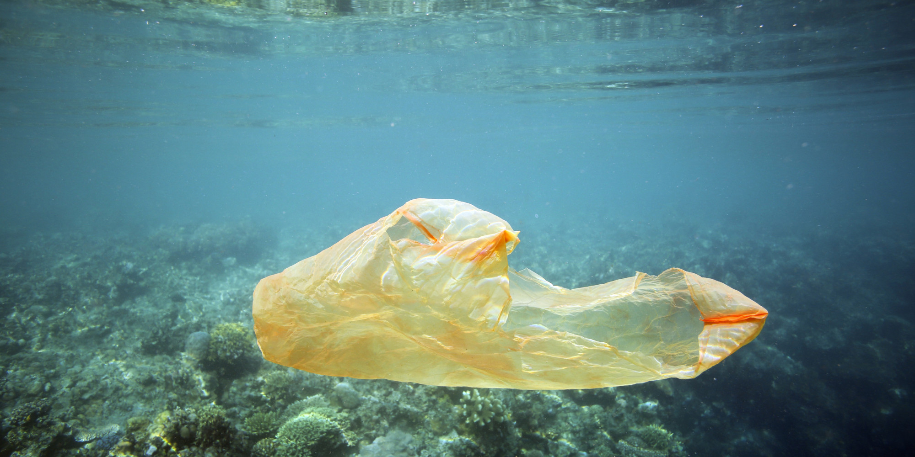
Degradation of Plastics
Process:
Chemical reaction from light, heat and water
UV radiation initiates breakdown, followed by hydrolysis
Factors that affect rate:
Polymer surface (macro versus micro)
Heteroatomic versus homoatomic
Additives for stability
Do plastics break down completely?

Slide 13
Degradation of Plastics
Polyethylene | Polystyrene | Polyethylene Terephthalate
H₂-C=C-H₂ | H₂-C=CH(C₆H₅) | C=O(C₆H₄)-O-CH₂-CH₂-O
UV Radiation produces alcohols, aldehydes & ketones (containing O₂) Hydrolysis breaks down free radicals to propane –ene, ethane –ene, butene Ending product is CO₂ | Process is faster because of phenyl ring (benzene) Produces benzene, ethylbenzene, benzyl alcohols and ketones | Water resistant causes UV radiation to initial breakdown and thermolytic Yellowing occurs as a result Produces carboxylic acids & methyl groups
Takes decades or longer to breakdown | Cancer causing compounds | Slow process

Slide 14
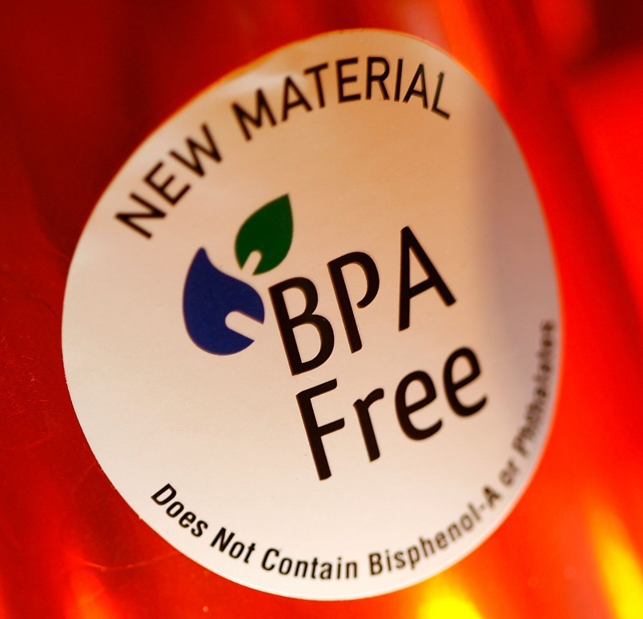
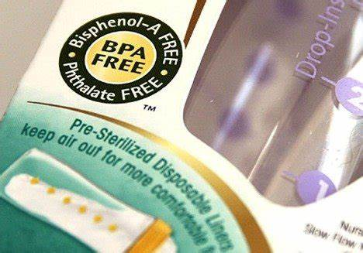
Bisphenol-A (BPA)
Chemical used in the process of making & binding plastics
  Found in detergents, perfumes, cosmetics, baby powders, body lotions, sunscreens, hairsprays, deodorant, soap, nail polish, shampoo, soft vinyl toys, teething rings, shower curtains
Endocrine disruptor
  Adverse developmental, neurological and immune effects in humans and wildlife
Heat causes leeching of BPA from plastic to source

Slide 15
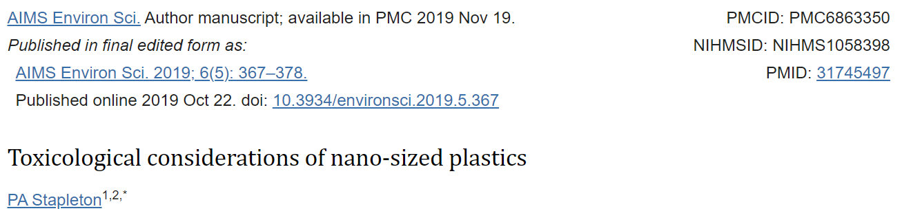
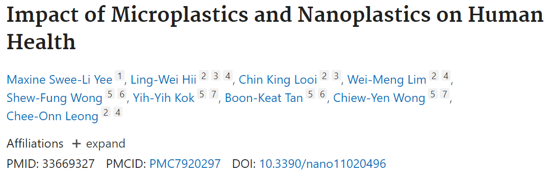
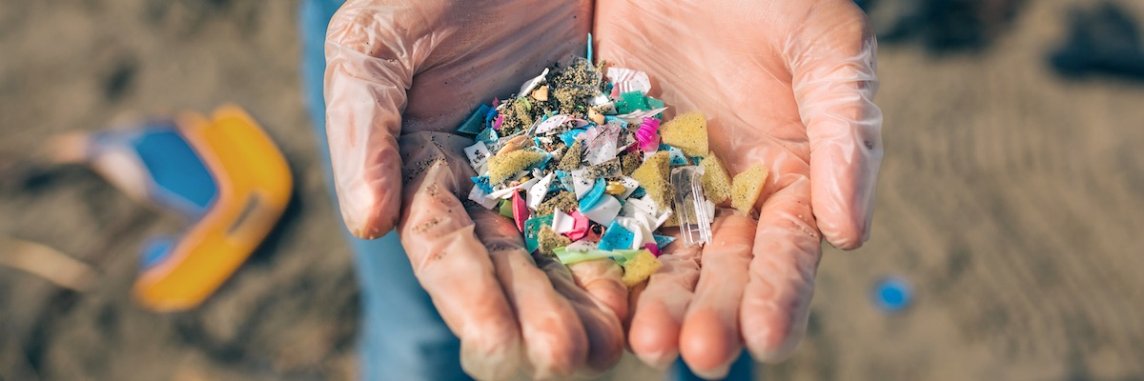
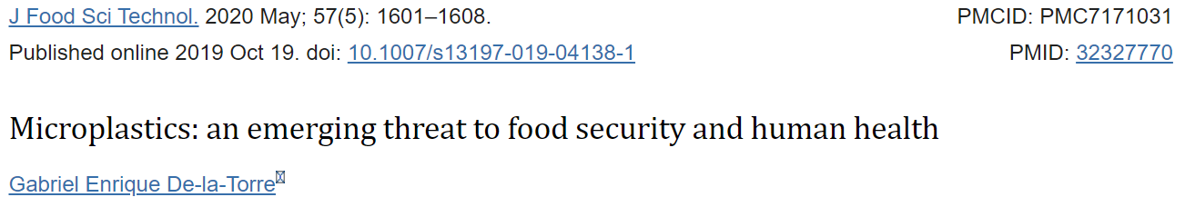
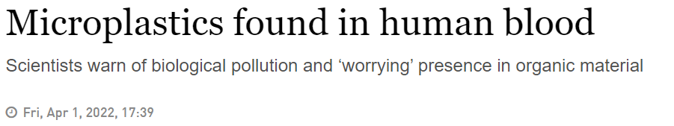
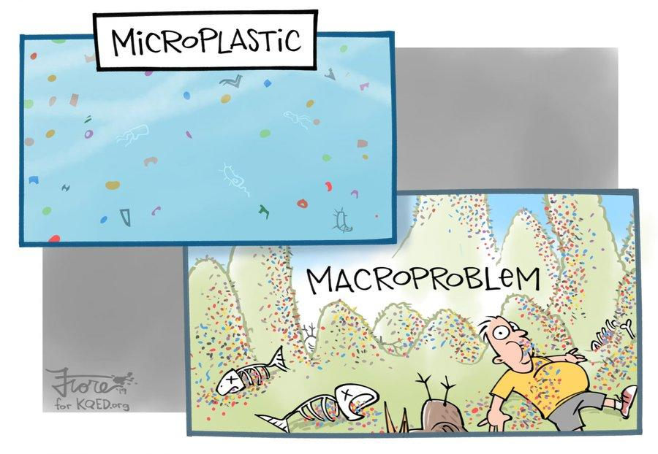
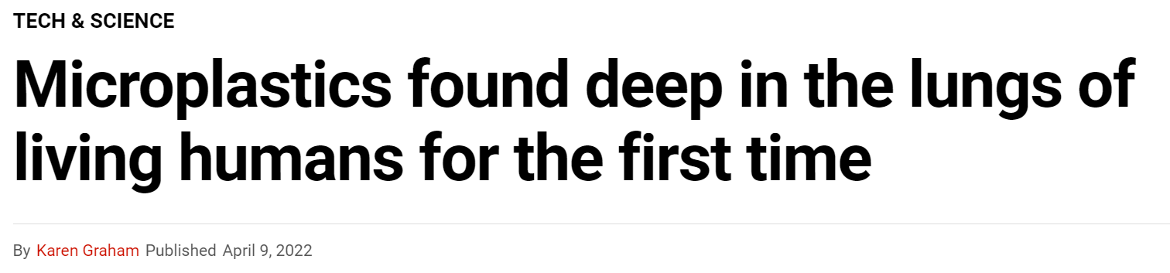
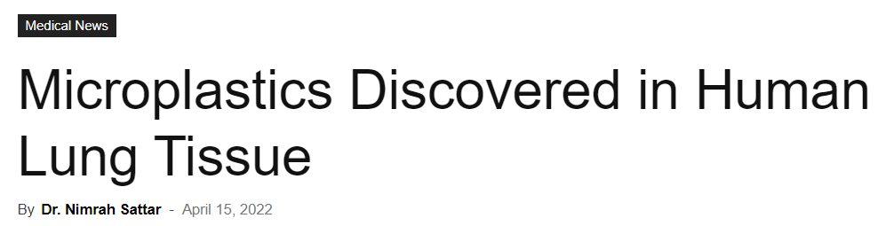
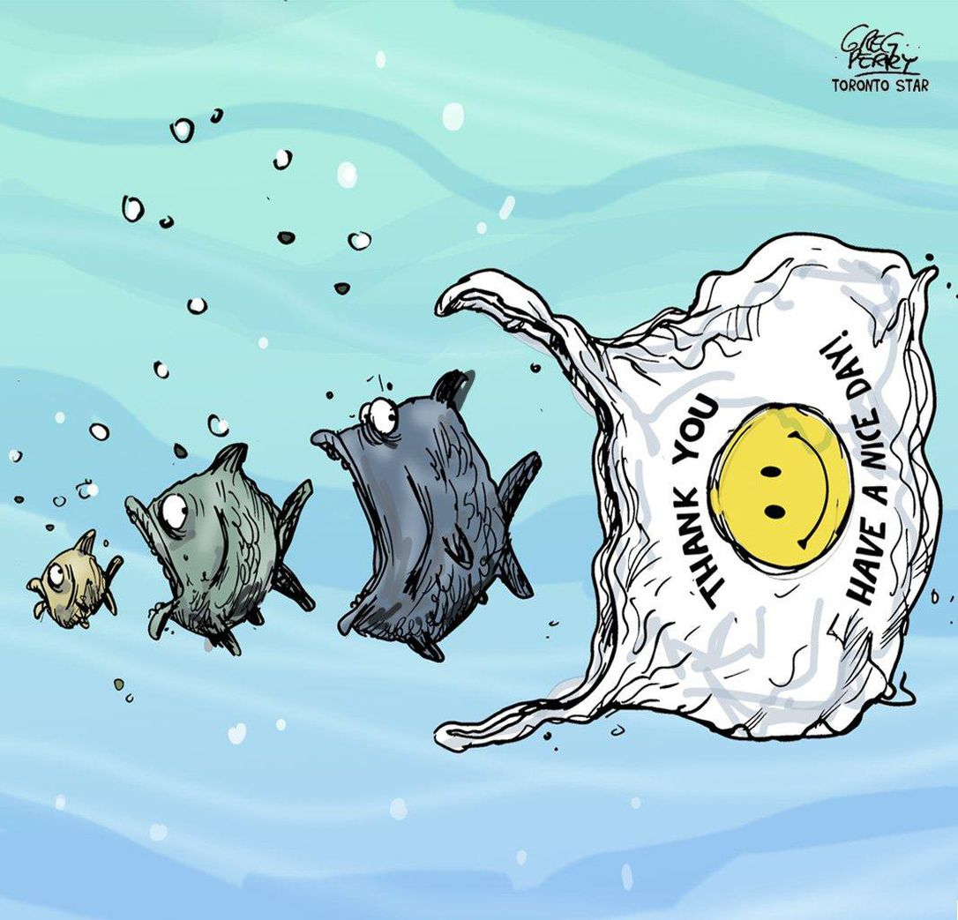
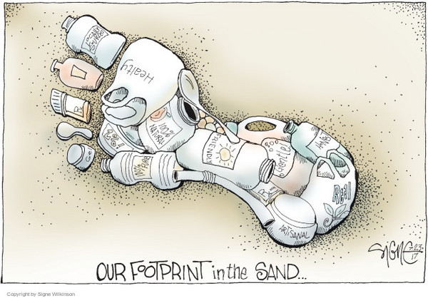
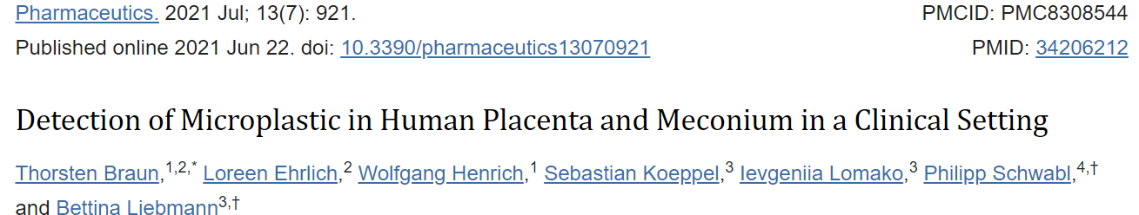
Micro & Nano Plastics
Does plastic completely breakdown?

Slide 16
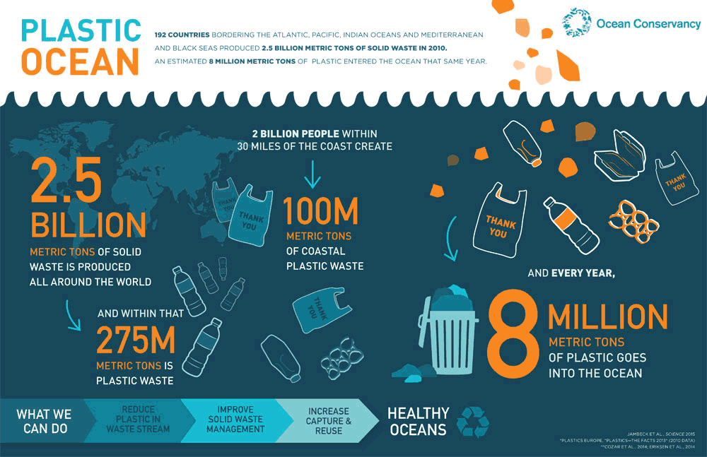
Do Your Part!
Change your relationship with plastic!
Refuse and Reduce consumption single-use plastics!
Invest in Reusable items like coffee mugs, water bottles, bags and cutlery
Recycle and Repurpose items at the end of their intended life
Individual
Community
Corporate
Global

Slide 17
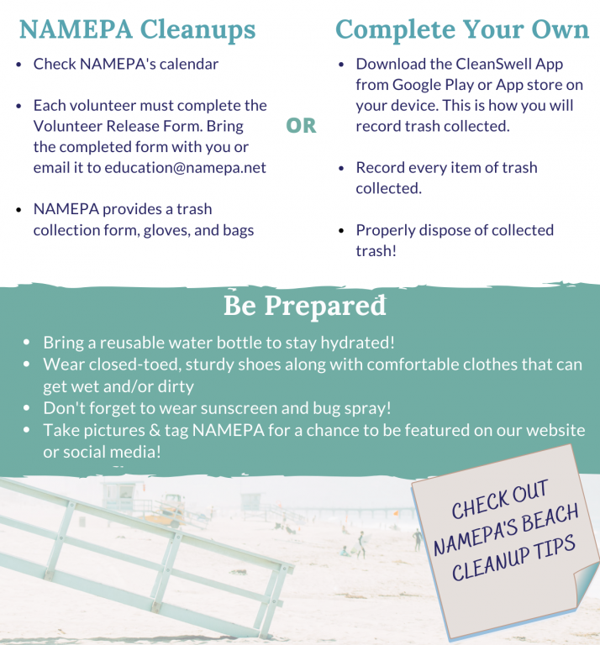
Take Action
Now!
NAMEPA brings communities together to protect marine environments.
We can all do our part to Save Our Seas!

Slide 18
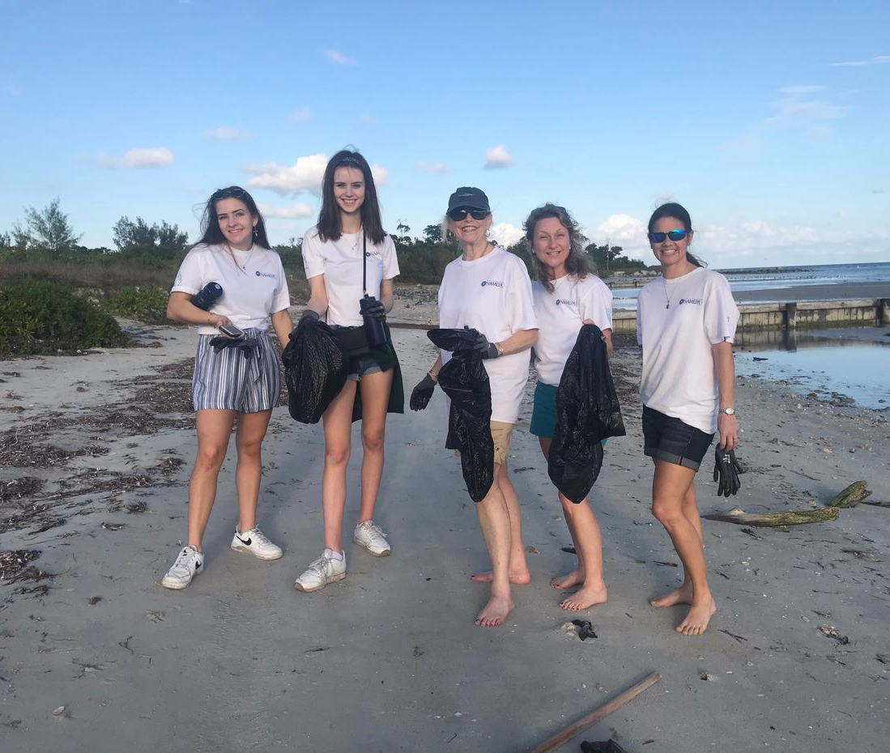
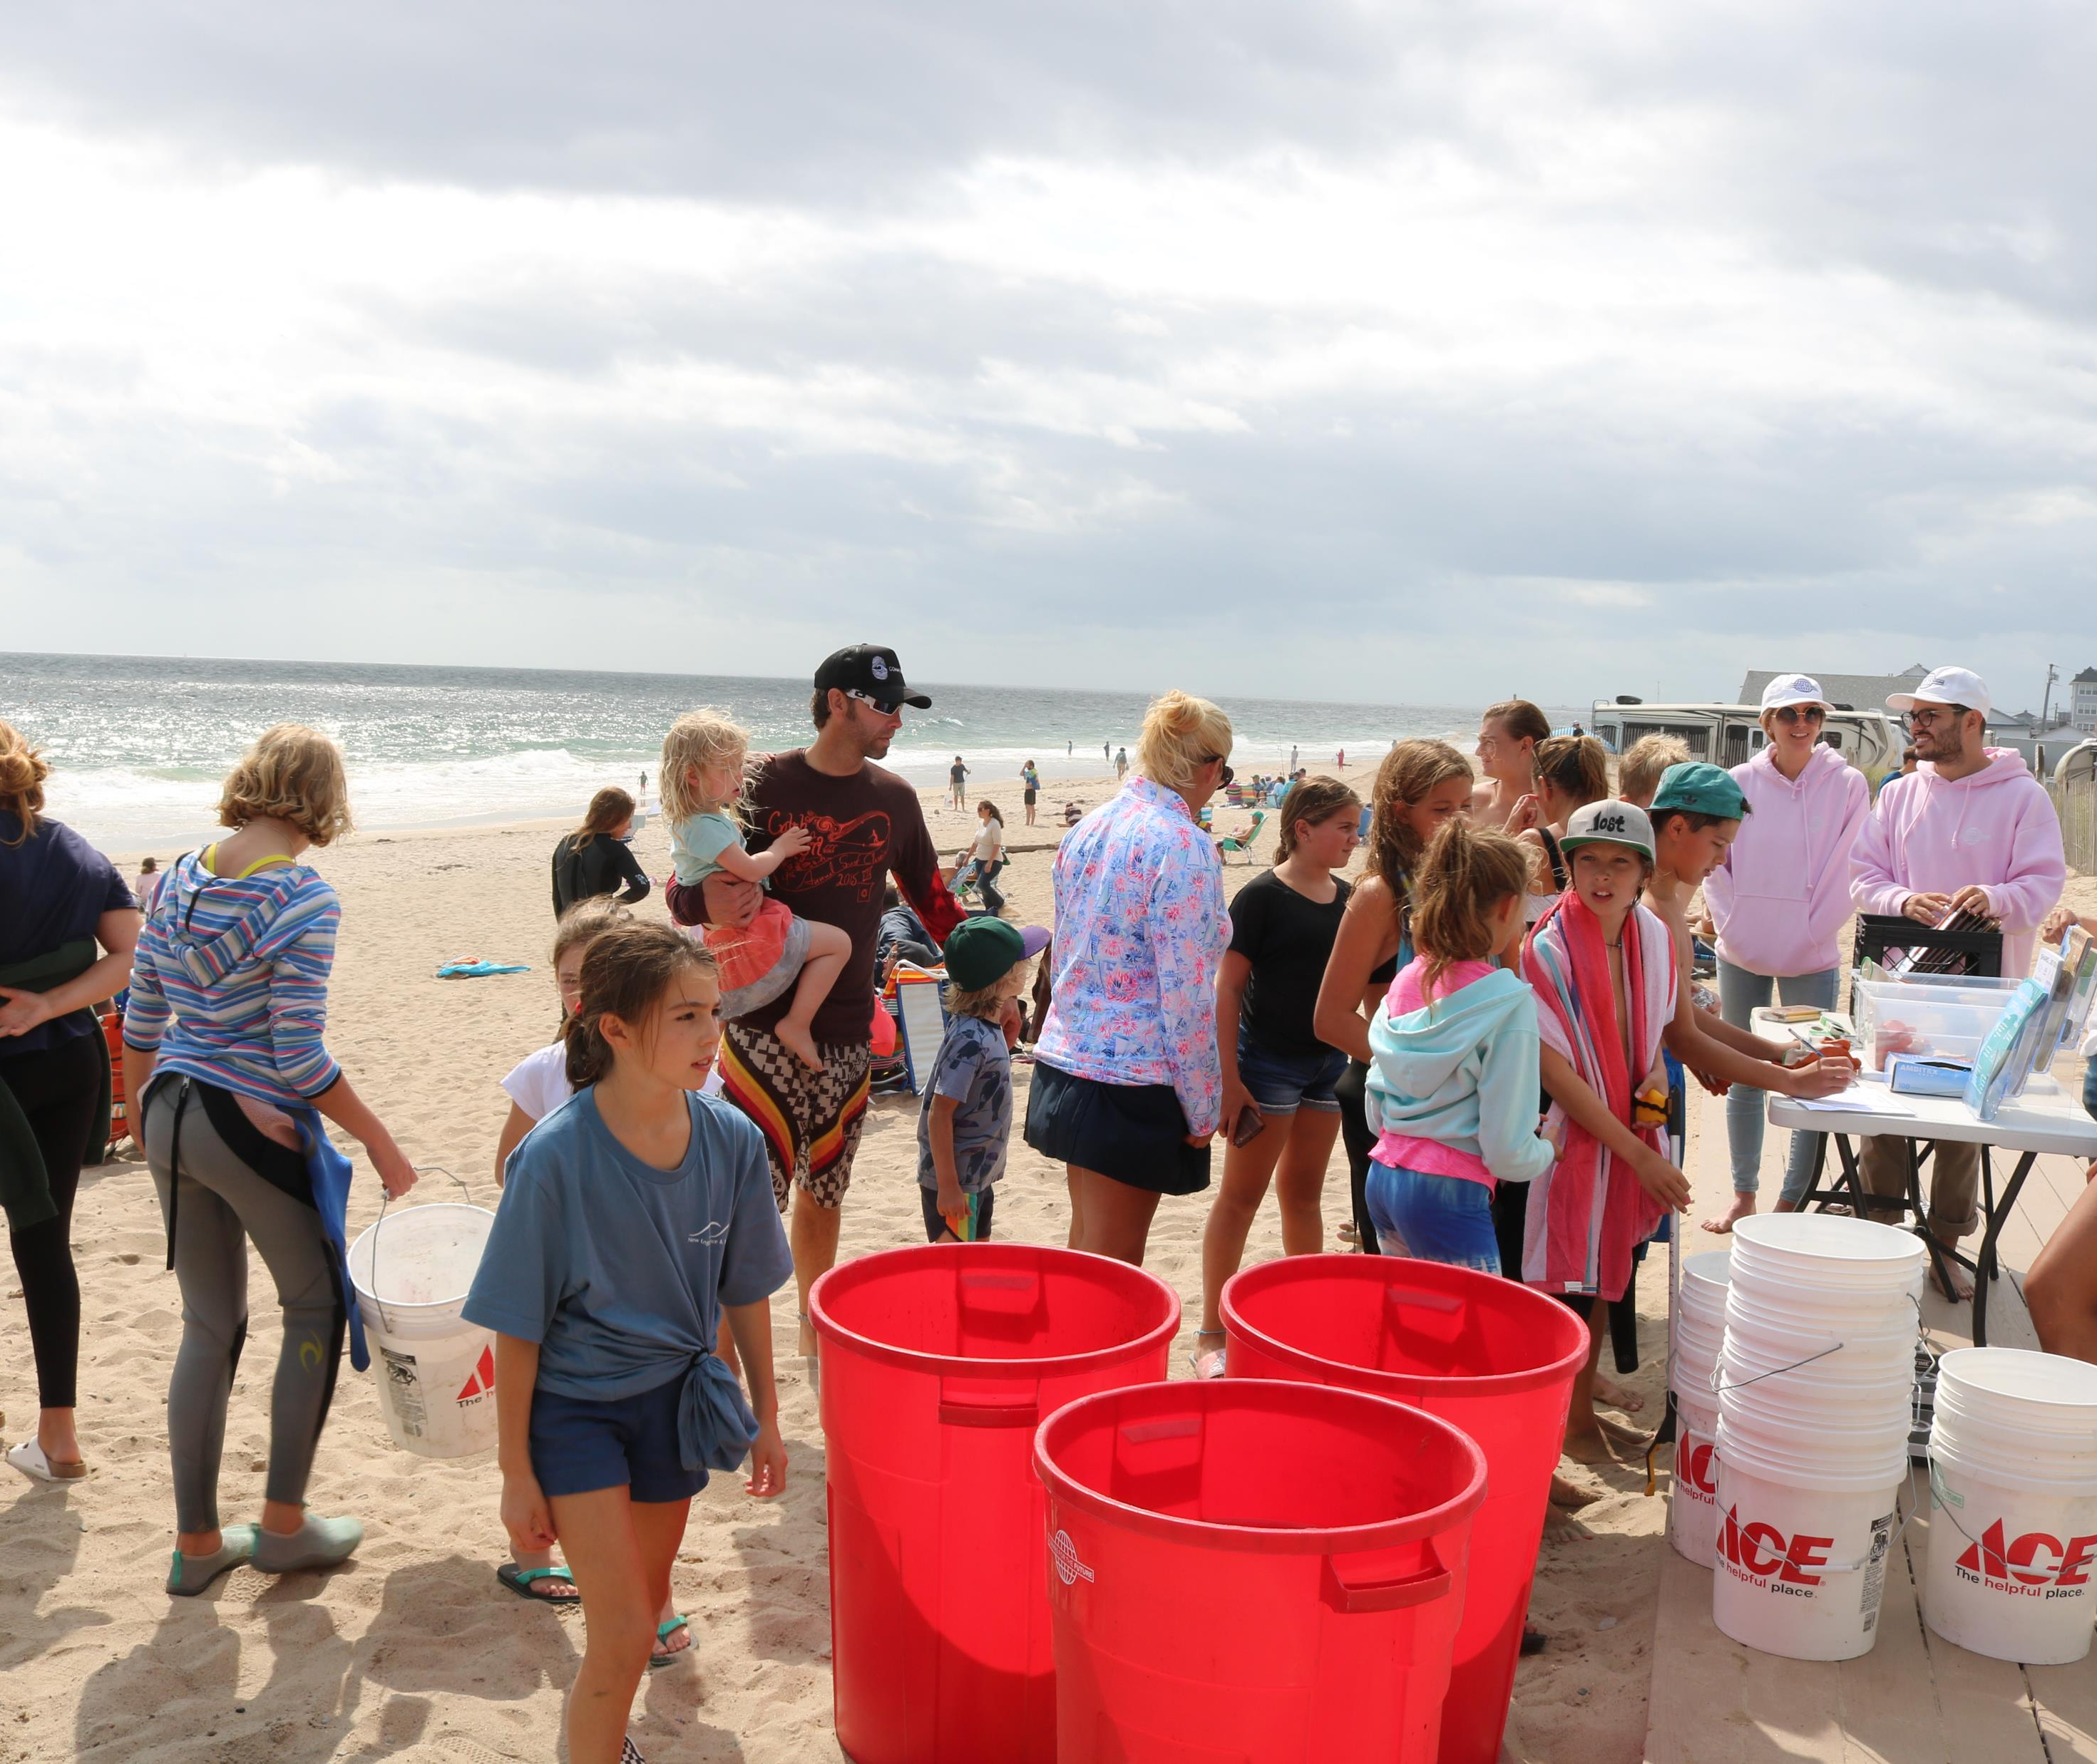
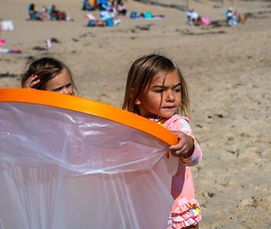
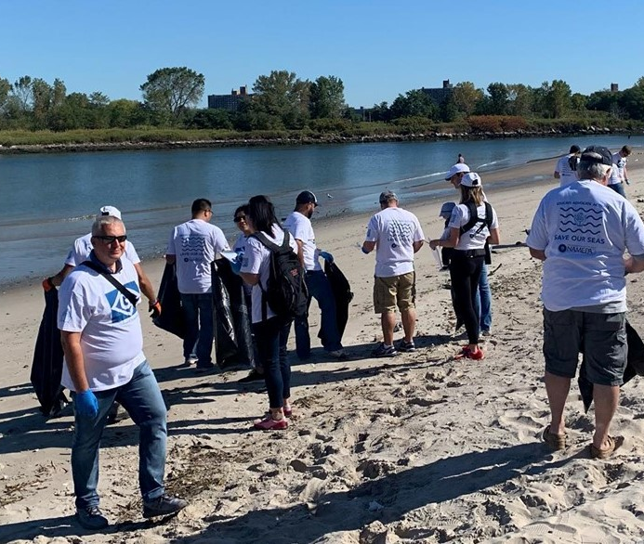
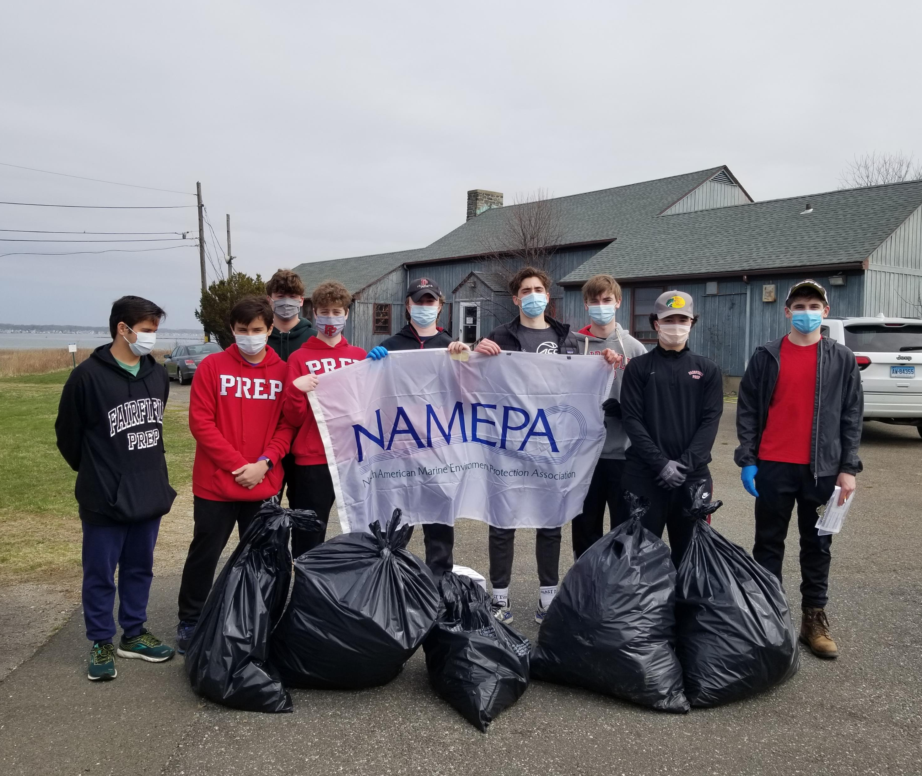


Slide 19







Slide 20





Chemistry of Plastic Plastic degradation and what this means for our oceans
ADVOCATE | EDUCATE | ACTIVATE
Carleen Lyden Walker
Co-Founder & Executive Director
executivedirector@namepa.net
Lyn Harris
Chief Operating Officer
l.harris@namepa.net
Our Mission
Preserving the marine environment by promoting sustainable maritime industry best practices and educating the public to Save Our Seas
Molly Dushay
Education & Outreach Director
m.dushay@namepa.net
www.namepa.net

