Slide 1

I am the ultimate recycler of nutrients.

Slide 2
Decomposer/Detritivore.

Slide 3
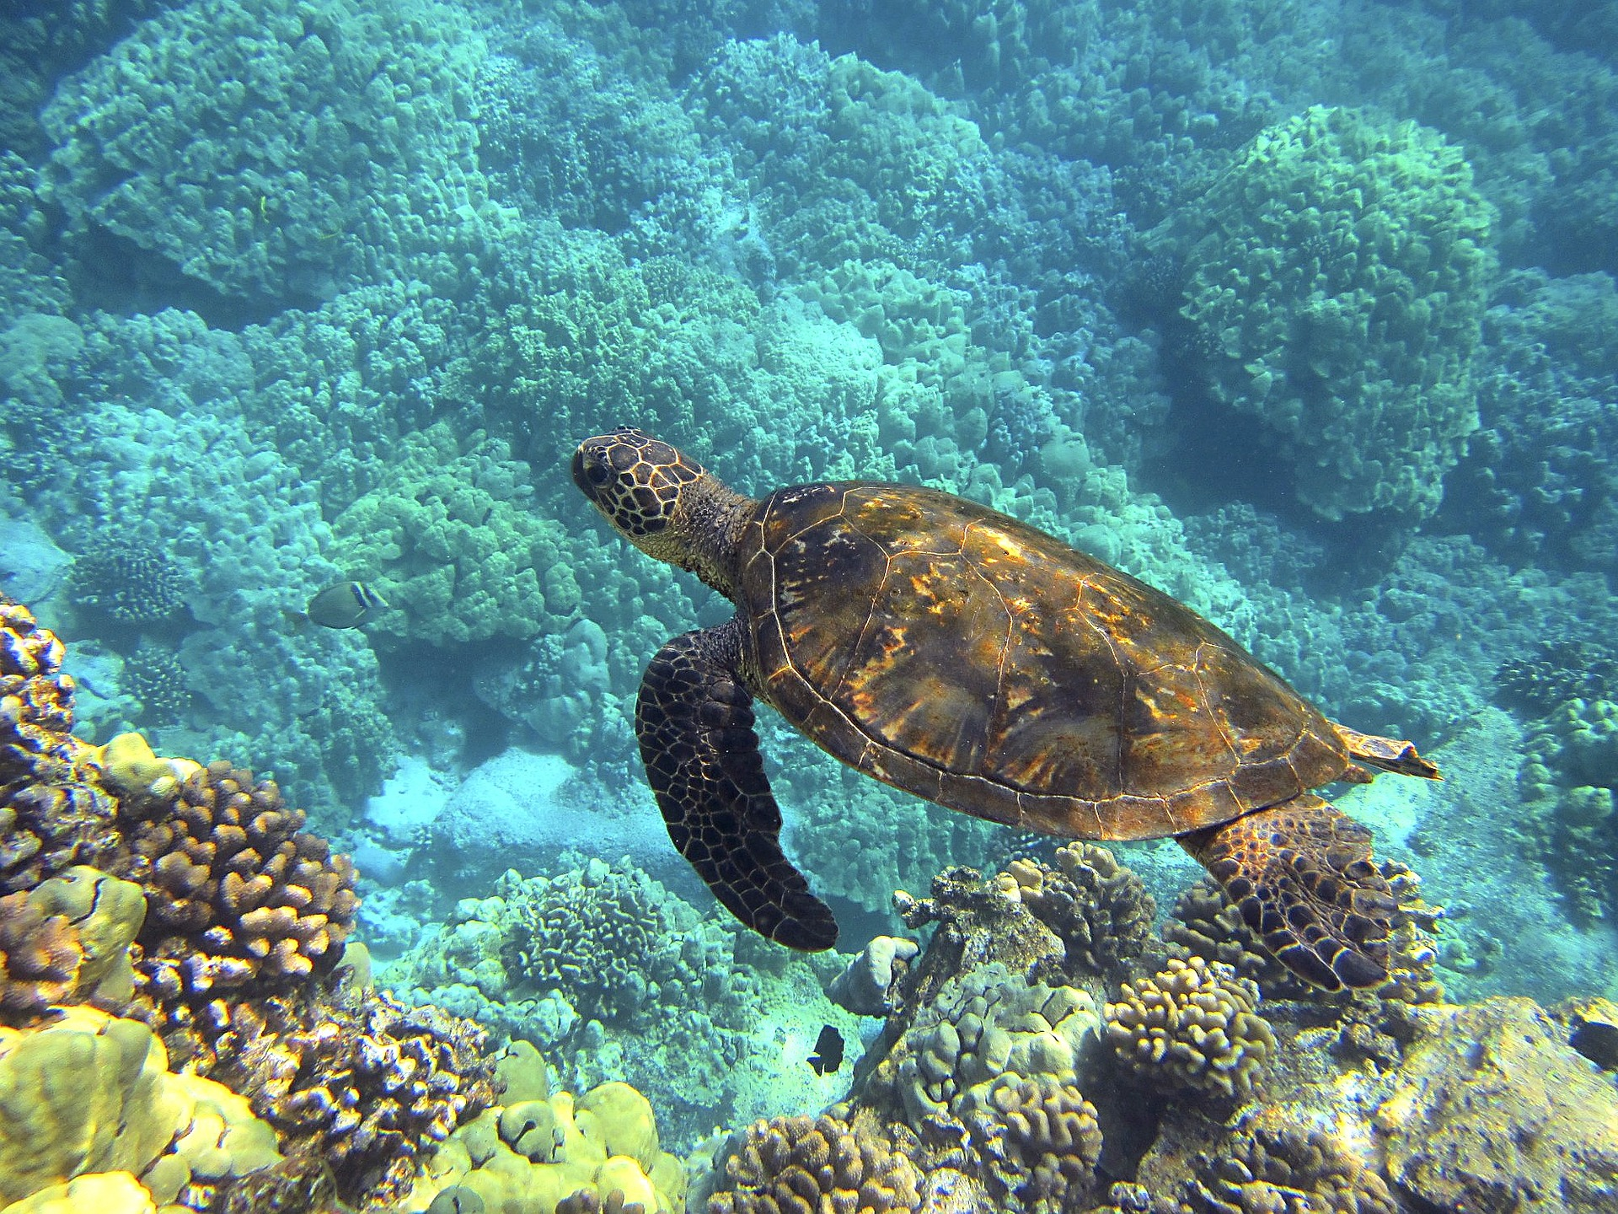
I am a common source of food for big fish.

Slide 4
Herbivore.

Slide 5
I am responsible for generating 50% of the oxygen you breathe.

Slide 6
Primary Producer.

Slide 7
Another name for me is: Photoautotroph.

Slide 8
Primary Producer.

Slide 9
I am the first organism in a food chain.

Slide 10
Primary Producer.

Slide 11
I keep the ecosystem in balance and am at the top of the food web.

Slide 12
Apex Predator.

Slide 13
I make food through photosynthesis.

Slide 14
Primary Producer.

Slide 15
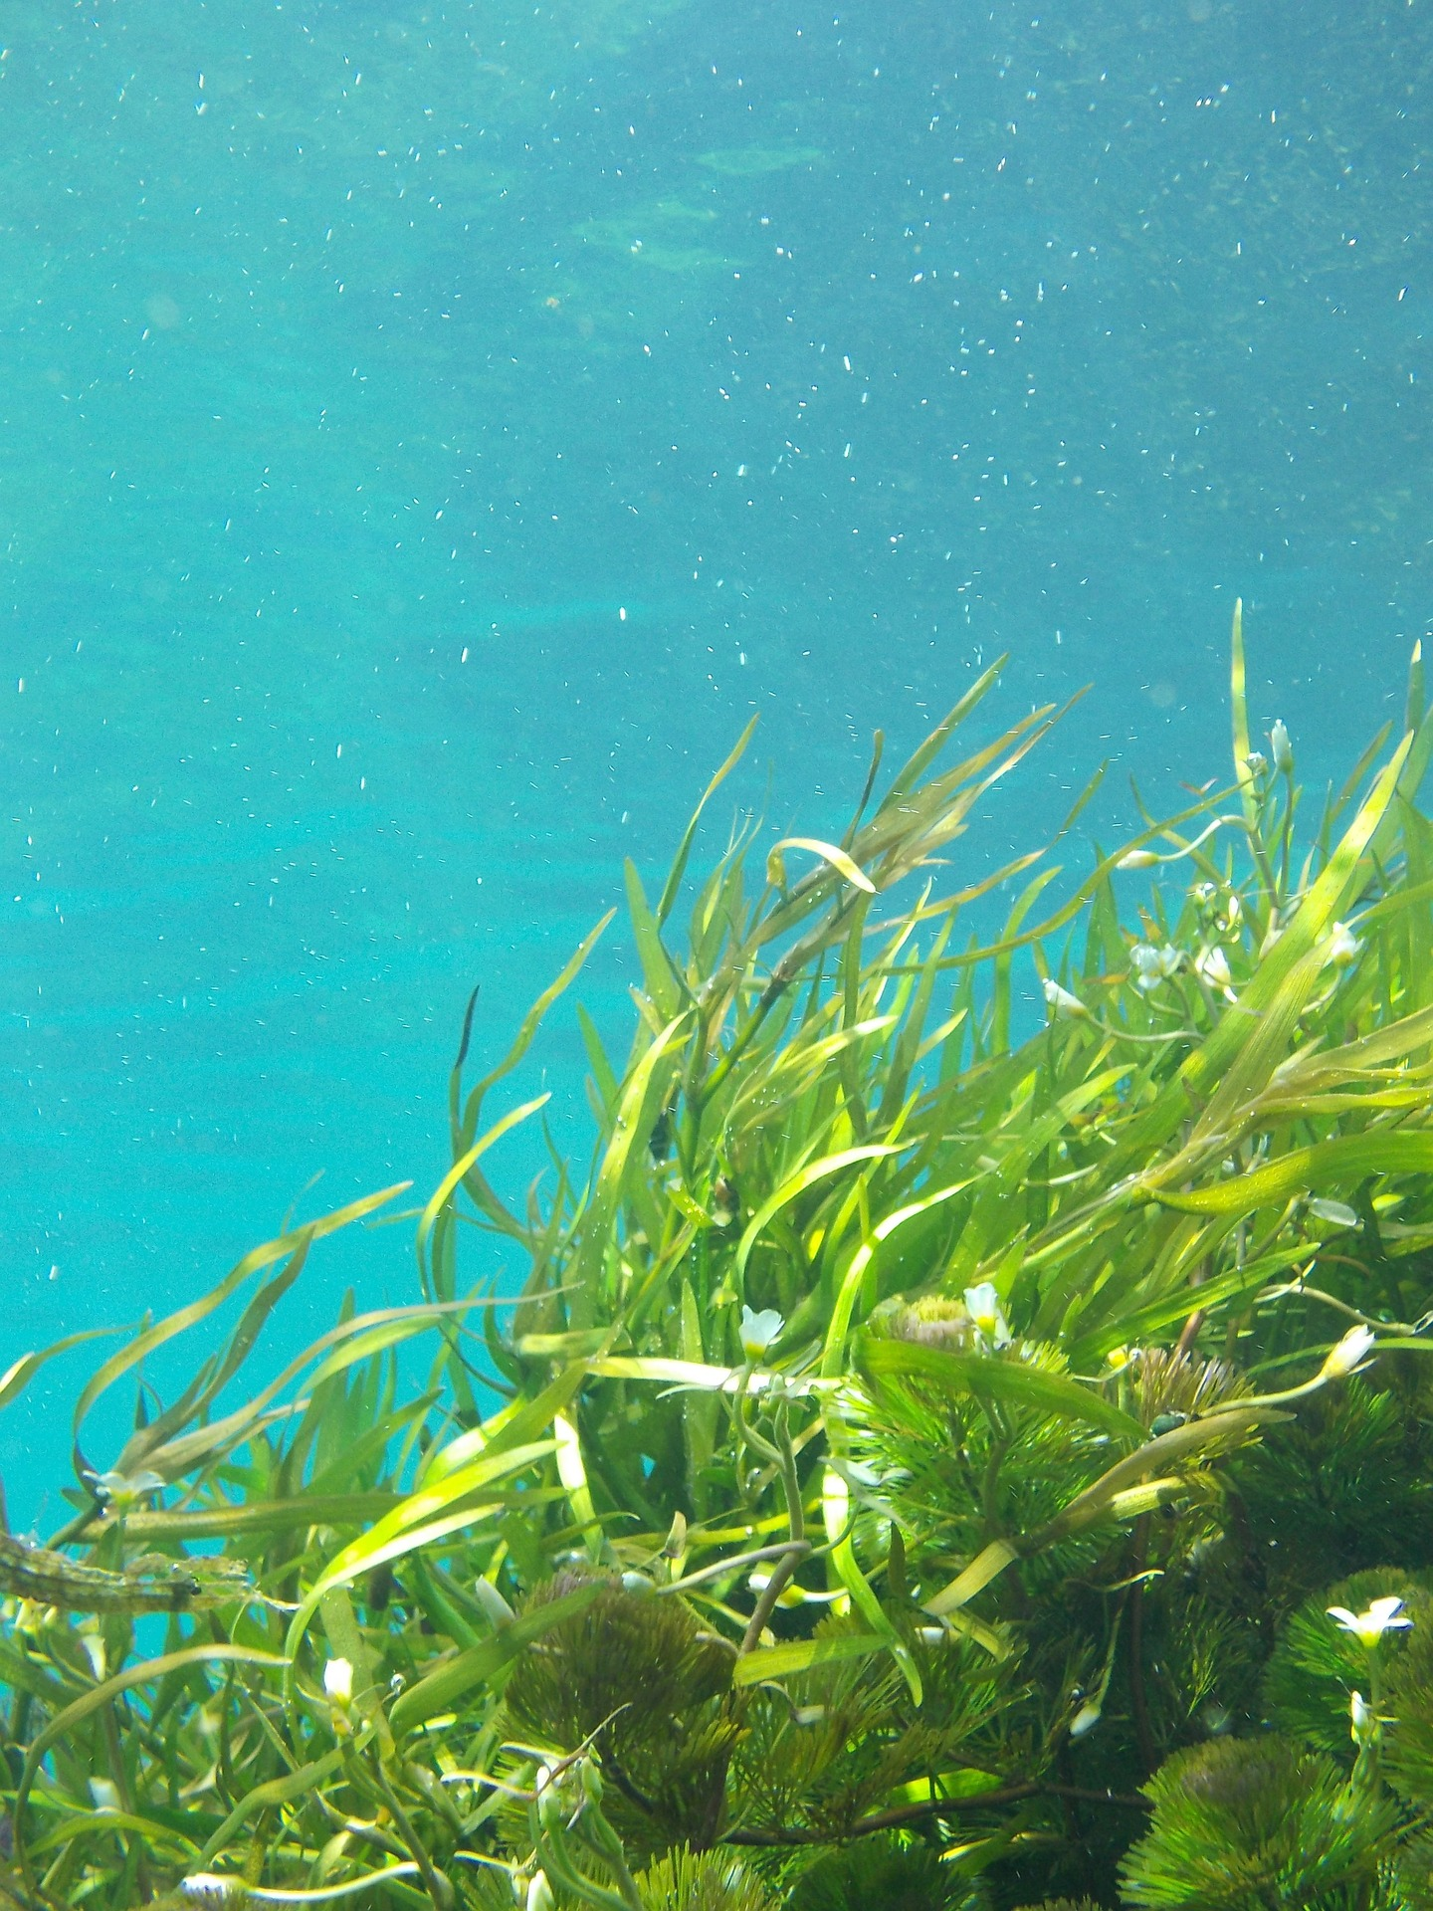
I am a tasty snack for a herbivore.

Slide 16
Primary Producer.

Slide 17
I turn sunlight into energy and make my own food.

Slide 18
Primary Producer.

Slide 19
Phytoplankton are a tasty snack for me.

Slide 20
Herbivore.

Slide 21
Some of my similar friends are: sea urchins, manatees, parrotfish.

Slide 22
Herbivore.

Slide 23
I live long and reproduce slowly.

Slide 24
Apex Predator.

Slide 25
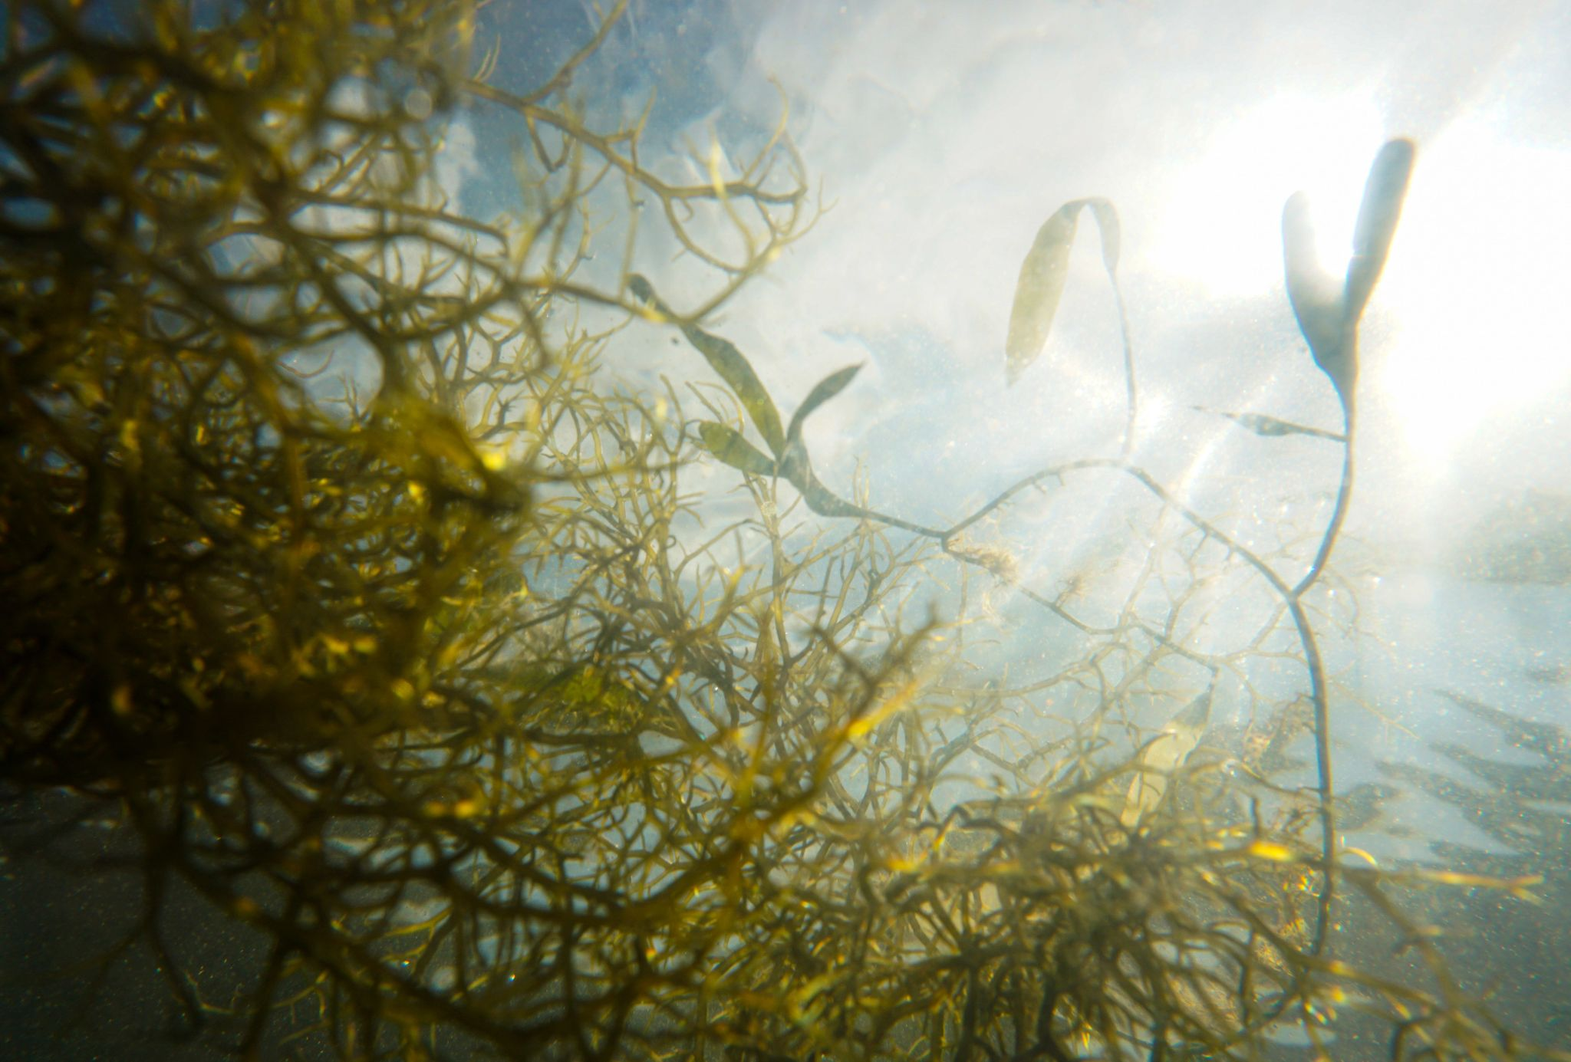
I am the source of all biomass on Earth.

Slide 26
Primary Producer.

Slide 27
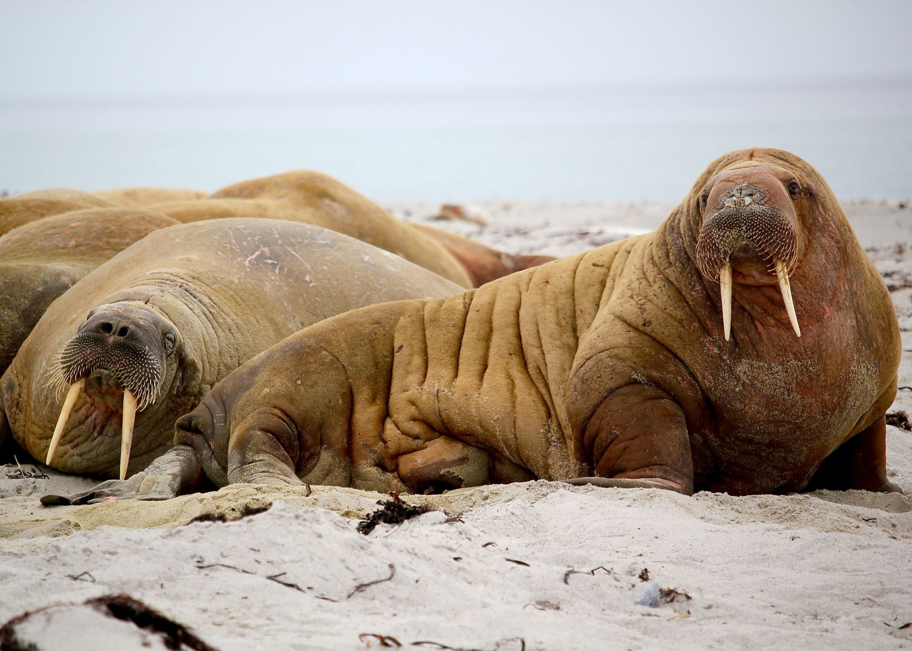
I don’t eat plants, but I do eat plant eaters.

Slide 28
Carnivore.

Slide 29
I am a meat eater.

Slide 30
Carnivore.

Slide 31
I eat other animals.

Slide 32
Carnivore.

Slide 33
Example of me are: Shark, Killer Whale, Human.

Slide 34
Apex Predator.

Slide 35
I break down organic material.

Slide 36
Decomposer.

Slide 37
Examples of me are: Bacteria, Fungi, Marine Worms, Mollusks.

Slide 38
Decomposers.

Slide 39
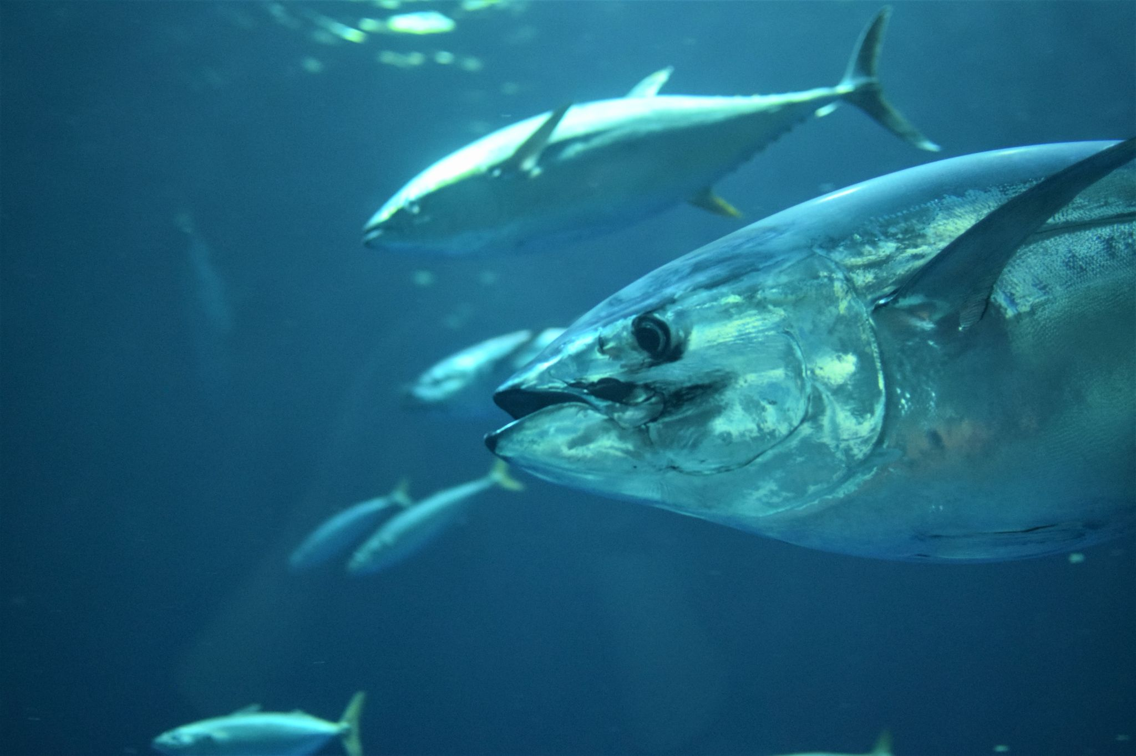

Slide 40
Carnivore.
Tuna.

Slide 41
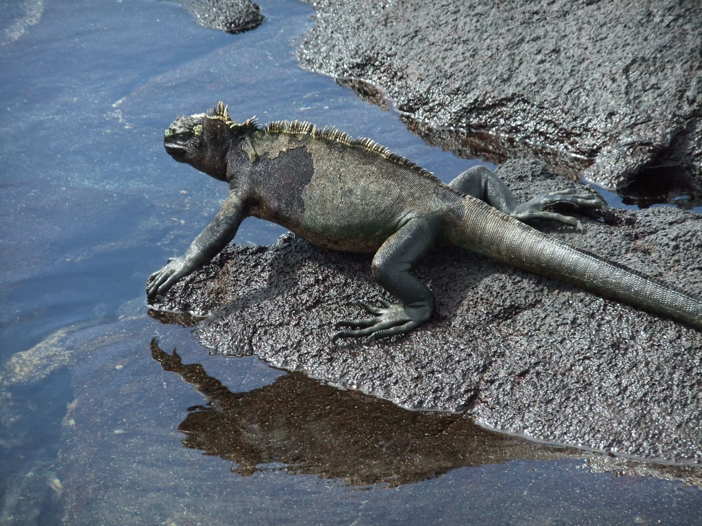

Slide 42
Herbivore.
Marine Iguana.

Slide 43
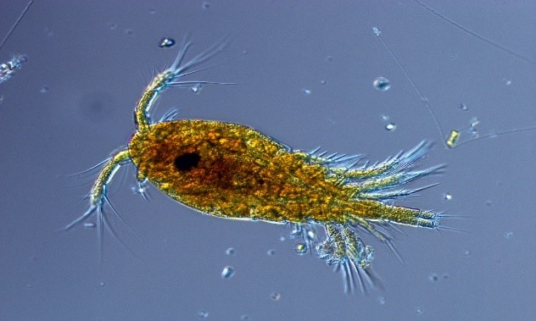

Slide 44
Herbivore.
Zooplankton.

Slide 45
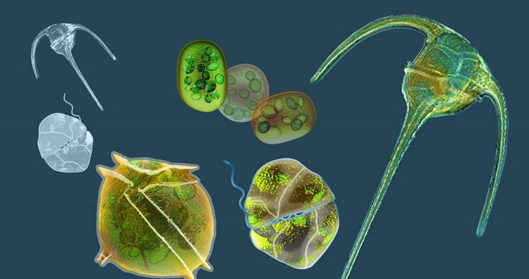

Slide 46
Primary Producer.
Phytoplankton.

Slide 47
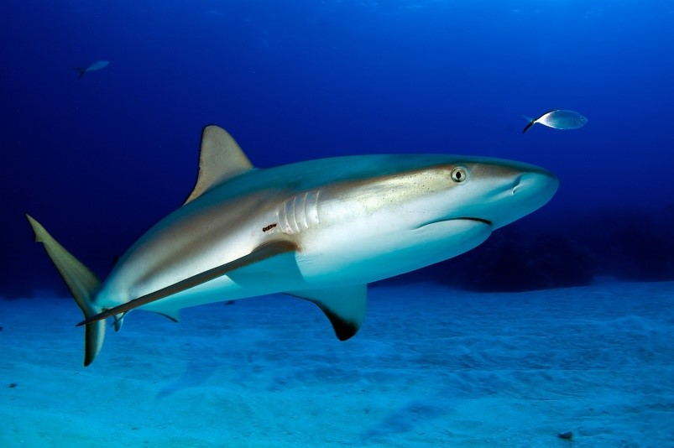

Slide 48
Apex Predator.
Shark.

Slide 49
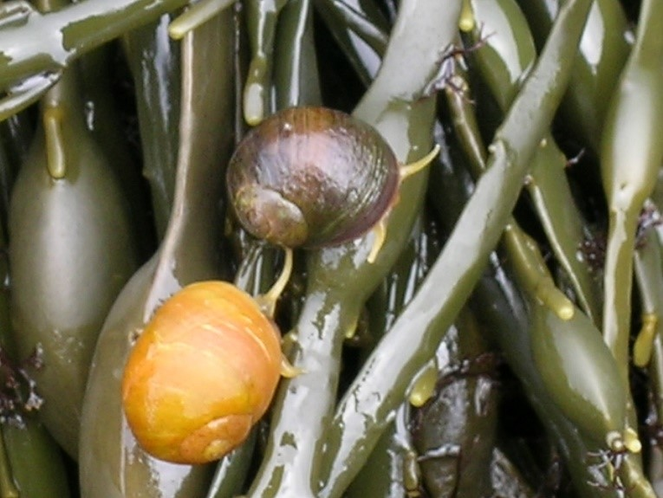

Slide 50
Herbivore.
Periwinkle Snail.

Slide 51
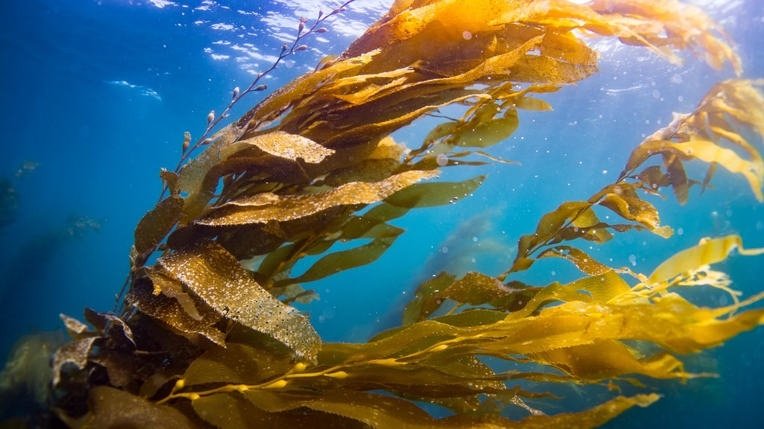

Slide 52
Primary Producer.
Kelp.

Slide 53
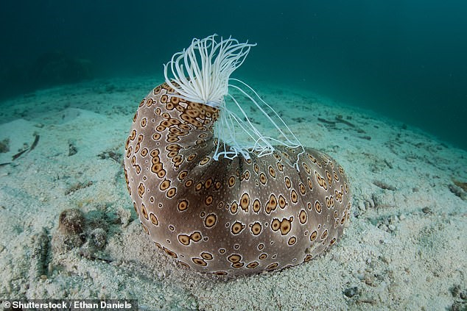

Slide 54
Decomposer/Detritivore.
Sea Cucumber.

Slide 55
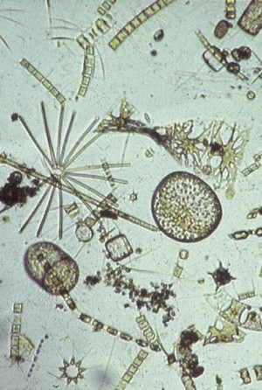

Slide 56
Primary Producer.
Microscopic Algae.

Slide 57
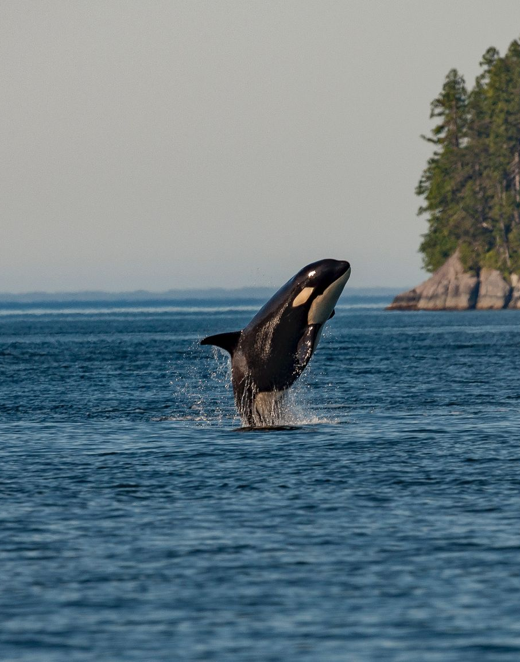

Slide 58
Apex Predator.
Killer Whale.

Slide 59
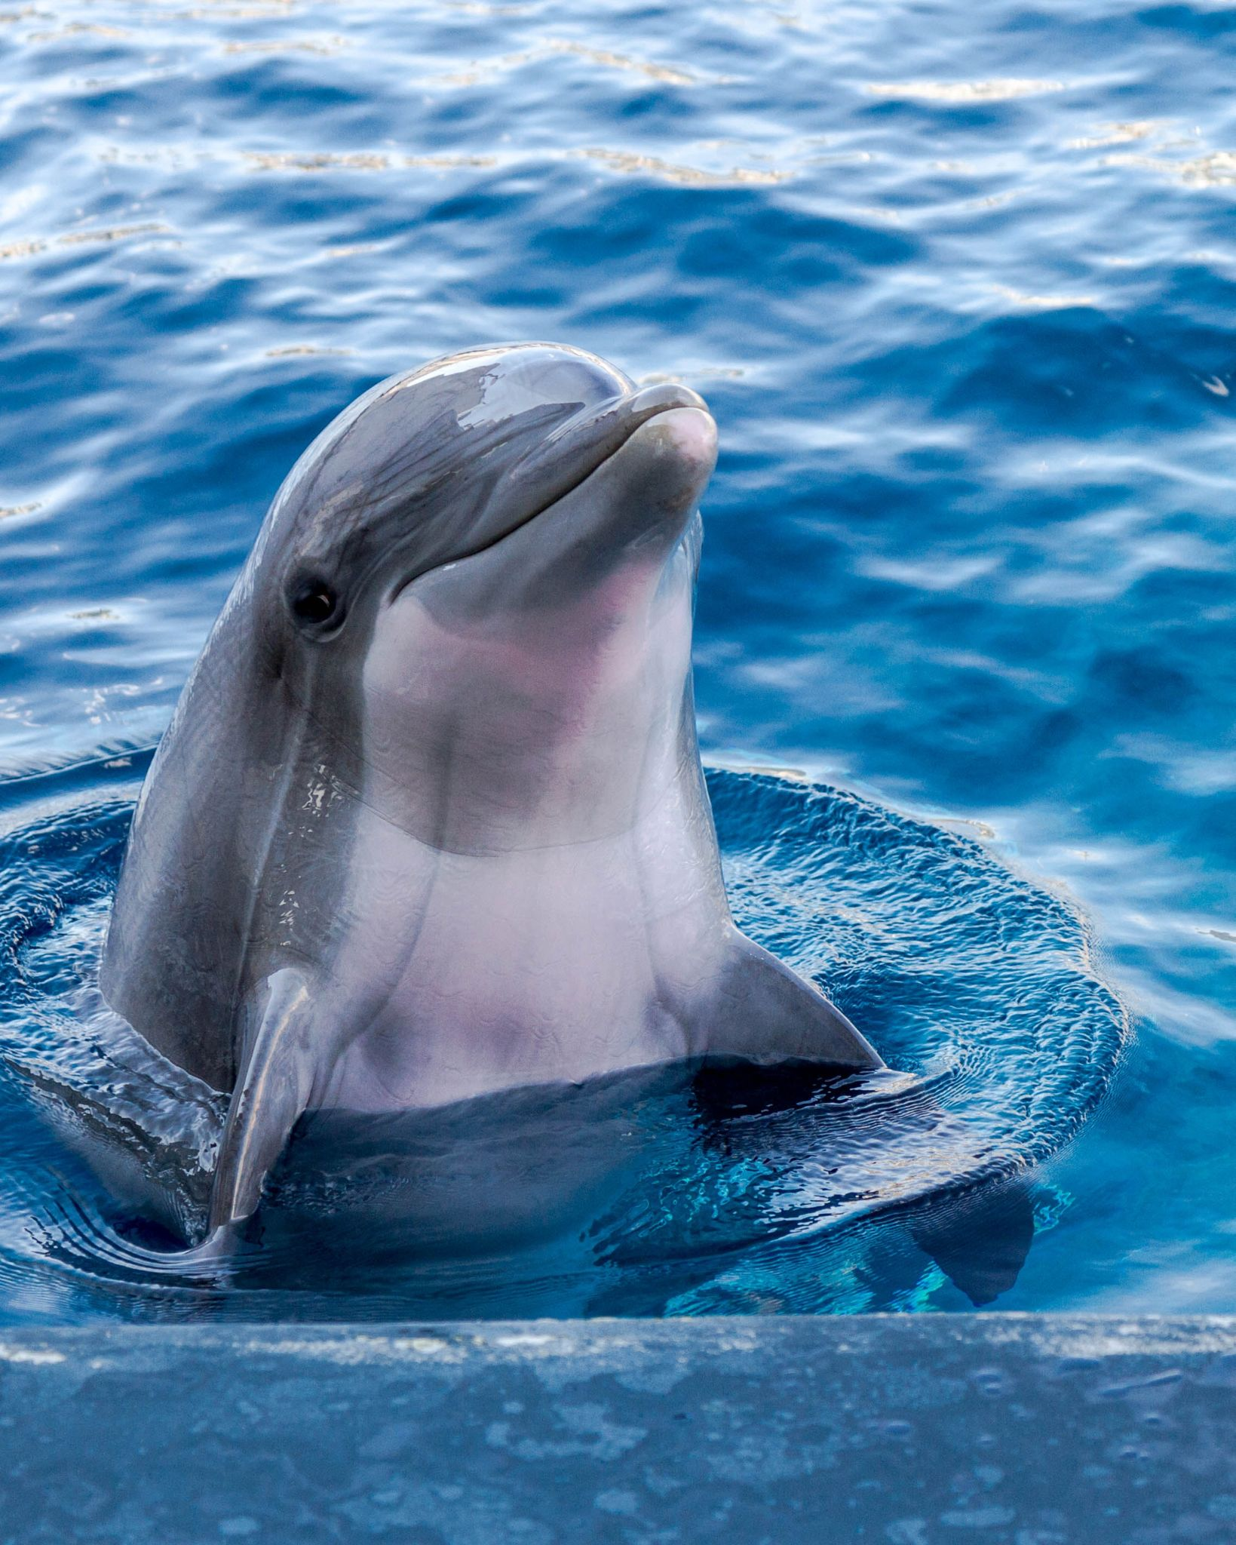

Slide 60
Carnivore.
Dolphin.

Slide 61
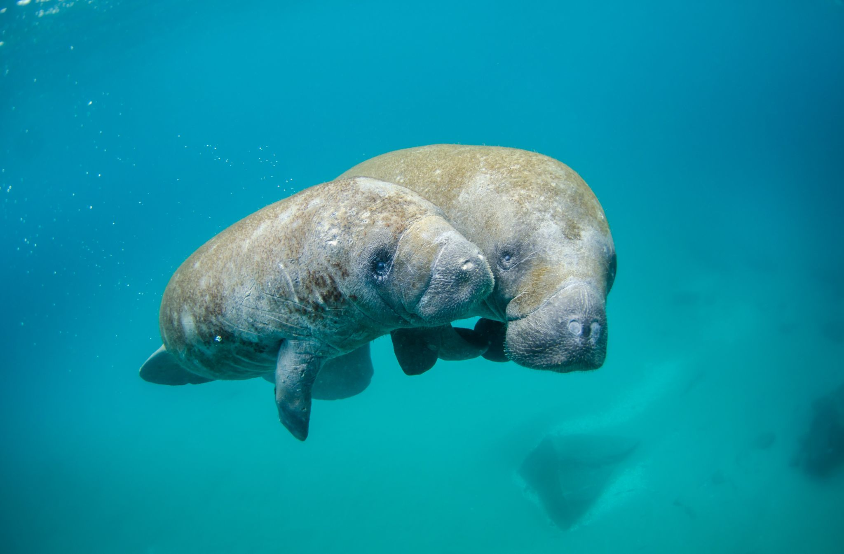

Slide 62
Herbivore.
Manatee.

